Slide 1
16.317
Microprocessor Systems Design I
Instructor: Dr. Michael Geiger
Fall 2012
Lecture 13:
Exam 1 Review

Slide 2
Lecture outline
Announcements/reminders
  No class Monday (Columbus Day)
  Lab 1 to be posted; due date likely 10/15
  Early feedback forms to be distributed Wed.
Today’s lecture: Exam 1 Review
  Exam stats
  Regrade requests
  Solution
Microprocessors I: Exam 1 Review

Slide 3
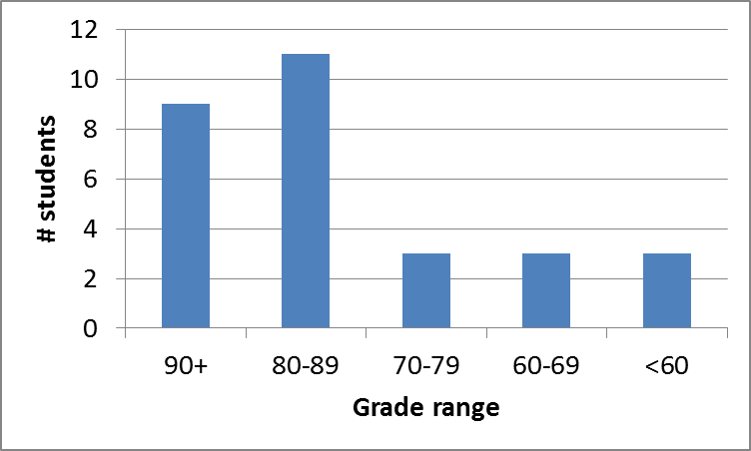
Exam stats & grade distribution
Average: 81.0
Median: 82
Std. deviation: 13.7
Max: 100
Question-by-question averages:
  Q1: 12.6 / 20 (63%)
  Q2: 35.2 / 40 (88%)
  Q3: 33.2 / 40 (83%)
Microprocessors I: Exam 1 Review

Slide 4
Regrade requests
Due Friday, 10/12
Must be written (preferably on a separate sheet)
You must also return your exam
  Do not write on your exam if you plan on submitting a regrade request
Must demonstrate understanding of problem
  Bad: “I deserve more points on Problem 3a.”
  Good: “I deserve more points on Problem 3a because I calculated a wrong result for one instruction based on a wrong result from a previous instruction. I used the right operation; I just plugged in the wrong value.”
Microprocessors I: Exam 1 Review

Slide 5
Final notes
Next time:
  Call/return instructions
  Early feedback forms
Reminders:
  No class Monday (Columbus Day)
  Lab 1 to be posted; due date likely 10/15
Microprocessors I: Exam 1 Review

