Slide 1
16.317
Microprocessor Systems Design I
Instructor: Dr. Michael Geiger
Fall 2012
Lecture 28:
PIC programming (continued)

Slide 2
Lecture outline
Announcements/reminders
  Lab 3 posted, due 11/30
    Must check out PICkit
  HW 4 posted, due 12/3
  Lab 4 posted, due 12/10
  HW 5 will be posted late this week/early next week, also due 12/10
Today’s lecture:
  Programming sequences: delay, blinking lights
Microprocessors I: Lecture 28

Slide 3

A Delay Subroutine
; ***********************************************************************************
; TenMs subroutine and its call inserts a delay of exactly ten milliseconds
; into the execution of code.
; It assumes a 4 MHz crystal clock. One instruction cycle = 4 * Tosc.
; TenMsH equ 13 ; Initial value of TenMs Subroutine's counter
; TenMsL equ 250
; COUNTH and COUNTL are two variables
TenMs
nop ; one cycle
movlw TenMsH ; Initialize COUNT
movwf COUNTH
movlw TenMsL
movwf COUNTL
Ten_1
decfsz COUNTL,F ; Inner loop
goto Ten_1
decfsz COUNTH,F ; Outer loop
goto Ten_1
return
Microprocessors I: Lecture 28
Notes:
Chapter 9

Slide 4
Blinking LED example
Assume three LEDs (Green, Yellow, Red) are attached to Port D bit 0, 1 and 2. Write a program for the PIC16F874 that toggles the three LEDs every half second in sequence: green, yellow, red, green, ….
For this example, assume that the system clock is 4MHz.
Microprocessors I: Lecture 28

Slide 5
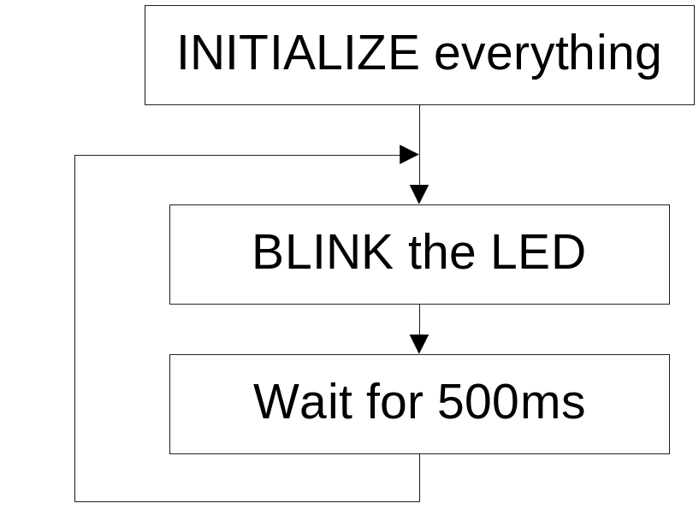
Top Level Flowchart
Initialize: Initialize port D, initialize the counter for 500ms.
Blink: Toggle the LED in sequence, green, yellow, red, green, …. Which LED to be toggled is determined by the previous state.
Wait for 500ms: Keep the LED on for 500ms and then toggle the next one.
Microprocessors I: Lecture 28

Slide 6

Strategy to “Blink”
The LEDs are toggled in sequence - green, yellow, red, green, yellow, red…
Let’s look at the lower three bits of PORTD
  001=green, 010=yellow, 100=red
The next LED to be toggled is determined by the current LED.
001->010->100->001->…
Microprocessors I: Lecture 28

Slide 7
“Blink” Subroutine
Blink
btfsc PORTD, 0 ; is it Green?
goto toggle1 ; yes, goto toggle1
btfsc PORTD, 1 ; else is it Yellow?
goto toggle2 ; yes, goto toggle2
;toggle0
bcf PORTD, 2 ; otherwise, must be red, change to green
bsf PORTD, 0 ; 100->001
return
toggle1
bcf PORTD, 0 ; change from green to yellow
bsf PORTD, 1 ; 001->010
return
toggle2
bcf PORTD, 1 ; change from yellow to red
bsf PORTD, 2 ; 010->100
return
Microprocessors I: Lecture 28

Slide 8
Another way to code “Blink” ---- Table Use
BlinkTable
movf PORTD, W ; Copy present state of LEDs into W
andlw B'00000111' ; and keep only LED bits
addwf PCL,F ; Change PC with PCLATH and offset in W
retlw B'00000001' ; (000 -> 001) reinitialize to green
retlw B'00000011' ; (001 -> 010) green to yellow
retlw B'00000110' ; (010 -> 100) yellow to red
retlw B'00000010' ; (011 -> 001) reinitialize to green
retlw B'00000101' ; (100 -> 001) red to green
retlw B'00000100' ; (101 -> 001) reinitialize to green
retlw B'00000111' ; (110 -> 001) reinitialize to green
retlw B'00000110' ; (111 -> 001) reinitialize to green
In calling program
call BlinkTable ; get bits to change into W
xorwf PORTD, F ; toggle them into PORTD
Microprocessors I: Lecture 28

Slide 9
Final notes
Next time
  Stepper motors
  Motor control with PIC
Reminders:
  Lab 3 posted, due 11/30
    Must check out PICkit
  HW 4 posted, due 12/3
  Lab 4 posted, due 12/10
  HW 5 will be posted late this week/early next week, also due 12/10
Microprocessors I: Lecture 28

