Slide 1
16.317
Microprocessor Systems Design I
Instructor: Dr. Michael Geiger
Fall 2013
Lecture 14
Compare instructions; conditional execution

Slide 2
Lecture outline
Announcements/reminders
  HW 4 to be posted; due 10/16
  Exam 1 regrade requests due 10/11
Today’s lecture
  Compare instructions
  CMOV
  Set on condition
  Early feedback forms
Microprocessors I: Lecture 14

Slide 3
Compare Instructions
Compare 2 values; store result in ZF/SF
General format: CMP D,S
  Works by performing subtraction (D) – (S)
    D, S unchanged
  ZF/SF/OF indicate result (signed values)
    ZF = 1 → D == S
    ZF = 0, (SF XOR OF) = 1 → D < S
    ZF = 0, (SF XOR OF) = 0 → D > S
Microprocessors I: Lecture 14
Notes:
Chapter 6 part 1
(D) (S) result CF SF AF
AX BX
2345>1234 0 0 0
1234<2345 1 1 1
1234>ABCD 1 0 1
ABCD<1234 0 1 0
ABCD>A000 0 0 0
A000<ABCD 1 1 1
7FFF 8000 overflow

Slide 4
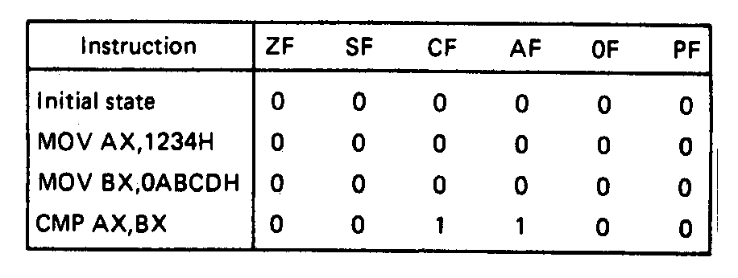
Compare Instructions- Example
Example—Initialization of internal registers with immediate data and compare. Example:
    MOV AX,1234H ;Initialize AX
    MOV BX,ABCDH ;Initialize BX
    CMP AX,BX ;Compare AX-BX
  Data registers AX and BX initialized from immediate data
  IMM16 → (AX) = 1234H → + integer
  IMM16 → (BX) = ABCDH → - integer
  Compare computation performed as:
  (AX) = 0001001000110100₂ (BX) = 1010101111001101₂
(AX) – (BX) = 0001001000110100₂ - 1010101111001101₂
  ZF = 0 = NZ
  SF = 0 = PL ;treats as signed numbers
  CF = 1 = CY
  AF = 1 = AC
  OF = 0 = NV
  PF = 0 = PO
Microprocessors I: Lecture 14
Notes:
Chapter 6 part 1

Slide 5
Condition codes
Conditional execution: result depends on value of flag bit(s)
Intel instructions specify condition codes
  Condition code implies certain flag values
  Opcodes written with cc as part of name
  cc can be replaced by any valid code
  Examples: CMOVcc, SETcc, Jcc
    Specific examples: CMOVE, SETL, SETZ, JNE, JG
Microprocessors I: Lecture 14

Slide 6
Condition codes (cont.)
Testing overflow
  O (OF = 1), NO (OF =0)
Testing carry flag
  C (CF = 1)
  NC (CF = 0)
Testing sign flag
  S (SF = 1), NS (SF = 0)
Testing parity flag
  P or PE (PF = 1)
  NP or PO (PF = 0)
Microprocessors I: Lecture 14

Slide 7
Condition codes (cont.)
Testing equality/zero result
  E or Z (ZF = 1)
  NE or NZ (ZF = 0)
Signed comparison
  L or NGE (SF XOR OF = 1)
  NL or GE (SF XOR OF = 0)
  LE or NG ((SF XOR OF) OR ZF = 1)
  NLE or G ((SF XOR OF) OR ZF = 0)
Unsigned comparison
  “Below” → less than, “above” → greater than
  B, NAE (CF = 1)
  NB, AE (CF = 0)
  BE or NA (CF OR ZF = 1)
  NBE or A (CF OR ZF = 0)
Microprocessors I: Lecture 14

Slide 8
Conditional move (CMOV)
Only in Pentium Pro & later
Perform move only if condition is true
Examples:
  CMOVZ AX, [SI] → move if ZF == 1
  CMOVG EBX, EAX → move if greater than
Microprocessors I: Lecture 14

Slide 9
Byte Set on Condition Instruction
Byte set on condition instruction
  Used to set byte based on condition code
  Can be used for boolean results—complex conditions
  General format:
    SETcc D
    cc = one of the supported conditional relationships
Microprocessors I: Lecture 14
Notes:
Chapter 6 part 1

Slide 10
Byte Set on Condition Instruction
Operation: Flags tested for conditions defined by “cc” and the destination in a register or memory updated as follows
If cc test True:
  00000001₂ = 01H → D
  If cc test False:
  00000000₂ = 00H → D
Examples of conditional tests:
SETE = set byte if equal → ZF = 1
SETC = set byte if carry → CF =1
SETBE = set byte if below or equal → CF = 1 +(or) ZF = 1
Example: SETA AL = set byte if above
  if CF = 0 • (and) ZF = 0
  (AL) = 01H
  Otherwise,
  (AL) =00H
Microprocessors I: Lecture 14
Notes:
Chapter 6 part 1

Slide 11
Example
Show the results of the following instructions, assuming that
  “A” = DS:100H = 0001H
  “B” = DS:102H = 0003H
  “C” = DS:104H = 1011H
  “D” = DS:106H = 1011H
  “E” = DS:108H = ABCDH
  “F” = DS:10AH = DCBAH
What complex condition does this sequence test?
MOV AX, [100H]
CMP AX, [102H]
SETLE BL
MOV AX, [104H]
CMP AX, [106H]
SETE BH
AND BL, BH
MOV AX, [108H]
CMP AX, [10AH]
SETNE BH
OR BL, BH
Microprocessors I: Lecture 14

Slide 12
Example solution
Condition being tested:
  To simplify, treat each word as a variable named “A” through “F”
  ((A <= B) && (C == D)) || (E != F)
Source: http://www.arl.wustl.edu/~lockwood/class/cs306/books/artofasm/Chapter_6/CH06-4.html
Microprocessors I: Lecture 14

Slide 13
Final notes
Next time:
  Jump and loop instructions
Reminders:
  HW 4 to be posted; due 10/16
  Exam 1 regrade requests due 10/11
Microprocessors I: Lecture 14

