Slide 1
16.317
Microprocessor Systems Design I
Instructor: Dr. Michael Geiger
Fall 2013
Lecture 21
x86 protected mode

Slide 2
Lecture outline
Announcements/reminders
  HW 5 due 10/30
  Advising: 10/28-11/8
Today’s lecture: x86 protected mode
Microprocessors I: Lecture 18

Slide 3
Protected mode
Common system features
  Multitasking
  Memory management
    Keep memory for different tasks separate
    Allow programs to “see” as much memory as needed
Usually managed/supported in operating system
80386DX: hardware support in protected mode
  Runs at higher privilege level
  Controlled by single bit in control register
  IP, flags extended to 32 bits (EIP, EFLAGS)
  Addresses extended to 32 bits
  Two general changes:
    Global vs local memory
    Variable segments
Microprocessors I: Lecture 7

Slide 4
Protected Mode Benefits
Memory management
  Larger memory space (up to 4GB physical memory)
  Flexible segment size in segmentation
  Can also be organized as 4KB “pages”
  Virtual memory (larger than physical memory size)
Multitasking
  Tasks sharing CPU, memory, I/O
Protection
  Safeguard against software bugs and integrity of OS
Virtual mode
  Allow execution of DOS applications
Microprocessors I: Lecture 7
Notes:
Chapter 8

Slide 5
Global vs. local memory
Multiple tasks → each task needs own state
  Copies of registers
  Range of memory to hold code and data
    Local memory: memory accessible for a single task
System level → store info about:
  Where each task’s register copies are saved
  Where each task’s local memory is actually stored
  Interrupts
  Global memory: memory accessible by any task (and, usually, system level program)
Microprocessors I: Lecture 7

Slide 6
Variable segments
Fixed size: need to specify starting address
  80386 real mode: segment registers hold starting address
Variable size: need to specify starting address and segment size
  Information stored in descriptor
  Descriptor holds 8 bytes:
    Segment base address (32 bits)
    Max segment offset (20 bits)
      Segment size = (max offset) + 1
      “Granularity bit”, if set, multiplies offset by 2¹² → allows 20 bit offset to specify segment size up to 4 GB
    Access information (12 bits)
  80386 protected mode: segment registers point to descriptor for given segment
Microprocessors I: Lecture 7

Slide 7
Memory accesses
Real mode
  Segment register indicates start of segment
  Physical addr. = (shifted segment register) + (effective address)
Protected mode
  Segment selector register points to descriptor table entry
  Descriptor indicates start (base) of segment
  “Linear addr.” = (segment base) + (effective address)
Microprocessors I: Lecture 7

Slide 8
Memory access questions
How do we know if an access is global or local?
How do we find the appropriate descriptor on a global memory access?
How do we find the appropriate descriptor on a local memory access?
Microprocessors I: Lecture 7

Slide 9
Selectors
Segment registers now hold selectors
  Index into table holding actual memory address
Selector format
  RPL: Requested privilege level
    4 levels → 0 highest, 3 lowest
    Used for checking access rights
  TI: Table indicator
    Global (TI == 0) or local (TI == 1) data/code
  Index: pointer into appropriate descriptor table
INDEX | TI | RPL
15 3 | 2 | 1 0
Microprocessors I: Lecture 7

Slide 10
Descriptor tables
Descriptors organized into “tables”
  Memory ranges holding all descriptors
Two memory types in protected mode
  Global memory: accessible to all tasks
    Descriptors in global descriptor table (GDT)
    Starting address of GDT = GDTR
  Local memory: memory accessible to only a single task
    Descriptors in local descriptor table (LDT)
    Each task has its own LDT
    Starting address of current LDT indicated by LDTR
Microprocessors I: Lecture 7

Slide 11
Global Descriptor Table Register (GDTR)
GDTR describes global descriptor table
  Lower 2 bytes define LIMIT (or size)
  Upper 4 bytes define base (starting address)
  Initialized before switching to protected mode
Example: GDTR = 001000000FFFH
  GDT base = 00100000H,
  GDT size = 0FFFH+1 = 1000H = 4096 bytes
  # of descriptors = 4096/8 = 512
  Highest address in GDT = 00100FFFH
Microprocessors I: Lecture 7
Notes:
Chapter 8

Slide 12
GDTR questions
What is the GDT base address and limit if
  GDTR = 1234000000FFH?
  GDTR = FEDC1AB20007H?
  GDTR = AABB11221F0FH?
What is the size of the GDT and number of descriptors it holds in each of the examples above?
What is the maximum GDT size and number of descriptors?
Microprocessors I: Lecture 7

Slide 13
Solutions
GDTR = 1234000000FFH?
  Base = 12340000H, limit = 00FFH
  GDT size = 00FF + 1 = 0100H = 256 bytes
  # descriptors = 256 / 8 = 32
GDTR = FEDC1AB20007H?
  Base = FEDC1AB2H, limit = 0007H
  GDT size = 0007 + 1 = 8 bytes
  # descriptors = 8 / 8 = 1
GDTR = AABB11221F0FH?
  Base = AABB1122H, limit = 1F0FH
  GDT size = 1F0F + 1 = 1F10H = 7952 bytes
  # descriptors = 7952 / 8 = 994
What is the maximum GDT size and number of descriptors?
  Max limit = FFFFH → max size = FFFF+1 = 10000H = 64K
  Max # descriptors = 64K / 8 = 8K = 8192
Microprocessors I: Lecture 7

Slide 14
Illustrating global memory access
MOV AX, [10H]
→ Logical addr = DS:10H
GDT | 00002000H
 | 000020FFH
DS = 0013H =
0000 0000 0001 0 | 0 | 11
RPL = 3
Index = 2
TI = 0 → global
Desc. 2
Base = 00000100H
Limit =
0FFFH
00002010H
GDTR =
00002000 | 00FF
Base Limit
Descriptor addr: (GDT base) + (selector index * 8)
00002000H
+ (0002H * 8)
00002010H
Actual mem addr: (seg base) + (effective address)
00000100H
+ 10H
00000110H
Microprocessors I: Lecture 7

Slide 15
Local Descriptor Table Register (LDTR)
Local descriptor table
  Defines local memory address space for the task
  Each task has its own LDT
  Contains local segment descriptors
LDTR: 16 bit selector pointing into GDT
  Each LDT is essentially a segment in global memory
  LDTR cache automatically loads when LDTR changed
LDTR cache: 48bit
  Lower 2 bytes define LDT LIMIT (or size)
  Upper 4 bytes define LDT base (physical address)
Microprocessors I: Lecture 7
Notes:
Chapter 8

Slide 16
Illustrating local memory access
MOV AX, [10H]
→ Logical addr = DS:10H
GDT | 00002000H
 | 000020FFH
DS = 0027H =
0000 0000 0010 0 | 1 | 11
RPL = 3
Index = 4
TI = 1 → local
Desc. 7
Base = 00002100H
Limit =
001FH
00002038H
LDTR = 003BH =
0000 0000 0011 1 | 0 | 11
GDTR =
00002000 | 00FF
Base Limit
Descriptor addr: (GDT base) + (selector index * 8)
00002000H
+ (0007H * 8)
00002038H
Microprocessors I: Lecture 7

Slide 17
Illustrating local memory access
MOV AX, [10H]
→ Logical addr = DS:10H
GDT | 00002000H
 | 000020FFH
LDT | 00002100H
 | 0000211FH
DS = 0027H =
0000 0000 0010 0 | 1 | 11
RPL = 3
Index = 4
TI = 1 → local
GDT descriptor 7 describes LDT for this task
→ LDTR cache =
00002100 | 001F
Desc. 4
Base = 00100000H
Limit =
001FH
00002120H
Base Limit
Descriptor addr: (LDT base) + (selector index * 8)
00002100H
+ (0004H * 8)
00002120H
Actual mem addr: (seg base) + (effective address)
00100000
+ 10H
00100010H
Microprocessors I: Lecture 7

Slide 18
Interrupt Descriptor Table Register (IDTR)
Interrupt descriptor table
  Up to 256 interrupt descriptors
    Describes segments holding interrupt service routines
  Described by IDTR
  Each entry (interrupt descriptor) takes 8 bytes
IDTR: 48-bit
  Lower 2 bytes define LIMIT (or size)
  Upper 4 bytes define the base (physical address)
  Initialized before switching to protected mode
Microprocessors I: Lecture 7
Notes:
Chapter 8

Slide 19
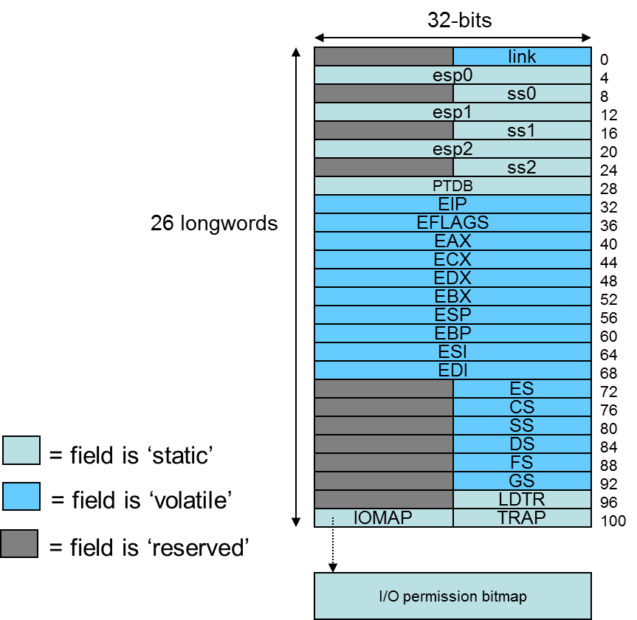
Multitasking
Most systems run multiple tasks
  Different programs
  Different threads in same program
Task switch: save state of current task; transfer control to new task
80386 specifics
  Task state segment (TSS): saved task state (picture at right)
    Every TSS resides in global memory
  Task register (TR): selector pointing to descriptor in GDT for current TSS
    Limit, base of current TSS cached
  Task switch = jump or call instruction that changes task
Figure from cs.usfca.edu/~cruse/cs630f06/lesson08.ppt
Microprocessors I: Lecture 7
Notes:
Chapter 8

Slide 20
Final notes
Next time:
  Continue with protected mode
Reminders:
  HW 5 due 10/30
  Advising: 10/28-11/8
Microprocessors I: Lecture 18

