Slide 1
16.317: Microprocessor System Design I
Instructor: Dr. Michael Geiger
Spring 2012
Lecture 11: Shift/rotate instructions
Notes:
Chapter 2

Slide 2
Lecture outline
Announcements/reminders
  HW 2 due Friday, 2/17
  Lab 1 posted; due 2/29
    Amanda’s OH: M/W 2:30-5, Tuesday 5-7
    Lab: Ball 407
  Exam 1: Friday, 2/24
    Review lecture Wednesday, 2/22
    Will be allowed calculator, one 8.5”x11” sheet of notes
  No class Monday, 2/20
Lecture outline
  Review: Multiplication/division, logical instructions
  Today
    Shift instructions
    Rotate instructions
Microprocessors I: Lecture 11

Slide 3
Review
Multiplication instructions
  MUL (unsigned), IMUL (signed)
  Result uses 2x bits of source
  Source usually implied (AL/AX/EAX)
Division instructions
  DIV (unsigned), IDIV (signed)
  Implied source (AX, (DX,AX), (EDX,EAX)) 2x bits of specified source
  Quotient/remainder split across result
Convert instructions (CBW, CWD, CWDE, CDQ)
Logical instructions (AND/OR/XOR/NOT)
Microprocessors I: Lecture 11

Slide 4
Logic instructions: example
Show the state of AL after each instruction in the following sequence:
  MOV AL, 55H
  AND AL, 1FH
  OR AL, C0H
  XOR AL, 0FH
  NOT AL
Microprocessors I: Lecture 11

Slide 5
Logic instructions: solution
Show the state of AL after each instruction
  MOV AL, 55H
    AL = 55H
  AND AL, 1FH
    AL = 55H AND 1FH = 01010101 AND 00011111
    = 00010101 = 15H
  OR AL, C0H
    AL = 15H OR C0H = 00010101 OR 11000000
    = 11010101 = D5H
  XOR AL, 0FH
    AL = D5H XOR 0FH = 11010101 XOR 00001111
    = 11011010 = DAH
  NOT AL
    AL = NOT DAH = NOT(11011010) = 00100101 = 25H
Microprocessors I: Lecture 11

Slide 6
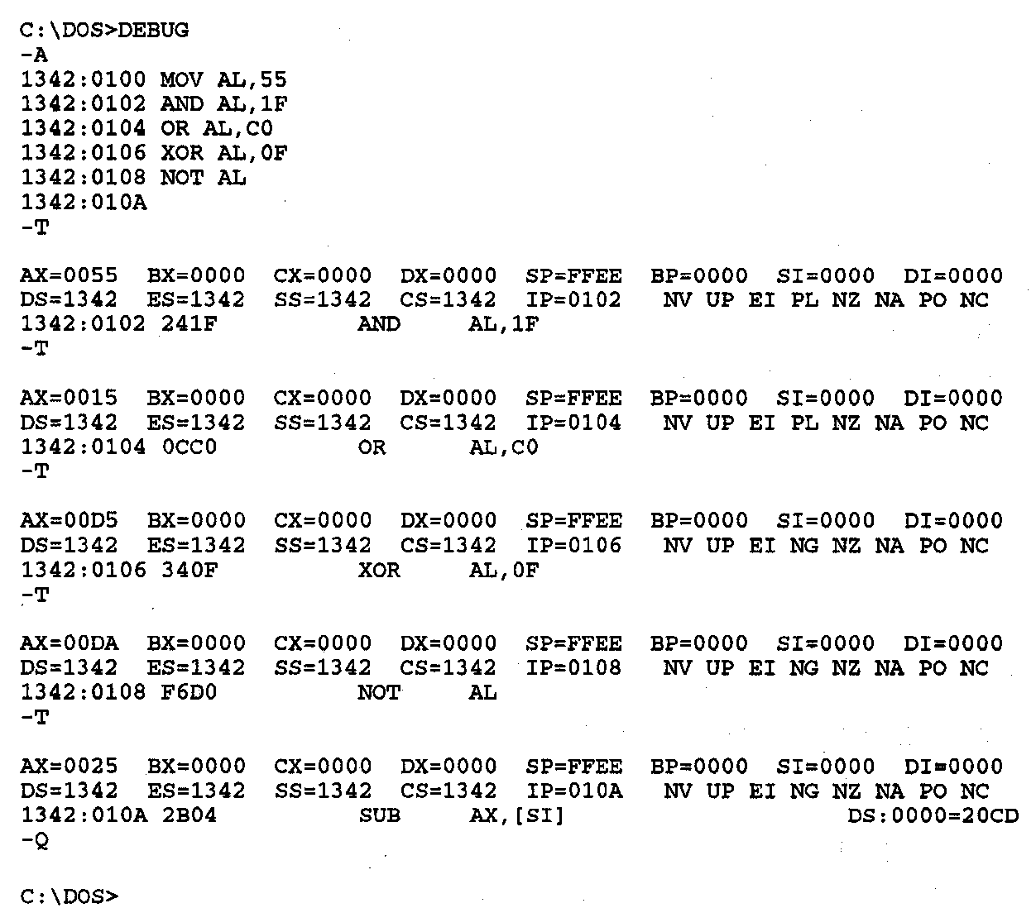
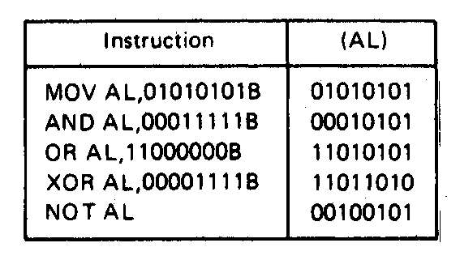
Logic Instructions- Example
Figure on right shows DEBUG program running this code
Each “T” executes one instruction; shows state of all registers/flags
Microprocessors I: Lecture 11
Notes:
Chapter 5 part 2

Slide 7
Logic Instructions- Mask Application
  Mask—to clear a bit or bits of a byte, word, or double word to 0.
    AND operation can be used to perform the mask operation
    1 AND 0 → 0; 0 and 0 → 0
      A bit or bits are masked by ANDing with 0
    1 AND 1 → 1; 0 AND 1 → 0
      ANDing a bit or bits with 1 results in no change
    Example: Masking the upper 12 bits of a value in a register
      AND AX,000FH
      (AX) =FFFF
      IMM16 AND (AX) → (AX)
      000FH AND FFFFH = 0000000000001111₂ AND 1111111111111111₂
    = 0000000000001111₂
    = 000FH
  OR operation can be used to set 1+ bits of a byte, word, or double word to 1
    X OR 0 → X; result is unchanged
    X or 1 → 1; result is always 1
    Example: Setting a control flag in a byte memory location to 1
      MOV AL,[CONTROL_FLAGS]
      OR AL, 10H ;00010000 sets fifth bit—b4
      MOV [CONTROL_FLAGS],AL
Microprocessors I: Lecture 11
Notes:
Chapter 5 part 2

Slide 8
Shift Instructions
  SAL/SHL → Shift arithmetic left/shift logical left
  SHR → Shift logical right
  SAR → Shift arithmetic right
  SHLD → Double precision shift left
  SHRD → Double precision shift right
Perform a variety of shift left and shift right operations on the bits of a destination data operand
Basic shift instructions—SAL/SHL, SHR, SAR
  Destination may be in either a register or a storage location in memory
  Shift count may be:
    1= one bit shift
    CL = 1 to 255 bit shift
    IMM8 = 1 to 255 bit shift
  Flags updated based on result
    CF, SF, ZF, PF
    AF undefined
    OF undefined if Count ≠ 1
Microprocessors I: Lecture 11
Notes:
Chapter 5 part 2

Slide 9
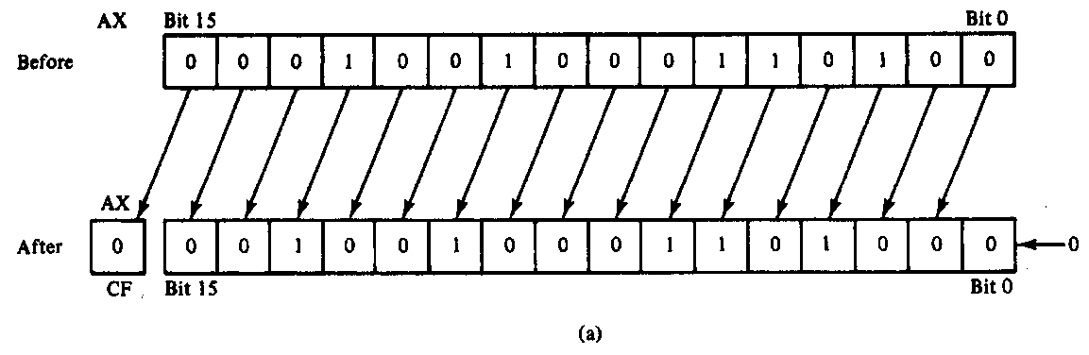
Operation of the SAL/SHL Instruction
  Typical instruction—count of 1
  SHL AX,1
  Before execution
  Dest = (AX) = 1234H = 0001 0010 0011 0100₂ , Count = 1, CF = X
  Operation
    The value in all bits of AX are shifted left one bit position
    Emptied LSB is filled with 0
    Value shifted out of MSB goes to carry flag
  After execution
  Dest = (AX) = 2468H = 0010 0100 0110 1000₂ , CF = 0
  Conclusion:
    MSB has been isolated in CF and can be acted upon by control flow instruction– conditional jump
    Result has been multiplied by 2
Microprocessors I: Lecture 11
Notes:
Chapter 5 part 2

Slide 10
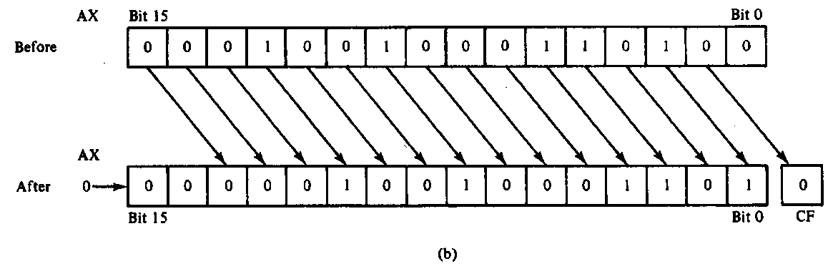
Operation of the SHR Instruction
  Typical instruction—count in CL
  SHR AX,CL
  Before execution
  Dest = (AX) = 1234H = 4660₁₀ = 0001 00100011 0100₂
  Count = 02H , CF = X
  Operation
    The value in all bits of AX are shifted right two bit positions
    Emptied MSBs are filled with 0s
    Values shifted out of LSBs go to carry flag
  After execution
  Dest = (AX) = 048DH = 1165₁₀ = 0000 0100 1000 1101₂ ,CF = 0
  Conclusion:
    Bit 1 has been isolated in CF and can be acted upon by control flow instruction– conditional jump
    Result has been divided by 4
      4 X 1165 = 4660
Microprocessors I: Lecture 11
Notes:
Chapter 5 part 2

Slide 11
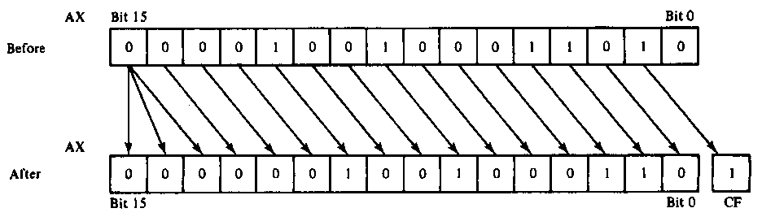
Operation of the SAR Instruction
Typical instruction—count in CL
SAR AX,CL
Before execution
Dest = (AX) = 091AH = 0000100100011010₂ = +2330, Count = 02H , CF = X
Operation
  The value in all bits of AX are shifted right two bit positions
  Emptied MSB is filled with the value of the sign bit—sign maintained
  Values shifted out of LSBs go to carry flag
After execution
Dest = (AX) = 0246H = 0000001001000110₂ = +582 , CF = 1
Conclusion
  Bit 1 has been isolated in CF and can be acted upon by control flow instruction– conditional jump
  Result has been signed extended
  Result value has been divided by 4 and rounded to integer
    4 X +582 = +2328
Microprocessors I: Lecture 11
Notes:
Chapter 5 part 2

Slide 12
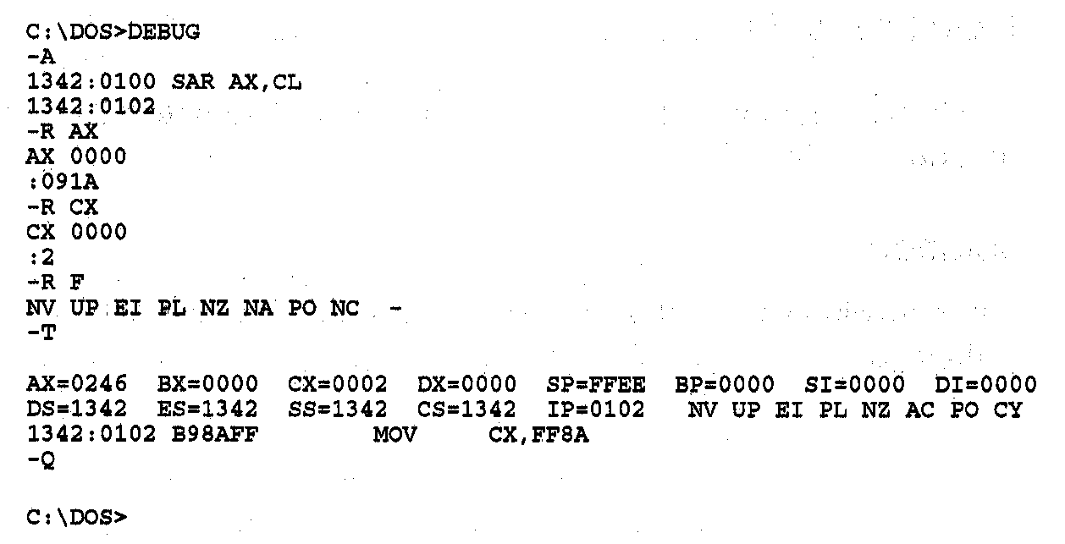
SAR Instruction Execution
Debug execution of SAR example
Microprocessors I: Lecture 11
Notes:
Chapter 5 part 2

Slide 13
Shift Instructions- Application
Application–Isolating a bit of a byte of data in memory in the carry flag
  Example:
    Instruction sequence
      MOV AL,[CONTROL_FLAGS]
      MOV CL, 04H
      SHR AL,CL
    Before execution
    (CONTROL_FLAGS) = B₇B₆B₅B₄B₃B₂B₁B₀
    After executing 1st instruction
    (AL) =B₇B₆B₅B₄B₃B₂B₁B₀
    After executing 2nd instruction
    (CL) = 04H
    After executing 3rd instruction
    (AL) = 0000B₇B₆B₅B₄
    (CF) = B₃
Microprocessors I: Lecture 11
Notes:
Chapter 5 part 2

Slide 14
Shift example
Example: Given AL = 15H, CL = 03H, and CF = 0 show the state of AL and CF after each instruction in the sequence below:
  SHL AL, 1
  SHR AL, CL
  SAL AL, 5
  SAR AL, 2
Microprocessors I: Lecture 11

Slide 15
Solution
Initially, AL = 15H = 00010101₂
SHL AL, 1
  AL = (00010101 << 1) = 00101010₂ = 2AH
  CF = last bit shifted out = 0
SHR AL, CL
  AL = (00101010 >> 3) = 00000101₂ = 05H
  CF = last bit shifted out = 0
SAL AL, 5
  “Arithmetic” left shift same as SHL
  AL = (00000101 << 5) = 10100000₂ = A0H
  CF = last bit shifted out = 0
SAR AL, 2
  Arithmetic right shift keeps sign intact—copy MSB to fill leftmost positions
  AL = (10100000 >> 2) = 11101000₂ = E8H
  CF = last bit shifted out = 0
Microprocessors I: Lecture 11

Slide 16
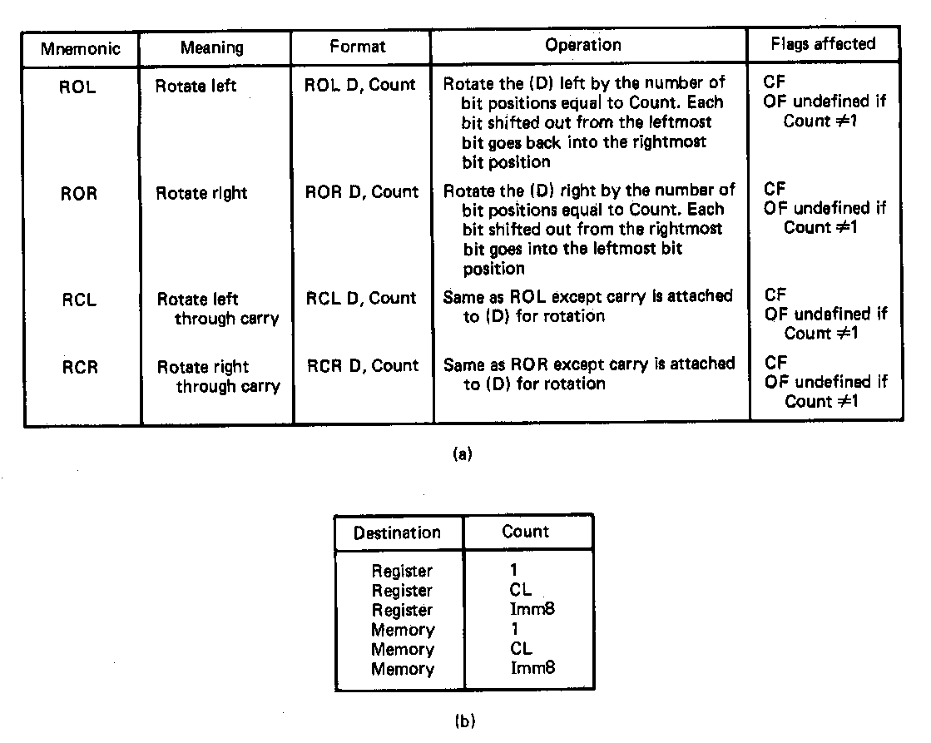
Rotate Instructions
Variety of rotate instruction provided
  ROL → Rotate left
  ROR → Rotate right
  RCL → Rotate left through carry
  RCR → Rotate right through carry
Perform a variety of rotate left and rotate right operations on the bits of a destination data operand
Overview of function
  Destination may be in either a register or a storage location in memory
  Rotate count may be:
    1= one bit rotate
    CL = 1 to 255 bit rotate
    IMM8 = 1 to 255 bit rotate
  Flags updated based on result
    CF
    OF undefined if Count ≠ 1
  Used to rearrange information
Microprocessors I: Lecture 11
Notes:
Chapter 5 part 2

Slide 17
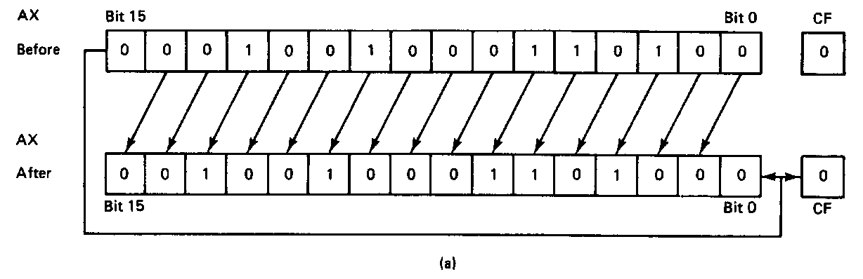
Operation of the ROL Instruction
  Typical instruction—count of 1
  ROL AX,1
  Before execution
  Dest = (AX) = 1234H
  = 0001 0010 0011 0100₂
  Count = 1
  CF = 0
  Operation
    The value in all bits of AX are rotated left one bit position
    Value rotated out of the MSB is reloaded at LSB
    Value rotated out of MSB copied to carry flag
  After execution
  Dest = (AX) = 2468H = 0010010001101000₂
  CF = 0
Microprocessors I: Lecture 11
Notes:
Chapter 5 part 2

Slide 18
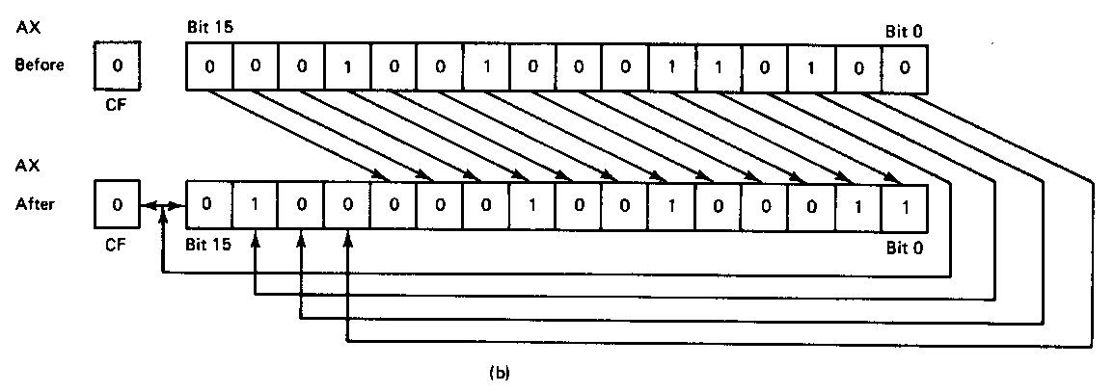
Operation of the ROR Instruction
Typical instruction—count in CL
ROR AX,CL
Before execution
Dest = (AX) = 1234H
= 0001 0010 0011 0100₂
Count = 04H, CF = 0
Operation
  The value in all bits of AX are rotated right four bit positions
  Values rotated out of the LSB are reloaded at MSB
  Values rotated out of MSB copied to carry flag
After execution
Dest = (AX) = 4123H = 0100000100100011₂
CF = 0
Conclusion:
  Note that the position of hex characters in AX have be rearranged
Microprocessors I: Lecture 11
Notes:
Chapter 5 part 2

Slide 19
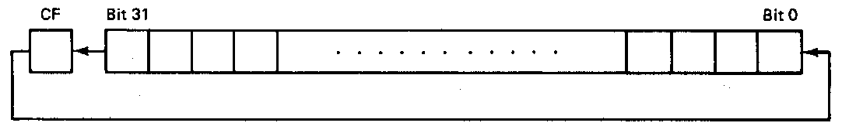
Operation of the RCL Instruction
RCL instruction operation
  Typical instruction—count in CL
  RCL BX,CL
  Before execution
  Dest = (BX) = 1234H = 0001 0010 0011 0100₂
  Count = 04H, CF = 0
  Operation
    The value in all bits of AX are shifted left four bit positions
    Emptied MSBs are rotated through the carry bit back into the LSB
    Last value rotated out of MSB retained in carry flag
    First rotate loads prior value of CF at the LSB
  After execution
  Dest = (BX) = 2340H = 0010 0011 0100 0000₂
  CF = 1
Microprocessors I: Lecture 11
Notes:
Chapter 5 part 2

Slide 20
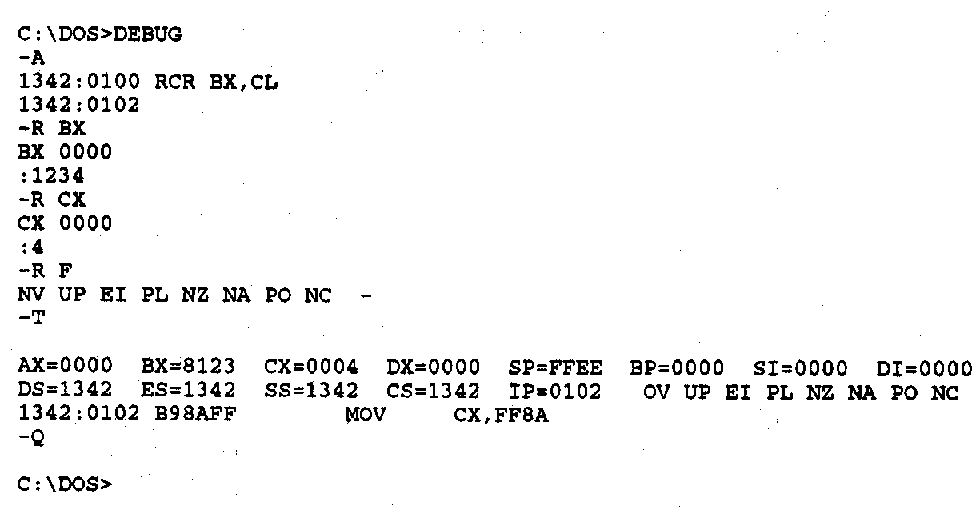
RCR Example
RCR instruction debug execution example
  Instruction—count in CL
  RCR BX,CL
  Before execution
  Dest = (BX) = 1234H
  = 0001 0010 0011 0100₂
  Count = 04H
  CF = 0
  After execution
  Dest = (BX) = 8123H = 1000000100100011₂
  CF = 0
Microprocessors I: Lecture 11
Notes:
Chapter 5 part 2

Slide 21
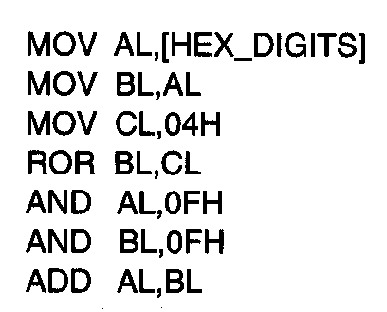
Rotate Instructions- Application
Disassembling and adding 2 hex digits
  1st Instruction → Loads AL with byte
  containing two hex digits
  2nd Instruction → Copies byte to BL
  3rd Instruction → Loads rotate count
  4th instruction → Aligns upper hex digit of BL with lower digit in AL
  5th Instruction → Masks off upper hex digit in AL
  6th Instruction → Masks off upper for bits of BL
  7th Instruction → Adds two hex digits
Microprocessors I: Lecture 11
Notes:
Chapter 5 part 2

Slide 22
Next time
Instruction sequence examples
Microprocessors I: Lecture 11

