Slide 1
16.317: Microprocessor System Design I
Instructor: Dr. Michael Geiger
Spring 2012
Lecture 29: Microcontroller intro
Notes:
Chapter 2

Slide 2
Lecture outline
Announcements/reminders
  Lab 3 report due today
  Lab 4 to be posted today, due 4/25
  HW 4 to be posted early next week
  Exam regrade requests due by Friday, 4/13
Lecture outline
  Microcontrollers
  PIC introduction
Microprocessors I: Lecture 29

Slide 3
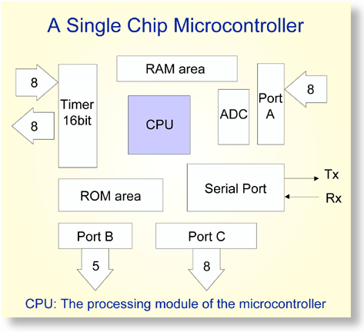
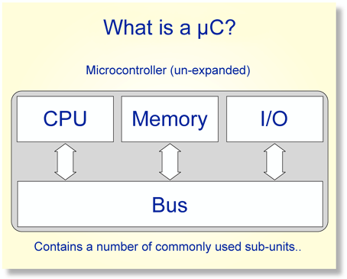
Overview of Microcontrollers
Basically, a microcontroller is a device which integrates a number of the components of a microprocessor system onto a single microchip.
Reference: http://mic.unn.ac.uk/miclearning/modules/micros/ch1/micro01notes.html#1.4
Microprocessors I: Lecture 29
Notes:
Chapter 9

Slide 4
Microcontroller features
Processor
  Usually general-purpose but can be app-specific
On-chip memory
  Often RAM for data, EEPROM/Flash for code
Integrated peripherals
  Common peripherals
    Parallel I/O port(s)
    Clock generator(s)
    Timers/event counters
  Special-purpose devices such as:
    Analog-to-digital converter (sensor inputs)
    Mixed signal components
    Serial port + other serial interfaces (SPI, USB)
    Ethernet
Microprocessors I: Lecture 29

Slide 5
Microcontroller features
Benefits
  Typically low-power/low-cost
    Target for embedded applications
  Easily programmable
    Simple ISAs (RISC processors)
    Use of development kits simplifies process
Limitations
  Small storage space (registers, memory)
  Restricted instruction set
  May be required to multiplex pins
  Not typically used for high performance
Microprocessors I: Lecture 29

Slide 6
PIC Microcontroller (PIC16F684)
High performance, low cost, for embedded applications
  Only 35 different instructions
  Interrupt capability
  Direct, indirect, relative addressing mode
Low Power
  8.5uA @ 32KHz, 2.0V
Peripheral Features
  12 I/O pins with individual direction control
  10-bit A/D converter
  8/16-bit timer/counter
Special Microcontroller Features
  Internal/external oscillator
  Power saving sleep mode
  High Endurance Flash/EEPROM cell
Microprocessors I: Lecture 29
Notes:
Chapter 9

Slide 7
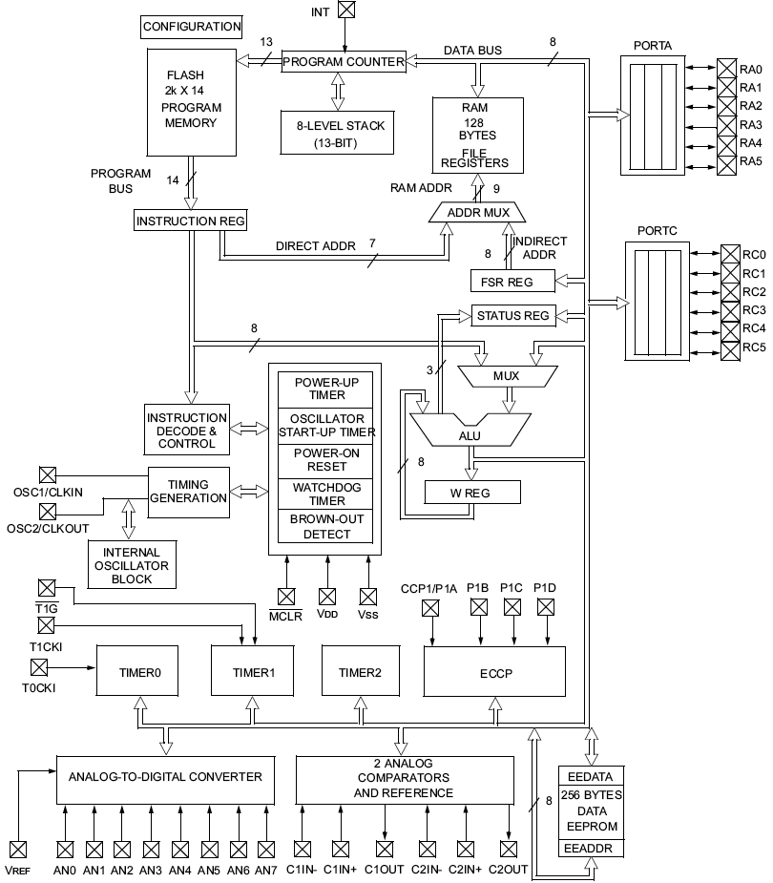
PIC16F684 Block Diagram
Microprocessors I: Lecture 29
Notes:
Chapter 9

Slide 8
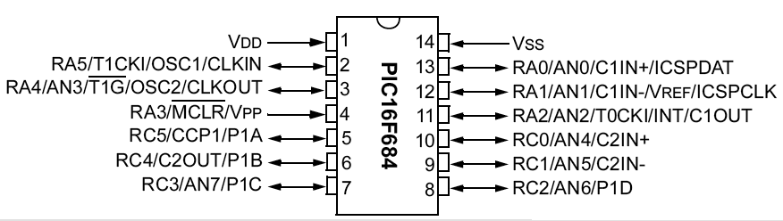
PIC16F684
12 pins, 2048 instructions, 128 byte variable memory, ADC, comparator, Timers, ICD
Microprocessors I: Lecture 29
Notes:
Chapter 9

Slide 9
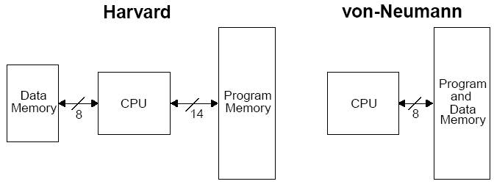
Harvard vs Von Neumann
Organization of program and data memory
Microprocessors I: Lecture 29
Notes:
Chapter 9

Slide 10
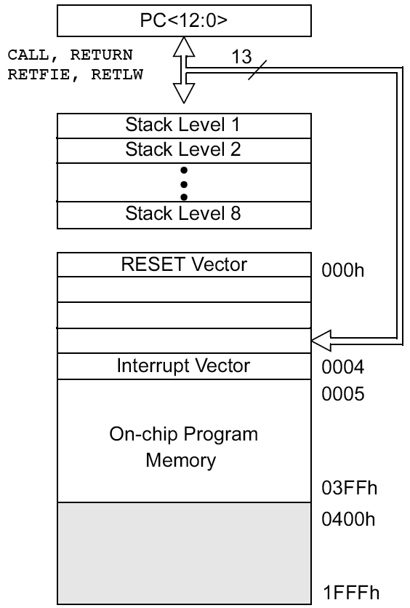
Program Memory Space
13-bit program counter to address 8K locations
Each location is 14-bit wide (instructions are 14 bits long)
RESET vector is 0000h
  When the CPU is reset, its PC is automatically cleared to zero.
Interrupt Vector is 0004h
  0004h is automatically loaded into the program counter when an interrupt occurs
Vector → address of code to be executed for given interrupt
Microprocessors I: Lecture 29
Notes:
Chapter 9

Slide 11
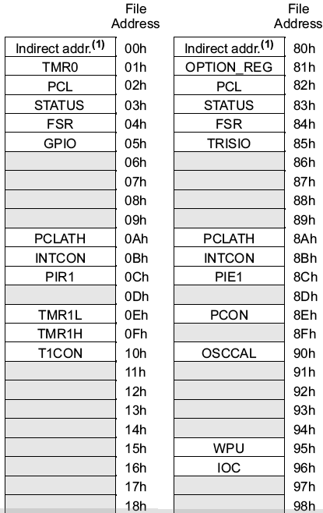
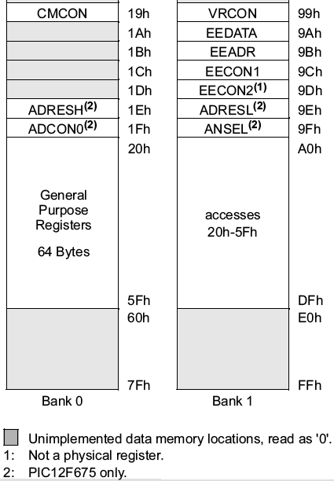
Data Memory Space
Microprocessors I: Lecture 29
Notes:
Chapter 9
Two banks. Special Function registers are located at the first 32 locations of each bank. RP0 bit in status (bit 5) selects the bank.
General purpose registers are at 20h-5Fh.

Slide 12
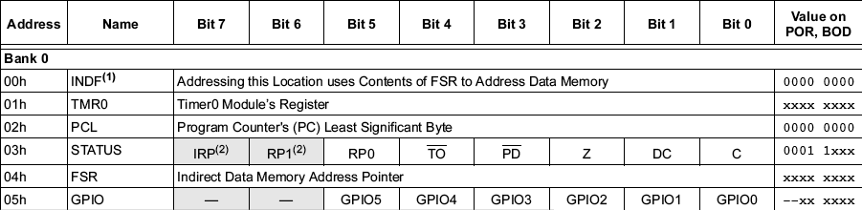
Special Function Registers
Microprocessors I: Lecture 29
Notes:
Chapter 9

Slide 13
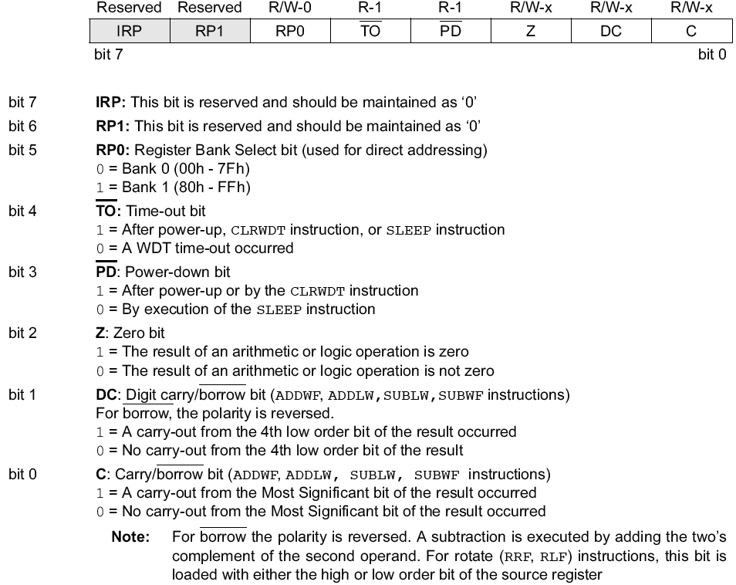
Status Register
Microprocessors I: Lecture 29
Notes:
Chapter 9

Slide 14
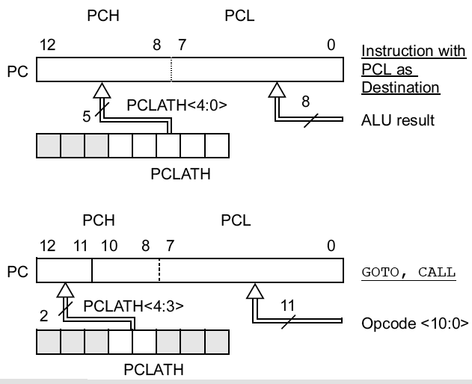
PCL and PCLATH
PC: Program Counter, 13 bits
PCL (02h): 8 bits, the lower 8 bits of PC
PCLATH (0Ah): PC Latch, provides the upper 5 (or 2) bits of PC when PCL is written to
1st example: PC is loaded by writing to PCL
2nd example: PC is loaded during a CALL or GOTO instruciton
Microprocessors I: Lecture 29
Notes:
Chapter 9

Slide 15
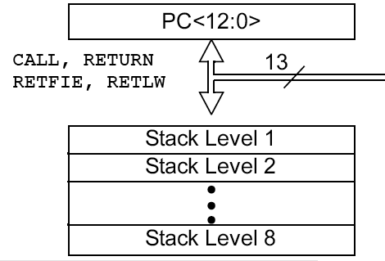
Stack
8-level deep x 13-bit wide hardware stack
The stack space is not part of either program or data space and the stackpointer is not readable or writable.
The PC is “PUSHed” onto the stack when a CALL instruction is executed, or an interrupt causes a branch.
The stack is “POPed” in the event of a RETURN, RETLW or a RETFIE instruction execution.
However, NO PUSH or POP instructions !
PCLATH is not affected by a “PUSH” or “POP” operation.
The stack operates as a circular buffer:
  after the stack has been PUSHed eight times, the ninth push overwrites the value that was stored from the first push.
Microprocessors I: Lecture 29

Slide 16
Next time
Continue with discussion of PIC
Microprocessors I: Lecture 29

