Slide 1
16.317: Microprocessor System Design I
Instructor: Dr. Michael Geiger
Spring 2012
Lecture 35: Exam 3 Preview
Notes:
Chapter 2

Slide 2
Lecture outline
Announcements/reminders
  Course evaluations
    Distributed today, online, or at start of exam period
    To ensure 100% participation, must turn in evaluation on 5/10 before getting exam
Assignments
  Labs through Lab 4 graded
  Lab 5 report due today
  Will post solution to HW 4 by end of day
Today: Exam 3 Preview
  General exam format
  Topics covered
    Memory interfacing—not tested
    PIC overview
    PIC programming
      ISA specifics
      Example programs
Microprocessors I: Lecture 35

Slide 3
Exam 3 notes
Time/location: Thursday, 5/10, 3-6 PM, Olsen 503
Allowed
  One 8.5” x 11” double-sided sheet of notes
  Calculator
No other notes or electronic devices (phone, laptop, etc.)
Exam will last three hours
  Will be written for ~50 minutes, but you’ll have whole exam period
Covers all lectures after Exam 2 except 28 (Lec. 29-34)
Format similar to previous exams
  1 multiple choice question
  2 short problems to solve/code sequences to evaluate
Microprocessors I: Lecture 35

Slide 4
Review: Microcontroller/PIC basics
Microcontrollers: CPU integrated with storage, I/O devices
  Examples
    Timers/event counters
    Parallel & serial ports
    Clock generator
    Analog to digital converter
  Benefits: low cost/low power, easy to program
  Limitations: storage, computational power
Introduced PIC 16F684 microcontroller
  14 pins—12 multiplexed I/O + power/ground
  All computations using 2 values use accumulator
  Harvard memory architecture
  Memory divided into SFR / GPR
  Dedicated 8-entry system stack for return addresses (subroutines/interrupts)
Microprocessors I: Lecture 35

Slide 5
Review: PIC Data Memory Organization
Made up of SFRs and GFRs
Banking: 128 byte chunks
  Max offset within bank 0x7f
  Controller may have 2 or 4 banks
Addressing Modes
  Direct addressing:
    7 bit address (within bank)
    RP1:RP0 selects bank
  Indirect addressing:
    Access to INDF causes indirect addressing
    Actual memory address in IRP+FSR
I/O ports
  Control register (e.g. TRISA) controls direction of each pin
    Bit = 1 → input, Bit = 0 → output
  Data register (e.g. PORTA) contains actual port state
Microprocessors I: Lecture 35

Slide 6
Review: PIC instructions
Four instruction formats
  Upper bits of all hold opcode
  Byte-oriented includes 1 bit destination, 7 bit direct address
  Bit-oriented includes 3 bit position (0-7), 7 bit direct address
  Literal/control includes 8 bit literal
  CALL/GOTO includes 11 bit literal
Variable declarations
  cblock <start_address>: start of variable declarations
  All names between cblock/endc directives assigned to consecutive bytes starting at <start_address>
Microprocessors I: Lecture 35

Slide 7
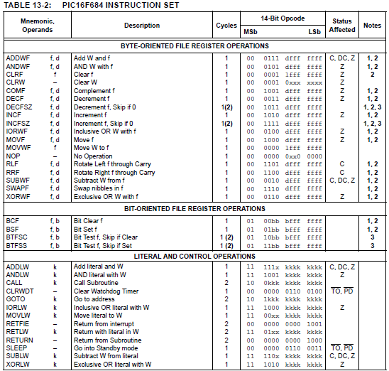
Microprocessors I: Lecture 35

Slide 8
Review: PIC instructions (cont.)
Clearing register: clrw/clrf
Moving values: movlw/movwf/movf
Swap nibbles: swapf
Single bit manipulation: bsf/bcf
Unary operations: incf/decf/comf
Arithmetic: addlw/addwf/sublw/subwf
Microprocessors I: Lecture 35

Slide 9
Review: PIC instructions (cont.)
Logical operations
  andlw/andwf
  iorlw/iorwf
  xorlw/xorwf
Rotates
  rrf
  rlf
Jumps/calls/return
  goto
  call
  return/retlw/retfie
Microprocessors I: Lecture 35

Slide 10
Review: PIC instructions (cont.)
Conditional execution
  Test bit and skip next instruction if clear/set: btfsc/btfss
  Increment/decrement register and skip next instruction if zero: incfsz/decfsz
Example use: combined with goto to create conditional jump
Microprocessors I: Lecture 35

Slide 11

Review: A Delay Subroutine
; ***********************************************************************************
; TenMs subroutine and its call inserts a delay of exactly ten milliseconds
; into the execution of code.
; It assumes a 4 MHz crystal clock. One instruction cycle = 4 * Tosc.
; TenMsH equ 13 ; Initial value of TenMs Subroutine's counter
; TenMsL equ 250
; COUNTH and COUNTL are two variables
TenMs
nop ; one cycle
movlw TenMsH ; Initialize COUNT
movwf COUNTH
movlw TenMsL
movwf COUNTL
Ten_1
decfsz COUNTL,F ; Inner loop
goto Ten_1
decfsz COUNTH,F ; Outer loop
goto Ten_1
return
Microprocessors I: Lecture 35
Notes:
Chapter 9

Slide 12

Review: Strategy to “Blink”
The LEDs are toggled in sequence - green, yellow, red, green, yellow, red…
Let’s look at the lower three bits of PORTD
  001=green, 010=yellow, 100=red
The next LED to be toggled is determined by the current LED.
001->010->100->001->…
Microprocessors I: Lecture 35

Slide 13
“Blink” Subroutine
Blink
btfsc PORTD, 0 ; is it Green?
goto toggle1 ; yes, goto toggle1
btfsc PORTD, 1 ; else is it Yellow?
goto toggle2 ; yes, goto toggle2
;toggle0
bcf PORTD, 2 ; otherwise, must be red, change to green
bsf PORTD, 0 ; 100->001
return
toggle1
bcf PORTD, 0 ; change from green to yellow
bsf PORTD, 1 ; 001->010
return
toggle2
bcf PORTD, 1 ; change from yellow to red
bsf PORTD, 2 ; 010->100
return
Microprocessors I: Lecture 35

Slide 14
Another way to code “Blink” ---- Table Use
BlinkTable
movf PORTD, W ; Copy present state of LEDs into W
andlw B'00000111' ; and keep only LED bits
addwf PCL,F ; Change PC with PCLATH and offset in W
retlw B'00000001' ; (000 -> 001) reinitialize to green
retlw B'00000011' ; (001 -> 010) green to yellow
retlw B'00000110' ; (010 -> 100) yellow to red
retlw B'00000010' ; (011 -> 001) reinitialize to green
retlw B'00000101' ; (100 -> 001) red to green
retlw B'00000100' ; (101 -> 001) reinitialize to green
retlw B'00000111' ; (110 -> 001) reinitialize to green
retlw B'00000110' ; (111 -> 001) reinitialize to green
In calling program
call BlinkTable ; get bits to change into W
xorwf PORTD, F ; toggle them into PORTD
Microprocessors I: Lecture 35

Slide 15
Next time
Exam 3: Thursday, 5/10, 3-6 in Olsen 503
Please remember to complete your course evaluations and bring them to the exam!
Microprocessors I: Lecture 35

