Slide 1
16.317
Microprocessor Systems Design I
Instructor: Dr. Michael Geiger
Spring 2012
Lecture 3: Data types, registers, memory segmentation

Slide 2
Lecture outline
Announcements/reminders
  Register for the discussion group on piazza.com
    Search by course # “16.317”
Lecture outline
  Review
    Processor architecture
    Software model
      80386DX registers, address space
  Today: More on 80386 software model
    Data types
    More detail on registers
    Memory segmentation
Microprocessors I: Lecture 3

Slide 3
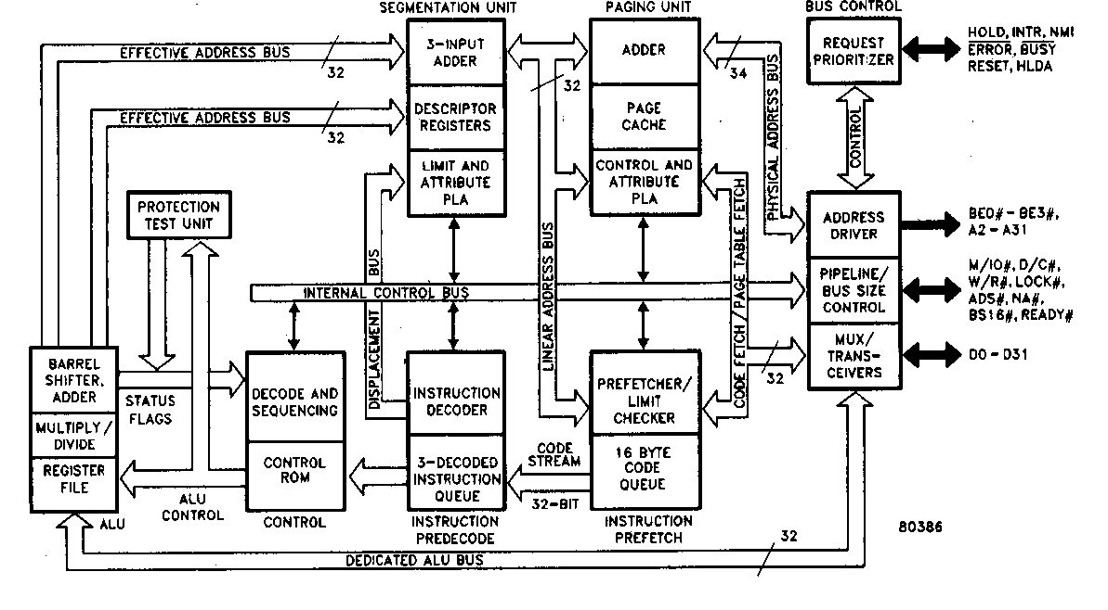
Review: Processor architecture
High level hardware view
80386: six functional units:
  Bus units
  Execution unit
  Segment unit
  Page unit
  Prefetch unit
  Decode unit
Microprocessors I: Lecture 3
Notes:
Chapter 2

Slide 4
Review: Software Model
Programmer’s understanding the operation of the microcomputer from a software point of view
Elements of the software model
  How much data is available?
    # registers; size of address space
  Where is data stored?
    Registers
    Memory
    I/O address space
  How is data used?
    Data vs. addresses vs. flags
    Different data sizes, formats
  What operations can be performed?
Microprocessors I: Lecture 3
Notes:
Chapter 2

Slide 5
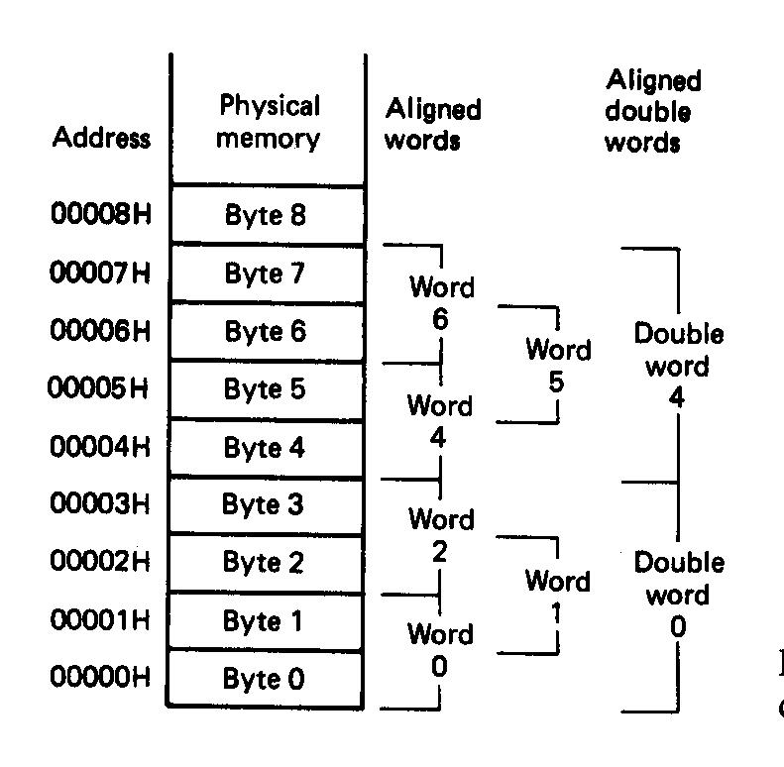
Review: Data in memory
Aligned data
  Words (16 bits) must start at even address
  Double words (32 bits) must start at address divisible by 4
  Performance penalty for accessing unaligned data
Multi-byte data stored using little endian format
  LSB has lowest address
  MSB has highest address
Microprocessors I: Lecture 3
Notes:
Chapter 2

Slide 6
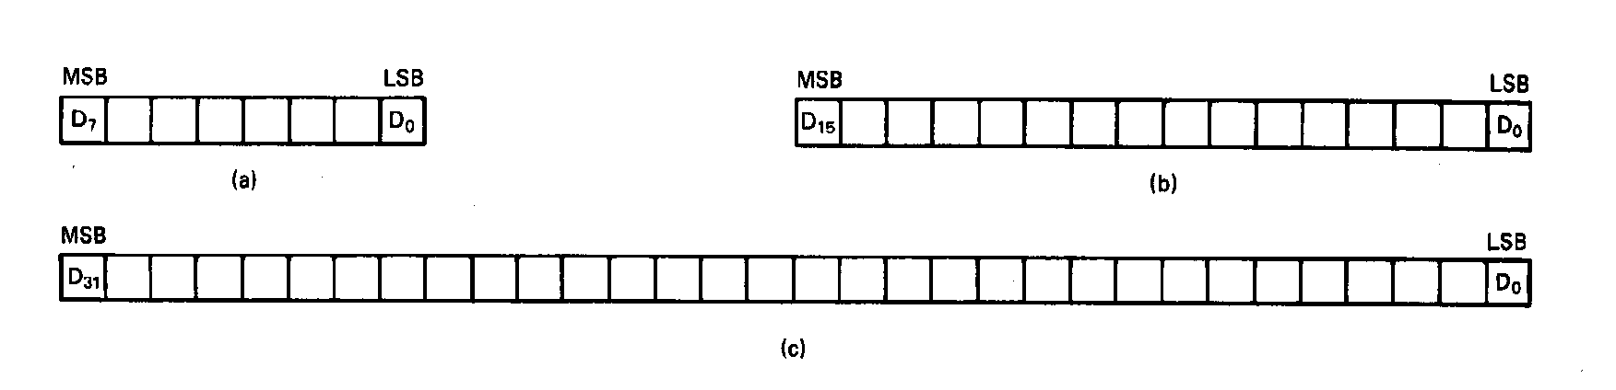
Unsigned Integers
All numbers are binary in memory
All bits represent data
Types:
Sizes Range
8-bit 0H → 255₁₀
16-bit 0H → 65,535₁₀
32-bit 0H → 4,294,967,295₁₀
Microprocessors I: Lecture 3
Notes:
Chapter 2

Slide 7
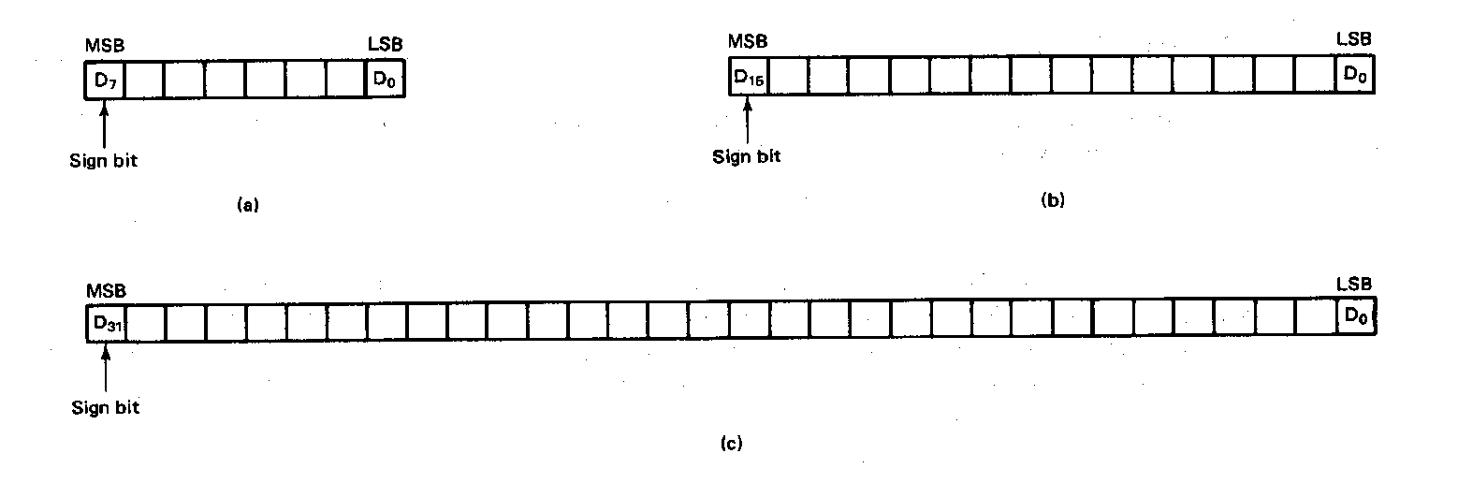
Signed Integers
MSB is sign bit ( 0/1 -> +/-)
Remaining bits represent value
Negative numbers expressed in 2’s complement notation
Types:
Sizes Range
8-bit -128 → +127
16-bit -32,768 → +32,767
32-bit -2,147,483,648 → +2,147,483,647
Microprocessors I: Lecture 3
Notes:
Chapter 2

Slide 8
Integer Examples
Given the 8-bit value: 1001 1111₂
Calculate the decimal value of this integer as
  An unsigned integer
  A signed integer
Microprocessors I: Lecture 3
Notes:
Chapter 2

Slide 9
Integer example solution
Given the 8-bit value: 1001 1111₂
Calculate the decimal value of this integer as
  An unsigned integer
  Solution:
    (1 x 2⁷) + (1 x 2⁴) + (1 x 2³) + (1 x 2²) + (1 x 2¹) + (1 x 2⁰)
    = 128 + 16 + 8 + 4 + 2 + 1 = 159
  A signed integer
  Solution:
    MSB = 1 → negative value
    To get magnitude, take 2’s complement:
    0110 0001₂ = (1 x 2⁶) + (1 x 2⁵) + (1 x 2⁰)
    = 64 + 32 + 1 = 97
    → Result = -97
Microprocessors I: Lecture 3

Slide 10
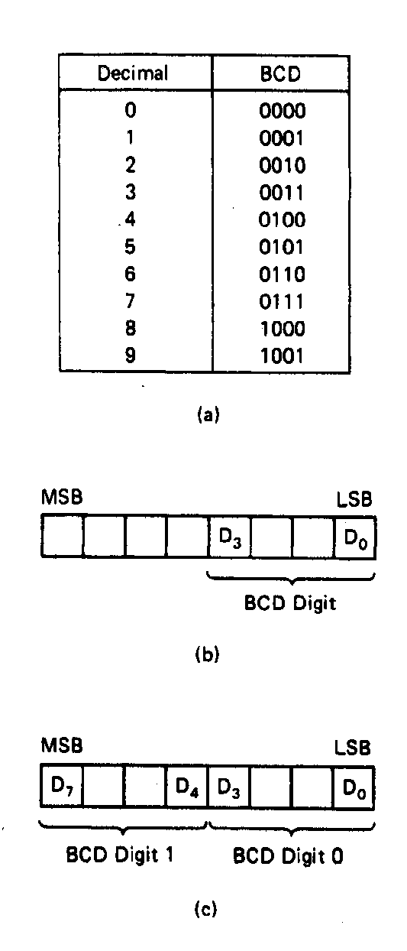
BCD Numbers
Direct coding of numbers as binary coded decimal (BCD) numbers supported
Unpacked BCD [Fig.2.10(b)]
  Lower four bits contain a digit of a BCD number
  Upper four bits filled with zeros (zero filled)
Packed BCD [Fig. 2.10(c)]
  Lower significant BCD digit held in lower 4 bits of byte
  More significant BCD digit held in upper 4 bits of byte
Example: Packed BCD byte at address 01000H is 10010001₂, what is the decimal number?
Organizing as BCD digits gives,
1001_{BCD} 0001_{BCD} = 91₁₀
Microprocessors I: Lecture 3
Notes:
Chapter 2

Slide 11
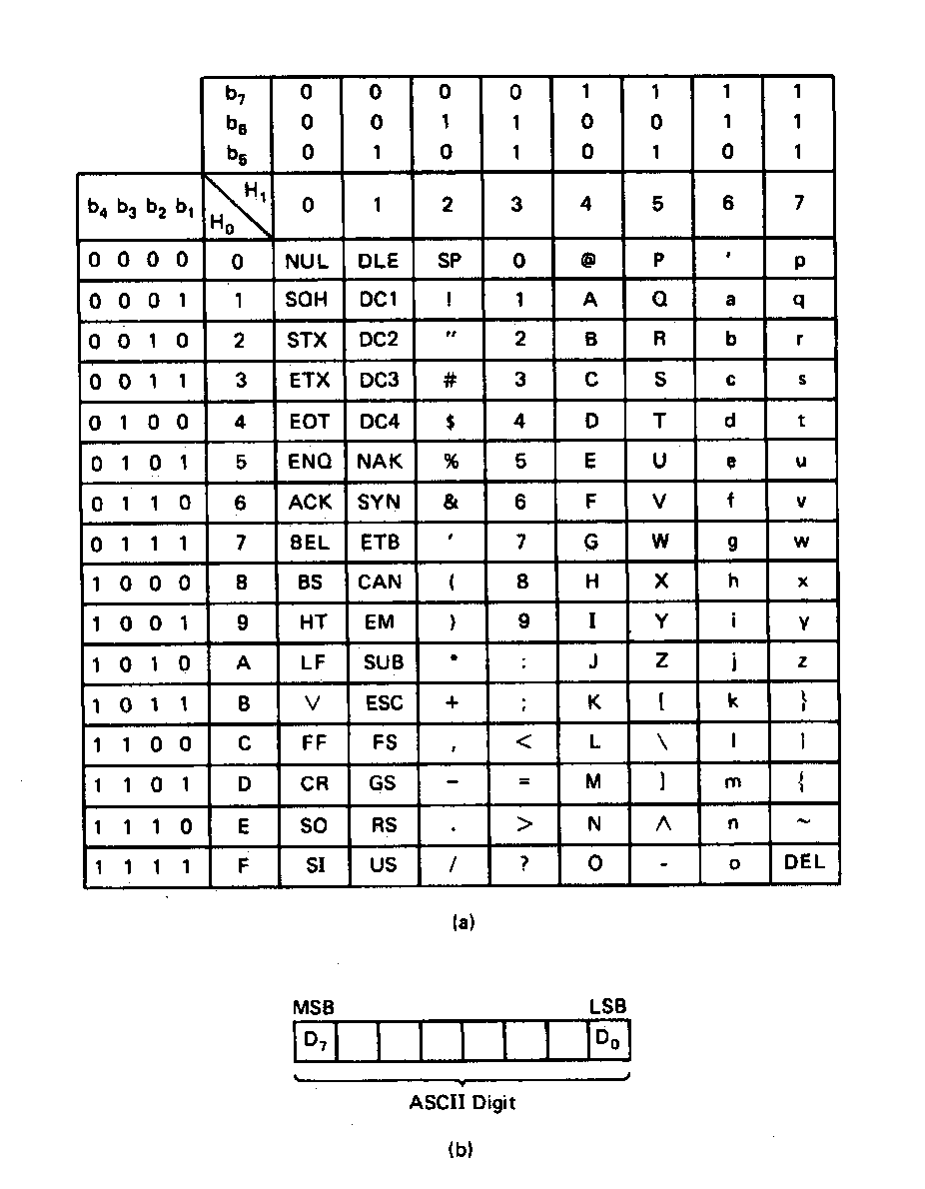
ASCII Data
American Code for Information Interchange (ASCII) code
ASCII information storage in memory
  Coded one character per byte
  7 LS-bits = b₇b₆b₅b₄b₃b₂b₁
  MS-bit filled with 0
Example: Addresses 01100H-01104H contain ASCII coded data 01000001, 01010011, 01000011, 01001001, and 01001001, respectively. What does the data stand for?
0 100 0001_{ASCII} = A
0 101 0011_{ASCI} = S
0 100 0011_{ASCII} = C
0 100 1001_{ASCII} = I
0 100 1001_{ASCII} = I
Microprocessors I: Lecture 3
Notes:
Chapter 2

Slide 12
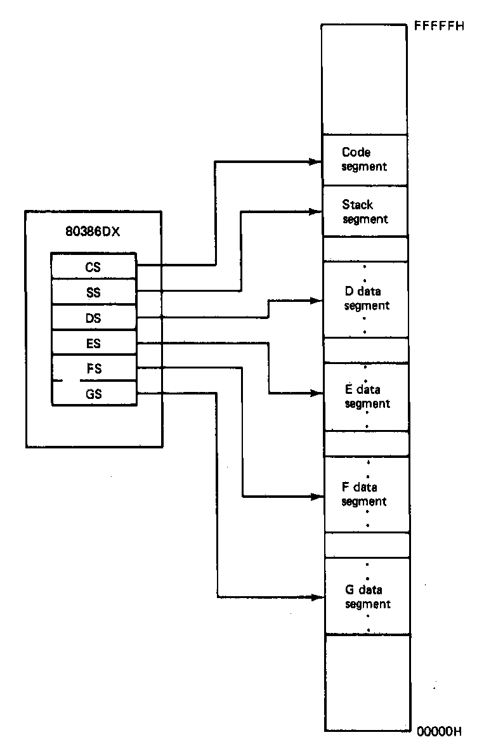
Active Segments of Memory
Memory segmentation
  Only subset of 80386 real-mode address space active
  Each segment register points to lowest address of 64KB contiguous segment
  Total active memory: 384 KB
    64 KB code segment (CS)
    64 KB stack segment (SS)
    256 KB over 4 data segments (DS, ES, FS, GS)
Microprocessors I: Lecture 3
Notes:
Chapter 2

Slide 13
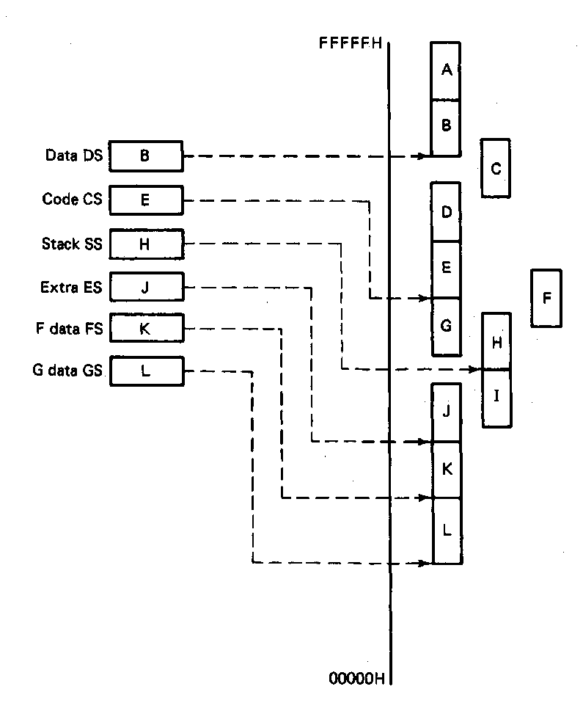
User access, Restrictions, and Orientation
Segment registers are user accessible
  Programmer can change values under software control
  Permits access to other parts of memory
Segments must start on 16-byte boundary
  Examples: 00000H, 00010H, 00020H
Orientation of segments:
  Contiguous—A&B or D,E&G
  Disjointed—C&F
  Overlapping—B&C, E&F, or F,G,&H
Microprocessors I: Lecture 3
Notes:
Chapter 2

Slide 14
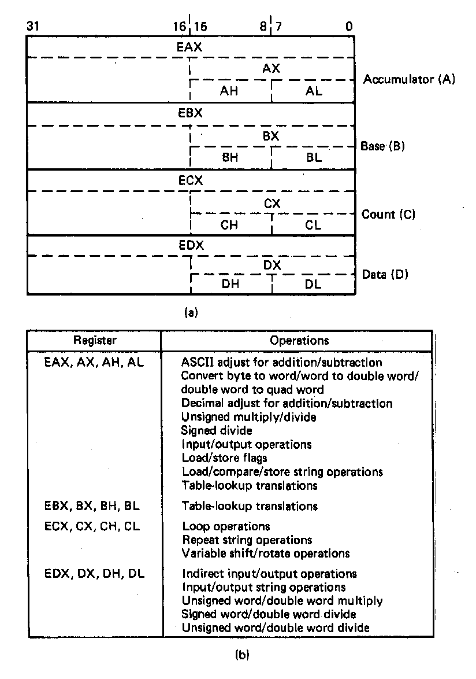
General Purpose Data Registers
Four general purpose data registers
  Accumulator (A) register
  Base (B) register
  Count (C) register
  Data (D) register
Can hold 8-bit, 16-bit, or 32-bit data
  AH/AL = high and low byte value
  AX = word value
  EAX = double word value
General uses:
  Hold data such as source or destination operands for most operations—ADD, AND, SHL
  Hold address pointers for accessing memory
Some also have dedicated special uses
  C—count for loop,
  B—table look-up translations, base address
  D—indirect I/O and string I/O
Microprocessors I: Lecture 3
Notes:
Chapter 2

Slide 15
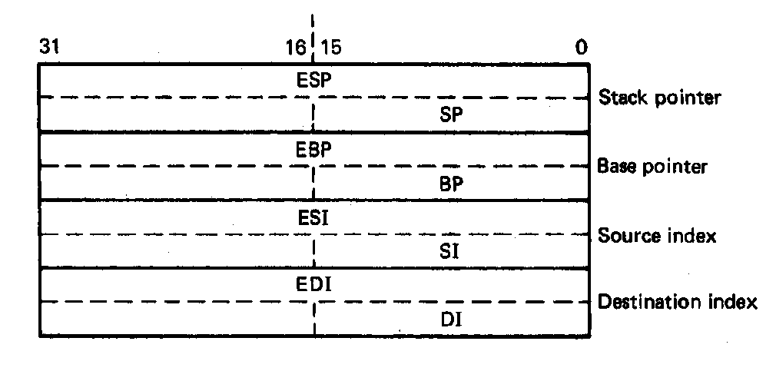
Pointer Registers
Two pointer registers
  Stack pointer register
    ESP = 32-bit extended stack pointer
    SP = 16-bit stack pointer
  Base pointer register
    EBP = 32-bit extended base pointer
    BP = 16-bit base pointer
Use to access information in stack segment of memory
  SP/BP offsets from the current value of the stack segment base address
  Select a specific storage location in the current 64K-byte stack segment
    SS:SP—points to top of stack (TOS)
    SS:BP—points to data in stack
Microprocessors I: Lecture 3
Notes:
Chapter 2

Slide 16
Index Registers
Two index registers
  Source index register
    ESI = 32-bit source index register
    SI = 16-bit source index register
  Destination index registers
    EDI = 32-bit destination index register
    DI = 16-bit destination index register
  Used to access source and destination operands in data segment of memory
    DS:SI—points to source operand in data segment
    DS:DI—points to destination operand in data segment
    Also used to access information in the extra segment (ES)
Microprocessors I: Lecture 3
Notes:
Chapter 2

Slide 17
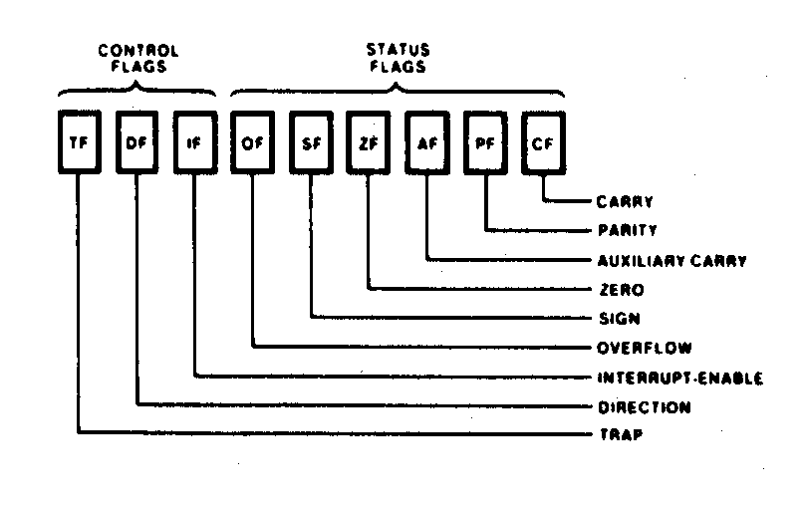
Flags Register
32-bit register holding single bit status and control information
9 active flags in real mode
Two categories
  Status flags: conditions resulting from instruction
    Most instructions update status
    Used as test conditions
  Control flags: control processor functions
    Used by software to turn on/off operating capabilities
Microprocessors I: Lecture 3
Notes:
Chapter 2

Slide 18
Status Flags
Carry flag (CF)
  1 = carry-out or borrow-in from MSB of the result during the execution of an arithmetic instruction
  0 = no carry or borrow has occurred
Parity flag (PF)
  1 = result produced has even parity
  0 = result produced has odd parity
Zero flag (ZF)
  1 = result produced is zero
  0 = result produced is not zero
Sign bit (SF)
  1 = result is negative
  0 = result is positive
Others
  Overflow flag (OF)
  Auxiliary carry flag (AF)
Microprocessors I: Lecture 3
Notes:
Chapter 2

Slide 19
Control Flags
Trap flag (TF)
  1/0 = turn on/off single-step mode
  Mode useful for debugging
  Employed by monitor to execute one instruction at a time (single step execution)
Interrupt flag (IF)
  Used to enable/disable external maskable interrupt requests
  1/0 = enable/disable external interrupts
Direction flag (DF)
  Used to determine the direction in which string operations occur
  1/0 = automatically decrement/increment string address—proceed from high address to low address
Microprocessors I: Lecture 3
Notes:
Chapter 2

Slide 20
Final notes
Next time: Continue with the 80386DX
  Address generation
  Stack
  I/O address space
Acknowledgements
  Thanks to Prof. Yan Luo for providing material used in this lecture
  Figures in these slides come from Triebel’s text The 80386, 80486, and Pentium Processor: Hardware, Software, and Interfacing
Microprocessors I: Lecture 3

