Slide 1
16.317: Microprocessor System Design I
Instructor: Dr. Michael Geiger
Spring 2012
Lecture 7: Addressing modes (cont.)
Notes:
Chapter 2

Slide 2
Lecture outline
Announcements/reminders
  HW 1 due Friday, 2/10
  Lab 1 posted; due date TBD
Lecture outline
  Review
    Assembly basics
    Addressing modes
      Register operand
      Immediate operand
      Memory: direct, register indirect
  Today
    Finish addressing modes
Microprocessors I: Lecture 7

Slide 3
Review: instruction classes
Assembly/machine code: several different instruction classes
  Data Transfer instructions
  Input/output instructions
  Arithmetic instructions
  Logic instructions
  String Instructions
  Control transfer instructions
  Processor control
Microprocessors I: Lecture 7

Slide 4
Review: Addressing modes
Addressing modes: how data is specified
  Register: MOV AX, BX
  Immediate: MOV AX, 1234H
  Memory
    Direct: MOV AX, [1010H]
    Will cover remaining modes today
    Can have at most one memory operand
    Segment base assumed to be DS; can override
Microprocessors I: Lecture 7

Slide 5
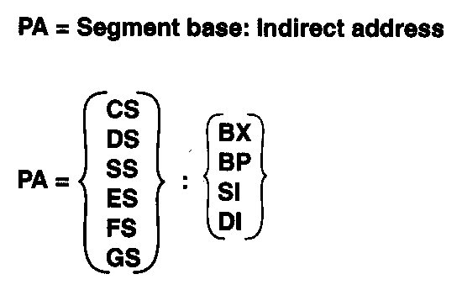
Register Indirect Addressing Mode
Register indirect addressing mode
  Similar to direct addressing in that the affective address is combined with the contents of DS to obtain the physical address
  Effective address resides in either a base or index register
Physical address computation
  PA = SBA:EA → 20-bit address
    PA = SBA:[Rx] → 16-bit offset
  Segment base address is DS by default
    PA = DS:[Rx]
  Segment override prefix (SEG) is required to enable use of another segment register
  PA = ES:[Rx]
Microprocessors I: Lecture 6
Notes:
Chapter 3

Slide 6
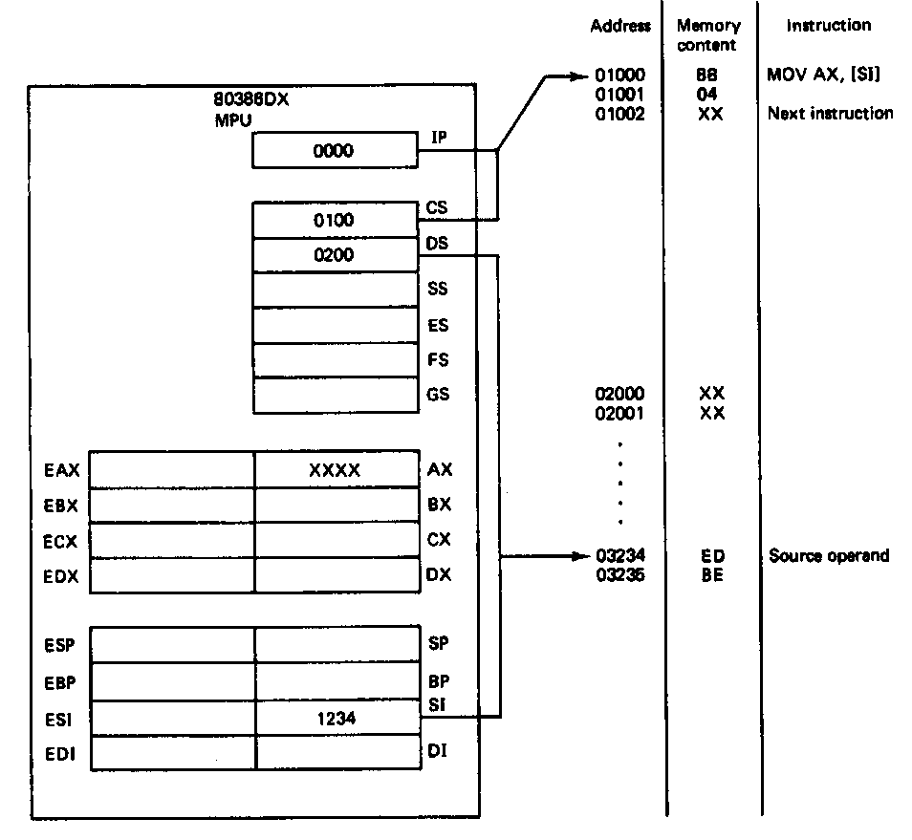
Register Indirect Addressing Mode (example: MOV AX, [SI] )
State before fetch and execution
  Instruction
  CS = 0100H, IP = 0000H
  CS:IP = 0100:0000H = 01000H
  (01000H,01001H) = Opcode = 8B04H
  Source operand—register indirect addressing
  DS = 0200H, SI = 1234H
  PA = DS:SI = 0200H:1234H
  = 02000H +1234H = 03234H
  (03235H,03234H) = BEEDH
  Destination operand—register operand addressing
  (AX) = XXXX → don’t care state
Microprocessors I: Lecture 6
Notes:
Chapter 3

Slide 7
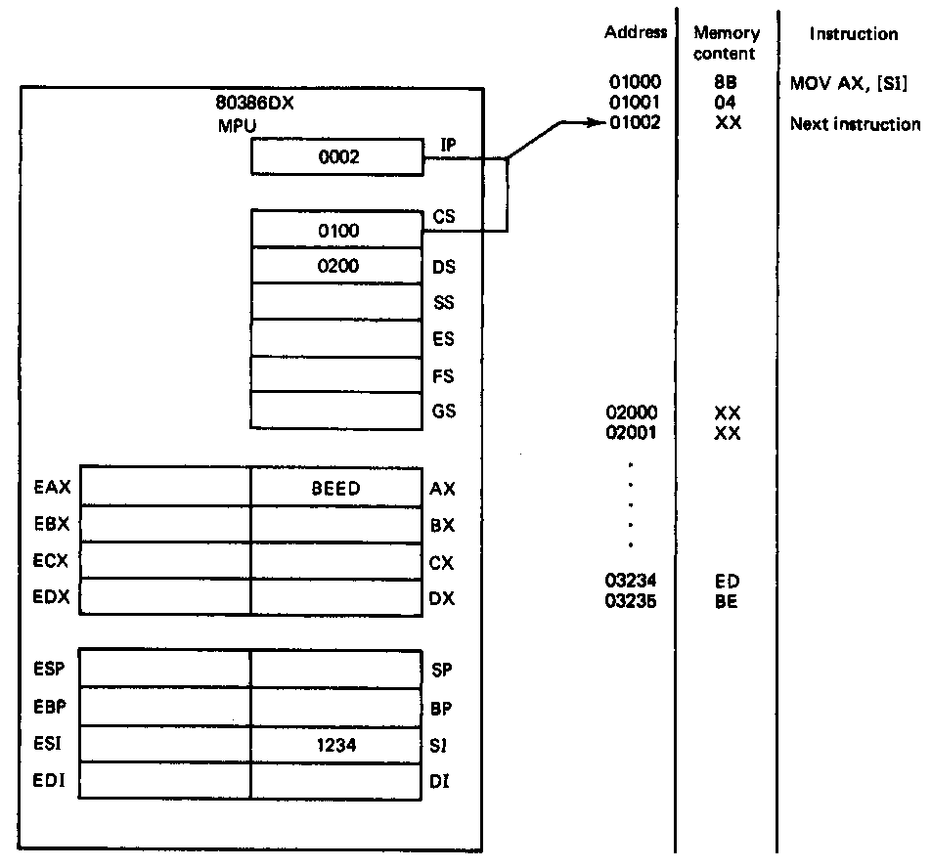
Register Indirect Addressing Mode (example: MOV AX, [SI] )
Example (continued)
State after execution
  Instruction
  CS:IP = 0100:0002 = 01002H
  01002H → points to next sequential instruction
  Source operand
  (03235H,03234H) = BEEDH → unchanged
  Destination operand
  (AX) = BEED
  Rest of bits in EAX unaffected
Microprocessors I: Lecture 6
Notes:
Chapter 3

Slide 8
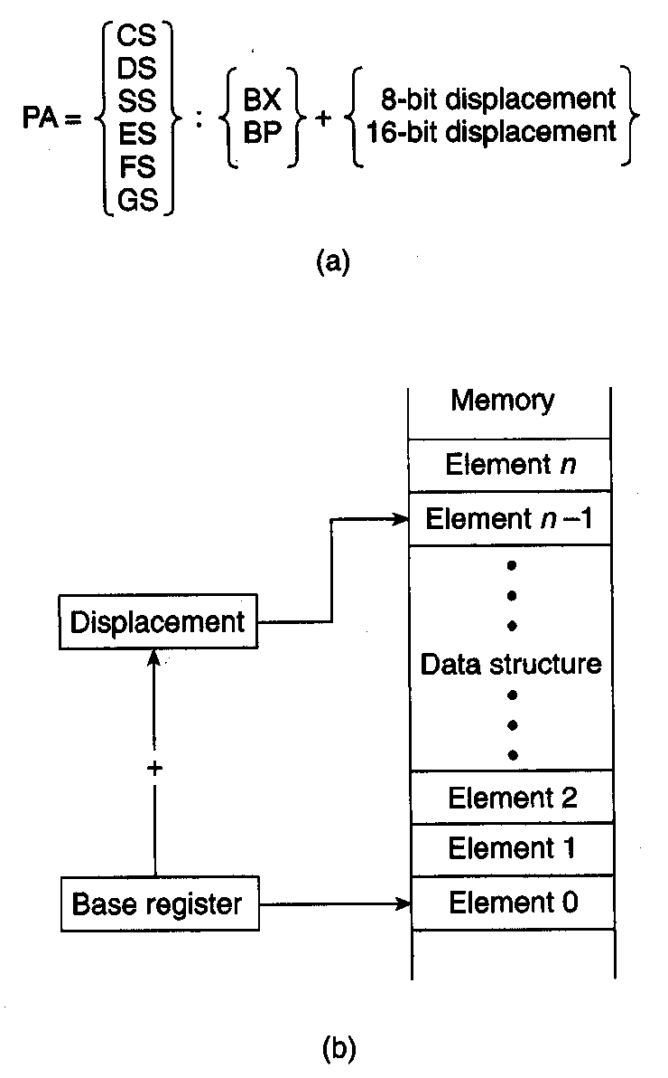
Base Addressing Mode
Based addressing mode
  Effective address formed from contents of a base register and a displacement
    Base register is either BX or BP (stack)
    Direct/indirect displacement is 8-bit or 16bit
Physical address computation
  PA = SBA:EA → 20-bit address
    PA = SBA:[BX or BP] + DA
Accessing a data structure
  Based addressing makes it easy to access elements of data in an array
  Address in base register points to start of the array
  Displacement selects the element within the array
  Value of the displacement is simply changed to access another element in the array
  Program changes value in base register to select another array
Microprocessors I: Lecture 7
Notes:
Chapter 3

Slide 9
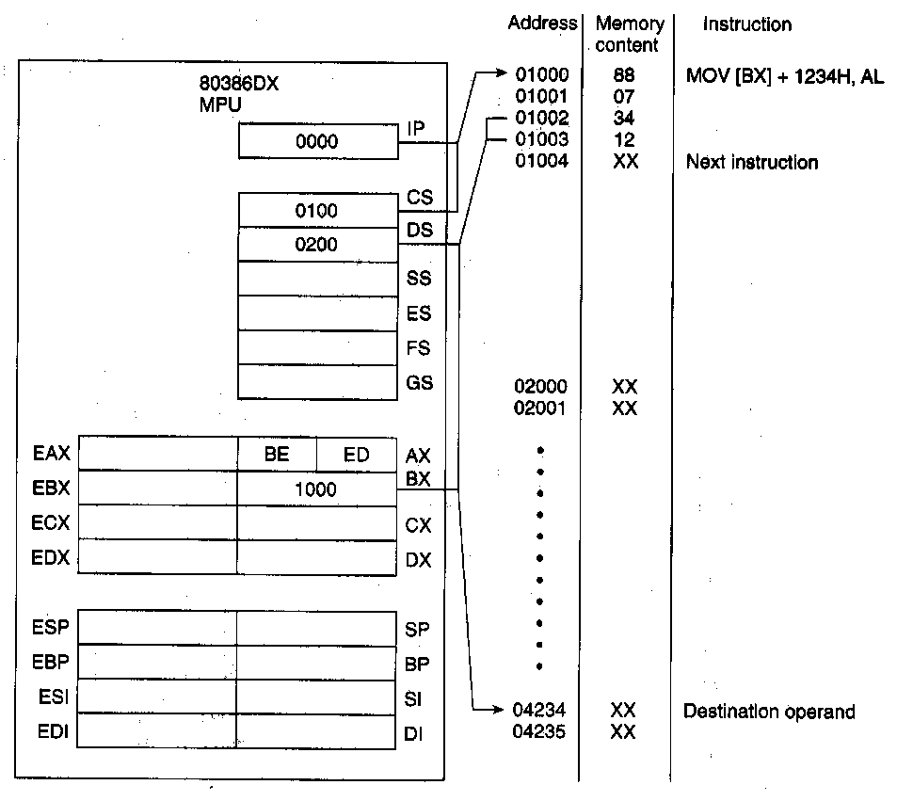
Base Addressing Mode
(Example: MOV [BX] + 1234H, AL)
Instruction
  CS = 0100H, IP = 0000H
  CS:IP = 0100:0000H = 01000H
  (01000H,01001H) = Opcode = 8807H
  (01003H,01002H) = displacement = 1234H
Destination operand—based addressing
  DS = 0200H,BX = 1000H
  DA = 1234H
  PA = DS:BX+DA = 0200H:1000H+1234H
  = 02000H+1000H+1234H
  = 04234H
  (04234H) = XXH
Source operand—register operand addressing
  (AL) = ED
Microprocessors I: Lecture 7
Notes:
Chapter 3

Slide 10
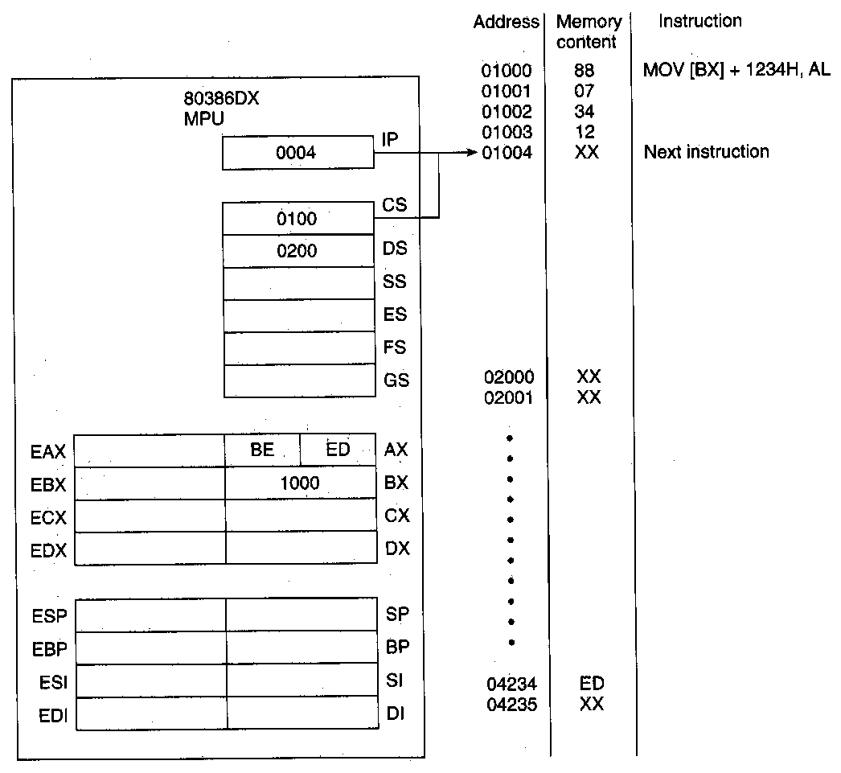
Base Addressing Mode
(Example: MOV [BX] + 1234H, AL)
State after execution
  Instruction
  CS:IP = 0100:0004 = 01004H
  01004H → points to next sequential instruction
  Destination operand
  (04234H) = EDH
  Source operand
  (AL) = EDH → unchanged
Microprocessors I: Lecture 7
Notes:
Chapter 3

Slide 11
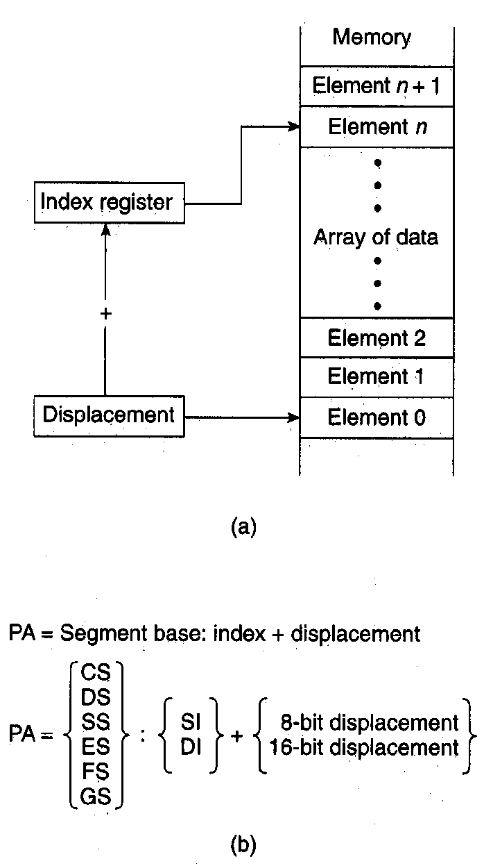
Indexed Addressing Mode
Indexed addressing mode
  Similar to based addressing, it makes accessing elements of data in an array easy
  Displacement points to the beginning of array in memory
  Index register selects element in the array
  Program simply changes the value of the displacement to access another array
  Program changes (recomputes) value in index register to select another element in the array
Effective address formed from direct displacement and contents of an index register
  Direct displacement is 8-bit or 16-bit
  Index register is either SI → source operand or DI → destination operand
Physical address computation
  PA = SBA:EA → 20-bit address
    PA = SBA: DA + [SI or DI]
Microprocessors I: Lecture 7
Notes:
Chapter 3

Slide 12
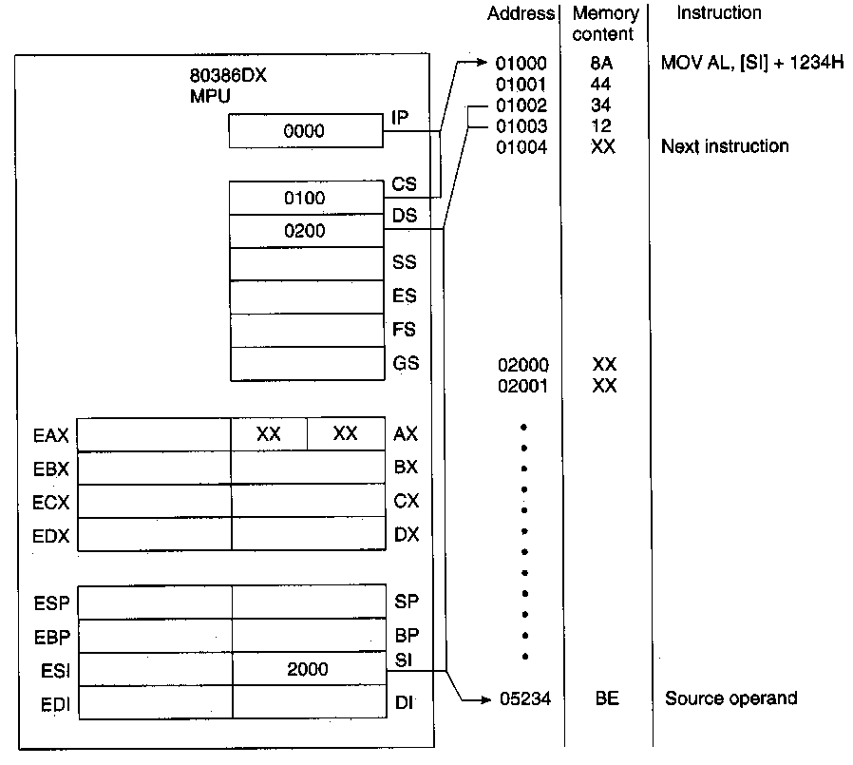
Indexed Addressing Mode
(Example: MOV AL,[SI] +1234H)
State before fetch and execution
  Instruction
  CS = 0100H, IP = 0000H
  CS:IP = 0100:0000H = 01000H
  (01000H,01001H) = Opcode = 8A44H
  (01003H,01002H) = Direct displacement = 1234H
  Source operand—indexed addressing
  DS = 0200H,SI = 2000H,DA = 1234H
  PA = DS:SI+DA = 0200H:2000H+1234H
  = 02000H+2000H+1234H
  = 05234H
  (05234H) = BEH
  Destination operand—register operand addressing
  (AL) = XX → don’t care state
Microprocessors I: Lecture 7
Notes:
Chapter 3

Slide 13
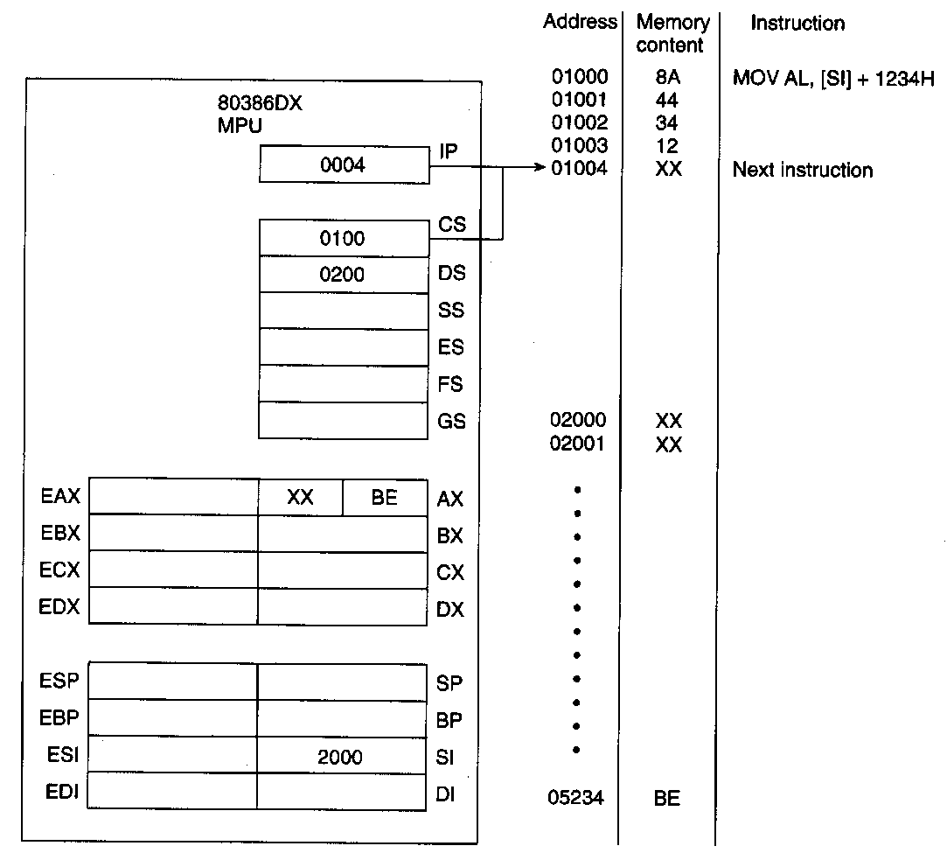
Indexed Addressing Mode
(Example: MOV AL,[SI] +1234H)
Example (continued)
State after execution
  Instruction
  CS:IP = 0100:0004 = 01004H
  01004H → points to next sequential instruction
  Source operand
  (05234H) = BEH → unchanged
  Destination operand
  (AL) = BEH
  Rest of bits in EAX unaffected
Microprocessors I: Lecture 7
Notes:
Chapter 3

Slide 14
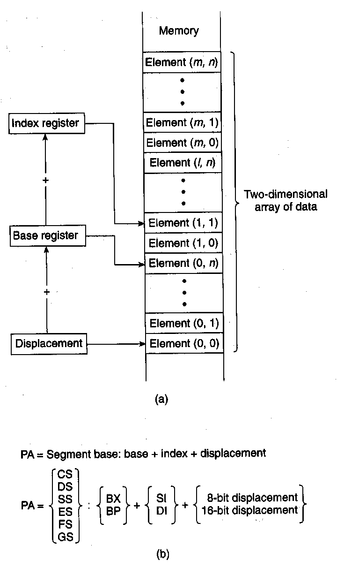
Based-Indexed Addressing Mode
  Combines the functions of based and indexed addressing modes
  Enables easy access to two-dimensional arrays of data
  Displacement points to the beginning of array in memory
  Base register selects a row (m) of elements
  Index register selects an element in column (n)
  Program simply changes the value of the displacement to access another array
  Program changes (recomputes) value in base register to select another row of elements
  Program changes (recomputes) the value of the index register to select the element in another column
Microprocessors I: Lecture 7
Notes:
Chapter 3

Slide 15
Based-Indexed Addressing Mode
Effective address formed from direct displacement and contents of a base register and an index register
  Direct displacement is 8-bit or 16bit
  Base register either BX or BP (stack)
  Index register is either SI → source operand or DI → destination operand
Physical address computation
  PA = SBA:EA → 20-bit address
    PA = SBA:DA + [BX or BP] + [SI or DI]
Microprocessors I: Lecture 7

Slide 16
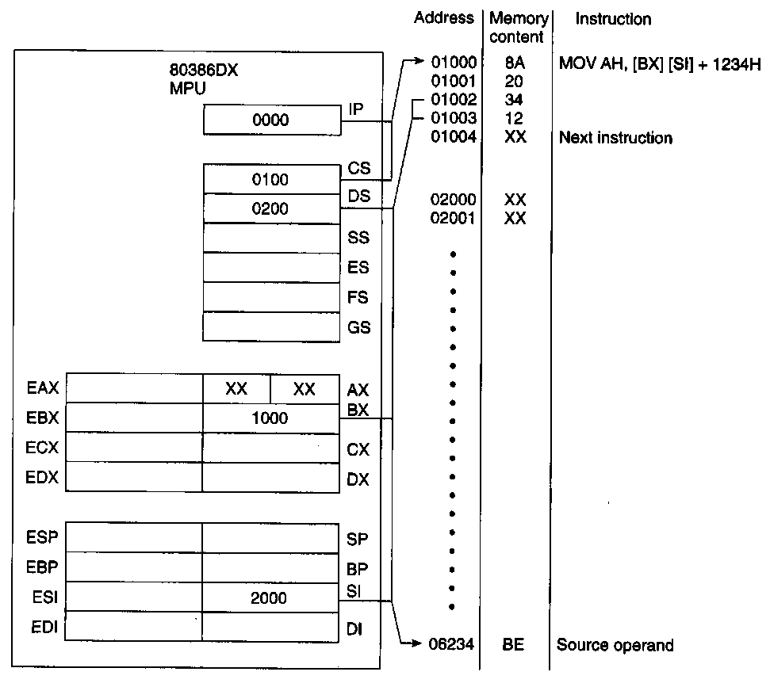
Based- Indexed Addressing Mode
Example(MOV AH,[BX][SI] +1234H)
State before fetch and execution
  Instruction
  CS = 0100H, IP = 0000H
  CS:IP = 0100:0000H = 01000H
  (01000H,01001H) = Opcode = 8A20H
  (01003H,01002H) = Direct displacement = 1234H
  Source operand—based-indexed addressing
  DA = 1234H,DS = 0200H,BX = 1000H
  SI = 2000H
  PA = DS:DA +BX +SI
  = 0200H:1234H + 1000H + 2000H
  = 02000H+1234H +1000H + 2000H
  = 06234H
  (06234H) = BEH
  Destination operand—register operand addressing
  (AH) = XX → don’t care state
Microprocessors I: Lecture 7
Notes:
Chapter 3

Slide 17
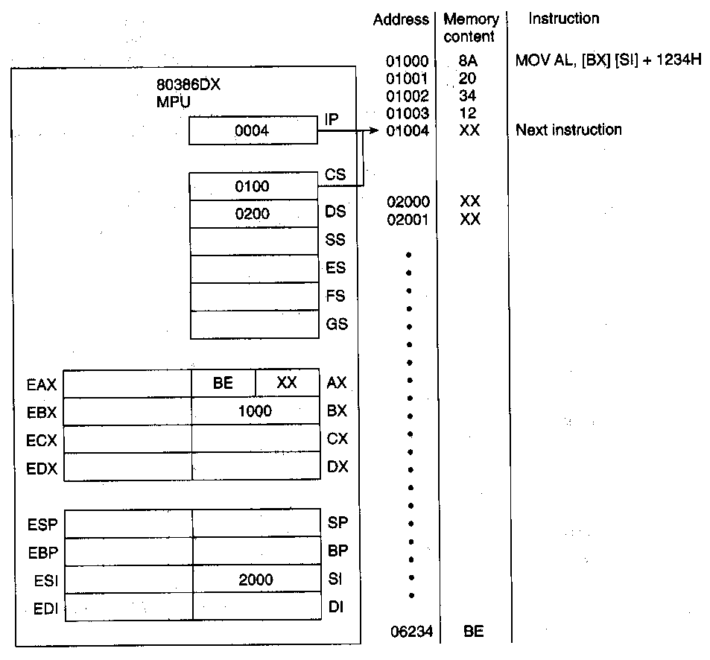
Based- Indexed Addressing Mode
Example(MOV AH,[BX][SI] +1234H)
Example (continued)
State after execution
  Instruction
  CS:IP = 0100:0004 = 01004H
  01004H → points to next sequential instruction
  Source operand
  (06234H) = BEH → unchanged
  Destination operand
  (AH) = BEH
  Rest of bits in EAX unaffected
Microprocessors I: Lecture 7
Notes:
Chapter 3

Slide 18
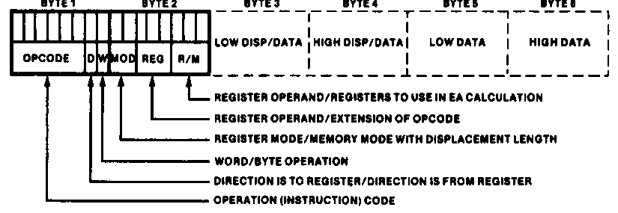
Instruction Encoding
80x86’s instruction set is variable length
  Multiple instruction sizes
    1 to 6 bytes in length for 8088/8086
    Up to 17 bytes for 80386,80486, and Pentium
  Variable length advantages (trait of CISC)
    Allows for many addressing modes
    Allows full size (32-bit) immediate data and addresses
    Instructions can use as many bytes as necessary
  Disadvantage of variable length
    Requires more complicated decoding hardware—speed of decoding is critical in modern uP
    Most uP use fixed length (trait of RISC)
Microprocessors I: Lecture 7
Notes:
Chapter 4

Slide 19
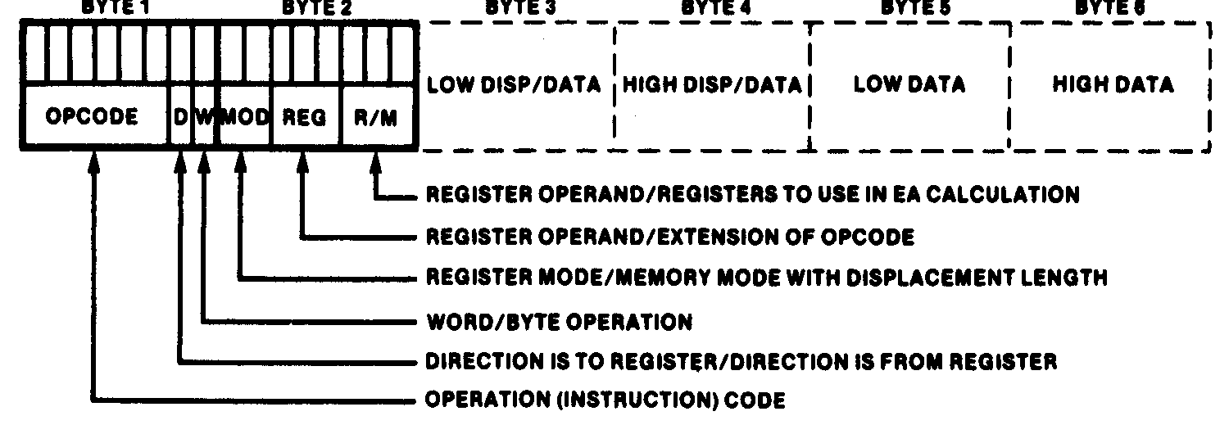
Instruction Encoding
Information encoded in an instruction
  What operation ?
  What operands ?
  Byte, word or double-word ?
  Operands in register or memory ?
  How the address is to be generated, if mem?
Microprocessors I: Lecture 7

Slide 20
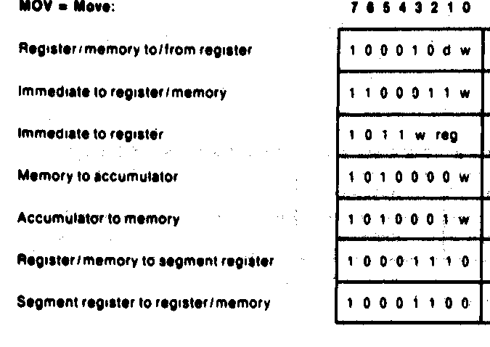
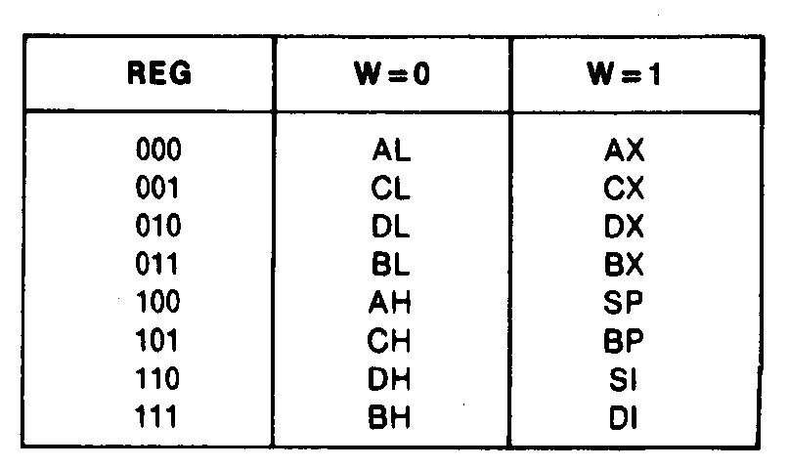
First Byte of an Instruction
  Opcode field (6-bits)—specifies the operation to be performed by the instruction
    Move immediate to registers/memory = 1100011
    Move memory to accumulator = 1010000
    Move segment register to register/memory = 10001100
  REG (3-bit)—selects a first operand as a register
    Move immediate to register = 1011(w)(reg)—only requires one register which is the destination
      Accumulator register= 000
      Count register = 001
      Data Register = 010
  W (1-bit)—data size word/byte for all registers
    Byte = 0, Word =1
  D (1-bit)—register direction: tells whether the register which is selected by the REG field in the second byte is the source or destination
    Add register to register = 000000(d)(w)
    D=0 → source operand, D=1 → destination operand
Microprocessors I: Lecture 7
Notes:
Chapter 4

Slide 21
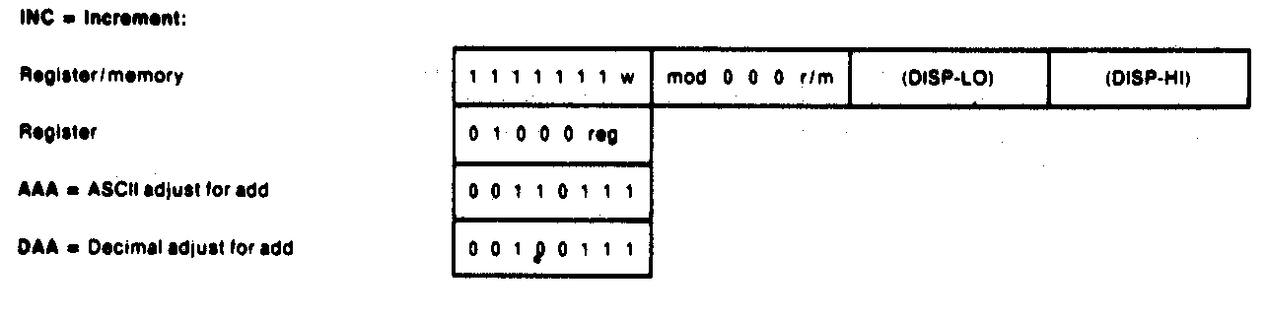
Example of One-Byte Instruction
One Byte Example:
  Encode the instruction in machine code
  INC CX
  Solution:
    Use “INC register” instruction format—special short form for 16-bit register
    01000 (REG)
    CX is destination register
    CX = 001
    Machine code is
    01000 (001) = 01000001 = 41H → one byte instruction
    INC CX = 41H
Microprocessors I: Lecture 7
Notes:
Chapter 4

Slide 22
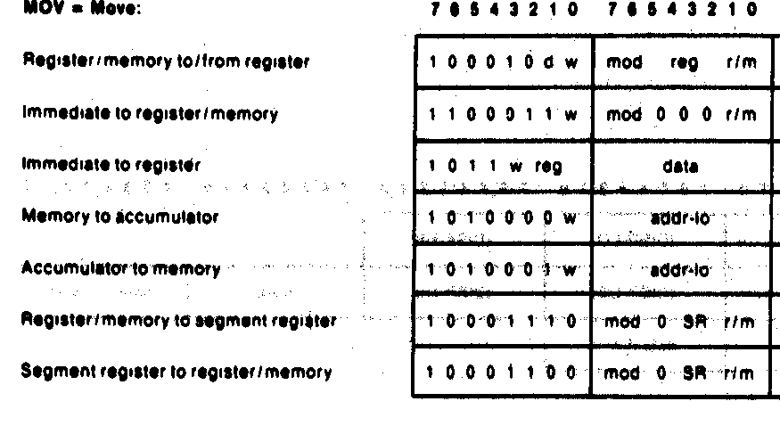
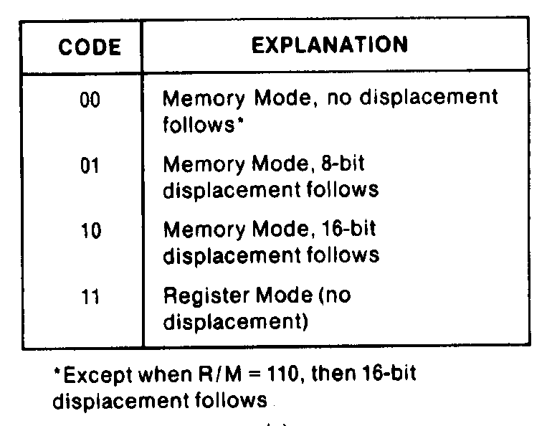
Second Byte of an Instruction
Byte 2 information:
  MOD (2-bit mode field)—specifies the type of the second operand
    Memory mode: 00, 01,10—Register to memory move operation
      00 = no immediate displacement (register used for addressing)
      01 = 8-bit displacement (imm8) follows (8-bit offset address)
      10 = 16-bit displacement (imm16) follows (16-bit offset address)
    Register mode: 11—register to register move operation
      11 = register specified as the second operand
Microprocessors I: Lecture 7
Notes:
Chapter 4

Slide 23
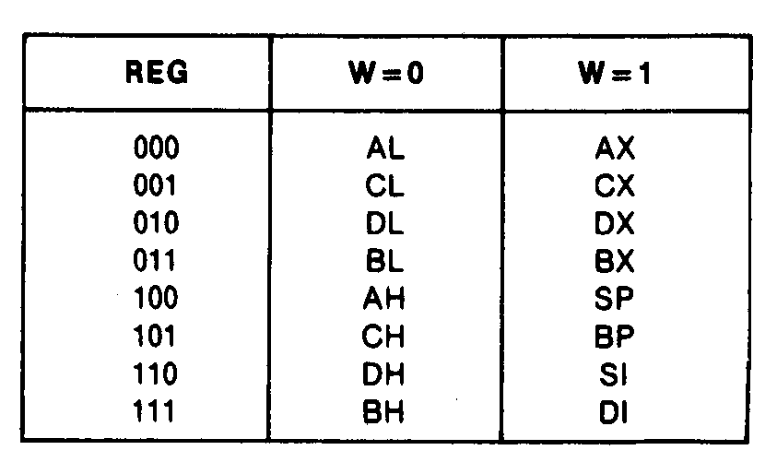
Second Byte of an Instruction (Cont.)
Byte 2 information (continued):
  REG (3-bit register field)—selects the register for a first operand, which may be the source or destination
    Accumulator register= 000
    Count register = 001
    Data Register = 010
    Move register/memory to/from register
      Byte 1= 100010(d)(w)
      Byte 2 = (mod) (reg) (r/m)
Affected by byte 1 information:
  W (1-bit)—data size word/byte for all registers
    Byte = 0
    Word =1
Microprocessors I: Lecture 7
Notes:
Chapter 4

Slide 24
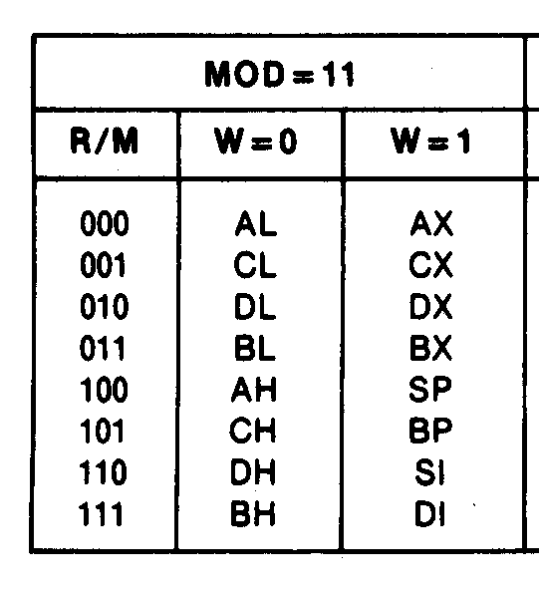
Second Byte of an Instruction (Cont.)
R/M (3-bit register/memory field)—specifies the second operand as a register or a storage location in memory
    Dependent on MOD field
      Mod = 11 R/M selects a register
        R/M = 000 Accumulator register
        R/M= 001 = Count register
        R/M = 010 = Data Register
    Move register/memory to/from register
      Byte 1= 100010(d)(w)
      Byte 2 = (mod) (reg) (r/m)
Affected by byte 1 information:
  W (1-bit)—data size word/byte for all registers
    Byte = 0
    Word =1
  D (1-bit)—register direction for first operand in byte 2 (reg)
    D = 0 → source operand
    D= 1 → destination operand
Microprocessors I: Lecture 7
Notes:
Chapter 4

Slide 25
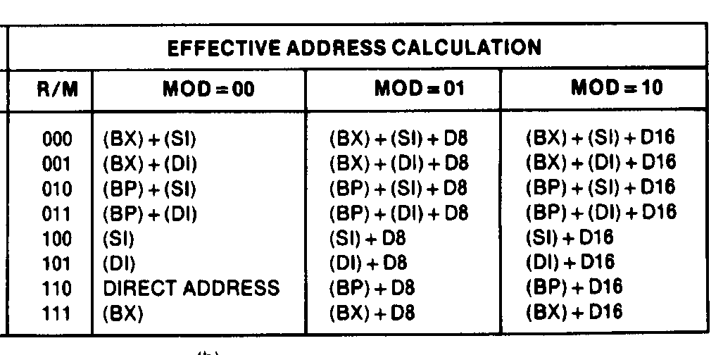
Second Byte of an Instruction (Cont.)
  MOD = 00, 01, or 10 selects an addressing mode for the second operand that is a storage location in memory, which may be the source or destination
    Dependent on MOD field
      Mod = 00 R/M
        R/M = 100 → effective address computed as
        EA = (SI)
        R/M= 000 = → effective address computed as
        EA = (BX)+(SI)
        R/M = 110 = → effective address is coded in the instruction as a direct address
        EA = direct address = imm8 or imm16
Microprocessors I: Lecture 7
Notes:
Chapter 4

Slide 26
Example: MOV
Move register/memory to/from register
    Byte 1= 100010(d)(w)
    Byte 2 = (mod) (reg) (r/m)
Affect of byte 1 information:
  W (1-bit)—data size word/byte for all registers
    Byte = 0
    Word =1
  D (1-bit)—register direction for first operand (REG) in byte 2
    D = 0 → source operand
    D= 1 → destination operand
Microprocessors I: Lecture 7
Notes:
Chapter 4

Slide 27
Example: INC CL
Two byte example using R/M field for a register:
  Encode the instruction in machine code
  INC CL
  Solution:
    Use “INC register/memory” instruction format—general form for 8-bit or 16-bit register/memory
    Byte 1
    1111111(W)
      CL= byte wide register → W = 0 11111110 =FEH
Microprocessors I: Lecture 7
Notes:
Chapter 4

Slide 28
Example: INC CL
Two Byte example using R/M field for a register (continued):
    Byte 2
      (MOD) 000 (R/M)
      Destination is register CL
        MOD = 11
        R/M = 001
        (11)000(001) = 11000001 =C1H
    Machine code is
    (Byte 1)(Byte 2) = 11111110 11000001 = FEC1H → two byte instruction
    INC CL = FEC1H
Microprocessors I: Lecture 7
Notes:
Chapter 4

Slide 29
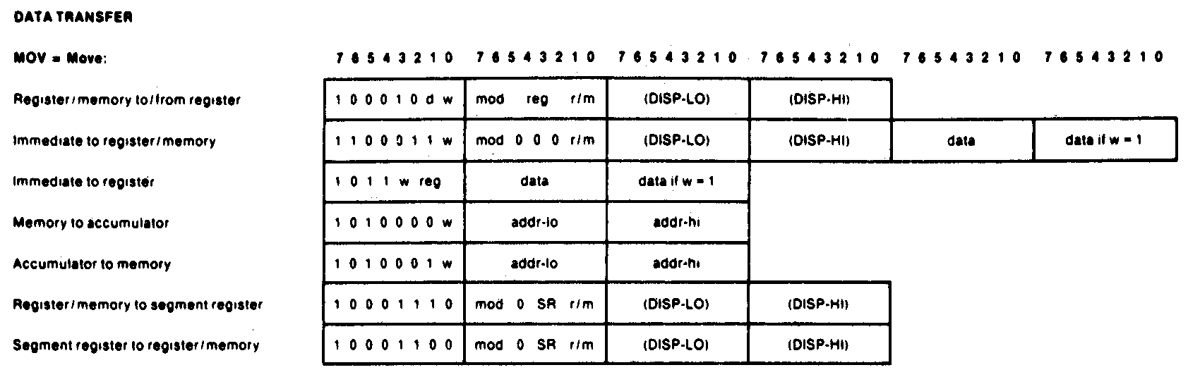
Example: MOV BL, AL
Two byte example using R/M field for a register:
  Encode the instruction in machine code
  MOV BL,AL
  Solution:
    Use “register/memory to/from register” instruction format—most general form of move instruction
    Byte 1
    100010(D)(W)
      Assuming AL (source operand) is the register encoded in the REG field of byte 2 (1st register)
        D = 0 = source
      Both registers are byte wide
        W = 0 = byte wide
      Byte 1 = 100010(0)(0) = 10001000 =88H
Microprocessors I: Lecture 7
Notes:
Chapter 4

Slide 30


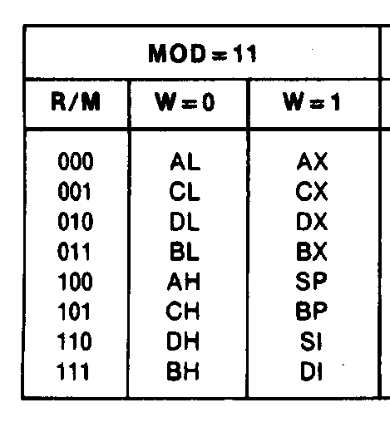
Example: MOV BL, AL
  Two Byte Example (continued):
    Byte 2
      (MOD)(REG)(R/M)
      Both operands are registers
        MOD = 11
      2nd register is destination register BL
        R/M = 011
      1st register is source register AL
        REG = 000
        (11)000(011) = 11000011 = C3H
    Machine code is
    (Byte 1)(Byte 2) = 10001000 11000011 = 88C3H → two byte instruction
  MOV BL,AL = 88C3H
Microprocessors I: Lecture 7
Notes:
Chapter 4

Slide 31
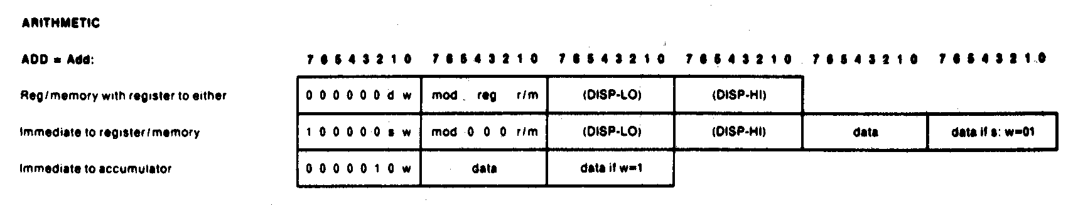
Example: ADD AX, [SI]
Two byte example using R/M field for memory:
  Encode the instruction in machine code
  ADD AX,[SI]
  Solution:
    Use “register/memory with register to either” instruction format
      Most general form of add instruction
      No displacement needed—register indirect addressing
    Byte 1
    000000(D)(W)
      AX (destination operand) is the register encoded in the REG field of byte 2 (1st register)
        D = 1 = destination
      Addition is of word wide data
        W = 1 = word wide
      Byte 1 = 000000(1)(1) = 00000011 =03H
Microprocessors I: Lecture 7
Notes:
Chapter 4

Slide 32
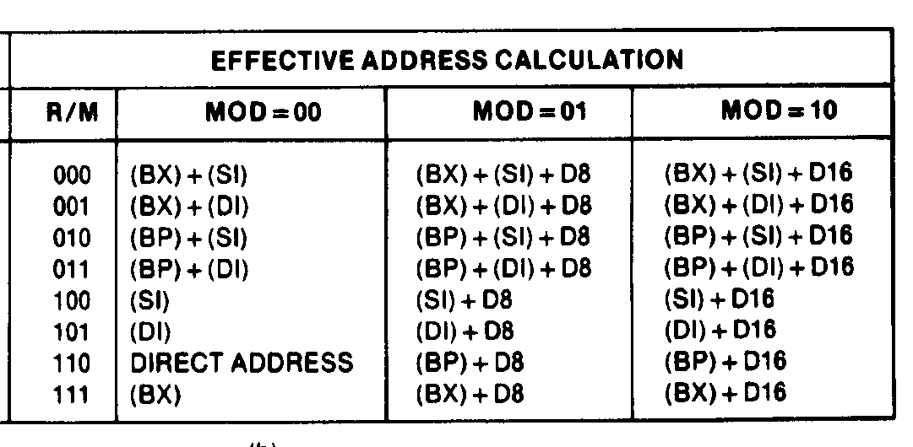
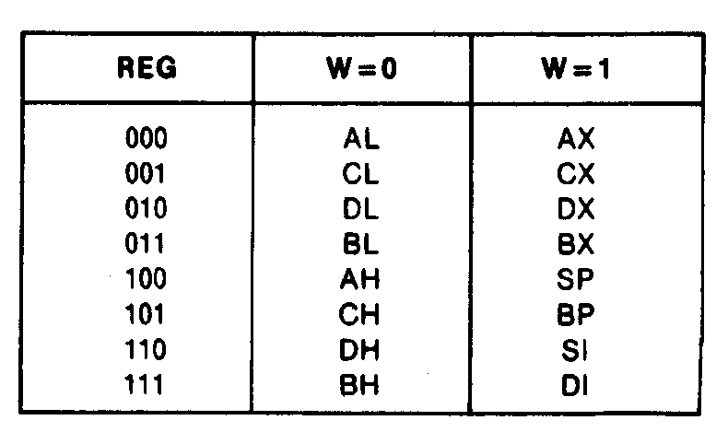
Example: ADD AX, [SI]
Two Byte example using R/M field for memory (continued):
    Byte 2
      (MOD)(REG)(R/M)
      Second operand is in memory and pointed to by address is SI
        MOD = 00 → [SI]
      R/M specifies the addressing mode
        R/M = 100 → [SI]
      1st register is destination register AX
        REG = 000
        (00)000(100) = 00000100 = 04H
    Machine code is
    (Byte 1)(Byte 2) = 00000011 00000100
    = 0304H → two byte instruction
  ADD AX,[SI] = 0304H
Microprocessors I: Lecture 7
Notes:
Chapter 4

Slide 33
Next time
Data transfer instructions
Microprocessors I: Lecture 7

