Slide 1
16.317
Microprocessor Systems Design I
Instructor: Dr. Michael Geiger
Spring 2013
Lecture 24:
PIC instruction set

Slide 2
Lecture outline
Announcements/reminders
  Lab 2 due 4/5
  Advising: Monday, 4/8 through Monday, 4/22
    Note: University closed Monday, 4/15
Today’s lecture: start PIC ISA
Microprocessors I: Lecture 24

Slide 3
Review
Microcontrollers: CPU integrated with storage, I/O devices
  Examples: Timers/event counters, parallel & serial ports, clock generator, analog to digital converter
  Benefits: low cost/low power, easy to program
  Limitations: storage, computational power
Introduced PIC 16F684 microcontroller
  14 pins—12 multiplexed I/O + power/ground
  All computations using 2 values use accumulator
  Harvard memory architecture
  Memory divided into SFR / GPR
    Split into 2/4 banks, specified by RP1:RP0
  Dedicated 8-entry system stack for return addresses (subroutines/interrupts)
Microprocessors I: Lecture 24

Slide 4
I/O Ports
General I/O pins are the simplest of peripherals used to monitor and control other devices.
For most ports, the I/O pin’s direction (input or output) is controlled by the data direction register TRISx (x=A,B,C,D,E): a ‘1’ in the TRIS bit corresponds to that pin being an input, while a ‘0’ corresponds to that pin being an output
The PORTx register is the latch for the data to be output. Reading PORTx register read the status of the pins, whereas writing to it will write to the port latch.
Example: Initializing PORTA (PORTA is an 8-bit port. Each pin is individually configurable as an input or output).
bcf STATUS, RP0 ; bank0
bcf STATUS, RP1
clrf PORTA ; initializing PORTA by clearing output data latches
bsf STATUS, RP0 ; select bank1
movlw 0xCF ; value used to initialize data direction
movwf TRISA ; WHAT BITS OF PORT A ARE INPUTS? ; WHAT BITS ARE OUTPUTS?
Microprocessors I: Lecture 24
Notes:
Chapter 9

Slide 5
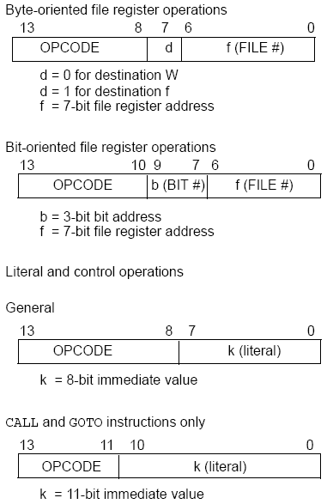
PIC16F684
Instructions
35 instructions
Each instruction is 14 bits
Byte-oriented OPCODE f, F(W)
  Source f: name of a SFR or a RAM variable
  Destination F(W):
    F if the destination is to be the same as the source register
    W if the destination is to be the working register
Bit-oriented OPCODE f, b
  Bit address b (0≤b≤7)
Literal and control OPCODE k
  Literal value k
Microprocessors I: Lecture 24
Notes:
Chapter 9

Slide 6
RAM variables
Memory variable: symbolic name to refer to space in memory (GPRs)
  Usable space on 16F684: 0x20–0x7F (Bank 0), 0xA0 – 0xBF (Bank 1)
  Once declared, use symbolic name, not address
Example PIC syntax (cblock/endc):
  cblock 0x20 ; cblock directive needs starting
  ; address
  var1 ; var1 = byte at 0x20
  var2 ; var2 = byte at 0x21
  var3 ; var3 = byte at 0x22
  endc ; End of variable block
Microprocessors I: Lecture 24

Slide 7
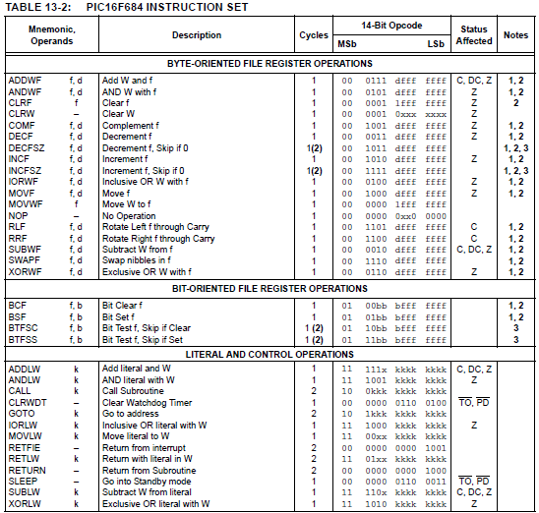
Microprocessors I: Lecture 24

Slide 8
Clear/Move
clrw ; Clear W register
clrf f ; Clear f register
movlw k ; move literal value k to W
movwf f ; move W to f
movf f, F(W) ; move f to F or W
swapf f, F(W) ; swap nibbles of f, putting result in F or W
STATUS bits:
clrw, clrf, movf: Z
movlw, movwf, swapf: none
Examples:
clrf TEMP1 ;Clear variable TEMP1
movlw 5 ;load 5 into W
movwf TEMP1 ;move W into TEMP1
movwf TEMP1, F ;Incorrect Syntax
movf TEMP1, W ;move TEMP1 into W ;
movf TEMP1, TEMP2 ;Incorrect Syntax
swapf TEMP1, F ;Swap 4-bit nibbles of TEMP1
swapf TEMP1, W ;Move TEMP1 to W, swap nibbles, leave TEMP1 unchanged
Microprocessors I: Lecture 24
Notes:
Chapter 9

Slide 9
Single Bit Manipulation
bcf f,b
Operation: Clear bit b of register f, where b=0 to 7
bsf f,b
Operation: Set bit b of register f, where b=0 to 7
STATUS bits:
none
Examples:
bcf PORTB, 0 ;Clear bit 0 off PORTB
bsf STATUS, C ;Set the Carry bit
bcf STATUS, RP1 ;
bsf STATUS, RP0 ;Select Bank 1
Microprocessors I: Lecture 24
Notes:
Chapter 9

Slide 10
Example
Show the values of all changed registers after the following sequence
cblock 0x30
x
y
endc
clrw
movwf x
movlw 0xFE
movwf y
swapf y, F
bcf y, 3
bsf x, 3
movf y, W
Microprocessors I: Lecture 24

Slide 11
Example solution
clrw → W = 0x00
movwf x → x = W = 0x00
movlw 0xFE → W = 0xFE
movwf y → y = W = 0xFE
swapf y, F → Swap nibbles of y → y = 0xEF
bcf y, 3 → Clear bit 3 of y = 1110 1111₂
→ y = 1110 0111₂ = 0xE7
bsf x, 3 → Set bit 3 of x
→ x = 0000 1000₂ = 0x08
movf y, W → W = y = 0xE7
Microprocessors I: Lecture 24

Slide 12
Final notes
Next time
  Continue with PIC instructions
Reminders:
  Lab 2 due 4/5
  Advising: Monday, 4/8 through Monday, 4/22
    Note: University closed Monday, 4/15
Microprocessors I: Lecture 24

