Slide 1
16.317
Microprocessor Systems Design I
Instructor: Dr. Michael Geiger
Spring 2014
Lecture 23
Exam 2 Preview

Slide 2
Lecture outline
Announcements/reminders
  Exam 2: Wednesday, 4/2
Today’s lecture: Exam 2 Preview
Microprocessors I: Exam 2 Preview

Slide 3
Exam 2 notes
Allowed
  One 8.5” x 11” double-sided sheet of notes
  Calculator
No other notes or electronic devices (phone, laptop, etc.)
Exam will last 50 minutes
Covers all lectures after Exam 1 (12-22)
Format similar to previous exam
  1 multiple choice question
  2-3 short problems to solve/code sequences to evaluate
Microprocessors I: Exam 2 Preview

Slide 4
Review: rotate instructions
Rotate instructions: bits that are shifted out one side are shifted back in other side
  ROL <src>, <amt> or ROR <src>, <amt>
  CF = last bit rotated
Rotate through carry instructions
  CF acts as “extra” bit that is part of value being rotated
  RCL <src>, <amt> or RCR <src>, <amt>
Microprocessors I: Exam 1 Preview

Slide 5
Review: bit test/scan
Bit test instructions
  Check state of bit and store in CF
  Basic test (BT) leaves bit unchanged
  Can also set (BTS), clear (BTR), or complement bit (BTC)
Bit scan instructions
  Find first non-zero bit and store index in dest.
  Set ZF = 1 if source non-zero; ZF = 0 if source == 0
  BSF: scan right to left (LSB to MSB)
  BSR: scan left to right (MSB to LSB)
Microprocessors I: Exam 1 Preview

Slide 6
Review: compare
CMP D, S
  Flags show result of (D) – (S)
Condition codes: mnemonics implying certain flag conditions
Microprocessors I: Lecture 4

Slide 7
Review: conditional instructions
Conditional move
  Move performed only if condition is true
SETcc D
  Sets single byte destination to 1 (01H) if condition true; all 0s (00H) if condition false
  Can be used to build up complex conditions
Microprocessors I: Lecture 4

Slide 8
Review: jump, loop
Two general types of jump
  Unconditional: JMP <target>
    Always go to target address
  Conditional: Jcc <target>
    Go to target address if condition true
Loop instructions
  Combines CX decrement with JNZ test
  May add additional required condition
    LOOPE/LOOPZ: loop if ((CX != 0) && (ZF == 1))
    LOOPNE/LOOPNZ: loop if (CX != 0) && (ZF == 0))
Microprocessors I: Exam 2 Preview

Slide 9
Review: subroutines
Subroutines: low-level functions
  When called, address of next instruction saved
    Return instruction ends routine; goes to that point
  May need to save state on stack
x86 specifics
  CALL <proc>: call procedure
    <proc> can be label (16-/32-bit imm), reg, mem
  RET: return from procedure
  Saving state to stack: push instructions
    Store data “above” current TOS; decrement SP
    Basic PUSH stores word or double word
    Directly storing flags: PUSHF
    Storing all 16-/32-bit general purpose registers: PUSHA/PUSHAD
  Restoring state: POP/POPF/POPA/POPAD
Microprocessors I: Exam 2 Preview

Slide 10
Review: HLL → assembly
Data accesses
  Global variables → static; allocated in data segment
  Other variables → dynamic; allocated on stack
  Stack frame for each function contains (from top)
    Saved variables within function
    Local variables for function (starting at EBP – 4)
    Saved EBP
    Saved EIP
    Function arguments (starting at EBP + 8)
Conditional statements (if-then-else)
  Evaluate condition (CMP instruction(s))
  Conditional jump (often to “else” case)
  “If” case ends with unconditional jump to skip “else”
Loops
  Initialize variable at start
  Test loop condition (similar to if)
  Change loop variable
Microprocessors I: Exam 2 Preview

Slide 11
Review: Exceptions & interrupts
Exception: unexpected event altering normal program flow
Interrupt: CPU signal that external event has occurred
Interrupt/exception vector: starting address of service routine
  Service routine: function to handle interrupt
  Vectors stored in table
When interrupt occurs
  Processor state (registers, flags) saved
  Interrupt return address pushed on stack
  ISR located (based on vector) and executed
Interrupt pins
  May have multiple levels of priority
  NMI: non-maskable interrupt
  If multiple devices sharing same interrupt, HW or SW required to determine which device actually caused interrupt
Microprocessors I: Exam 2 Preview

Slide 12
Review: PIC instructions
Four typical instruction formats (+ few special purpose)
  Upper bits of all hold opcode
  Byte-oriented includes 1 bit destination, 7 bit direct address
  Bit-oriented includes 3 bit position (0-7), 7 bit direct address
  Literal/control includes 8 bit literal
  CALL/GOTO includes 11 bit literal
Variable declarations
  cblock <start_address>: start of variable declarations
  All names between cblock/endc directives assigned to consecutive bytes starting at <start_address>
Microprocessors I: Lecture 22

Slide 13
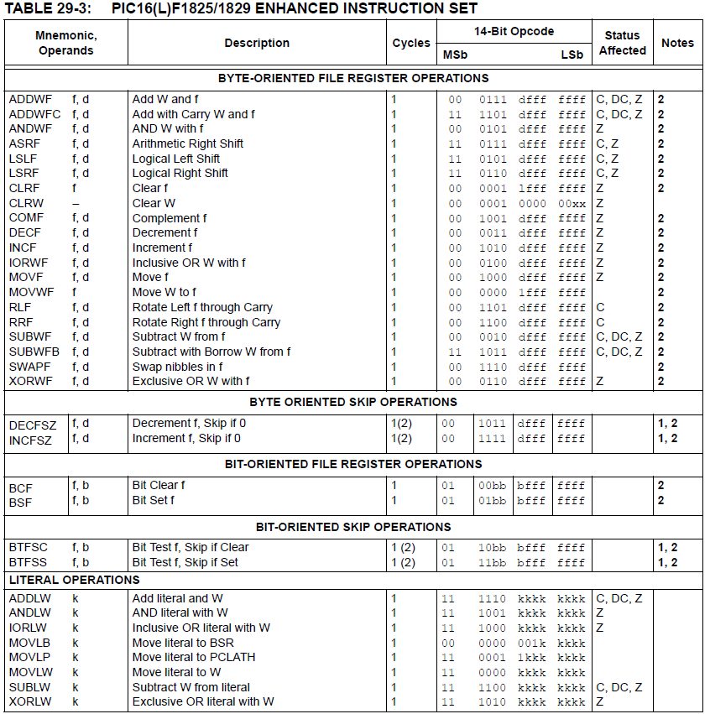
Microprocessors I: Lecture 22

Slide 14
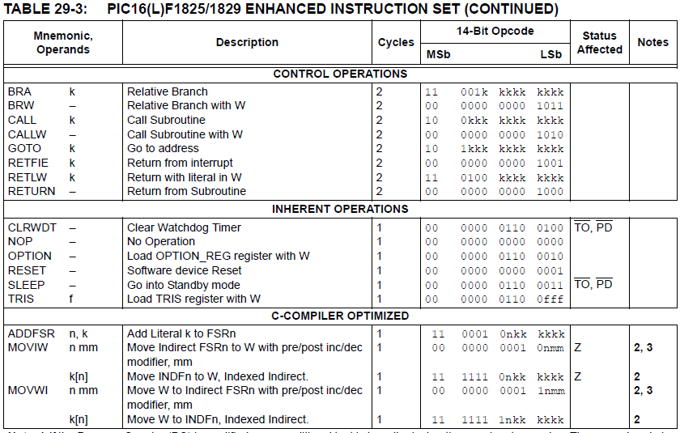
Microprocessors I: Lecture 22

Slide 15
Review: PIC instructions (cont.)
Clearing register: clrw/clrf
Moving values: movlw/movwf/movf
Swap nibbles: swapf
Single bit manipulation: bsf/bcf
Unary operations: incf/decf/comf
Arithmetic: addlw/addwf/addwfc/sublw/subwf/subwfb
Logical operations
  andlw/andwf
  iorlw/iorwf
  xorlw/xorwf
Shifts/rotates
  asrf/lsrf/lslf
  rrf/rlf
Microprocessors I: Lecture 22

Slide 16
Final notes
Next time:
  Exam 2—PLEASE BE ON TIME
Microprocessors I: Exam 2 Preview

