Slide 1
16.317
Microprocessor Systems Design I
Instructor: Dr. Michael Geiger
Spring 2014
Lecture 2:
Data storage and addressing

Slide 2
Lecture outline
Announcements/reminders
  Sign up for the course discussion group on Piazza
Today’s lecture
  Review: instruction set architecture
  Data types
  Data storage
  Addressing modes
Microprocessors I: Lecture 2

Slide 3
Review: instruction set architecture
Defines how programmer interfaces with hardware
Operations generally fall into one of four groups
  Data transfer: move data across storage locations
  Arithmetic: add, subtract, etc.
  Logical: AND, OR, shifts, etc.
  Program control: jumps/branches/calls
Operands: the data being operated on
  How are the bits interpreted? (int, FP, signed/unsigned)
  What size are they? (byte, word, etc.)
  How do we reference operands?
Instruction formats: how instructions are encoded
Microprocessors I: Lecture 2

Slide 4
Data types
Also seen in high-level languages
  Think about C types: int, double, char, etc.
  What does a data type specify?
    How big is each piece of data?
    How do we interpret the bits representing those data?
Data sizes
  Smallest addressable unit: byte (8 bits)
  Can also deal with multi-byte data: 16, 32, 64 bits
  Often deal with words of data
    Word size processor-dependent (16 bits on x86, 32 bits on MIPS)
    Can have double words, quad words, half words …
Interpreting bits
  Numbers: Integers, floating-point; signed vs. unsigned
  May treat as characters, other special formats
Microprocessors I: Lecture 2

Slide 5
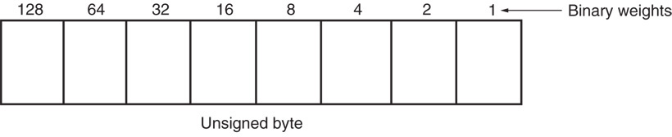
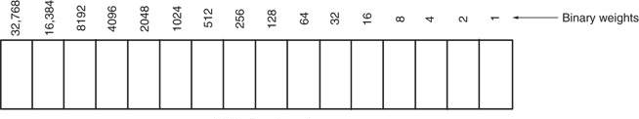
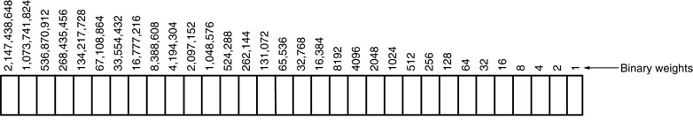
Unsigned Integers
Types:
Sizes Range
8-bit 0H → 255₁₀
16-bit 0H → 65,535₁₀
32-bit 0H → 4,294,967,295₁₀
Microprocessors I: Lecture 2
Notes:
Chapter 2

Slide 6
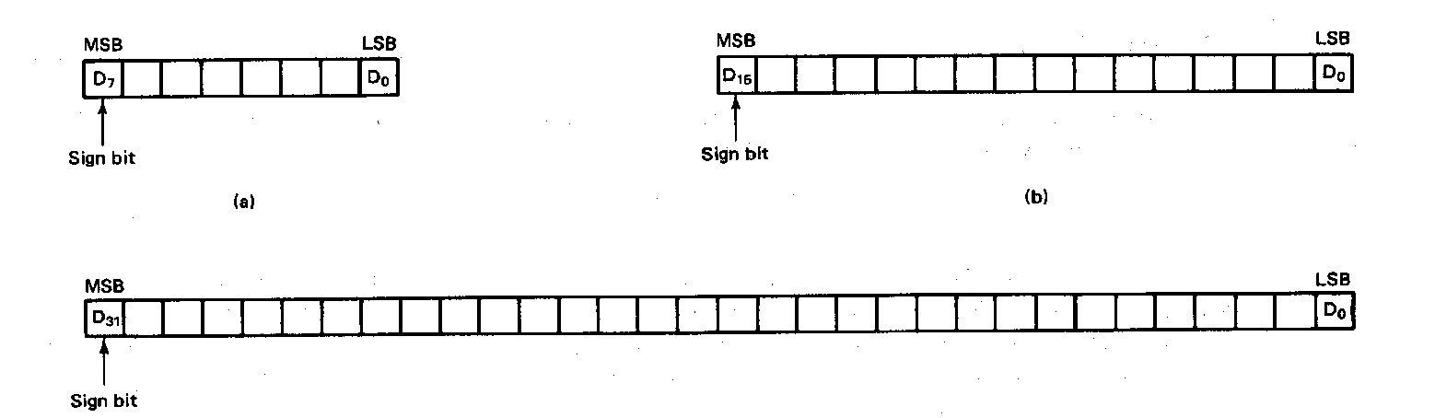
Signed Integers
MSB is sign bit ( 0/1 -> +/-)
Remaining bits represent value
Negative numbers expressed in 2’s complement notation
Types:
Sizes Range
8-bit -128 → +127
16-bit -32,768 → +32,767
32-bit -2,147,483,648 → +2,147,483,647
Microprocessors I: Lecture 2
Notes:
Chapter 2

Slide 7
Integer Examples
Given the 8-bit value: 1001 1111₂
Calculate the decimal value of this integer as
  An unsigned integer
  A signed integer
Microprocessors I: Lecture 2
Notes:
Chapter 2

Slide 8
Integer example solution
Given the 8-bit value: 1001 1111₂
Calculate the decimal value of this integer as
  An unsigned integer
  Solution:
    (1 x 2⁷) + (1 x 2⁴) + (1 x 2³) + (1 x 2²) + (1 x 2¹) + (1 x 2⁰)
    = 128 + 16 + 8 + 4 + 2 + 1 = 159
  A signed integer
  Solution:
    MSB = 1 → negative value
    To get magnitude, take 2’s complement:
    0110 0001₂ = (1 x 2⁶) + (1 x 2⁵) + (1 x 2⁰)
    = 64 + 32 + 1 = 97
    → Result = -97
Microprocessors I: Lecture 2

Slide 9
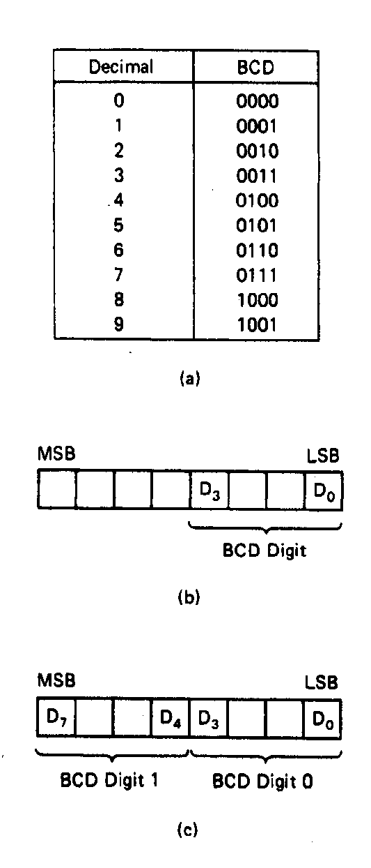
BCD Numbers
Direct coding of numbers as binary coded decimal (BCD) numbers supported
Unpacked BCD [Fig.2.10(b)]
  Lower four bits contain a digit of a BCD number
  Upper four bits filled with zeros (zero filled)
Packed BCD [Fig. 2.10(c)]
  Lower significant BCD digit held in lower 4 bits of byte
  More significant BCD digit held in upper 4 bits of byte
Example: Packed BCD byte at address 01000H is 10010001₂, what is the decimal number?
Organizing as BCD digits gives,
1001_{BCD} 0001_{BCD} = 91₁₀
Microprocessors I: Lecture 2
Notes:
Chapter 2

Slide 10
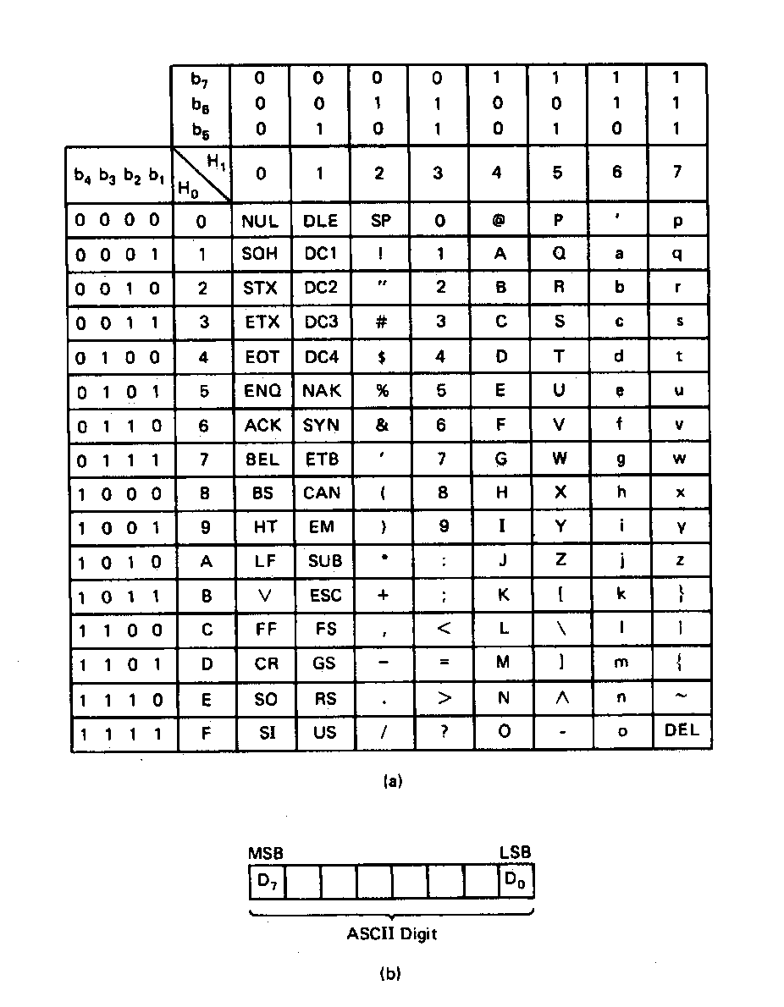
ASCII Data
American Code for Information Interchange (ASCII) code
ASCII information storage in memory
  Coded one character per byte
  7 LS-bits = b₇b₆b₅b₄b₃b₂b₁
  MS-bit filled with 0
Example: Addresses 01100H-01104H contain ASCII coded data 01000001, 01010011, 01000011, 01001001, and 01001001, respectively. What does the data stand for?
0 100 0001_{ASCII} = A
0 101 0011_{ASCI} = S
0 100 0011_{ASCII} = C
0 100 1001_{ASCII} = I
0 100 1001_{ASCII} = I
Microprocessors I: Lecture 2
Notes:
Chapter 2

Slide 11
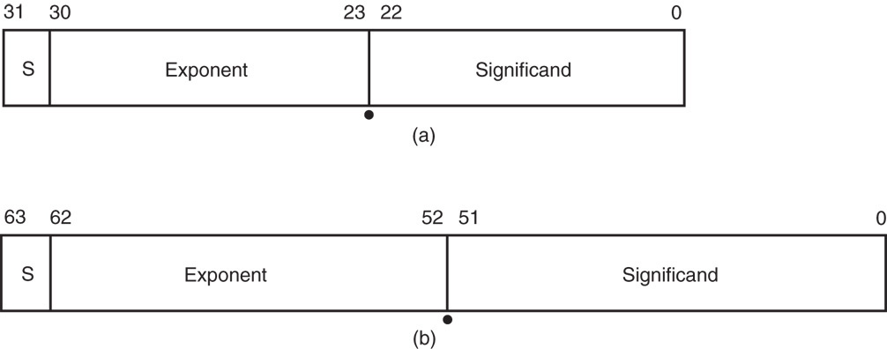
Real Numbers
Floating-point data stored in two parts
  Significand (fraction)
  Exponent
Single-precision (32 bits) or double-precision (64 bits)
Microprocessors I: Lecture 2

Slide 12
Data storage
What characteristics do we want storage media to have?
Two primary answers
  Speed
  Capacity
  Very difficult to get both in single storage unit
Processors use two different types of storage
  Registers
  Memory
Microprocessors I: Lecture 2

Slide 13
Registers
Small, fast set of storage locations close to processor
Primarily used for computation, short-term storage
  Speed → ideal for individual operations
  Lack of capacity → will frequently overwrite
Reference registers by name
  Example: ADD EAX, EBX → EAX = EAX + EBX
  EAX, EBX are registers in x86 architecture
Microprocessors I: Lecture 2

Slide 14
Memory
Provides enough capacity for all code, data (possibly I/O as well)
Typically organized as hierarchy
Used primarily for long-term storage
  Lacks speed of registers
  Provides capacity to ensure data not overwritten
Reference memory by address
  Example: MOV EAX, DS:[100H]
  → EAX = memory at address DS:[100H]
Microprocessors I: Lecture 2

Slide 15
Memory (continued)
Accessing single byte is easy
Considerations with multi-byte data
  Are the data aligned?
    Easier/faster to access aligned data
  How are the data organized in memory (“endianness”)?
    Given 32-bit number: DEADBEEFH or 0xDEADBEEF
    Which byte—MSB (0xDE) or LSB (0xEF) gets stored in memory first?
Microprocessors I: Lecture 2

Slide 16
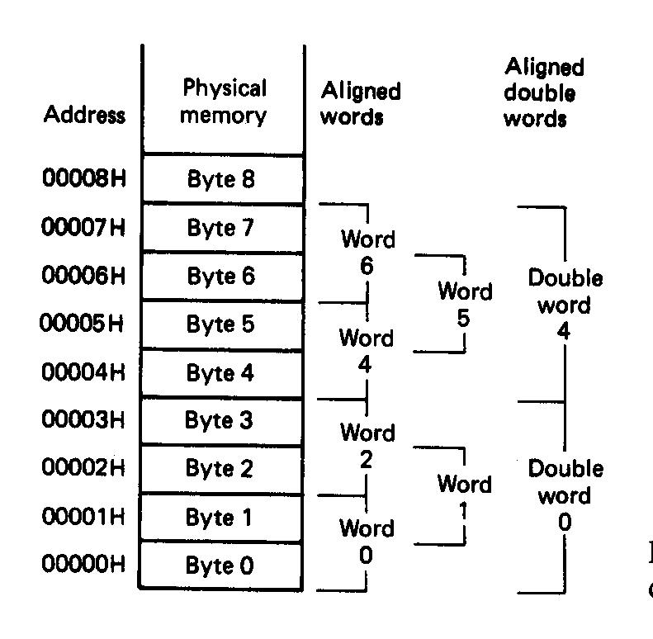
Aligned Words, Double words
Aligned data: address is divisible by number of bytes
  2 bytes → address must be even
  4 bytes → address must be multiple of 4
In figure at left
  Words 0, 2, 4, 6 aligned
  Double words 0, 4 aligned
  “Word X” = word with starting address X
Microprocessors I: Lecture 2
Notes:
Chapter 2

Slide 17
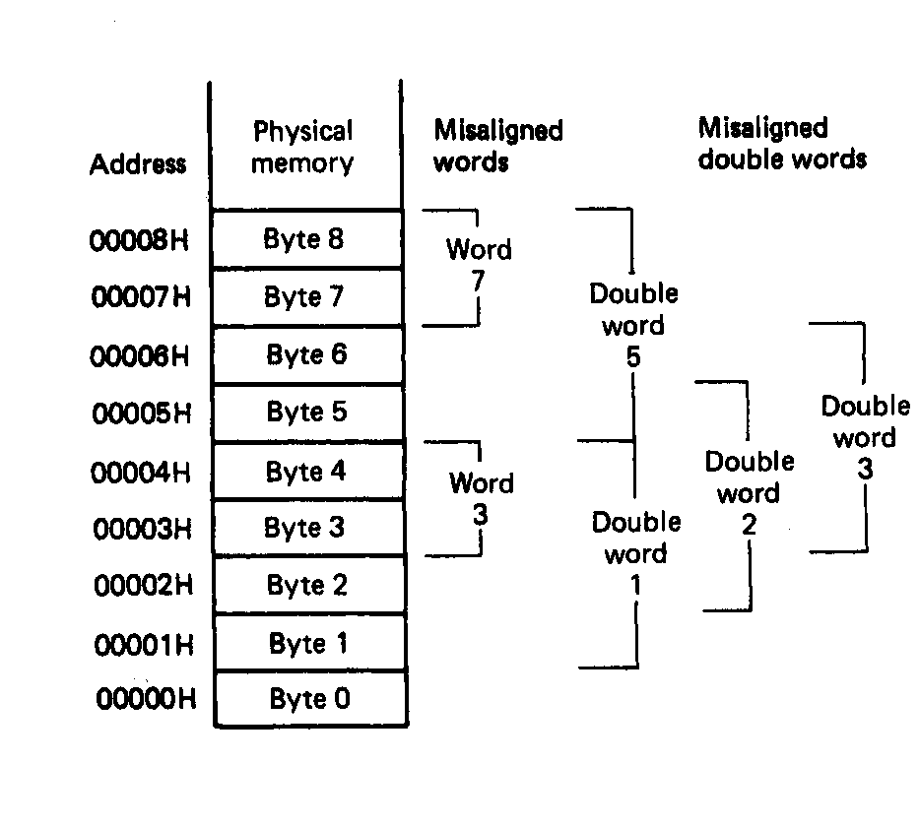
Misaligned Words
x86 architecture doesn’t require aligned data access
In figure, misaligned data:
  Words 3, 7
  Double words 1, 2, 3, 5
Performance impact for accessing unaligned data in memory (32-bit data bus)
Microprocessors I: Lecture 2
Notes:
Chapter 2

Slide 18
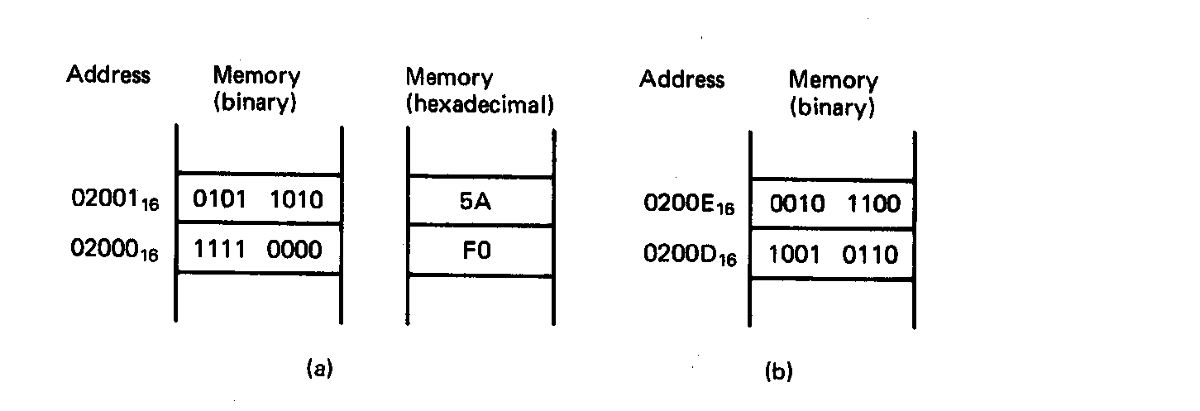
Examples of Words of Data
“Little endian” organization
Most significant byte at high address
Least significant byte at low address
Example [Fig. 2.5 (a)]
(02001₁₆) = 0101 1010₂=5AH= MS-byte
(02000₁₆) = 1111 0000₂=F0H= LS-byte
as a word they give
01011010 11110000₂=5AF0H
Microprocessors I: Lecture 2
Notes:
Chapter 2

Slide 19
Examples of Words of Data
What is the data word shown in this figure?
  Express your result in hexadecimal
Is the word aligned?
Answer:
  MSB = 00101100₂ = 2C₁₆
  LSB = 10010110₂ = 96₁₆
  → Full word = 2C96₁₆
  Starting address = 0200D₁₆
  → Address not divisible by 2
  → Word is not aligned
Microprocessors I: Lecture 2
Notes:
Chapter 2

Slide 20
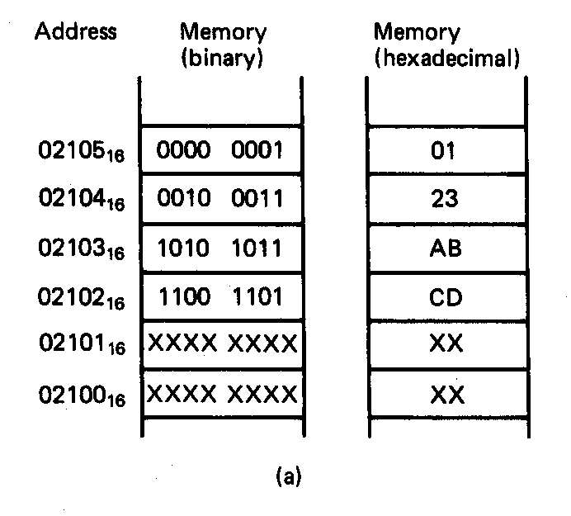
Example of Double Word
What is the double word shown in this figure?
Is it aligned?
Answer:
  LSB = CD₁₆
  MSB = 01₁₆
  → Arranging as 32-bit data:
  0123ABCD₁₆
  Starting address = 02102₁₆
  → Not divisible by 4
  → Double word is unaligned
Microprocessors I: Lecture 2
Notes:
Chapter 2

Slide 21
Addressing modes
Addressing modes: ways of specifying operand location
Where are operands stored? (3 location types)
  Registers → register addressing
    Provide name of register; value read from register
  Memory
    Provide address in memory; value read from that location
    Several modes for specifying memory address
  In the instruction → immediate addressing
Microprocessors I: Lecture 2

Slide 22
Memory addressing
Instructions accessing memory generate effective address (EA)
  Address calculated as part of instruction
  EA can be used as
    Actual memory address in a simple memory system
    Address within a particular segment in a segmented memory architecture
Effective address calculations can involve
  A constant value
  One or more values stored in registers
  Some combination of register and constant
Microprocessors I: Lecture 2

Slide 23
General memory addressing modes
Memory direct addressing
  EA = constant value encoded in instruction
Register indirect addressing
  EA = value stored in register
Base + displacement addressing
  EA = constant displacement + base register(s)
  Can have variations of this mode based on number and type of registers
Less commonly used modes on some MPUs
  Memory indirect addressing
  Scaled addressing
Microprocessors I: Lecture 2

Slide 24
Final notes
Next time:
  x86 introduction
Reminders:
  Sign up for the discussion group on Piazza
Microprocessors I: Lecture 2

