Slide 1
16.317
Microprocessor Systems Design I
Instructor: Dr. Michael Geiger
Spring 2014
Lecture 3:
x86 introduction

Slide 2
Lecture outline
Announcements/reminders
  Sign up for the course discussion group on Piazza
  HW 1 to be posted this week
Review
  Data types
  Storage media
  Alignment
  Endianness
Today’s lecture
  x86 introduction
Microprocessors I: Lecture 3

Slide 3
Review: ISA, storage
Operands: the data being operated on
  How are the bits interpreted? (int, FP, signed/unsigned)
  What size are they? (byte, word, etc.)
Data storage
  Registers
    Small, fast set of on-chip storage (primarily for speed)
    Referenced by name
  Memory
    Larger, slower set of storage (primarily for capacity)
    Organized as hierarchy …
    … but programmer references single range of addresses
    Memory issues
      Aligned data: address divisible by number of bytes
      Endianness: 80x86 data is little endian
Microprocessors I: Lecture 3

Slide 4
Addressing modes
Addressing modes: ways of specifying operand location
Where are operands stored? (3 location types)
  Registers → register addressing
    Provide name of register; value read from register
  Memory
    Provide address in memory; value read from that location
    Several modes for specifying memory address
  In the instruction → immediate addressing
Microprocessors I: Lecture 3

Slide 5
Memory addressing
Instructions accessing memory generate effective address (EA)
  Address calculated as part of instruction
  EA can be used as
    Actual memory address in a simple memory system
    Address within a particular segment in a segmented memory architecture
Effective address calculations can involve
  A constant value
  One or more values stored in registers
  Some combination of register and constant
Microprocessors I: Lecture 3

Slide 6
General memory addressing modes
Memory direct addressing
  EA = constant value encoded in instruction
Register indirect addressing
  EA = value stored in register
Base + displacement addressing
  EA = constant displacement + base register(s)
  Can have variations of this mode based on number and type of registers
Less commonly used modes on some MPUs
  Memory indirect addressing
  Scaled addressing
Microprocessors I: Lecture 3

Slide 7
x86 intro
“x86” → family of Intel processors
  Starts with 8086 processor (1978)
  Used (w/extensions) in current processors
General purpose processor
Supports use of 8, 16, 32, or 64 bit data
Allows both register and memory operands
Segmented memory architecture
Real and protected mode operation
  Protected mode supports virtual memory
Microprocessors I: Lecture 3

Slide 8
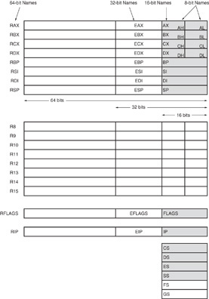
Register Set
Nine 32-bit registers
  (4) Data registers- EAX, EBX, ECX, EDX, can be used as 32, 16 or 8bit
  (2) Pointer registers- EBP, ESP
  (2) Index registers- ESI, EDI
  (1) Instruction pointer- EIP
Six 16-bit registers
  (6) Segment registers- CS, DS, SS, ES, FS, GS
Flags (status) register-EFLAGS
Microprocessors I: Lecture 3
Notes:
Chapter 2

Slide 9
Register Set
64-bit extensions
  Added with Pentium 4
  Data/pointer/index/IP/ flag register extended to 64 bits
  8 additional data registers (R8-R15)
Microprocessors I: Lecture 3
Notes:
Chapter 2

Slide 10
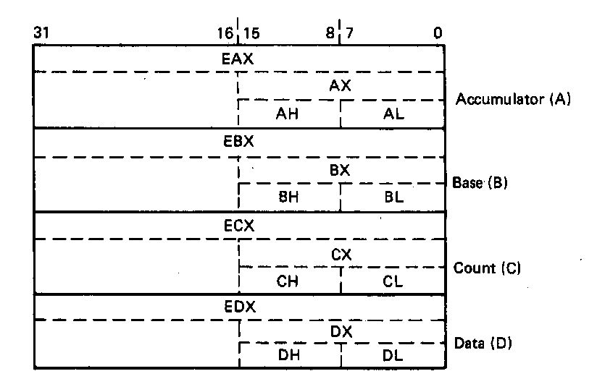
General Purpose Data Registers
Four general purpose data registers
  Accumulator (A) register
  Base (B) register
  Count (C) register
  Data (D) register
Can hold 8-bit, 16-bit, or 32-bit data
  AH/AL = high and low byte value
  AX = word value
  EAX = double word value
General uses:
  Hold data such as source or destination operands for most operations—ADD, AND, SHL
  Hold address pointers for accessing memory
Some also have dedicated special uses
  C—count for loop,
  B—table look-up translations, base address
  D—indirect I/O and string I/O
Microprocessors I: Lecture 3
Notes:
Chapter 2

Slide 11
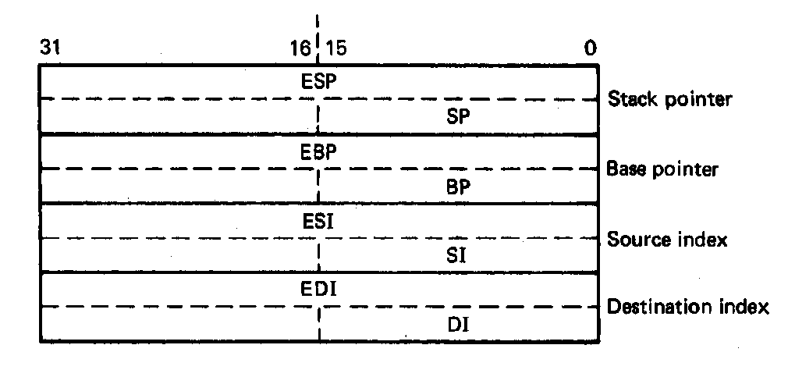
Pointer Registers
Two pointer registers
  Stack pointer register
    ESP = 32-bit extended stack pointer
    SP = 16-bit stack pointer
  Base pointer register
    EBP = 32-bit extended base pointer
    BP = 16-bit base pointer
Use to access information in stack segment of memory
  SP/BP offsets from the current value of the stack segment base address
  Select a specific storage location in the current 64K-byte stack segment
    SS:SP—points to top of stack (TOS)
    SS:BP—points to data in stack
Microprocessors I: Lecture 3
Notes:
Chapter 2

Slide 12
Index Registers
Two index registers
  Source index register
    ESI = 32-bit source index register
    SI = 16-bit source index register
  Destination index registers
    EDI = 32-bit destination index register
    DI = 16-bit destination index register
  Used to access source and destination operands in data segment of memory
    DS:SI—points to source operand in data segment
    DS:DI—points to destination operand in data segment
    Also used to access information in the extra segment (ES)
Microprocessors I: Lecture 3
Notes:
Chapter 2

Slide 13
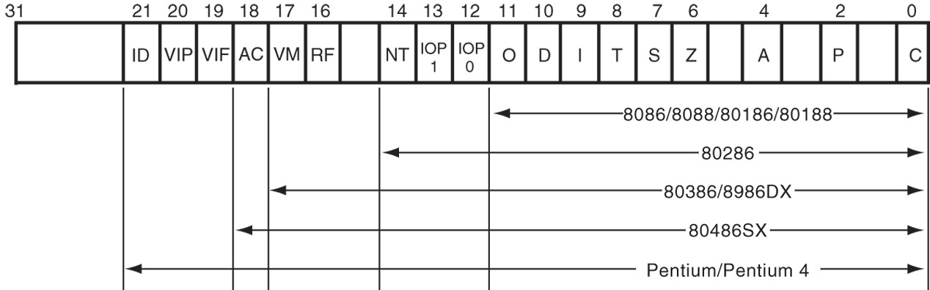
Flags Register
32-bit register holding single bit status and control information
9 active flags in real mode
Two categories
  Status flags: conditions resulting from instruction
    Most instructions update status
    Used as test conditions
  Control flags: control processor functions
    Used by software to turn on/off operating capabilities
Microprocessors I: Lecture 3
Notes:
Chapter 2

Slide 14
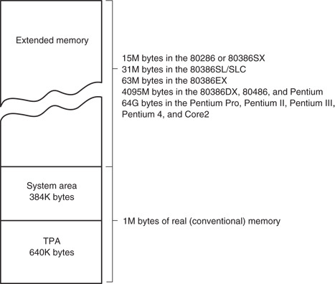
x86 memory spaces
x86 architecture implements independent memory and input/output (not shown) address spaces
Memory address space
  1 MB “real” memory
    System + transient program area (TPA)
  Extended memory size dependent on processor
Input/output address space- 65,536 bytes long (64KB)
Microprocessors I: Lecture 3
Notes:
Chapter 2

Slide 15
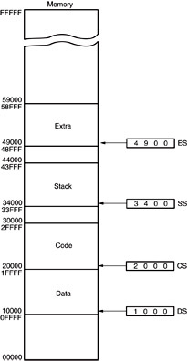
Memory segmentation
Only subset of address space is active (accessible)
Memory split into segments
  Active sections of memory
  Segments may overlap
  Segment size can be fixed (as in x86 real mode) or variable (as in protected mode)
Architecture requires register(s) to store start of active segment(s)
Microprocessors I: Lecture 3
Notes:
Chapter 2

Slide 16
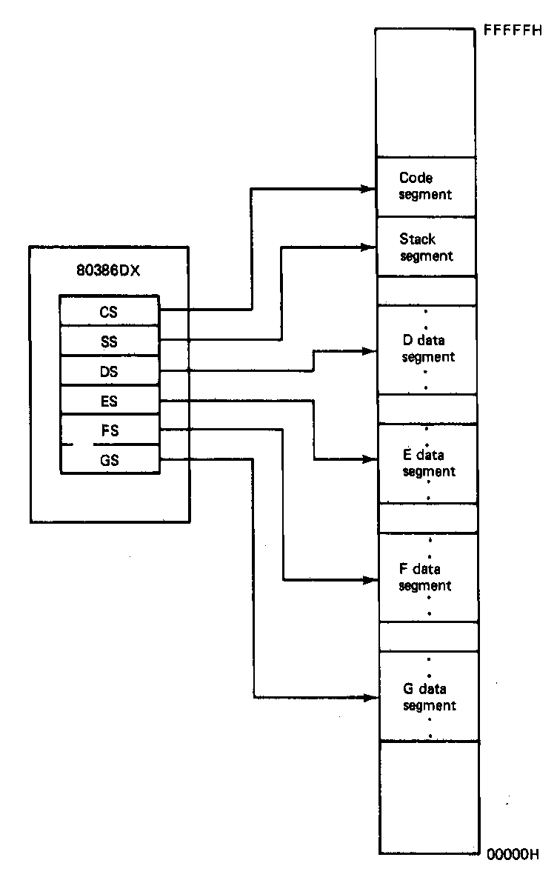
Segmentation in x86
Each real mode segment 64KB
Six programmer-controlled segment registers indicate start of each segment
Each segment must start on 16-byte boundary
  Valid starting addresses: 00000H, 00010H, 00020H, etc.
Total active memory: 384 KB
  64 KB code segment (CS)
  64 KB stack segment (SS)
  256 KB over 4 data segments (DS, ES, FS, GS)
Microprocessors I: Lecture 3
Notes:
Chapter 2

Slide 17
x86 memory addressing
Two pieces to address in segmented memory
  Starting address of segment
  Offset within segment
x86 real mode specifics
  All addresses are 20 bits
  Segment registers hold upper 16 bits of segment base address
    Where are the lower 4 bits of the base address?
      Always 0, since starting address must be divisible by 16
  Calculated effective address used as 16-bit offset
    Why is offset 16 bits?
      64KB = 2¹⁶ → 16 bit address needed to choose location within segment
Microprocessors I: Lecture 3

Slide 18
x86 memory addressing
Within instruction, address is combination of segment register/effective address
  Address of form SBA:EA
    SBA = segment base address
    EA = effective address
  EA based on addressing mode
  Address examples
    CS:IP → address of current instruction
    SS:SP → address of top of stack
    DS:0100H → address within current data segment with offset 0100H
Use this information to find linear address
  Program-generated location in memory space
Microprocessors I: Lecture 3

Slide 19
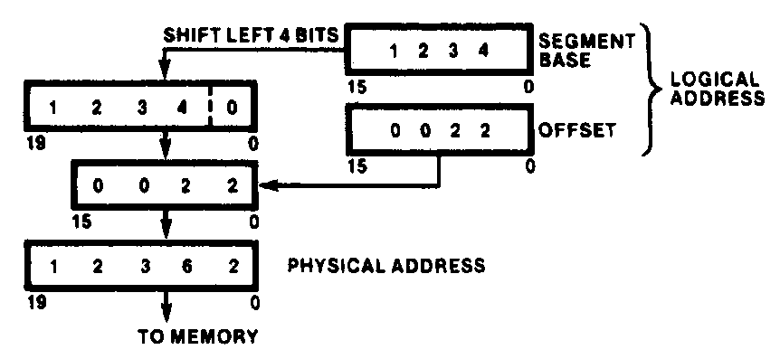
Generating Real-Mode Memory Address
  Segment base address = 1234H
  Offset = 0022H
  1234H = 0001001000110100₂
  0022H = 0000000000100010₂
  Shifting base address,
  00010010001101000000₂ = 12340H
  Adding binary segment address and offset
00010010001101000000₂ + 0000000000100010₂
= 00010010001101100010₂
    = 12362H
  In hex:
  12340H + 0022H = 12362H
Microprocessors I: Lecture 3
Notes:
Chapter 2

Slide 20
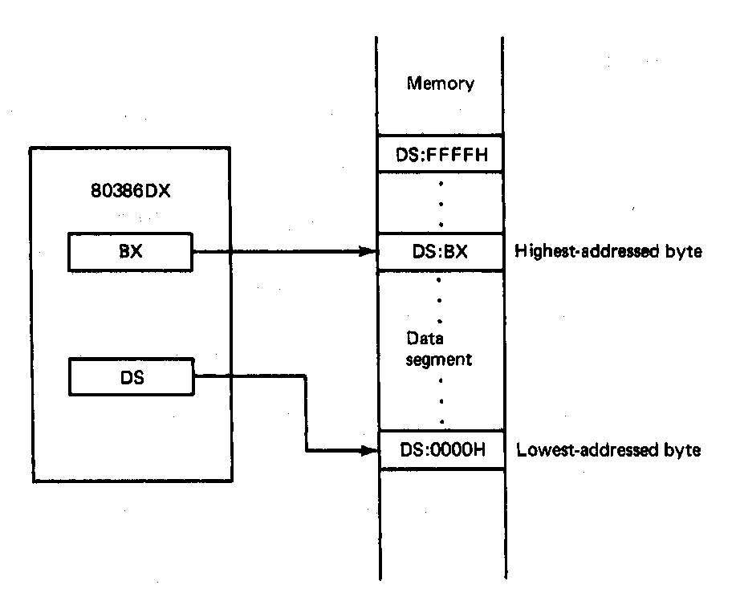
Boundaries of a Segment
Six active segments: CS, DS, ES. GS, FS, SS
  Each 64K-bytes in size → maximum of 384K-bytes of active memory
    64K-bytes for code
    64K-bytes for stack
    256K-bytes for data
Starting address of a data segment
DS:0H → lowest addressed byte
Ending address of a data segment
DS:FFFFH → highest addressed byte
Address of an element of data in a data segment
  DS:BX → address of a byte, word, or
  double word element of data in the
  data segment
Microprocessors I: Lecture 3
Notes:
Chapter 2

Slide 21
Final notes
Next time:
  More on x86 memory
  Assembly programming basics
Reminders:
  Sign up for the discussion group on Piazza
  HW 1 to be posted this week
Microprocessors I: Lecture 3

