Slide 1
16.317
Microprocessor Systems Design I
Instructor: Dr. Michael Geiger
Spring 2015
Lecture 11:
Exam 1 Review

Slide 2
Lecture outline
Announcements/reminders
  Please see me to get your exam
  HW 3 to be posted; due date TBD
Today’s lecture: Exam 1 Review
  Regrade requests
  Exam stats
  Solution
Microprocessors I: Exam 1 Review

Slide 3
Regrade requests
Due Monday, 3/2
Must be written (preferably on a separate sheet)
You must also return your exam
  Do not write on your exam if you plan on submitting a regrade request
Must demonstrate understanding of problem
  Bad: “I deserve more points on Problem 3.”
  Good: “I deserve more points on Problem 3 because I calculated a wrong result for one instruction based on a wrong result from a previous instruction. I used the right operation; I just plugged in the wrong value.”
Microprocessors I: Exam 1 Review

Slide 4

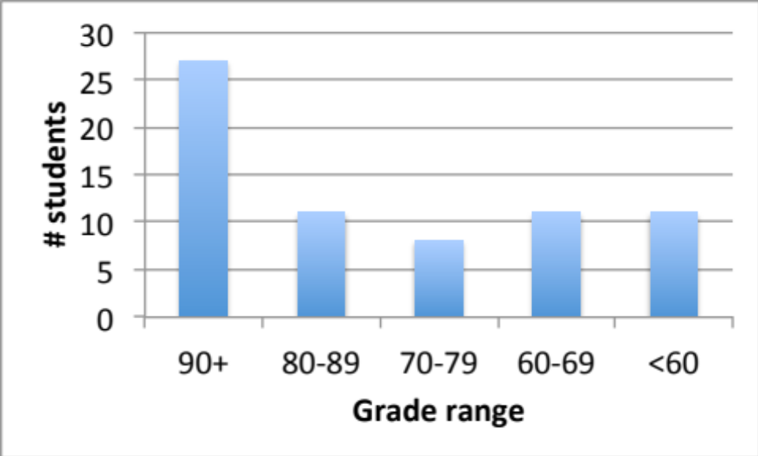
Exam stats & grade distribution
Question-by-question averages:
  Q1: 13.8 / 20 (70%)
  Q2: 24.6 / 30 (82%)
  Q3: 20.2 / 25 (81%)
  Q4: 20.4 / 25 (82%)
  Q5: 3.1 / 10 (40 responses)
Average: 79
Median: 82
Std. deviation: 16.8
Max: 100
Microprocessors I: Exam 1 Review

Slide 5
Final notes
Next time:
  Jump & loop instructions
Microprocessors I: Exam 1 Review

