Slide 1
16.317
Microprocessor Systems Design I
Instructor: Dr. Michael Geiger
Spring 2015
Lecture 9:
Conditional execution

Slide 2
Lecture outline
Announcements/reminders
  HW 2 due 12:00 PM (noon), 2/18
    No late submissions allowed
  Exam 1: Friday, 2/20
    Allowed calculator, one double-sided 8.5” x 11” note sheet
    Will be given list of instructions covered so far
Review
  Rotate instructions
  Bit test instructions
  Bit scan instructions
Today’s lecture
  Conditional execution
Microprocessors I: Lecture 9

Slide 3
Review: rotate instructions
Rotate instructions: bits that are shifted out one side are shifted back in other side
  ROL <src>, <amt> or ROR <src>, <amt>
  CF = last bit rotated
Rotate through carry instructions
  CF acts as “extra” bit that is part of value being rotated
  RCL <src>, <amt> or RCR <src>, <amt>
Microprocessors I: Lecture 9

Slide 4
Review: bit test/scan
Bit test instructions
  Check state of bit and store in CF
  Basic test (BT) leaves bit unchanged
  Can also set (BTS), clear (BTR), or complement bit (BTC)
Bit scan instructions
  Find first non-zero bit and store index in dest.
  Set ZF = 1 if source non-zero; ZF = 0 if source == 0
  BSF: scan right to left (LSB to MSB)
  BSR: scan left to right (MSB to LSB)
Microprocessors I: Lecture 9

Slide 5
Example
Given initial state shown in handout
List all changed registers/memory locations and their values, as well as CF
Instructions
  BT WORD PTR [21102H], 4
  BTC WORD PTR [21110H], 1
  BTS WORD PTR [21104H], 1
  BSF CX, WORD PTR [2110EH]
  BSR DX, WORD PTR [21109H]
Microprocessors I: Lecture 8

Slide 6
Example solution
BT WORD PTR [21102H], 4
  Word at 21102 = 1010H = 0001 0000 0001 0000
  CF = bit 4 = 1
BTC WORD PTR [21110H], 1
  Word at 21110 = 001EH = 0000 0000 0001 1110
  CF = bit 1 = 1
  Complement bit 1
    Word at 21110 = 0000 0000 0001 1100 = 001CH
Microprocessors I: Lecture 8

Slide 7
Example solution (cont.)
BTS WORD PTR [21104H], 1
  Word at 21104 = 0189H = 0000 0001 1000 1001
  CF = bit 1 = 0
  Set bit 1
    Word at 21110 = 0000 0001 1000 1011 = 018BH
BSF CX, WORD PTR [2110EH]
  Word at 2110E = 00FFH = 0000 0000 1111 1111
  Word is not zero → ZF = 1
  First non-zero bit (starting from bit 0) is bit 0 → CX = 0000H
BSR DX, WORD PTR [21109H]
  Word at 2110E = 0000H = 0000 0000 0000 0000
  Word is zero → ZF = 0
  DX unchanged
Microprocessors I: Lecture 8

Slide 8
Compare Instructions
Compare 2 values; store result in ZF/SF
General format: CMP D,S
  Works by performing subtraction (D) – (S)
    D, S unchanged
  ZF/SF/OF indicate result (signed values)
    ZF = 1 → D == S
    ZF = 0, (SF XOR OF) = 1 → D < S
    ZF = 0, (SF XOR OF) = 0 → D > S
Microprocessors I: Lecture 9
Notes:
Chapter 6 part 1
(D) (S) result CF SF AF
AX BX
2345>1234 0 0 0
1234<2345 1 1 1
1234>ABCD 1 0 1
ABCD<1234 0 1 0
ABCD>A000 0 0 0
A000<ABCD 1 1 1
7FFF 8000 overflow

Slide 9
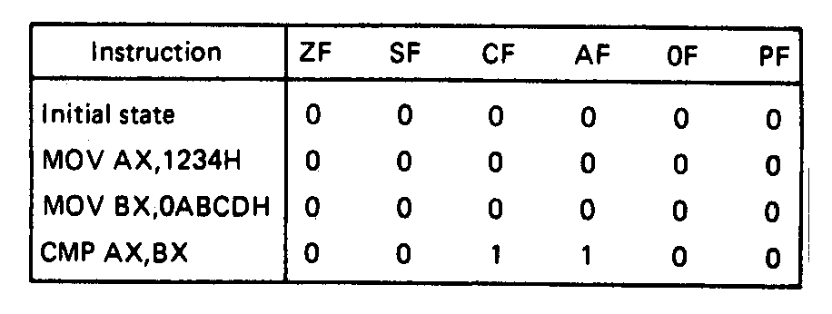
Compare Instructions- Example
Example—Initialization of internal registers with immediate data and compare. Example:
    MOV AX,1234H ;Initialize AX
    MOV BX,ABCDH ;Initialize BX
    CMP AX,BX ;Compare AX-BX
  Data registers AX and BX initialized from immediate data
  IMM16 → (AX) = 1234H → + integer
  IMM16 → (BX) = ABCDH → - integer
  Compare computation performed as:
  (AX) = 0001001000110100₂ (BX) = 1010101111001101₂
(AX) – (BX) = 0001001000110100₂ - 1010101111001101₂
  ZF = 0 = NZ
  SF = 0 = PL ;treats as signed numbers
  CF = 1 = CY
  AF = 1 = AC
  OF = 0 = NV
  PF = 0 = PO
Microprocessors I: Lecture 9
Notes:
Chapter 6 part 1

Slide 10
Condition codes
Conditional execution: result depends on value of flag bit(s)
Intel instructions specify condition codes
  Condition code implies certain flag values
  Opcodes written with cc as part of name
  cc can be replaced by any valid code
  Examples: CMOVcc, SETcc, Jcc
    Specific examples: CMOVE, SETL, SETZ, JNE, JG
Microprocessors I: Lecture 9

Slide 11
Condition codes (cont.)
Testing overflow
  O (OF = 1), NO (OF =0)
Testing carry flag
  C (CF = 1)
  NC (CF = 0)
Testing sign flag
  S (SF = 1), NS (SF = 0)
Testing parity flag
  P or PE (PF = 1)
  NP or PO (PF = 0)
Microprocessors I: Lecture 9

Slide 12
Condition codes (cont.)
Testing equality/zero result
  E or Z (ZF = 1)
  NE or NZ (ZF = 0)
Signed comparison
  L or NGE (SF XOR OF = 1)
  NL or GE (SF XOR OF = 0)
  LE or NG ((SF XOR OF) OR ZF = 1)
  NLE or G ((SF XOR OF) OR ZF = 0)
Unsigned comparison
  “Below” → less than, “above” → greater than
  B, NAE (CF = 1)
  NB, AE (CF = 0)
  BE or NA (CF OR ZF = 1)
  NBE or A (CF OR ZF = 0)
Microprocessors I: Lecture 9

Slide 13
Conditional move (CMOV)
Only in Pentium Pro & later
Perform move only if condition is true
Examples:
  CMOVZ AX, [SI] → move if ZF == 1
  CMOVG EBX, EAX → move if greater than
Microprocessors I: Lecture 9

Slide 14
Byte Set on Condition Instruction
Byte set on condition instruction
  Used to set byte based on condition code
  Can be used for boolean results—complex conditions
  General format:
    SETcc D
    cc = one of the supported conditional relationships
  Result
    D = 01h if condition true
    D = 00h if condition false
Microprocessors I: Lecture 9
Notes:
Chapter 6 part 1

Slide 15
Byte Set on Condition Instruction
Operation: Flags tested for conditions defined by “cc” and the destination in a register or memory updated as follows
If cc test True:
  00000001₂ = 01H → D
  If cc test False:
  00000000₂ = 00H → D
Examples of conditional tests:
SETE = set byte if equal → ZF = 1
SETC = set byte if carry → CF =1
SETBE = set byte if below or equal → CF = 1 +(or) ZF = 1
Example: SETA AL = set byte if above
  if CF = 0 • (and) ZF = 0
  (AL) = 01H
  Otherwise,
  (AL) =00H
Microprocessors I: Lecture 9
Notes:
Chapter 6 part 1

Slide 16
Example
Show the results of the following instructions, assuming that
  “A” = (100H) = 0001H
  “B” = (102H) = 0003H
  “C” = (104H) = 1011H
  “D” = (106H) = 1011H
  “E” = (108H) = ABCDH
  “F” = (10AH) = DCBAH
What complex condition does this sequence test?
MOV AX, [100H]
CMP AX, [102H]
SETLE BL
MOV AX, [104H]
CMP AX, [106H]
SETE BH
AND BL, BH
MOV AX, [108H]
CMP AX, [10AH]
SETNE BH
OR BL, BH
Microprocessors I: Lecture 9

Slide 17
Example solution
Condition being tested:
  To simplify, treat each word as a variable named “A” through “F”
  ((A <= B) && (C == D)) || (E != F)
Source: http://www.arl.wustl.edu/~lockwood/class/cs306/books/artofasm/Chapter_6/CH06-4.html
Microprocessors I: Lecture 9

Slide 18
Final notes
Next time:
  Exam 1 Preview
Reminders:
  HW 2 due 12:00 PM (noon), 2/18
    No late submissions allowed
  Exam 1: Friday, 2/20
    Allowed calculator, one double-sided 8.5” x 11” note sheet
    Will be given list of instructions covered so far
Microprocessors I: Lecture 9

