Slide 1
16.317
Microprocessor Systems Design I
Instructor: Dr. Michael Geiger
Summer 2012
Lecture 2:
Addressing modes
80386DX memory spaces and addressing

Slide 2
Lecture outline
Announcements /reminders
  Register for the discussion group on piazza.com
  Lab 1 posted; will push due date back to Wednesday, 7/18
Review
  General microprocessor introduction
  Instruction set architecture
  Operations
  Data
Today’s lecture
  Addressing modes
  Review of 80386DX intro + closer look at memory spaces
  Segmented memory architecture
  80386DX addressing
Microprocessors I: Lecture 2

Slide 3
Review
Processor components
  Microprocessor for computation
  Input/output to communicate with outside world
  Storage to hold code/data
Instruction set architecture
  Defines how programmer interfaces with hardware
  Operations generally fall into one of four groups
    Data transfer: move data across storage locations
    Arithmetic: add, subtract, etc.
    Logical: AND, OR, shifts, etc.
    Program control: jumps/branches/calls
Microprocessors I: Lecture 2

Slide 4
Review (cont.)
Instruction set architecture (cont.)
  Operands: the data being operated on
    How are the bits interpreted? (int, FP, signed/unsigned)
    What size are they? (byte, word, etc.)
    How do we reference operands?
  Instruction formats: how instructions are encoded
Data storage
  Registers
    Small, fast set of on-chip storage (primarily for speed)
    Referenced by name
  Memory
    Larger, slower set of storage (primarily for capacity)
    Organized as hierarchy …
    … but programmer references single range of addresses
    Memory issues
      Aligned data: address divisible by number of bytes
      Endianness: 80x86 data is little endian
Microprocessors I: Lecture 2

Slide 5
Addressing modes
Addressing modes: ways of specifying operand location
Where are operands stored? (3 location types)
  Registers → register addressing
    Provide name of register; value read from register
  Memory
    Provide address in memory; value read from that location
    Several modes for specifying memory address
  In the instruction → immediate addressing
Microprocessors I: Lecture 2

Slide 6
Memory addressing
Instructions accessing memory generate effective address (EA)
  Address calculated as part of instruction
  EA can be used as
    Actual memory address in a simple memory system
    Address within a particular segment in a segmented memory architecture
Effective address calculations can involve
  A constant value
  One or more values stored in registers
  Some combination of register and constant
Microprocessors I: Lecture 2

Slide 7
General memory addressing modes
Memory direct addressing
  EA = constant value encoded in instruction
Register indirect addressing
  EA = value stored in register
Base + displacement addressing
  EA = constant displacement + base register(s)
  Can have variations of this mode based on number and type of registers
Less commonly used modes on some MPUs
  Memory indirect addressing
  Scaled addressing
Microprocessors I: Lecture 2

Slide 8
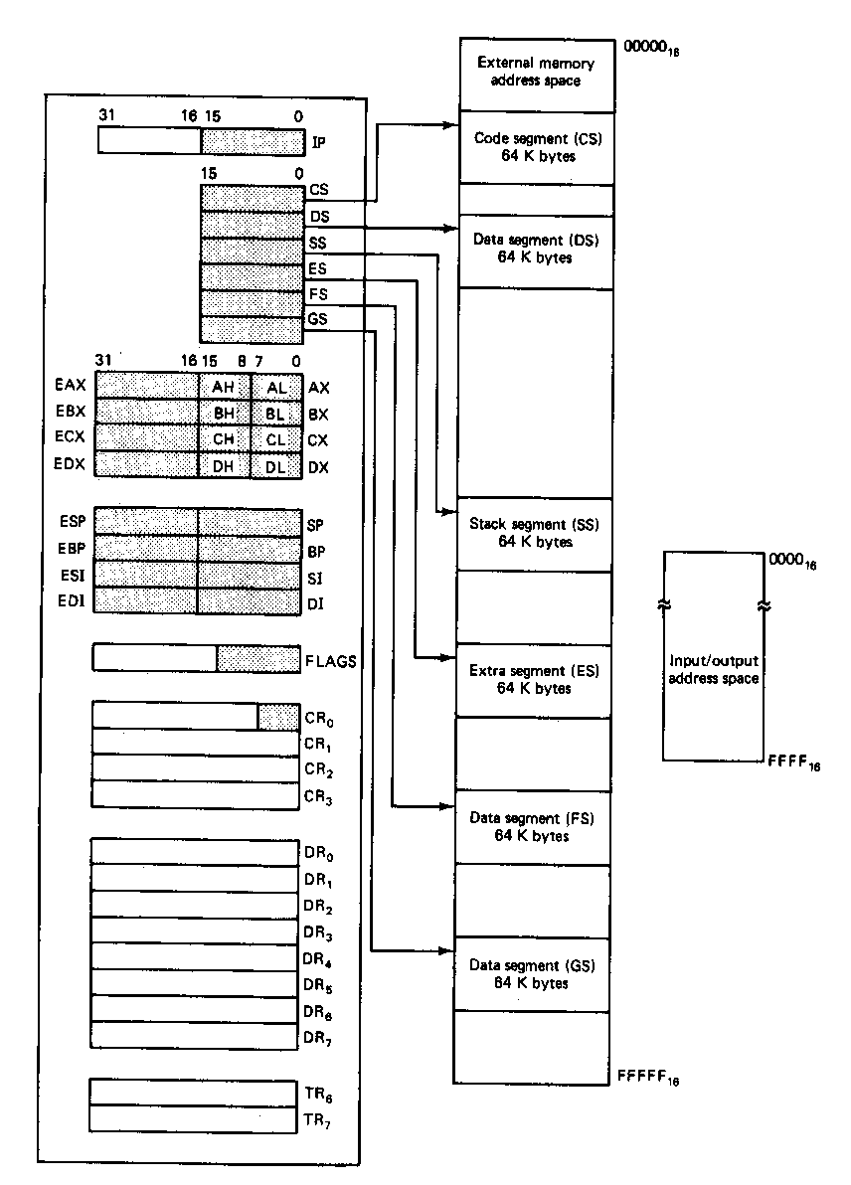
80386DX memory spaces
Architecture implements independent memory and input/output address spaces
Memory address space- 1,048,576 bytes long (1MB)
  Real mode uses 20-bit address
  1MB = 2²⁰
Input/output address space- 65,536 bytes long (64KB)
Microprocessors I: Lecture 2
Notes:
Chapter 2

Slide 9
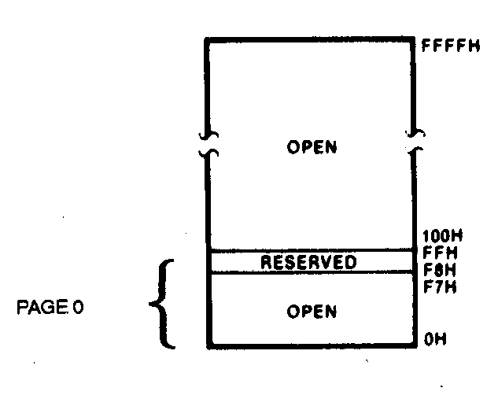
I/O address space
Input/output address space
  Place where I/O devices are normally implemented
  I/O addresses are only 16-bits in length
  Independent 64K-byte address space
  Address range 0000H through FFFFH
Advantages of Isolated I/O
  Complete memory address space available for use by memory
  I/O instructions tailored to maximize performance
Disadvantage of Isolated I/O
  All inputs/outputs must take place between I/O port and accumulator register
Microprocessors I: Lecture 2

Slide 10
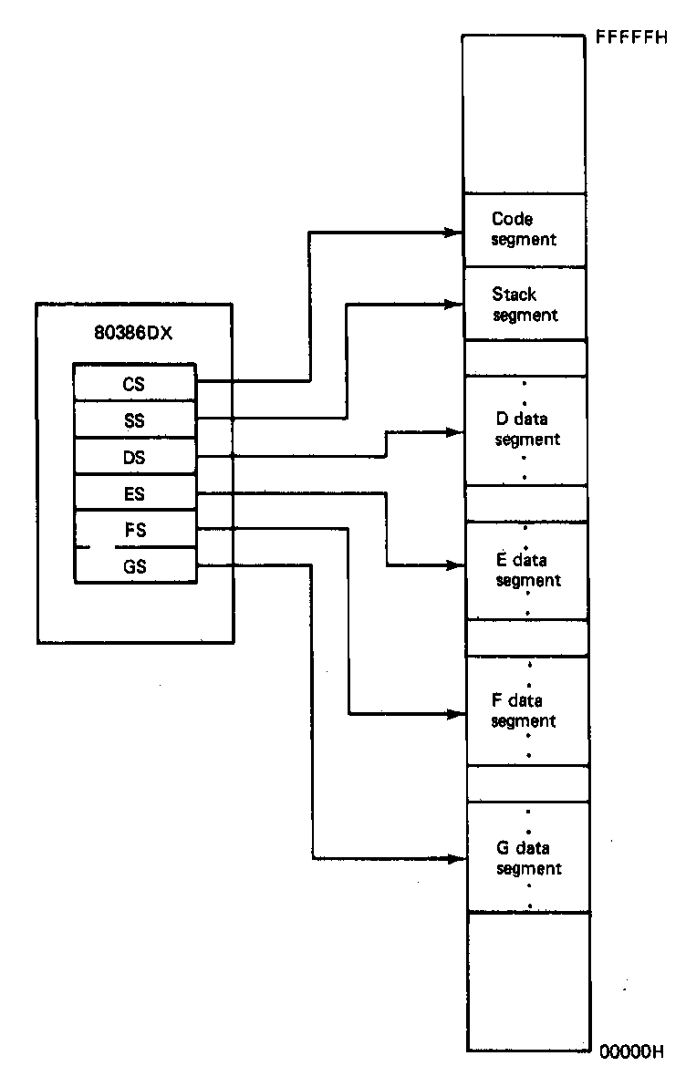
Memory segmentation
Only subset of address space is active (accessible)
Memory split into segments
  Active sections of memory
  Segments may overlap
  Segment size can be fixed (as in x86 real mode) or variable (as in protected mode)
Architecture requires register(s) to store start of active segment(s)
Microprocessors I: Lecture 2
Notes:
Chapter 2

Slide 11
Segmentation on 80386DX
Each real mode segment 64KB
Six programmer-controlled segment registers indicate start of each segment
Each segment must start on 16-byte boundary
  Valid starting addresses: 00000H, 00010H, 00020H, etc.
Total active memory: 384 KB
  64 KB code segment (CS)
  64 KB stack segment (SS)
  256 KB over 4 data segments (DS, ES, FS, GS)
Microprocessors I: Lecture 2
Notes:
Chapter 2

Slide 12
80386DX memory addressing
Two pieces to address in segmented memory
  Starting address of segment
  Offset within segment
80386 real mode specifics
  All addresses are 20 bits
  Segment registers hold upper 16 bits of segment base address
    Where are the lower 4 bits of the base address?
      Always 0, since starting address must be divisible by 16
  Calculated effective address used as 16-bit offset
    Why is offset 16 bits?
      64KB = 2¹⁶ → 16 bit address needed to choose location within segment
Microprocessors I: Lecture 2

Slide 13
80386DX Logical vs. Physical Addresses
80386DX addresses can be specified as “logical addresses”
  Address of form SBA:EA
    SBA = segment base address
    EA = effective address
  EA based on addressing mode
  Examples of logical addresses
    CS:IP → address of current instruction
    SS:SP → address of top of stack
    DS:0100H → address within current data segment with offset 0100H
Use logical address to find physical address
  Actual location in memory space
Microprocessors I: Lecture 2

Slide 14
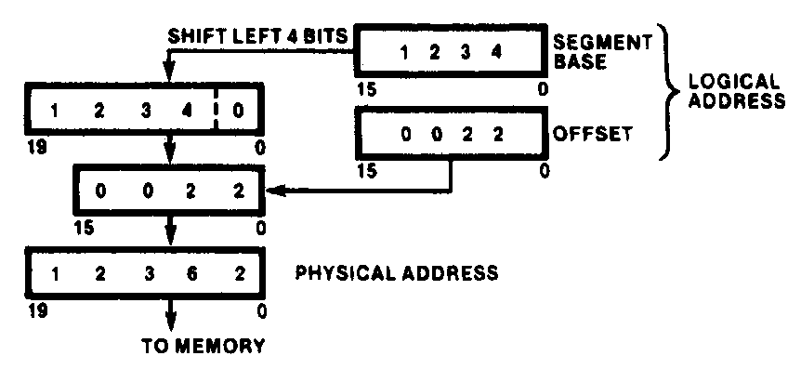
Generating Real-Mode Memory Address
  Segment base address = 1234H
  Offset = 0022H
  1234H = 0001001000110100₂
  0022H = 0000000000100010₂
  Shifting base address,
  00010010001101000000₂ = 12340H
  Adding binary segment address and offset
00010010001101000000₂ + 0000000000100010₂
= 00010010001101100010₂
    = 12362H
  In hex:
  12340H + 0022H = 12362H
Microprocessors I: Lecture 2
Notes:
Chapter 2

Slide 15
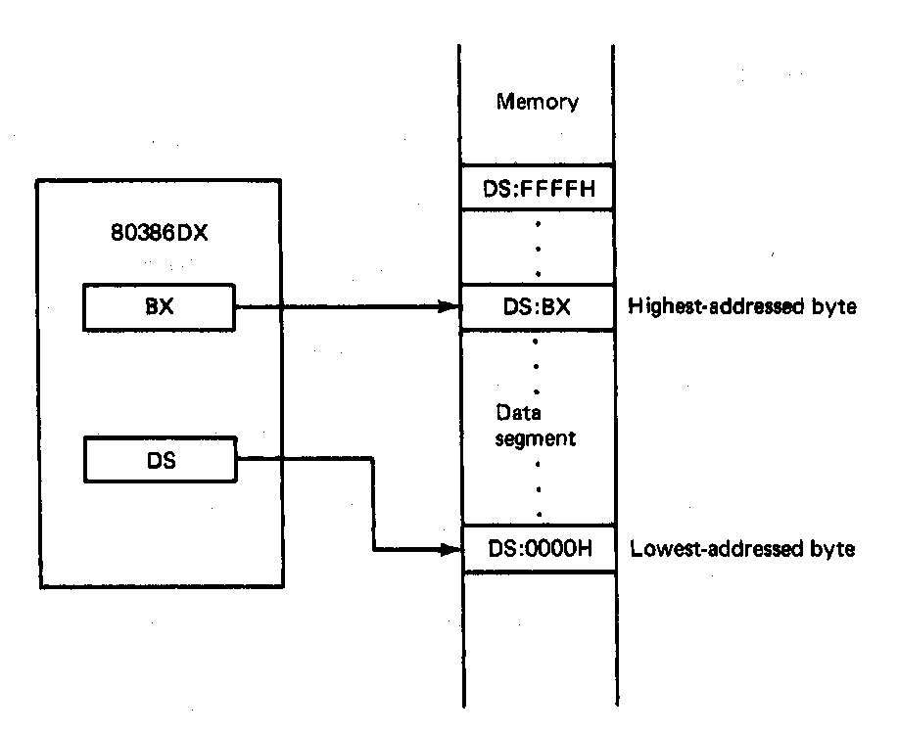
Boundaries of a Segment
Six active segments: CS, DS, ES. GS, FS, SS
  Each 64K-bytes in size → maximum of 384K-bytes of active memory
    64K-bytes for code
    64K-bytes for stack
    256K-bytes for data
Starting address of a data segment
DS:0H → lowest addressed byte
Ending address of a data segment
DS:FFFFH → highest addressed byte
Address of an element of data in a data segment
  DS:BX → address of a byte, word, or
  double word element of data in the
  data segment
Microprocessors I: Lecture 2
Notes:
Chapter 2

Slide 16
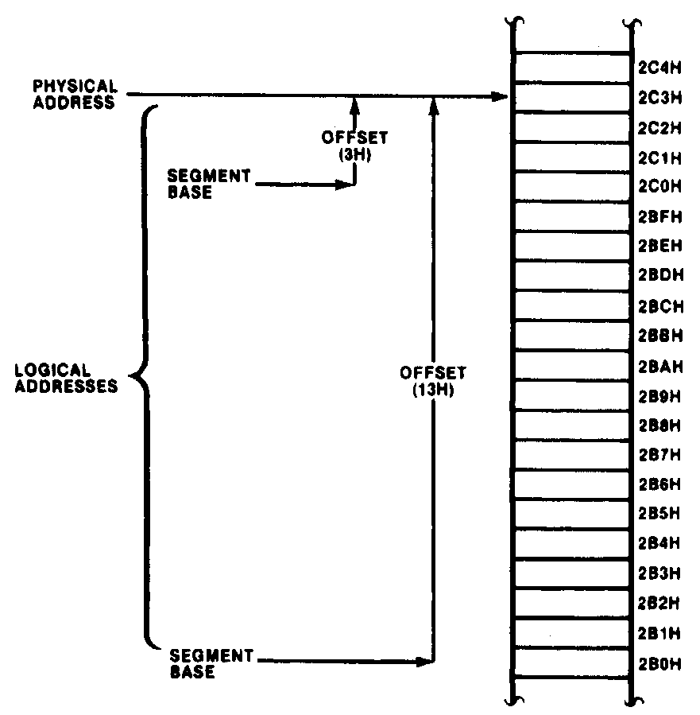
Aliases
Many different logical address can map to the same physical address
Examples:
  2BH:13H = 002B0H+0013H = 002C3H
  2CH:3H = 002C0H + 0003H = 002C3H
Said to be “aliases”
Microprocessors I: Lecture 2
Notes:
Chapter 2

Slide 17
Address generation examples
Given the following register values:
  CS = 0x1000
  SS = 0x2000
  DS = 0x3000
  ES = 0x4000
  IP = 0x0100
  ESP = 0x0002FF00
  EBP = 0x0000F000
  ESI = 0x0001000E
  EBX = 0xABCD1234
What physical addresses correspond to the following logical addresses?
  CS:IP
  SS:SP
  SS:BP
  DS:SI
  ES:BX
Microprocessors I: Lecture 2

Slide 18
Example solutions
CS:IP
  CS << 4 = 0x10000
  Address = 0x10000 + 0x0100 = 0x10100
SS:SP
  SS << 4 = 0x20000
  SP = lower 16 bits of ESP = 0xFF00
  Address = 0x20000 + 0xFF00 = 0x2FF00
SS:BP
  SS << 4 = 0x20000
  BP = lower 16 bits of EBP = 0xF000
  Address = 0x20000 + 0xF000 = 0x2F000
Microprocessors I: Lecture 2

Slide 19
Example solutions (cont.)
DS:SI
  DS << 4 = 0x30000
  SI = lower 16 bits of ESI = 0x000E
  Address = 0x30000 + 0x000E = 0x3000E
ES:BX
  ES << 4 = 0x40000
  BX = lower 16 bits of EBX = 0x1234
  Address = 0x40000 + 0x1234 = 0x41234
Microprocessors I: Lecture 2

Slide 20
80386DX memory operands
Addresses in 80386DX instructions enclosed by brackets
Most instructions don’t explicitly specify segment register
  DS is usually default
  Some instructions use SS, CS as default
Examples (using basic MOV instruction)
  MOV AX, [0100H] → move data from DS:100H to AX
  MOV AX, DS:[0100H] → same as above
  MOV AX, ES:[0100H] → move data from ES:100H to AX
In all examples above
  0100H is effective address
  Segment register is either DS or ES
Microprocessors I: Lecture 2

Slide 21
80386 addressing modes
All examples of general addressing modes discussed earlier
Direct addressing
  EA = constant value
  Example: MOV AX, [0100H]
Register indirect addressing
  EA = value stored in register
  Valid registers: SI, DI, BX, BP
    SS default segment if BP used; DS otherwise
  Example: MOV [DI], AX
Microprocessors I: Lecture 2

Slide 22
80386 addressing modes (cont.)
Based addressing and indexed addressing
  EA = register + constant value (base+disp)
    “Based” → BX or BP is register
    “Indexed” → SI or DI is register
  Examples
    MOV AX, 10H[SI] -or- MOV AX, [SI + 10H]
    MOV 100H[BP], AX -or- MOV [BP+100H], AX
      Uses SS, not DS
Based-indexed addressing
  EA = base register (BX/BP) + index register (SI/DI)
  Example: MOV AX, [SI][BX] -or- MOV AX, [SI+BX]
Based-indexed + displacement addressing
  EA = base register + index register + constant
  Example: MOV AX, 10H[SI][BX] -or-
  MOV AX, [10H+SI+BX]
Microprocessors I: Lecture 2

Slide 23
Example
Compute the physical address for the specified operand in each of the following instructions. The register contents and variables are as follows:
  (CS) = 0A00₁₆
  (DS) = 0B00₁₆
  (ESI) = 00000100₁₆
  (EDI) = 00000200₁₆
  (EBX) = 00000300₁₆
Destination operand in: MOV [DI], AX
Source operand in: MOV DI, [SI]
Destination operand in: MOV [BX+0400H], CX
Destination operand in: MOV [DI+0400H], AH
Destination operand in MOV [BX+DI+0400H], AL
Microprocessors I: Lecture 2

Slide 24
Example solutions
Note: all memory operands in problem use data segment
  DS = 0B00H → segment base address (SBA) = 0B000H
  Physical address (PA) = SBA + effective address (EA)
Destination operand in: MOV [DI], AX
  EA = value in DI = 0200H
  PA = 0B000H + 0200H = 0B200H
Source operand in: MOV DI, [SI]
  EA = value in SI = 0100H
  PA = 0B000H + 0100H = 0B100H
Microprocessors I: Lecture 2

Slide 25
Example solutions (cont.)
Destination operand in: MOV [BX+0400H], CX
  EA = value in BX + 0400H = 0300H + 0400H = 0700H
  PA = 0B000H + 0700H = 0B700H
Destination operand in: MOV [DI+0400H], AH
  EA = value in DI + 0400H = 0200H + 0400H = 0600H
  PA = 0B000H + 0600H = 0B600H
Destination operand in MOV [BX+DI+0400H], AL
  EA = BX + DI + 0400H
  = 0300H + 0200H + 0400H = 0900H
  PA = 0B000H + 0900H = 0B900H
Microprocessors I: Lecture 2

Slide 26
Lab 1 notes
Change due date since card access not done
Will learn to use Windows DEBUG prompt
  Can simulate assembly code
  Lab focuses on basic functionality/commands
To run DEBUG on Windows 7 machine
  Download DOS emulator DOSbox (http://www.dosbox.com)
  Download DEBUG clone (will put full link on web and in lab assignment)
    Recommend choosing a directory in which you can put all 16.317 lab-related stuff; place DEBUG files there
  Within DOSbox, mount directory as a drive
    E.g., if C:\Users\Michael_Geiger\MicrosI holds lab files, type
    mount c c:\Users\Michael_Geiger\MicrosI
    at DOSbox prompt
    Enter drive name (C:) at prompt to change to that directory
Microprocessors I: Lecture 2

Slide 27
Final notes
Next time: assembly intro
  General format of assembly files
  Start learning 80386DX instructions
Reminders
  Lab 1 due Wednesday, 7/18
  HW 1 to be posted; due Wednesday, 7/18
  Check the course web page
  Join the course discussion group on piazza.com
Microprocessors I: Lecture 2

