Slide 1
16.317
Microprocessor Systems Design I
Instructor: Dr. Michael Geiger
Summer 2012
Lecture 3:
Assembly programming introduction
Instructions: data transfer, arithmetic

Slide 2
Lecture outline
Announcements/reminders
  Register for the discussion group on piazza.com
  Lab 1, HW 1 both due Wednesday
  Lab 2 posted; due Monday, 7/23
  Should now have lab access in Ball 407
  Exam 1 this Friday, 7/20
Review
  Addressing modes
  80386 memory
    Segmented memory
    80386 addressing
Today’s lecture
  Assembly intro
  80386DX instructions
    Data transfer
    Arithmetic
Microprocessors I: Lecture 3

Slide 3
Review
Addressing modes
  Register addressing → data in register
  Immediate addressing → data in instruction
  Memory addressing → data in memory
    Need effective address
    EA calculation
      Direct addressing → EA = constant
      Register indirect → EA = register value
      Base + displacement addressing → EA = constant + reg(s)
80386 memory
  Data/code and I/O separated
  General memory uses segmented architecture
    Only subset of memory active at time
    Segment register(s) hold starting address of segment(s)
Microprocessors I: Lecture 3

Slide 4
Review (cont.)
More 80386 memory specifics
  Six segment registers: CS (code), SS (stack), DS, ES, FS, GS (data)
  Each segment 64 KB, starts on 16B boundary
    Lowest hex digit of 20-bit address = 0
  Logical address → SBA:EA
    Examples: DS:SI, SS:SP, CS:IP, DS:1000H
  Physical address: actual memory address
    Shift 16-bit segment register to left by 4 bits = SBA
    Add 16-bit EA to SBA
  Calculating EA
    Direct addressing: EA = const
    Register indirect—either “based” or “indexed”: EA = reg
      Possible register: SI, DI, BX, BP
      Only BP uses SS; others use DS by default
    Based-indexed: EA = base reg. + index reg.
    Based-indexed + displacement: EA = base reg + index reg + const
Microprocessors I: Lecture 3

Slide 5
Software
Instruction -> Program -> Software
Machine language -> Assembly Language -> High Level Language (C/C++, Java)
Source code -> Object code -> Executable
Assembly language
  Instruction: Label: Instruction ; comment
  Example: START: MOV EAX, EBX; COPY EBX INTO EAX
  List file: line number, offset, machine language (code), instruction, comments
Microprocessors I: Lecture 3

Slide 6
Instruction Assembly Notation
Each instruction is represented by a mnemonic that describes its operation—called its operation code (opcode)
  MOV = move (data transfer)
  ADD = add (arithmetic)
  AND = logical AND (logic)
  JMP = unconditional jump (control transfer)
Operands are the other parts of an assembly language instructions
    Identify whether the elements of data to be processed are in registers or memory
      Source operand– location of one operand to be process
      Destination operand—location of the other operand to be processed and the location of the result
Microprocessors I: Lecture 3

Slide 7
Assembly Language Statements
General structure of an assembly language statement
LABEL: INSTRUCTION ;COMMENT
  Label—address identifier for the statement
  Instruction—the operation to be performed
  Comment—documents the purpose of the statement
  Example:
START: MOV AX, BX ; Copy BX into AX
Other examples:
  INC SI ;Update pointer
ADD AX, BX
  Few instructions have a label—usually marks a jump to point
  Not all instructions need a comment
Microprocessors I: Lecture 3
Notes:
Chapter 3

Slide 8
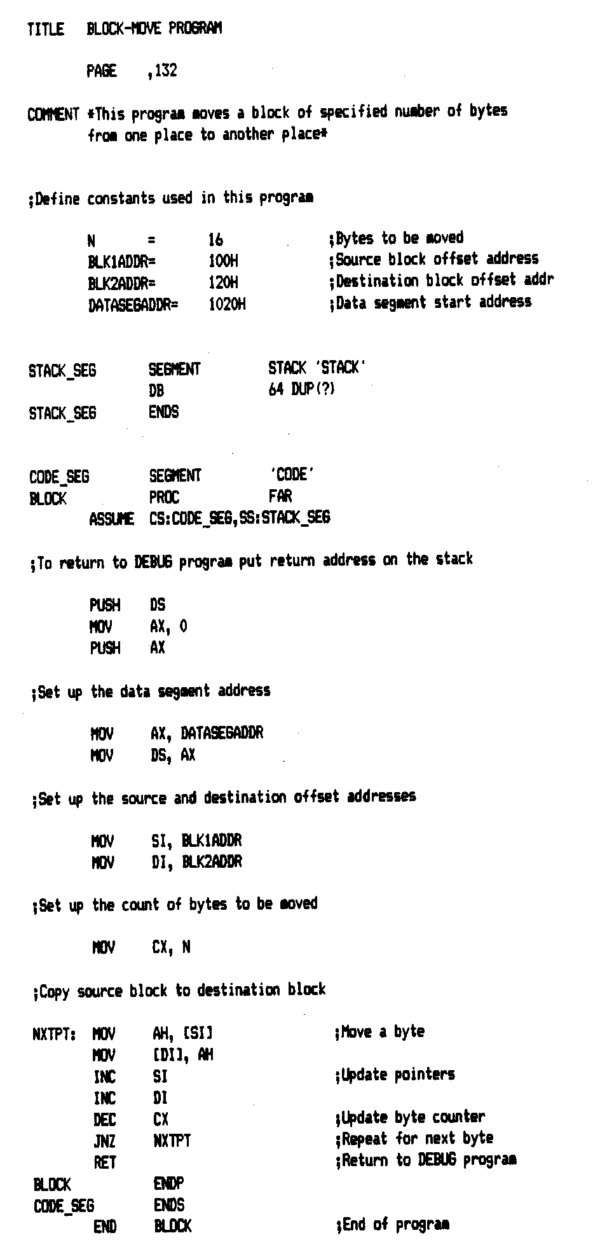
Source Program
Title/comment
Constant declaration
  Similar to #define
Set up segments
  SEGMENT directive for SS, CS
  Explicitly set DS
Actual code within process (PROC)
Microprocessors I: Lecture 3
Notes:
Chapter 3

Slide 9
Assembler and the source program
Assembly language program
  Assembly language program (.asm) file—known as source code
  Converted to machine code by a process called assembling
  Assembling performed by a software program—an 80x86 assembler
  Machine (object ) code that can be run is output in the executable (.exe) file
  Source listing output in (.lst) file—printed and used during execution and debugging of program
DEBUG—part of disk operating system (DOS) of the PC
  Permits programs to be assembled and disassembled
  Line-by-line assembler
  Also permits program to be run and tested
Microprocessors I: Lecture 3

Slide 10
The Listing File
Instruction statements—operations to be performed by the program
  Example—line 53
0013 8A 24 NXTPT: MOV AH, [SI] ;Move a byte
Where:
0013 = offset address of first byte of code in the current CS
8A24 = machine code of the instruction
NXTPT: = Label
MOV = instruction mnemonic
AH = destination operand—a register
[SI] = source operand—in memory
;Move xxxxx = comment
Directives—provides directions to the assembler program
  Example—line 20
  0000 0040 DB 64 DUP(?)
Defines and leaves un-initialized a block of 64 bytes in memory for the stack
Microprocessors I: Lecture 3

Slide 11
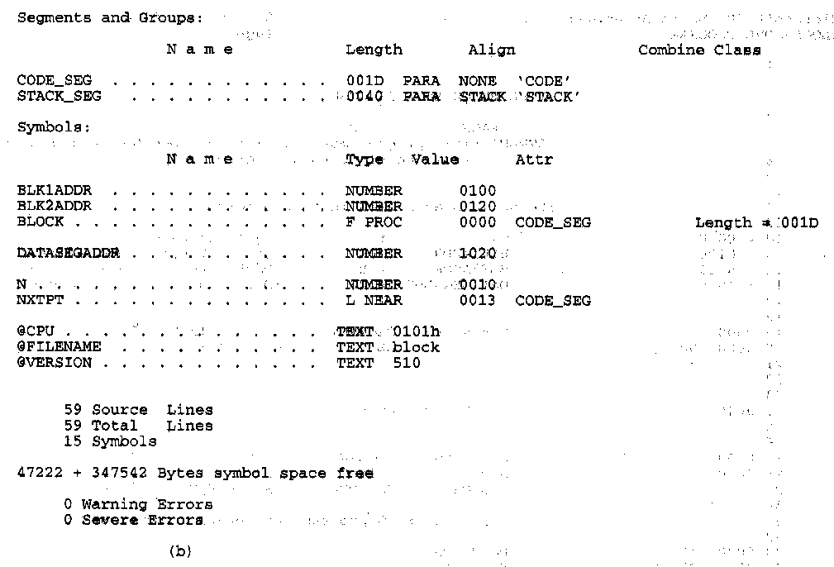
More Information in the Listing
Other information provided in the listing
  Size of code segment and stack
  Names, types, and values of constants and variables
  # lines and symbols used in the program
  # errors that occurred during assembly
Microprocessors I: Lecture 3
Notes:
Chapter 3

Slide 12
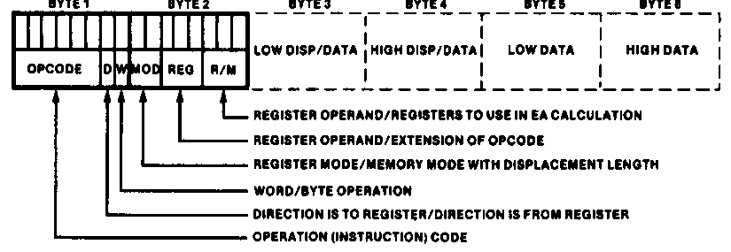
Instruction Encoding
80x86’s instruction set is variable length
  Multiple instruction sizes
    1 to 6 bytes in length for 8088/8086
    Up to 17 bytes for 80386,80486, and Pentium
  Variable length advantages (trait of CISC)
    Allows for many addressing modes
    Allows full size (32-bit) immediate data and addresses
    Instructions can use as many bytes as necessary
  Disadvantage of variable length
    Requires more complicated decoding hardware—speed of decoding is critical in modern uP
    Most uP use fixed length (trait of RISC)
Microprocessors I: Lecture 3
Notes:
Chapter 4

Slide 13
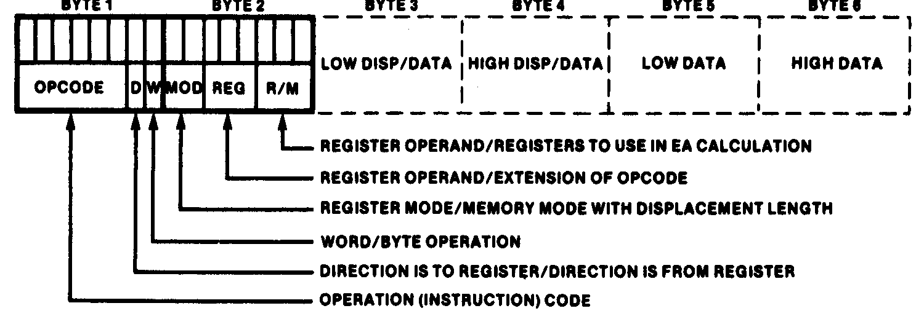
Instruction Encoding
Information encoded in an instruction
  What operation ?
  What operands ?
  Byte, word or double-word ?
  Operands in register or memory ?
  How the address is to be generated, if mem?
Microprocessors I: Lecture 3

Slide 14
80386DX data types (“review”)
Refresher on 80386DX registers
  Gen. purpose registers: 16 or 32 bits
  Data registers can hold 8 bit data as well
  Determining size: register name
  Example: “accumulator” register
    8 bit data: AL = lowest byte; AH = next lowest byte
    16 bit data: AX = lowest 16 bits (AH/AL together as word)
    32 bit data: EAX = entire 32 bits
Say EAX = 1A2B3C4DH
  What are AL, AH, and AX?
  AL = 4DH, AH = 3CH, AX = 3C4DH
Microprocessors I: Lecture 3

Slide 15
80386 memory accesses
# bytes from memory usually = # bytes in register
Example: MOV AX, [100H]
  AX is 16-bit register → move word from DS:100H to AX
Sometimes necessary to specify size
  Use “<size> PTR”: BYTE PTR, WORD PTR, DWORD PTR
  Example: MOVZX EAX, BYTE PTR [100H]
    Take byte from memory
    Zero-extend data to 32 bits and store in EAX
Remember, 80386DX uses little-endian data
Microprocessors I: Lecture 3

Slide 16
Instruction types
Recall the four general types of instructions used by most microprocessors
  Data transfer
  Arithmetic
  Logical (including shifts, bitwise, etc.)
  Program control
80386DX has some additional types (many of which we won’t cover)
  Processor control
  String instructions
  Input/output instructions
Microprocessors I: Lecture 3

Slide 17
Data transfer instructions
MOV
MOVSX
MOVZX
XCHG
LEA
Load full pointer
Microprocessors I: Lecture 3

Slide 18
MOV
Used to copy data between
  Registers
  Registers/memory
  Immediate value (source only) to register/memory
Format: MOV D, S
Operation: (D) = (S)
Restrictions
  Immediate value can only be used as source
  If segment register is destination, source must be memory or register (no immediate)
Microprocessors I: Lecture 3

Slide 19
MOV examples
Assume: AX = 0100H, CS = 3000H, (DS:100H) = 00H, (DS:101H) = FFH
MOV BL, AL
  BL = AL = 00H
MOV DX, CS
  DX = CS = 3000H
MOV CX, [100H]
  CX = word starting at DS:100H = FF00H
Microprocessors I: Lecture 3

Slide 20
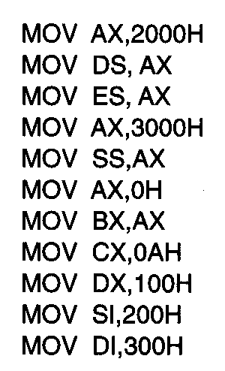
Usage of Move Instruction
Example—Initialization of internal registers with immediate data and address information
  What is the final state of all affected registers?
  Why is AX used to initialize segment registers?
Microprocessors I: Lecture 3
Notes:
Chapter 5 (I)

Slide 21
Usage of Move Instruction (soln)
MOV AX, 2000H → AX = 2000H
MOV DS, AX → DS = AX = 2000H
MOV ES, AX → ES = AX = 2000H
MOV AX, 3000H → AX = 3000H
MOV SS, AX → SS = 3000H
MOV AX, 0H → AX = 0000H
MOV BX, AX → BX = AX = 0000H
MOV CX, 0AH → CX = 000AH
MOV DX, 100H → DX = 0100H
MOV SI, 200H → SI = 0200H
MOV DI, 300H → DI = 0300H
Microprocessors I: Lecture 3
Notes:
Chapter 5 (I)

Slide 22
MOVSX/MOVDX
Move and extend data (fill upper bits with 0/1)
  ZX → zero extend
  SX → sign extend → copy MSB of source
Format: MOVZX D, S
MOVSX D, S
Operation: lower bits of D = S
upper bits of D = 0 (MOVZX) or
upper bits of D = MSB of S (MOVSX)
Restrictions
  Only register/memory operands (no immediates)
  Source must contain fewer bits than destination
  If memory operand used, size must be specified
Microprocessors I: Lecture 3

Slide 23
MOVSX/MOVZX examples
Assume: AX = 0100H, DX = 8100H, (DS:100H) = 00H, (DS:101H) = FFH
What are the results of the following instructions?
MOVSX EBX, AX
MOVSX EBX, DX
MOVZX EBX, DX
MOVSX EBX, BYTE PTR [100H]
MOVSX EBX, WORD PTR [100H]
Microprocessors I: Lecture 3

Slide 24
MOVSX/MOVZX examples (soln)
Assume: AX = 0100H, DX = 8100H, (DS:100H) = 00H, (DS:101H) = FFH
What are the results of the following instructions?
MOVSX EBX, AX
  EBX = AX sign-extended = 00000100H (orig. value underlined)
MOVSX EBX, DX
  EBX = DX sign-extended = FFFF8100H
MOVZX EBX, DX
  EBX = DX zero-extended = 00008100H
MOVSX EBX, BYTE PTR [100H]
  EBX = byte at DS:100 sign-extended = 00000000H
MOVSX EBX, WORD PTR [100H]
  EBX = word at DS:100 sign-extended = FFFFFF00H
Microprocessors I: Lecture 3

Slide 25
XCHG
Swap contents of source and destination
Format: XCHG D, S
Operation: (D) = (S)
(S) = (D)
Restrictions:
  Memory operand can only be used as destination
Microprocessors I: Lecture 3

Slide 26
LEA
Perform effective address computation and store result in register
Format: LEA D, EA
Operation: D = EA
Example: LEA SI, [10H + DI]
Microprocessors I: Lecture 3

Slide 27
Load full pointer
Load contents of memory into both register and segment register
Format: Lxx D, addr
  xx = DS, ES, FS, GS, SS
Operation:
  (D) = contents of addr
  Segment register xx = contents of:
    addr + 2 if D is 16-bit register
    addr + 4 if D is 32-bit register
Microprocessors I: Lecture 3

Slide 28
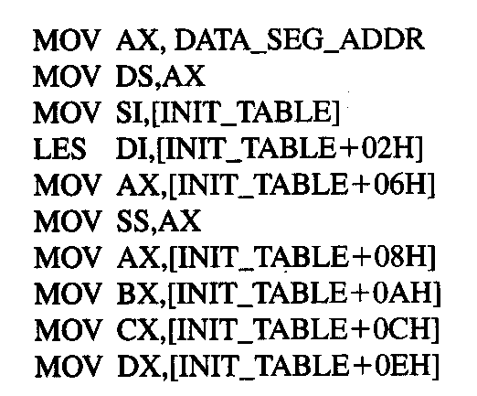
Example
DATA_SEG_ADDR:0000
DATA_SEG_ADDR:INIT_TABLE | 11 | 22
 | 33 | 44
 | 55 | 66
 | 77 | 88
 | 99 | AA
 | BB | CC
 | DD | EE
 | FF | 16
 | 03 | 17
Show the results of running the following program if DATA_SEG_ADDR = 1200H:
Microprocessors I: Lecture 3

Slide 29
Example solution
DATA_SEG_ADDR:0000
DATA_SEG_ADDR:INIT_TABLE | 11 | 22
 | 33 | 44
 | 55 | 66
 | 77 | 88
 | 99 | AA
 | BB | CC
 | DD | EE
 | FF | 16
 | 03 | 17
MOV AX,DATA_SEG_ADDR
  AX = DATA_SEG_ADDR
  = 1200H
MOV DS, AX
  DS = AX = 1200H
MOV SI, [INIT_TABLE]
  SI = memory @ DS:INIT_TABLE
  = 2211H
LES DI,[INIT_TABLE+02H]
  DI = memory @ DS:INIT_TABLE+02H
  = 4433H
  ES = memory @ DS:INIT_TABLE+04H
  = 6655H
Microprocessors I: Lecture 3

Slide 30
Example solution (cont.)
DATA_SEG_ADDR:0000
DATA_SEG_ADDR:INIT_TABLE | 11 | 22
 | 33 | 44
 | 55 | 66
 | 77 | 88
 | 99 | AA
 | BB | CC
 | DD | EE
 | FF | 16
 | 03 | 17
MOV AX,[INIT_TABLE+06H]
  AX = memory @ DS:INIT_TABLE+06H
  = 8877H
MOV SS, AX
  SS = AX = 8877H
MOV AX,[INIT_TABLE+08H]
  AX = memory @ DS:INIT_TABLE+08H
  = AA99H
MOV BX,[INIT_TABLE+0AH]
  BX = memory @ DS:INIT_TABLE+0AH
  = CCBBH
Microprocessors I: Lecture 3

Slide 31
Example solution (cont.)
DATA_SEG_ADDR:0000
DATA_SEG_ADDR:INIT_TABLE | 11 | 22
 | 33 | 44
 | 55 | 66
 | 77 | 88
 | 99 | AA
 | BB | CC
 | DD | EE
 | FF | 16
 | 03 | 17
MOV CX,[INIT_TABLE+0CH]
  CX = memory @ DS:INIT_TABLE+0CH
  = EEDDH
MOV DX,[INIT_TABLE+0EH]
  DX = memory @ DS:INIT_TABLE+0EH
  = 16FFH
Microprocessors I: Lecture 3

Slide 32
Arithmetic instructions
Addition
  ADD
  ADC
  INC
Subtraction
  SUB
  SBB
  DEC
  NEG
Multiplication/division (covered Wednesday)
  MUL
  IMUL
  DIV
  IDIV
Microprocessors I: Lecture 3

Slide 33
Flags
All arithmetic instructions set flags
  CF = carry flag (carry output from MSB of add/sub)
  OF = overflow flag
  ZF = zero flag (result is zero)
  SF = sign flag (1 if negative, 0 if positive)
  PF = parity flag (even parity in LSB)
  AF = auxiliary carry (carry between nibbles)
Stored in FLAGS register
Referenced in conditional instructions
Microprocessors I: Lecture 3

Slide 34
Addition instructions
ADD D, S
  Operation: (D) = (D) + (S)
ADC D, S
  Operation: (D) = (D) + (S) + (CF)
INC D
  Operation: (D) = (D) + 1
Microprocessors I: Lecture 3

Slide 35
Subtraction instructions
SUB D, S
  Operation: (D) = (D) – (S)
SBB D, S
  Operation: (D) = (D) – (S) – (CF)
DEC D
  Operation: (D) = (D) – 1
NEG D
  Operation: (D) = -(D)
  Two’s complement negation
Microprocessors I: Lecture 3

Slide 36
Addition/subtraction examples
Given the following initial state:
  AX = 1234H
  BL = ABH
  Memory location SUM = 00CDH
Show the results of each step of the following instruction sequences:
  ADD AX, [SUM]
  ADC BL, 05H
  NEG BL
  SUB AX, 12H
  INC WORD PTR [SUM]
Microprocessors I: Lecture 3

Slide 37
Example solution
ADD AX, [SUM]
  (DS:SUM) + (AX) → (AX)
  00CDH + 1234H = 1301H
  (AX) = 1301H, (CF) = unchanged
ADC BL,05H
  (BL) + IMM8 +(CF) → BL
  ABH + 05H + 0 = B0H
  (BL) = B0H, (CF) = unchanged
NEG BL
  –(BL) → BL
  –B0H = –(1011 0000)₂ = 0101 0000₂ = 50H
Microprocessors I: Lecture 3
Notes:
Chapter 5 (I)

Slide 38
Example solution (cont.)
SUB AX, 12H
  (AX) – 0012H → AX
  1301H – 0012H = 12EFH
  (AX) = 12EFH, (CF) = unchanged
INC WORD PTR [SUM]
  (DS:SUM) + 1 → (DS:SUM)
  00CDH + 1 = 00CEH
  (SUM) = 00CEH, (CF) = unchanged
Microprocessors I: Lecture 3

Slide 39
Final notes
Next time: more 80386DX instructions
  Multiply/divide
  Logical instructions
  Shift and rotate instructions
  Bitwise instructions
  Exam 1 Preview
Reminders
  Lab 1, HW 1 due Wednesday
  Exam 1 Friday
    Allowed to use calculator, one 8.5” x 11” note sheet
    Provide with list of instructions
Microprocessors I: Lecture 3

