Slide 1
16.317
Microprocessor Systems Design I
Instructor: Dr. Michael Geiger
Summer 2012
Lecture 6
Subroutine instructions (and stack discussion)

Slide 2
Lecture outline
Announcements/reminders
  HW 2, Lab 3 due Monday, 7/30
  Exam 1 regrade requests due in writing Monday, 7/30
    Answer to 1d should be (ii), not (iii)
  Exam 2: Wednesday, 8/2
  Exam 3: move to Monday, 8/13 (not Wed 8/15)?
Today’s lecture
  Review: 80386DX instructions
    Bit test/scan, flag control
    Compare
    Jumps
    Loops
  80386DX subroutine instructions, stack discussion
  Protected mode
    Benefits
    Memory management
Microprocessors I: Lecture 6

Slide 3
Review
Bit test instructions
  Check state of bit and store in CF
  Basic test (BT) leaves bit unchanged
  Can also set (BTS), clear (BTR), or complement bit (BTC)
Bit scan instructions
  Find first non-zero bit and store index in dest.
  Set ZF = 1 if source non-zero; ZF = 0 if source == 0
  BSF: scan right to left (LSB to MSB)
  BSR: scan left to right (MSB to LSB)
Flag control instructions
  Initialize carry flag to 0 (CLC), 1 (STC), or ~CF (CMC)
  Set (STI) or clear (CLI) interrupt flag
  Transfer flags to (LAHF) or from (SAHF) register AH
Microprocessors I: Lecture 6

Slide 4
Review (cont.)
CMP D, S
  Flags show result of (D) – (S)
    Assumes signed computation
  ZF = 1 → D == S
  ZF = 0, (SF XOR OF) = 1 → D < S
  ZF = 0, (SF XOR OF) = 0 → D > S
Condition codes: mnemonics implying certain flag conditions
SETcc D
  Sets single byte destination to all 1s (FFH) if condition true; all 0s (00H) if condition false
  Can be used to build up complex conditions
Microprocessors I: Lecture 6

Slide 5
Review (cont.)
Two general types of jump
  Unconditional: JMP <target>
    Always go to target address
  Conditional: Jcc <target>
    Go to target address if condition true
Target can be:
  Intrasegment: same segment; only IP changes
    Add constant 8/16 bit offset, or
    Replace IP with 16 bit value from register/memory
  Intersegment: different segment; CS/IP both change
    Target is 32-bit value
    Upper 16 bits overwrite CS; lower bits overwrite IP
Loop instructions
  Combines CX decrement with JNZ test
  May add additional required condition
    LOOPE/LOOPZ: loop if ((CX != 0) && (ZF == 1))
    LOOPNE/LOOPNEZ: loop if (CX != 0) && (ZF == 0))
Microprocessors I: Lecture 6

Slide 6
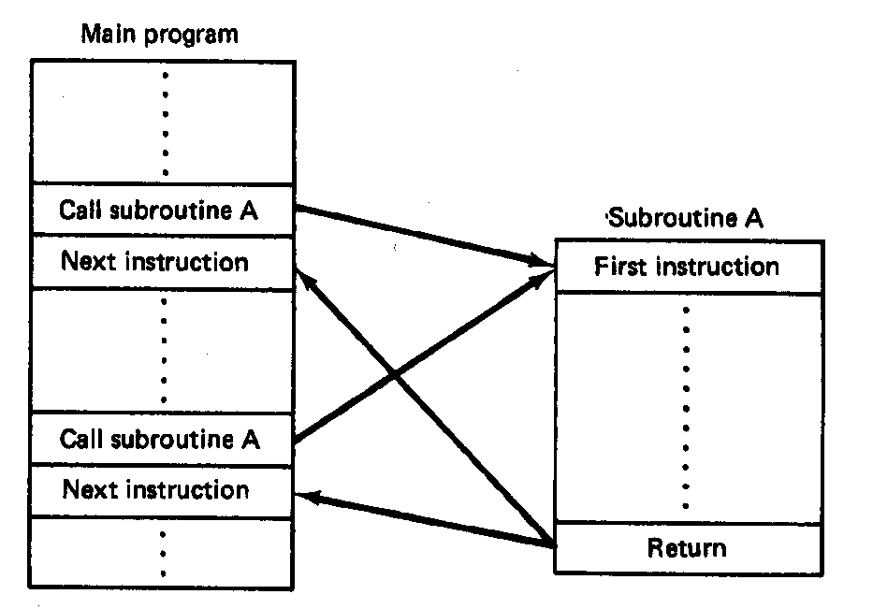
Subroutines
Subroutine: special program segment that can be “called” from any point in program
  Implements HLL functions/procedures
  Written to perform operation that must be repeated in program
  Actual subroutine code only written once
Microprocessors I: Lecture 6
Notes:
Chapter 6 part 2

Slide 7
Subroutine operation
When called, address of next instruction saved
  State may need to be saved before call
  Parameters can be passed
Control of program transferred to subroutine
After subroutine finished, return instruction goes back to saved address
Microprocessors I: Lecture 6
Notes:
Chapter 6 part 2

Slide 8
80386 subroutines
Specify starting point with pseudo-op
  <name> PROC NEAR → same segment
  <name> PROC FAR → different segment
May save state/allocate variables at start
  If so, will restore at end of subroutine
Last instruction returns to saved address
  Always RET
Pseudo-op after RET indicates routine end
  <name> ENDP
Microprocessors I: Lecture 6

Slide 9
Subroutine example
SQUARE PROC NEAR
PUSH AX ; Save AX to stack
MOV AL, BL ; Copy BL to AL
IMUL BL ; AL = BL * AL
; = original BL squared
MOV BX, AX ; Copy result to BX
POP AX ; Restore AX
RET
SQUARE ENDP
Microprocessors I: Lecture 6

Slide 10
Call/return
Calling subroutine: CALL <proc>
  Address of next instruction saved on stack
    Either IP (near) or CS, IP (far)
  <proc> can be 16- or 32-bit label/immediate, register, memory operand
    16-bit immediate added to IP
    16-bit register/memory replaces IP
    32-bit values replace CS/IP
Ending subroutine: RET
  Saved address restored to IP (& CS if needed)
Microprocessors I: Lecture 6

Slide 11
Example
Assuming AX = 2 and BX = 4, show the results of the following sequence (Ex. 6.11):
  Assume the addresses of the first three instructions are CS:0005, CS:0008, and CS:0009, respectively
    Typo in handout—segment register should be CS, not DS
  CALL SUM
  RET ; End main function
  SUM PROC NEAR
  MOV DX, AX
  ADD DX, BX
  RET
  SUM ENDP
Microprocessors I: Lecture 6

Slide 12
Saving state
May need to save state before routine starts
  Overwritten registers (that aren’t return values)
  Flags
Placing data on stack: PUSH
  Store data “above” current TOS; decrement SP
    Stack grows toward lower addresses
    New SP points to start of data just stored
  Basic PUSH stores word or double word
  Directly storing flags: PUSHF
  Storing all 16-/32-bit general purpose registers: PUSHA/PUSHAD
Microprocessors I: Lecture 6

Slide 13
Restoring state
Removing data from TOS: POP
  Data removed from TOS; SP incremented
  Basic POP removes word/double word
  Directly removing flags: POPF
  Removing all 16-/32-bit general purpose registers: POPA/POPAD
POP instructions generally executed in reverse order of corresponding PUSH instructions
Microprocessors I: Lecture 6

Slide 14
Revisiting subroutine example
SQUARE PROC NEAR
PUSH AX ; Save AX to stack
MOV AL, BL ; Copy BL to AL
IMUL BL ; AL = BL * AL
; = original BL squared
MOV BX, AX ; Copy result to BX
POP AX ; Restore AX
RET
SQUARE ENDP
Microprocessors I: Lecture 6

Slide 15
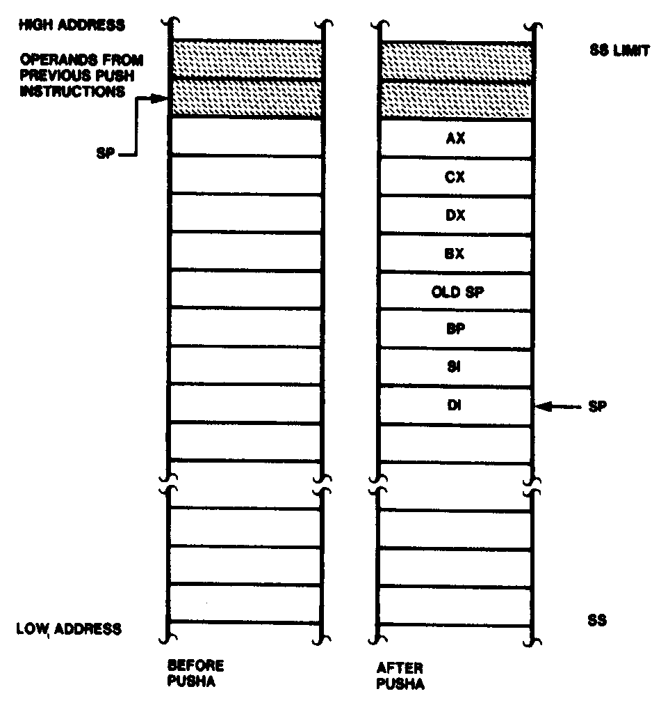
Push All and Pop All Operations
Microprocessors I: Lecture 6
Notes:
Chapter 6 part 2

Slide 16
Stack examples
Assume initial state shown in handout
What is the resulting stack state of each of the following sequences?
  PUSH BX
  PUSH AX
  PUSH EBX
  PUSH EAX
  PUSHA
Microprocessors I: Lecture 6

Slide 17
Protected mode
Common system features
  Multitasking
  Memory management
    Keep memory for different tasks separate
    Allow programs to “see” as much memory as needed
Usually managed/supported in operating system
80386DX: hardware support in protected mode
  Runs at higher privilege level
  Controlled by single bit in control register
  IP, flags extended to 32 bits (EIP, EFLAGS)
  Addresses extended to 32 bits
  Two general changes:
    Global vs local memory
    Variable segments
Microprocessors I: Lecture 6

Slide 18
Protected Mode Benefits
Memory management
  Larger memory space (up to 4GB physical memory)
  Flexible segment size in segmentation
  Can also be organized as 4KB “pages”
  Virtual memory (larger than physical memory size)
Multitasking
  Tasks sharing CPU, memory, I/O
Protection
  Safeguard against software bugs and integrity of OS
Virtual mode
  Allow execution of DOS applications
Microprocessors I: Lecture 6
Notes:
Chapter 8

Slide 19
Global vs. local memory
Multiple tasks → each task needs own state
  Copies of registers
  Range of memory to hold code and data
    Local memory: memory accessible for a single task
System level → store info about:
  Where each task’s register copies are saved
  Where each task’s local memory is actually stored
  Interrupts
  Global memory: memory accessible by any task (and, usually, system level program)
Microprocessors I: Lecture 6

Slide 20
Variable segments
Fixed size: need to specify starting address
  80386 real mode: segment registers hold starting address
Variable size: need to specify starting address and segment size
  Information stored in descriptor
  Descriptor holds 8 bytes:
    Segment base address (32 bits)
    Max segment offset (20 bits)
      Segment size = (max offset) + 1
      “Granularity bit”, if set, multiplies offset by 2¹² → allows 20 bit offset to specify segment size up to 4 GB
    Access information (12 bits)
  80386 protected mode: segment registers point to descriptor for given segment
Microprocessors I: Lecture 6

Slide 21
Memory accesses
Real mode
  Segment register indicates start of segment
  Physical addr. = (shifted segment register) + (effective address)
Protected mode
  Segment selector register points to descriptor table entry
  Descriptor indicates start (base) of segment
  “Linear addr.” = (segment base) + (effective address)
Microprocessors I: Lecture 6

Slide 22
Memory access questions
How do we know if an access is global or local?
How do we find the appropriate descriptor on a global memory access?
How do we find the appropriate descriptor on a local memory access?
Microprocessors I: Lecture 6

Slide 23
Selectors
Segment registers now hold selectors
  Index into table holding actual memory address
Selector format
  RPL: Requested privilege level
    4 levels → 0 highest, 3 lowest
    Used for checking access rights
  TI: Table indicator
    Global (TI == 0) or local (TI == 1) data/code
  Index: pointer into appropriate descriptor table
INDEX | TI | RPL
15 3 | 2 | 1 0
Microprocessors I: Lecture 6

Slide 24
Descriptor tables
Descriptors organized into “tables”
  Memory ranges holding all descriptors
Two memory types in protected mode
  Global memory: accessible to all tasks
    Descriptors in global descriptor table (GDT)
    Starting address of GDT = GDTR
  Local memory: memory accessible to only a single task
    Descriptors in local descriptor table (LDT)
    Each task has its own LDT
    Starting address of current LDT indicated by LDTR
Microprocessors I: Lecture 6

Slide 25
Global Descriptor Table Register (GDTR)
GDTR describes global descriptor table
  Lower 2 bytes define LIMIT (or size)
  Upper 4 bytes define base (starting address)
  Initialized before switching to protected mode
Example: GDTR = 001000000FFFH
  GDT base = 00100000H,
  GDT size = 0FFFH+1 = 1000H = 4096 bytes
  # of descriptors = 4096/8 = 512
  Highest address in GDT = 00100FFFH
Microprocessors I: Lecture 6
Notes:
Chapter 8

Slide 26
GDTR questions
What is the GDT base address and limit if
  GDTR = 1234000000FFH?
  GDTR = FEDC1AB20007H?
  GDTR = AABB11221F0FH?
What is the size of the GDT and number of descriptors it holds in each of the examples above?
What is the maximum GDT size and number of descriptors?
Microprocessors I: Lecture 6

Slide 27
Illustrating global memory access
MOV AX, [10H]
→ Logical addr = DS:10H
GDT | 00002000H
 | 000020FFH
DS = 0013H =
0000 0000 0001 0 | 0 | 11
RPL = 3
Index = 2
TI = 0 → global
Desc. 2
Base = 00000100H
Limit =
0FFFH
00002010H
GDTR =
00002000 | 00FF
Base Limit
Descriptor addr: (GDT base) + (selector index * 8)
00002000H
+ (0002H * 8)
00002010H
Actual mem addr: (seg base) + (effective address)
00000100H
+ 10H
00000110H
Microprocessors I: Lecture 6

Slide 28
Local Descriptor Table Register (LDTR)
Local descriptor table
  Defines local memory address space for the task
  Each task has its own LDT
  Contains local segment descriptors
LDTR: 16 bit selector pointing into GDT
  Each LDT is essentially a segment in global memory
  LDTR cache automatically loads when LDTR changed
LDTR cache: 48bit
  Lower 2 bytes define LDT LIMIT (or size)
  Upper 4 bytes define LDT base (physical address)
Microprocessors I: Lecture 6
Notes:
Chapter 8

Slide 29
Illustrating local memory access
MOV AX, [10H]
→ Logical addr = DS:10H
GDT | 00002000H
 | 000020FFH
DS = 0027H =
0000 0000 0010 0 | 1 | 11
RPL = 3
Index = 4
TI = 1 → local
Desc. 7
Base = 00002100H
Limit =
001FH
00002038H
LDTR = 003BH =
0000 0000 0011 1 | 0 | 11
GDTR =
00002000 | 00FF
Base Limit
Descriptor addr: (GDT base) + (selector index * 8)
00002000H
+ (0007H * 8)
00002038H
Microprocessors I: Lecture 6

Slide 30
Illustrating local memory access
MOV AX, [10H]
→ Logical addr = DS:10H
GDT | 00002000H
 | 000020FFH
LDT | 00002100H
 | 0000211FH
DS = 0027H =
0000 0000 0010 0 | 1 | 11
RPL = 3
Index = 4
TI = 1 → local
GDT descriptor 3 describes LDT for this task
→ LDTR cache =
00002100 | 001F
Desc. 4
Base = 00100000H
Limit =
001FH
00002120H
Base Limit
Descriptor addr: (LDT base) + (selector index * 8)
00002100H
+ (0004H * 8)
00002120H
Actual mem addr: (seg base) + (effective address)
00100000
+ 10H
00100010H
Microprocessors I: Lecture 6

Slide 31
Interrupt Descriptor Table Register (IDTR)
Interrupt descriptor table
  Up to 256 interrupt descriptors
    Describes segments holding interrupt service routines
  Described by IDTR
  Each entry (interrupt descriptor) takes 8 bytes
IDTR: 48-bit
  Lower 2 bytes define LIMIT (or size)
  Upper 4 bytes define the base (physical address)
  Initialized before switching to protected mode
Microprocessors I: Lecture 6
Notes:
Chapter 8

Slide 32
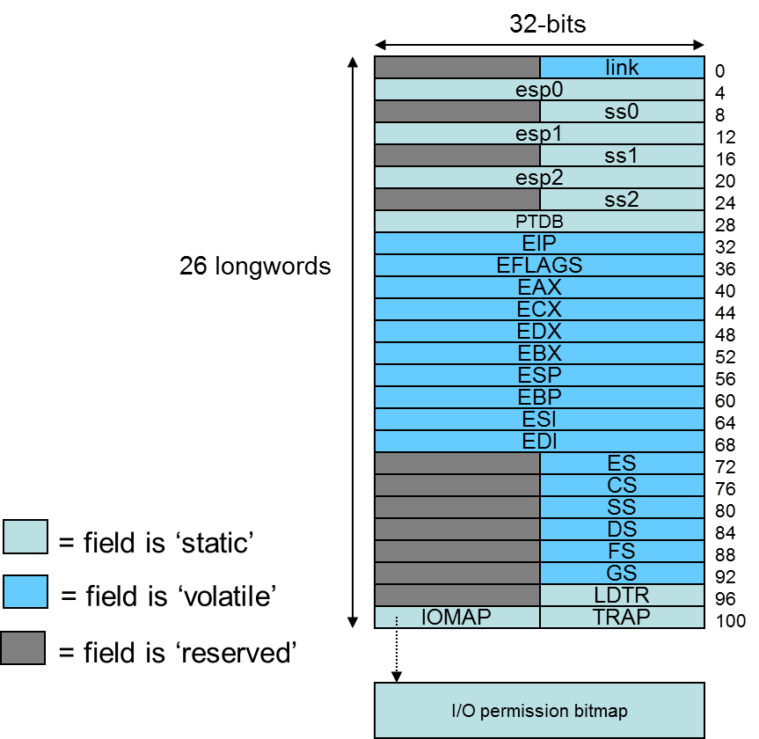
Multitasking
Most systems run multiple tasks
  Different programs
  Different threads in same program
Task switch: save state of current task; transfer control to new task
80386 specifics
  Task state segment (TSS): saved task state (picture at right)
    Every TSS resides in global memory
  Task register (TR): selector pointing to descriptor in GDT for current TSS
    Limit, base of current TSS cached
  Task switch = jump or call instruction that changes task
Figure from cs.usfca.edu/~cruse/cs630f06/lesson08.ppt
Microprocessors I: Lecture 6
Notes:
Chapter 8

Slide 33
Final notes
Next time: Finish 80386DX
  Virtual memory
  80386DX interfacing
Reminders
  HW 2, Lab 3 both due Monday, 7/30
  Exam 2 one week from Wednesday (8/2)
Microprocessors I: Lecture 6

