Slide 1
16.317
Microprocessor Systems Design I
Instructor: Dr. Michael Geiger
Summer 2013
Lecture 1:
Course overview
General microprocessor introduction
Data: types, storage, and addressing modes

Slide 2
Lecture outline
Course overview
  Instructor information
  Course materials
  Course policies
  Resources
  Tentative course outline
General microprocessor introduction
  History
  Role of the instruction set architecture
Data types
Data storage
Addressing modes
Microprocessors I: Lecture 1

Slide 3
Course staff & meeting times
Lectures:
  T/Th 10 AM-1 PM, Ball 326
  F (7/26 and 8/9) 10 AM-1PM, Ball 326
Labs:
  Open lab hours in Ball Hall 407
  Will get card access ASAP
Instructor: Dr. Michael Geiger
  E-mail: Michael_Geiger@uml.edu
  Phone: 978-934-3618 (x43618 on campus)
  Office: 118A Perry Hall
  Office hours: TBD (likely on campus TWTh; appointments recommended)
Microprocessors I: Lecture 1

Slide 4
Course materials
Textbook: Barry B. Brey, The Intel Microprocessors: Architecture Programming, and Interfacing, 2008, Prentice Hall.
  ISBN: 0135026458
Course website: http://mgeiger.eng.uml.edu/16317/sum13/index.htm
  Will contain lecture slides, handouts, assignments
Discussion group through piazza.com
  Allow common questions to be answered for everyone
  All course announcements will be posted here
  Will use as class mailing list—you must enroll by Thursday
Microprocessors I: Lecture 1

Slide 5
Course policies
Prerequisites: 16.265 (Logic Design), 16.365 (Electronics I)
Assignments
  Homework, labs, and some “hybrid” assignments (problems + programming exercise(s))
  Late assignments: 10% penalty per day
  All HW individual
  Labs
    Can work in groups of 1 or 2 students
    Each student must complete individual lab report
      Group members may share data generated in lab (screenshots, etc.) but must write own description
      Report format specified in separate document
Microprocessors I: Lecture 1

Slide 6
Course policies (cont.)
Academic honesty
  All assignments are to be done individually unless explicitly specified otherwise by the instructor
  Any copied solutions, whether from another student or an outside source, are subject to penalty
  You may discuss general topics or help one another with specific errors, but not share assignment solutions
    Must acknowledge assistance from classmate in submission
Microprocessors I: Lecture 1

Slide 7
Course policies (cont.)
Grading breakdown
  Assignments: 55%
  Exam 1: 15%
  Exam 2: 15%
  Final: 15%
Exam dates
  Exam 1: Tuesday, July 23 (~1 hour)
  Exam 2: Thursday, August 1 (~1 hour)
  Exam 3: Thursday, August 15 (full class period)
Microprocessors I: Lecture 1

Slide 8
What you should learn in this class
Basics of computers vs. microprocessors
Two major aspects:
  How to program
    Focus on assembly language
    Will look at HLL → assembly translation, integration
    Use of HLL with microcontrollers
  How a microprocessor works with other components
    Focus on interfacing circuits and control schemes
Will work with two processor families:
  Intel x86 architecture → assembly language simulation
  PIC microcontroller → actual microcontroller programming, interfacing
Microprocessors I: Lecture 1
· To understand the interconnection of the CPU, memory, and I/O

Slide 9
Tentative course outline
General microprocessor introduction
Assembly language programming
  Start with x86; PIC microcontroller at end
  Areas will include
    Addressing modes
    Instruction types
    Programming modes
    HLL and assembly—translation; combination
External interfacing
  Processor signals used in interfacing
  Interface circuitry
  External memory
Interrupts
Microcontroller-based systems
  Microcontrollers vs. microprocessors
  Design of microcontroller-based circuits
  High-level programming of microcontrollers
Microprocessors I: Lecture 1

Slide 10
What is a computer?
From The American Heritage Dictionary:
  “One who computes”
    We could argue that people are computers
  “A device that computes, especially a programmable electronic machine that performs high-speed mathematical or logical operations or that assembles, stores, correlates, or otherwise processes information.”
    Anything from a simple abacus to the microprocessor-based computers of today
Microprocessors I: Lecture 1

Slide 11
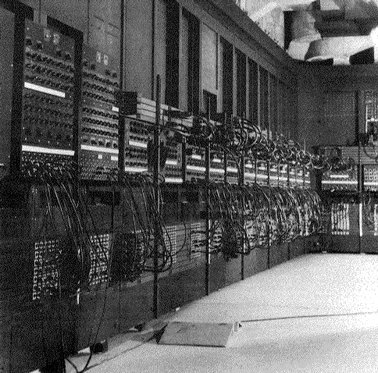
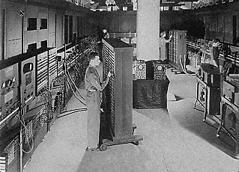
Computing history
Thirty tons
Forced air cooling
200KW
19,000 vacuum tubes
Punch card
Manual wiring
Numerical computation
The first electronic digital computer – ENIAC, built in UPenn in 1946
Source: http://ei.cs.vt.edu/~history/ENIAC.Richey.HTML
Microprocessors I: Lecture 1
Notes:
Chapter 1

Slide 12
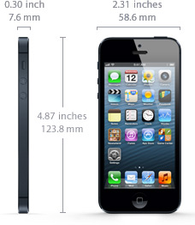
Today’s computer: one example
iPhone 5 Technical Specifications
Screen size 4 inches
Screen resolution 1136 by 640 at 326 ppi
Input method Multi-touch
Operating system iOS 6.1.4
Storage 16 / 32 / 64 GB
Cellular network UMTS/GSM/CDMA
Wireless data Wi-Fi (802.11a/b/g/n) + LTE + Bluetooth 4.0
Camera 8.0 megapixels
Battery Up to 8 hrs Internet, 8 hrs talk,
10 hrs video, 40 hrs audio,
225 hrs standby
Dimensions 4.87 x 2.3 x 0.3 inches
Weight 3.95 ounces
Source: http://www.apple.com/iphone/specs.html
Microprocessors I: Lecture 1
Notes:
Chapter 1

Slide 13
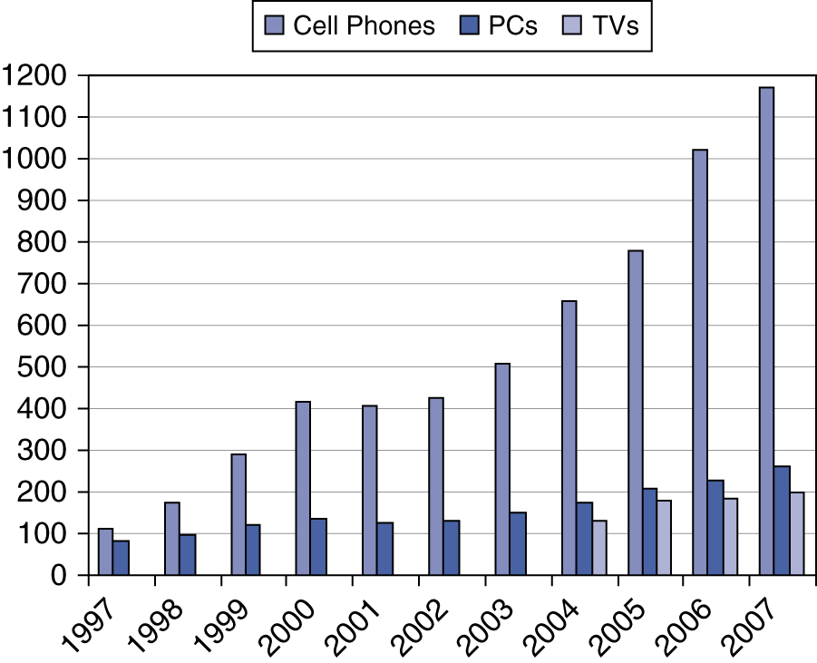
Processor market (as of 2007)
“Computer” used to just refer to PCs
Processors—and, therefore, computers—are now everywhere
Microprocessors I: Lecture 1

Slide 14
Computer components
What are the key components of a computer?
  Microprocessor (MPU/CPU) performs computation
  Input to read data from external devices
    Examples: Keyboard, mouse, ports (Ethernet, USB, etc.)
  Output to transmit data to external devices
    Examples: screen, speaker, VGA interface, ports (Ethernet, USB, etc.)
  Storage to hold program code and data
    RAM, hard disk, possibly other media (CD/DVD, external drive)
Will see that microprocessor contains smaller-scale versions of these components
  Computation engine
  I/O interface
  Internal storage
Microprocessors I: Lecture 1
Notes:
Chapter 1

Slide 15
Processor architecture
“Architecture” can refer to
  High-level description of hardware; could be
    Overall system
    Microprocessor
    Subsystem within processor
  Operations available to programmer
    Instruction set architecture
  Other applications to computing (e.g., “software architecture”) we won’t discuss
Commonly used to discuss functional units and how they work together
Microprocessors I: Lecture 1

Slide 16

Role of the ISA
User writes high-level language (HLL) program
Compiler converts HLL program into assembly for the particular instruction set architecture (ISA)
Assembler converts assembly into machine language (bits) for that ISA
Resulting machine language program is loaded into memory and run
Microprocessors I: Lecture 1

Slide 17
Abstraction of program control
Easiest for humans to understand high-level languages
Processor interprets machine language
Assembly language: abstraction with intermediate level of detail
  Breaks machine code into instructions
  Gives some insight into how each instruction behaves
  More readable than bit patterns!
Microprocessors I: Lecture 1

Slide 18
ISA design
Think about a HLL statement like
X[i] = i * 2;
ISA defines how such statements are translated to machine code
  What information is needed?
Microprocessors I: Lecture 1

Slide 19
ISA design (cont.)
Think about a HLL statement like
X[i] = i * 2;
Questions answered in every ISA (or “software model”)
  How will the processor implement this statement?
    What operations are available?
    How many operands does each instruction use?
  Where are X[i] and i?
    How do we reference the operands?
  What type(s) of data are X[i] and i?
    What types of operands are supported?
    How big are those operands?
  Instruction format issues
    How many bits per instruction?
    What does each bit or set of bits represent?
    Are all instructions the same length?
Microprocessors I: Lecture 1

Slide 20
Operation types
Operations: what should processor be able to do?
  Data transfer
    Move data between storage locations
  Arithmetic operations
    Typical: add, subtract, maybe multiply/divide, negation
  Logical operations
    Typical: AND, OR, NOT, XOR
    Often includes bit manipulation: shifts, rotates, test/set/clear single bit
  Program control
    “Jump” to another part of program
    May be based on condition
    Used to implement loops, conditionals, function call/return
  Typically some processor-specific special purpose ops
Microprocessors I: Lecture 1

Slide 21
Operands
Two major questions when dealing with data
  “How” do we store them? → what do the bits represent?
  Where do we store them?
    … and how do we access those locations)?
First question deals with data types
Second question deals with data storage and addressing
Microprocessors I: Lecture 1

Slide 22
Data types
Also seen in high-level languages
  Think about C types: int, double, char, etc.
  What does a data type specify?
    How big is each piece of data?
    How do we interpret the bits representing those data?
Data sizes
  Smallest addressable unit: byte (8 bits)
  Can also deal with multi-byte data: 16, 32, 64 bits
  Often deal with words of data
    Word size processor-dependent (16 bits on x86, 32 bits on MIPS)
    Can have double words, quad words, half words …
Interpreting bits
  Numbers: Integers, floating-point; signed vs. unsigned
  May treat as characters, other special formats
Microprocessors I: Lecture 1

Slide 23
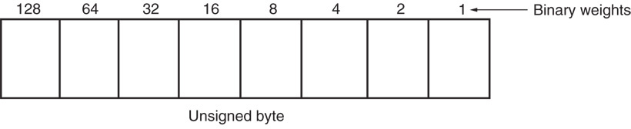
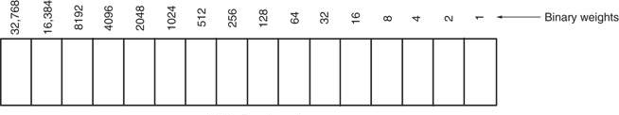
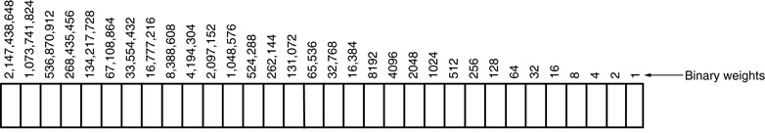
Unsigned Integers
Types:
Sizes Range
8-bit 0H → 255₁₀
16-bit 0H → 65,535₁₀
32-bit 0H → 4,294,967,295₁₀
Microprocessors I: Lecture 1
Notes:
Chapter 2

Slide 24
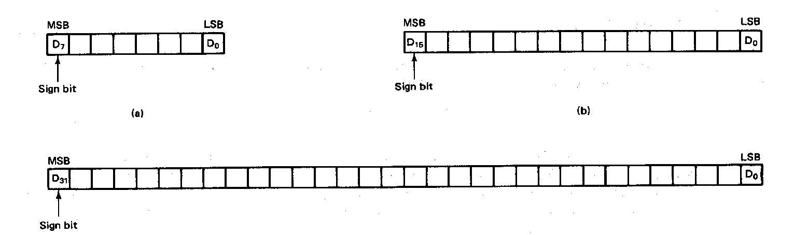
Signed Integers
MSB is sign bit ( 0/1 -> +/-)
Remaining bits represent value
Negative numbers expressed in 2’s complement notation
Types:
Sizes Range
8-bit -128 → +127
16-bit -32,768 → +32,767
32-bit -2,147,483,648 → +2,147,483,647
Microprocessors I: Lecture 1
Notes:
Chapter 2

Slide 25
Integer Examples
Given the 8-bit value: 1001 1111₂
Calculate the decimal value of this integer as
  An unsigned integer
  A signed integer
Microprocessors I: Lecture 1
Notes:
Chapter 2

Slide 26
Integer example solution
Given the 8-bit value: 1001 1111₂
Calculate the decimal value of this integer as
  An unsigned integer
  Solution:
    (1 x 2⁷) + (1 x 2⁴) + (1 x 2³) + (1 x 2²) + (1 x 2¹) + (1 x 2⁰)
    = 128 + 16 + 8 + 4 + 2 + 1 = 159
  A signed integer
  Solution:
    MSB = 1 → negative value
    To get magnitude, take 2’s complement:
    0110 0001₂ = (1 x 2⁶) + (1 x 2⁵) + (1 x 2⁰)
    = 64 + 32 + 1 = 97
    → Result = -97
Microprocessors I: Lecture 1

Slide 27
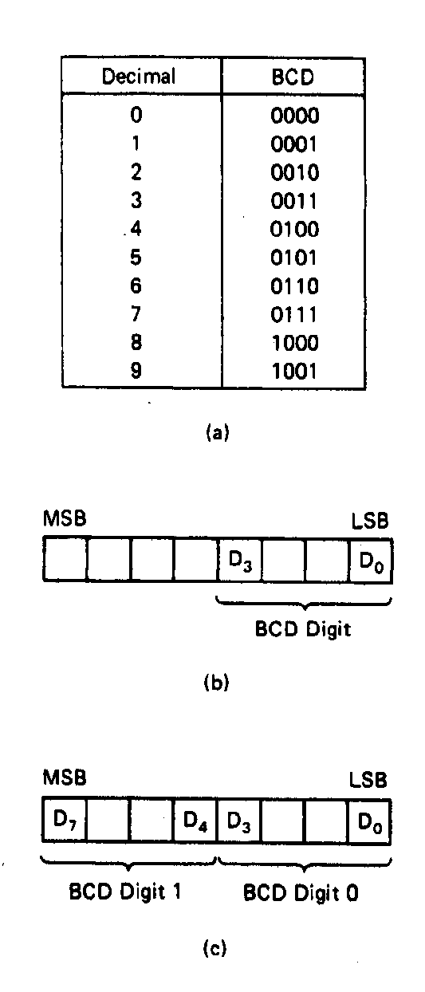
BCD Numbers
Direct coding of numbers as binary coded decimal (BCD) numbers supported
Unpacked BCD [Fig.2.10(b)]
  Lower four bits contain a digit of a BCD number
  Upper four bits filled with zeros (zero filled)
Packed BCD [Fig. 2.10(c)]
  Lower significant BCD digit held in lower 4 bits of byte
  More significant BCD digit held in upper 4 bits of byte
Example: Packed BCD byte at address 01000H is 10010001₂, what is the decimal number?
Organizing as BCD digits gives,
1001_{BCD} 0001_{BCD} = 91₁₀
Microprocessors I: Lecture 1
Notes:
Chapter 2

Slide 28
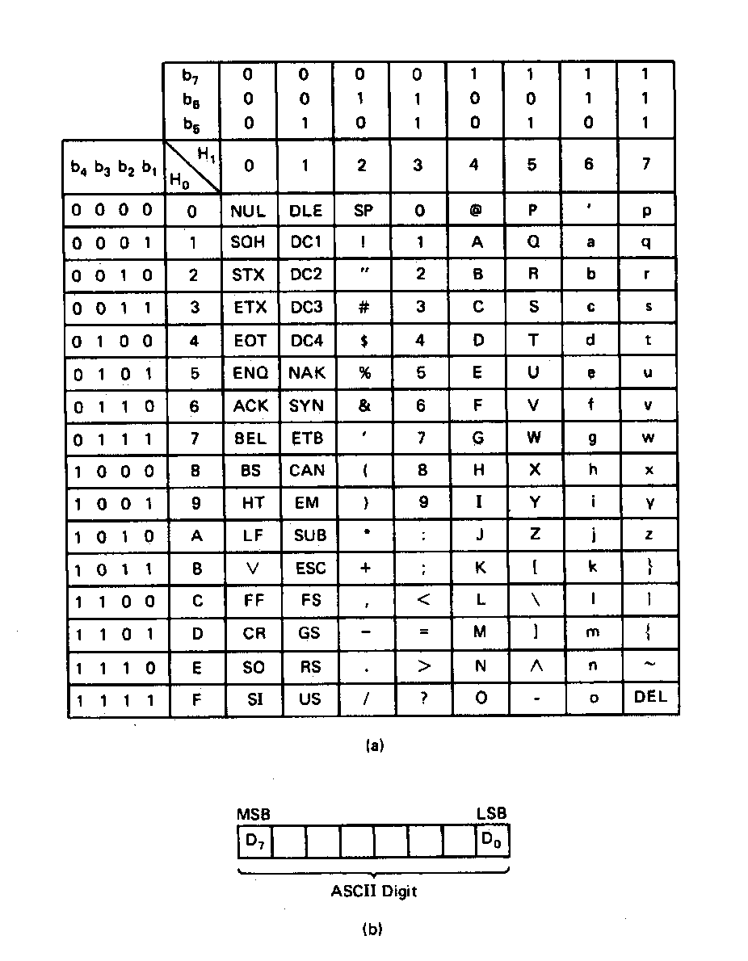
ASCII Data
American Code for Information Interchange (ASCII) code
ASCII information storage in memory
  Coded one character per byte
  7 LS-bits = b₇b₆b₅b₄b₃b₂b₁
  MS-bit filled with 0
Example: Addresses 01100H-01104H contain ASCII coded data 01000001, 01010011, 01000011, 01001001, and 01001001, respectively. What does the data stand for?
0 100 0001_{ASCII} = A
0 101 0011_{ASCI} = S
0 100 0011_{ASCII} = C
0 100 1001_{ASCII} = I
0 100 1001_{ASCII} = I
Microprocessors I: Lecture 1
Notes:
Chapter 2

Slide 29
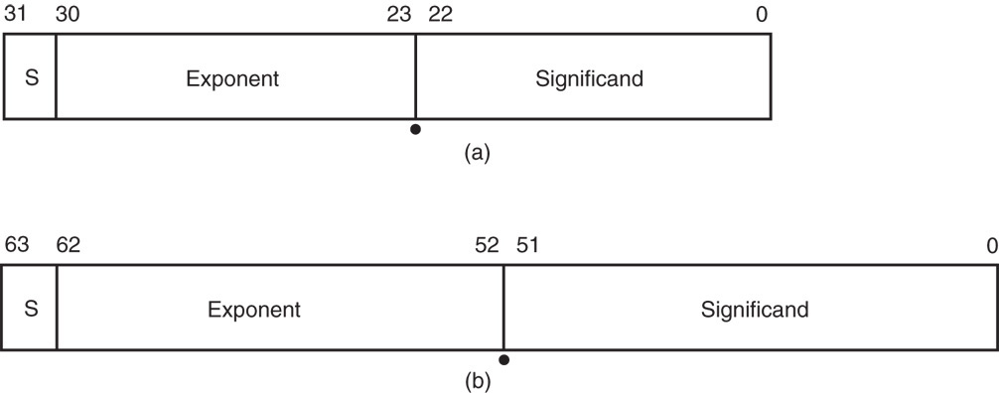
Real Numbers
Floating-point data stored in two parts
  Significand (fraction)
  Exponent
Single-precision (32 bits) or double-precision (64 bits)
Microprocessors I: Lecture 1

Slide 30
Data storage
What characteristics do we want storage media to have?
Two primary answers
  Speed
  Capacity
  Very difficult to get both in single storage unit
Processors use two different types of storage
  Registers
  Memory
Microprocessors I: Lecture 1

Slide 31
Registers
Small, fast set of storage locations close to processor
Primarily used for computation, short-term storage
  Speed → ideal for individual operations
  Lack of capacity → will frequently overwrite
Reference registers by name
  Example: ADD EAX, EBX → EAX = EAX + EBX
  EAX, EBX are registers in x86 architecture
Microprocessors I: Lecture 1

Slide 32
Memory
Provides enough capacity for all code, data (possibly I/O as well)
Typically organized as hierarchy
Used primarily for long-term storage
  Lacks speed of registers
  Provides capacity to ensure data not overwritten
Reference memory by address
  Example: MOV EAX, DS:[100H]
  → EAX = memory at address DS:[100H]
Microprocessors I: Lecture 1

Slide 33
Memory (cont.)
Accessing single byte is easy
Considerations with multi-byte data
  Are the data aligned?
    Easier/faster to access aligned data
  How are the data organized in memory (“endianness”)?
    Given 32-bit number: DEADBEEFH or 0xDEADBEEF
    Which byte—MSB (0xDE) or LSB (0xEF) gets stored in memory first?
Microprocessors I: Lecture 1

Slide 34
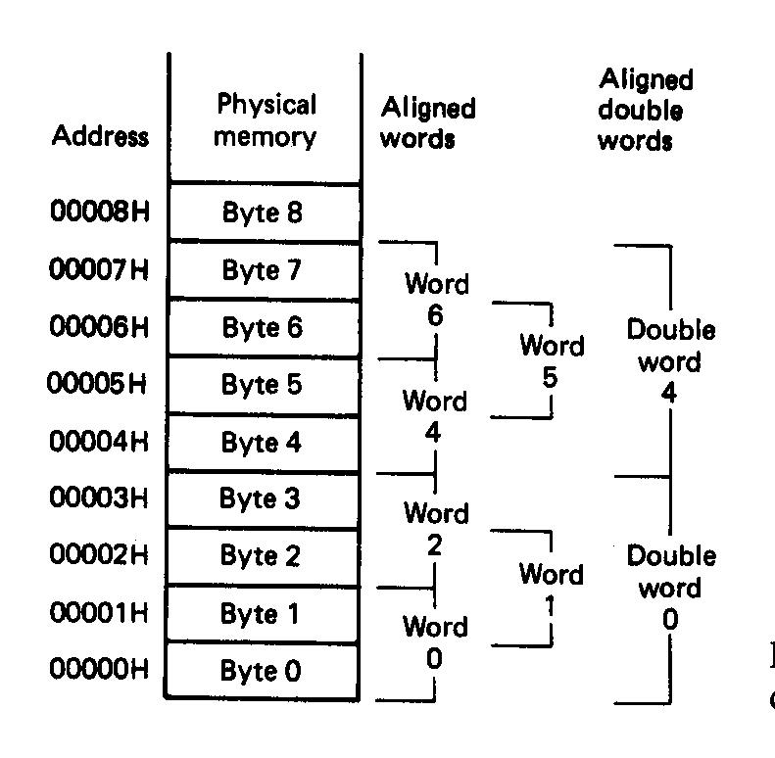
Aligned Words, Double words
Aligned data: address is divisible by number of bytes
  2 bytes → address must be even
  4 bytes → address must be multiple of 4
In figure at left
  Words 0, 2, 4, 6 aligned
  Double words 0, 4 aligned
  “Word X” = word with starting address X
Microprocessors I: Lecture 1
Notes:
Chapter 2

Slide 35
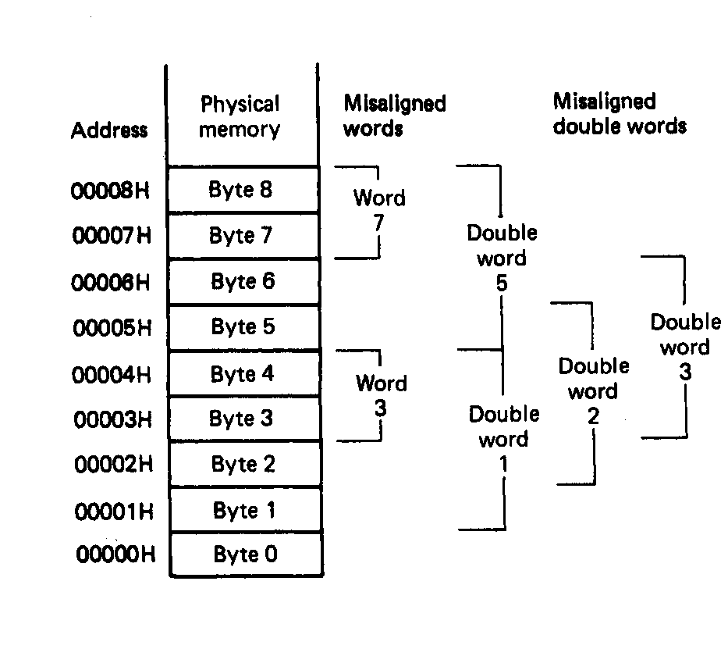
Misaligned Words
x86 architecture doesn’t require aligned data access
In figure, misaligned data:
  Words 3, 7
  Double words 1, 2, 3, 5
Performance impact for accessing unaligned data in memory (32-bit data bus)
Microprocessors I: Lecture 1
Notes:
Chapter 2

Slide 36
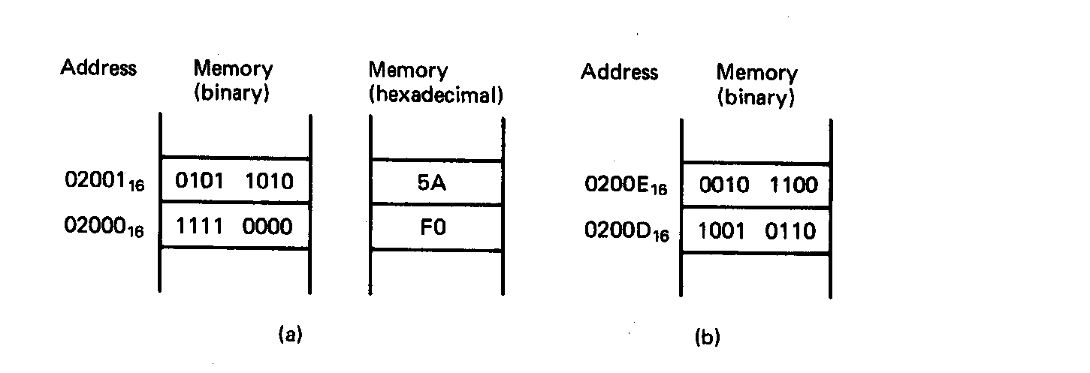
Examples of Words of Data
“Little endian” organization
Most significant byte at high address
Least significant byte at low address
Example [Fig. 2.5 (a)]
(02001₁₆) = 0101 1010₂=5AH= MS-byte
(02000₁₆) = 1111 0000₂=F0H= LS-byte
as a word they give
01011010 11110000₂=5AF0H
Microprocessors I: Lecture 1
Notes:
Chapter 2

Slide 37
Examples of Words of Data
What is the data word shown in this figure?
  Express your result in hexadecimal
Is the word aligned?
Answer:
  MSB = 00101100₂ = 2C₁₆
  LSB = 10010110₂ = 96₁₆
  → Full word = 2C96₁₆
  Starting address = 0200D₁₆
  → Address not divisible by 2
  → Word is not aligned
Microprocessors I: Lecture 1
Notes:
Chapter 2

Slide 38
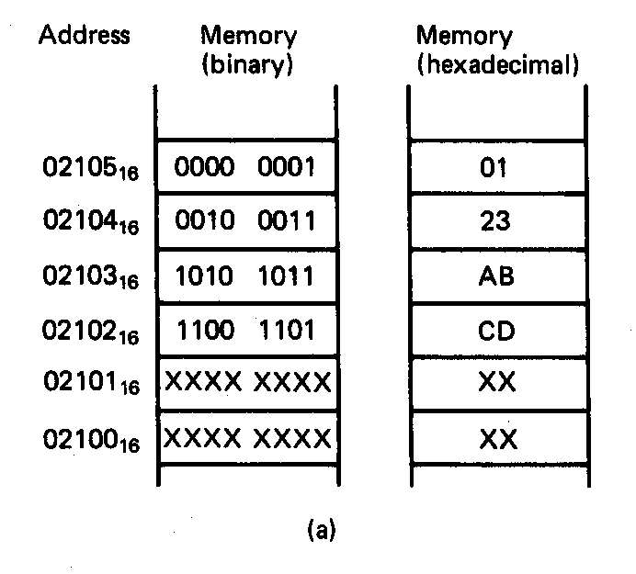
Example of Double Word
What is the double word shown in this figure?
Is it aligned?
Answer:
  LSB = CD₁₆
  MSB = 01₁₆
  → Arranging as 32-bit data:
  0123ABCD₁₆
  Starting address = 02102₁₆
  → Not divisible by 4
  → Double word is unaligned
Microprocessors I: Lecture 1
Notes:
Chapter 2

Slide 39
Addressing modes
Addressing modes: ways of specifying operand location
Where are operands stored? (3 location types)
  Registers → register addressing
    Provide name of register; value read from register
  Memory
    Provide address in memory; value read from that location
    Several modes for specifying memory address
  In the instruction → immediate addressing
Microprocessors I: Lecture 1

Slide 40
Memory addressing
Instructions accessing memory generate effective address (EA)
  Address calculated as part of instruction
  EA can be used as
    Actual memory address in a simple memory system
    Address within a particular segment in a segmented memory architecture
Effective address calculations can involve
  A constant value
  One or more values stored in registers
  Some combination of register and constant
Microprocessors I: Lecture 1

Slide 41
General memory addressing modes
Memory direct addressing
  EA = constant value encoded in instruction
Register indirect addressing
  EA = value stored in register
Base + displacement addressing
  EA = constant displacement + base register(s)
  Can have variations of this mode based on number and type of registers
Less commonly used modes on some MPUs
  Memory indirect addressing
  Scaled addressing
Microprocessors I: Lecture 1

Slide 42
Visual Studio intro
Will use Microsoft Visual Studio for assembly programming
  Requires Windows machine
  Hope to install it in Ball 407
  Lab in Southwick has older version (VS 2008) that should be sufficient for at least first assignment
Express version available from Microsoft website (see link on main web page)
Can get full version through Dreamspark
Brief demo showing
  Starting new project
  Creating appropriate file and adding it to project
Microprocessors I: Lecture 1

Slide 43
Final notes
Next time: x86 intro
Reminders:
  Sign up for the discussion group on Piazza
  HW 1 (due Friday, 7/12) to be posted; relatively brief assignment that tests
    Number conversion (working with binary/hex)
    Basic use of Visual Studio
      I’ll provide code
      You’ll have to create a new project, run the code, and answer some questions about the program simply to verify that you can
Microprocessors I: Lecture 1

