Slide 1
EECE.3220 Data Structures
Instructor:
Dr. Michael Geiger
Spring 2017
Lecture 1:
Course overview
Going from C to C++

Slide 2
Lecture outline
Course overview
Instructor information
Course materials
Course policies
Resources
Course outline
Going from C to C++
Introductory look at basic differences

Slide 3
Course meeting time, instructor info
Lectures: MWF 3-3:50, Ball 208
Instructor: Dr. Michael Geiger
E-mail: Michael_Geiger@uml.edu
Phone: 978-934-3618 (x43618 on campus)
Office: 301A Ball Hall
Office hours: MWF 1-1:50 PM; TTh by appointment

Slide 4
Course materials
Textbook: Larry Nyhoff, ADTs, Data Structures, and Problem Solving with C++, 2nd edition, 2005, Pearson/Prentice Hall.
ISBN: 0-13-140909-3
Course tools: Need IDE that compiles/runs C++ code
Recommended IDEs (all free; links on web)
Windows: Visual Studio Community (MS website)
Mac: Xcode (Mac App Store)
Linux: g++/gdb (text-based; can run through terminal on Mac as well)

Slide 5
Additional course materials
Course websites:
http://mjgeiger.github.io/eece3220/sp19/index.htm
http://mjgeiger.github.io/eece3220/sp19/schedule.htm
Will contain lecture slides, handouts, assignments
Course Blackboard site
Will post announcements/email class
Assignments to be submitted here
May use discussion board feature
Login via https://lowell.umassonline.net/

Slide 6
Grading and exam dates
Grading breakdown
Programming assignments/homework: 55%
Exam 1: 15%
Exam 2: 15%
Exam 3: 15%
Exam dates tentative
Would like to share 2 hour block with OS
Conflicts from 2-3 PM M, W, or F?
Exam 1: Week 5 (W 2/20 or F 2/22)
Exam 2: Week 10 (M 3/25 or W 3/27)
Exam 3: TBD (during finals)

Slide 7
Programming assignments
Will submit all code via Blackboard
Penalty after due date: -(2^{n-1}) points per day
i.e., -1 after 1 day, -2 after 2 days, -4 after 3 days …
Assignments that are 8+ days late receive 0
Will be allowed one penalty-free resubmission per assignment

Slide 8
Academic honesty
All assignments are to be done individually
Don’t share code
Don’t write programs together
Any copied solutions, whether from another student or an outside source, are subject to penalty

Slide 9
Course “rules”
A couple of unofficial rules:
Please call me “Dr. Geiger” or “Prof. Geiger”
Not “Michael,” “Mike,” or “Geiger”
Please don’t talk when I’m talking
Doing so distracts your classmates and me
If you have a question, please raise your hand and ask—I want questions during lecture!

Slide 10
Tentative outline: what you should learn
Fundamentals of C++ programming
Differences between C and C++ (I/O, structs, argument passing)
Object-oriented programming: classes, composition, inheritance
Analyzing algorithmic complexity
How fast is a particular algorithm/data structure, both on average and in the worst case?
Specific types of algorithms: sorting, recursive structure traversal
How to design and use various data structures
Linked lists
Stacks
Queues
Binary trees
Heaps
Priority queues
Hash tables

Slide 11
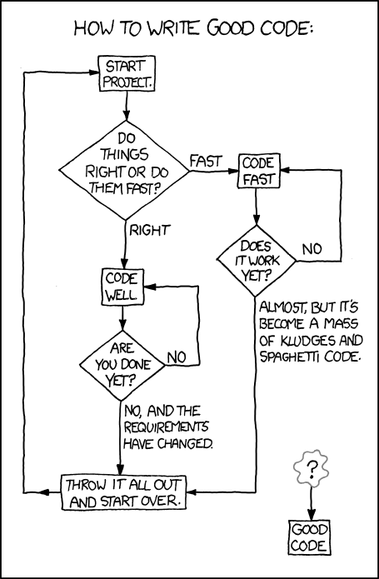
What you’ll really learn … ?
http://xkcd.com/844

Slide 12
C vs. C++: the basics
C is a procedural language
Based around functions (or procedures)—a series of steps to be carried out when called
For a function to operate on data, data must be passed as arguments
C++ is an object-oriented language
Objects contain attributes (data members) and behaviors (member functions)
Function calls (most of them) associated with specific object → no need to pass object to function

Slide 13
Why object-oriented programming?
Object orientation
Natural way of thinking about world (& computer programs)
Object-oriented design (OOD)
Models real-world objects in software
Models communication among objects
Encapsulates attributes and operations (behaviors)
Information hiding
Communication through well-defined interfaces
Object-oriented programming (OOP)
Programmers create user-defined types called classes
Contain data members (attributes) and member functions (behaviors)
Object: specific instance of a given class

Slide 14
Why procedural programming?
If C++ is so great, why learn C in the first place?
C best suited for system-level programming
C language easiest HLL for accessing hardware
Hardware support for procedural programming
Call/return instructions
System stack (or other argument-passing methods)

Slide 15
C vs. C++: simple data types
Most simple data types are the same
From EECE.2160: int, double, float, char
Other matching types (rarely used in EECE.2160)
unsigned: Non-negative whole numbers
Basic int is signed—can be + or –
unsigned is short for “unsigned int”
short: 16-bit integer
Saves space vs. int; has smaller range of values
One additional simple type in C++: bool
Models boolean (true/false) data
Can set variables of type bool equal to true or false
Recall that non-boolean data true if nonzero

Slide 16
C vs. C++: similarities
Most programming constructs are the same
Variable declarations
Arithmetic operators (+, -, *, /, %)
Boolean operators (&&, ||, !)
Relational operators (<, >, <=, >=, ==, !=)
Bitwise operators (&, |, ^, >>, <<)
Control structures (if/else, switch)
Loops (while, do-while, for)
Non-member functions
Arrays and pointers
Structures

Slide 17
C vs. C++: major differences
Input/output
Use redirection operators, not functions
Formatting done through use of manipulators
Object-oriented programming
Use of objects means different ways of organizing and interacting with data
Most function calls operate on single object that isn’t passed to function

Slide 18
Final notes
Next time: more on going from C to C++
Input and output in C++
Structures in C++

