Slide 1
EECE.2160 ECE Application Programming
Instructor:
Dr. Michael Geiger
Fall 2018
Lecture 11:
PE1: Loops and conditionals

Slide 2
Lecture outline
Announcements/reminders
Program 2 regrade requests due 10/3
Program 3 due Monday, 10/1
Exam 1: Friday, 10/5
Allowed one double-sided 8.5” x 11” note sheet
No calculators or other electronic devices allowed
Today’s lecture
Review: loops
PE2: Conditionals and while loops

Slide 3
Review: while/do-while loops
Used for repetition of code
while (<expression>)
<statements> ← loop body
do { <statements> } while ( <expression> );

Slide 4
Today’s program should:
Prompt user to enter an input character and an integer, n.
If not correctly formatted, print error, clear line, and repeat
Depending on the character entered, do the following:
‘F’ or ‘f’: Compute and print the factorial of n, n!
For example, if the user enters F 5, print 5! = 120
‘P’ or ‘p’: Compute 2^{n}, but only if n >= 0.
For example, if the user enters p 2, print 2^2 = 4
Print an error if n < 0.
‘X’ or ‘x’: Exit the program
In all other cases, print an error:
For example: Invalid command Z entered
If the user enters any command other than ‘X’ or ‘x’, return to the initial prompt and repeat the program.
Will cover parts in red in another lecture

Slide 5
Flowcharts
Graphical representation of process
Shows all steps and their order
In programming, use to organize program before writing code
Basic elements
Process
Terminator (start/end)
Input/Output
Connector
Decision
Connector (off page)

Slide 6
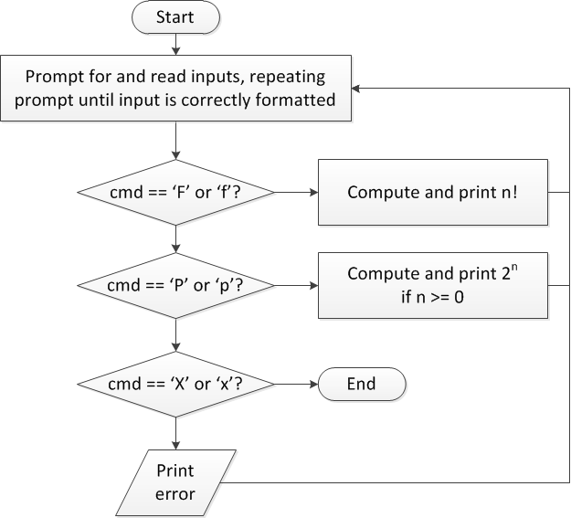
Flow charts: overall flow

Slide 7
Discussion: Overall flow
Whole program contains loop
Repeats process until user enters ‘X’ or ‘x’
Use while or do-while—unknown # of iterations
Since exit condition ends program, “infinite” loop
Testing cmd: switch statement
Checking equality of cmd to constant values
Exiting program: return statement
Use return at any point to end current function (including main)

Slide 8
Code: overall flow (skeleton code)
while (1) { // Loop repeats until user enters 'X' or 'x'
/* Code to read cmd, n */
/* Evaluate cmd and perform appropriate operation */
switch (cmd) {
case 'F':
case 'f':
/* Calculate n! */
break;
case 'P':
case 'p':
/* Calculate 2^n, if n >= 0; print error otherwise */
break;
case 'X':
case 'x':
return; // Exit program
default:
printf("Invalid command %c entered\n", cmd);
}
}

Slide 9
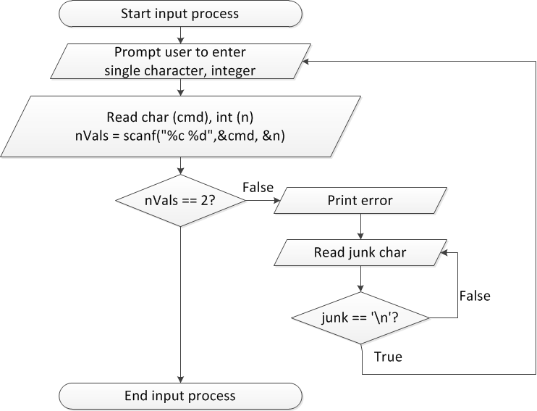
Flow charts: reading input

Slide 10
Discussion: Reading input
Loop that repeats as long as input incorrect
Loop inside that one to handle reading of remainder of line
Read character until you reach end of line
Both while/do-while loops

Slide 11
Code: Reading input
do {
printf("Enter command and integer: ");
nVals = scanf("%c %d", &cmd, &n);
// Otherwise, print error & clear line
if (nVals != 2) {
printf("Incorrectly formatted input\n“);
do {
scanf("%c", &junk);
} while (junk != '\n');
}
} while (nVals != 2);

Slide 12
Input errors
In general, may want to repeat prompt if any error occurs
Logical OR of all error conditions to continue loop
Prioritize error testing—format errors usually first
Why test inputs if they weren’t read correctly?
Example: also test for n < 0 as an error
do {
printf("Enter command and integer: ");
nVals = scanf("%c %d", &cmd, &n);
if (nVals != 2) {
// Handle error
}
else if (n < 0) { ← Test after we know no
// Handle error formatting error
}
} while ((nVals != 2) || (n < 0));

Slide 13
Error flags
Flag: variable that indicates a particular condition occurred
Allows you to simplify conditional tests later in program
Possible uses
Waiting for some condition—set flag when condition occurs
Testing multiple errors—set/increment flag any time there’s an error
int flag;
do {
flag = 0;
printf("Enter command and integer: ");
nVals = scanf("%c %d", &cmd, &n);
if (nVals != 2) {
// Handle error
flag = 1;
}
else if (n < 0) {
// Handle error
flag = 1;
}
} while (flag == 1);

Slide 14
Final notes
Next time
For loops
Reminders:
Program 2 regrade requests due 10/3
Program 3 due Monday, 10/1
Exam 1: Friday, 10/5
Allowed one double-sided 8.5” x 11” note sheet
No calculators or other electronic devices allowed

