Slide 1
EECE.2160 ECE Application Programming
Instructors:
Dr. Michael Geiger
Fall 2018
Lecture 12:
For loops

Slide 2
Announcements/reminders
Program 2 regrade requests due 10/3
CHANGE IN HANDLING REGRADE REQUESTS—PLEASE RESUBMIT BLACKBOARD “ASSIGNMENT” AND DO NOT SEND E-MAIL
Program 3 due Monday, 10/1
Program 4 to be posted; due date TBD
Exam 1: Friday, 10/5
Allowed one double-sided 8.5” x 11” note sheet
No calculators or other electronic devices allowed
You must attend the section for which you are registered
Next week: lecture Thursday, not Monday

Slide 3
Lecture outline
Current programming issues
Style issues
Using test cases
Error checking with formatting errors
Input validation (PE1)

Slide 4
Style issues: Variables
Declarations
Declare related variables together—don’t just group by data type
Don’t need to declare just one per line
Comment each declaration
Example (Program 2)
double Vs; // Voltage source
double R1, R2, R3; // Resistors
double iSeries; // Current in series ckt

Slide 5
Style issues: printf() / scanf()
Call printf() before scanf()
Tell user what to enter, then read what they enter
Exception: using scanf() to clear extra chars
Example: “junk” loop from PE1
Passing test cases doesn’t necessarily mean program works right
Easier to see in interactive IDE
Wrong:
scanf("%d %d", &x, &y);
printf("Enter x and y: ");
Right:
printf("Enter x and y: ");
scanf("%d %d", &x, &y);

Slide 6
Using test cases
Program needs to follow full specification
Test cases = specific examples to show how program behaves in some cases
Your solution must work in all cases
Do not program only with specific cases in mind
Example: challenge 4.4.1
If asked, I gave specific examples
i.e. If countLimit = 5, program prints 0 1 2 3 4 5
Correct loop condition: (printVal <= countLimit)
Incorrect condition: (printVal <= 5)

Slide 7
Error checking with formatting errors
Formatting error = scanf() can’t read input(s)
Test using scanf() return value
Given: nVals = scanf("%d %d", &x, &y);
Error test: if (nVals < 2)
If formatting error occurs, can’t trust inputs
Don’t even test for other errors!
Code org. depends on simultaneous errors
At most 1 error message: if/else if error tests
Possibly 1+ error: independent if statements
Formatting error test must be first
Other tests inside else block

Slide 8
Example: at most 1 error
int x, y; // Input values
int nVals; // # values read
printf("Enter x, y: ");
nVals = scanf("%d %d", &x, &y);
// Formatting error
if (nVals < 2) { … }
// x should be <= y
else if (x > y) { … }

Slide 9
Example: 1+ error(s)
int x, y; // Input values
int nVals; // # values read
printf("Enter x, y: ");
nVals = scanf("%d %d", &x, &y);
// Formatting error
if (nVals < 2) { … }
// Other errors: x > y, x < 0, y < 0
else {
if (x > y) { … }
if (x < 0) { … }
if (y < 0) { … }
}

Slide 10
Input errors with loops
In general, may want to repeat prompt if any error occurs
Logical OR of all error conditions to continue loop
Prioritize error testing—format errors usually first
Why test inputs if they weren’t read correctly?
Example: also test for n < 0 as an error
do {
printf("Enter command and integer: ");
nVals = scanf("%c %d", &cmd, &n);
if (nVals != 2) {
// Handle error
}
else if (n < 0) { ← Test after we know no
// Handle error formatting error
}
} while ((nVals != 2) || (n < 0));

Slide 11
Error flags
Flag: variable that indicates a particular condition occurred
Allows you to simplify conditional tests later in program
Possible uses
Waiting for some condition—set flag when condition occurs
Testing multiple errors—set/increment flag any time there’s an error
int flag;
do {
flag = 0;
printf("Enter command and integer: ");
nVals = scanf("%c %d", &cmd, &n);
if (nVals != 2) {
// Handle error
flag = 1;
}
else if (n < 0) {
// Handle error
flag = 1;
}
} while (flag == 1);

Slide 12
Justifying for loops
Common loop structure
Initialize variable
Loop until that variable reaches certain limit
At end of each iteration, change variable by fixed amount
Example: squares program
i = 0;
while (i <= 10) {
iSquared = i * i;
printf("%2d%10d\n", i, iSquared);
i = i + 1;
}

Slide 13
for loops
for loops include all three aspects in one construct
Form:
for (<init var>; <test>; <change var>)
<statements>
<init var> is basic assignment
<test> same type of condition as if, while
<change var> change variable by fixed amount
Example: for (i = 0; i < 20; i++)
… You may be wondering what i++ means

Slide 14
Changing variables
Can do operation + assignment w/one operator
Simply adding/subtracting 1:
x++ → x = x + 1 (post-increment)
x-- → x = x – 1 (post-decrement)
++x → x = x + 1 (pre-increment)
--x → x = x – 1 (pre-decrement)
Augmented assignment: change variable by amount other than 1
x += y → x = x + y
x -= y → x = x – y
x *= y → x = x * y
x /= y → x = x / y

Slide 15
Pre- vs. post-increment/decrement
Pre-increment/decrement: perform increment/ decrement, then evaluate expression
Post-increment/decrement: evaluate expression, then perform increment/decrement
Example: what does the following print?
int n = 5;
printf(“n = %d\n”, ++n);
printf(“Now, n = %d\n”, n++);
printf(“Finally, n = %d\n”, n);

Slide 16
Example soln.
int n = 5;
printf(“n = %d\n”, ++n);
printf(“Now, n = %d\n”, n++);
printf(“Finally, n = %d\n”, n);
Output:
n = 6 (n pre-incremented)
Now, n = 6 (n post-incremented)
Finally, n = 7 (Shows effect of n++)

Slide 17
Simple usage of for loop
Common sequence of code:
x=0; while (x<12) { printf("%d ",x); x++; }
Output:
0 1 2 3 4 5 6 7 8 9 10 11

Slide 18
Intro to for loops
Common sequence of code:
x=0; while (x<12) { printf("%d ",x); x++; }
Equivalent for construct
for (x=0 ; x<12 ; x++ ) { printf("%d ",x); }
Initial value
Test condition
Body of loop (may be 0, 1, or several statements)
End of loop change

Slide 19
Repetition with for loop
Rewriting squares program with loop
int main() {
int i; // Number to square
int iSquared; // Square of the number
printf(" i i^2\n"); // Column headings
// Compute and display the squares of numbers 0 to 10
for (i = 0; i <= 10; i++) { // Loop until i > 10
iSquared = i * i;
printf("%2d%10d\n", i, iSquared);
}
return 0;
}

Slide 20
Repetition with for loop (cont.)
Generalizing program:
int main() {
int i; // Number to square
int iSquared; // Square of the number
int iStart; // Initial value
int iStop; // Last value
int iStep; // Increment
printf(“Enter start, stop, and increment: “);
scanf(“%d %d %d”, &iStart, &iStop, &iStep);
printf(" i i^2\n"); // Column headings
// Compute and display the squares of numbers iStart to iStop
// with increment iStep
for (i = iStart; i <= iStop; i += iStep) {
iSquared = i * i;
printf("%2d%10d\n", i, iSquared);
}
return 0;
}

Slide 21
Example: for loops
What does each of the following print?
for (i=5; i<40; i+=8) { printf("%d ", i); }
for (i=10; i<=100; i=i+10) { if (i%20) printf("%d ", i); }
for (i=-5; i<-10; i--) { printf("%d ", i); }
for (i=5; i<10; i+=i%2) { printf("%d ", i++); }

Slide 22
Example solution
What does each of the following print?
for (i=5; i<40; i+=8) { printf("%d ", i); }
OUTPUT: 5 13 21 29 37
for (i=10; i<=100; i=i+10) { if (i%20) printf("%d ", i); }
OUTPUT: 10 30 50 70 90
for (i=-5; i<-10; i--) { printf("%d ", i); }
OUTPUT: No output
for (i=5; i<10; i+=i%2) { printf("%d ", i++); }
OUTPUT: 5 6 8

Slide 23
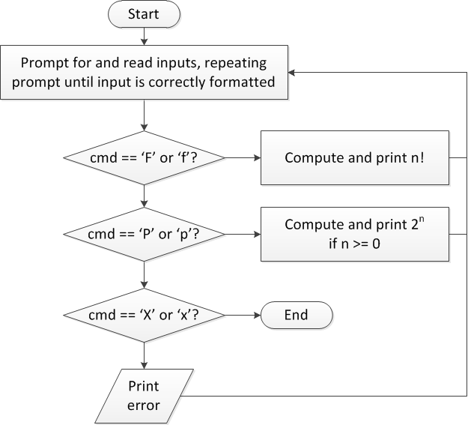
Finishing PE2: overall flow (review)

Slide 24
Finishing PE2: next steps
Write flowcharts for
Computing n!
Computing 2^{n} if n >= 0
Complete code

Slide 25
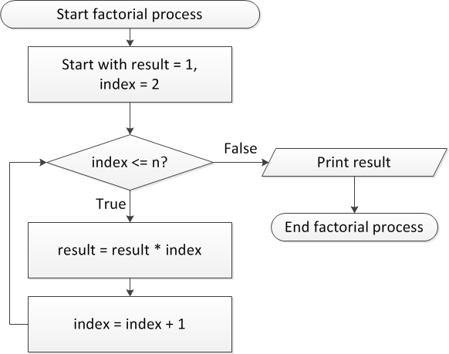
Flow charts: Calculating n!

Slide 26
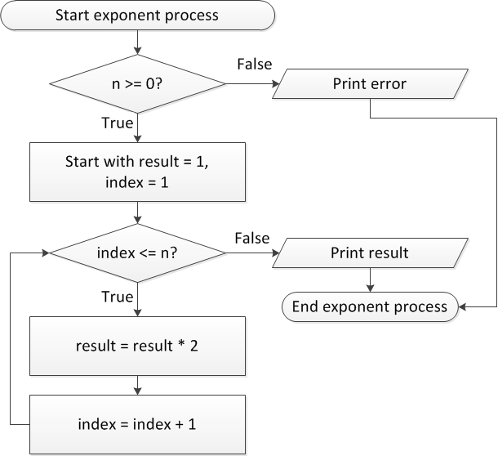
Flow charts: Calculating 2^{n}

Slide 27
Discussion: Factorial/2^{n}
Loop for each process covers fixed range of values
Use for loop
Can declare single variable to hold both results, since only one will be calculated

Slide 28
Code: factorial
result = 1;
for (i = n; i > 1; i--) {
result *= i;
}
printf("%d! = %d\n", n, result);
Slightly different approach than flow chart
Counts down instead of counting up
No benefit to doing one over the other

Slide 29
Code: 2^{n}
if (n < 0)
printf("Error: bad n value\n");
else {
result = 1;
for (i = 0; i < n; i++) {
result *= 2;
}
printf("2^%d = %d\n", n, result);
}

Slide 30
Final notes
Next time
Exam 1 Preview
Reminders:
Program 2 regrade requests due 10/3
CHANGE IN HANDLING REGRADE REQUESTS—PLEASE RESUBMIT BLACKBOARD “ASSIGNMENT” AND DO NOT SEND E-MAIL
Program 3 due Monday, 10/1
Program 4 to be posted; due date TBD
Exam 1: Friday, 10/5
Allowed one double-sided 8.5” x 11” note sheet
No calculators or other electronic devices allowed
You must attend the section for which you are registered
Next week: lecture Thursday, not Monday

