Slide 1
EECE.2160 ECE Application Programming
Instructors:
Dr. Michael Geiger & Dr. Lin Li
Spring 2019
Lecture 23
Exam 2 Preview

Slide 2
Lecture outline
Announcements/reminders
Exam 2 in class Monday, 11/5
Will be allowed one 8.5” x 11” note sheet
Will cover lectures 13-22 (except lecture 14)
Please attend the section for which you are registered
Program 5 due 4/5
Today’s lecture
Program 5 overview
Exam 2 Preview

Slide 3
P5 overview
Integral approximation through trapezoidal method
Program split into three files
zyBooks IDE allows you to view one at a time
prog5_integral.c: main() function only
prog5_functions.h: function prototypes
Do not need to modify unless you’re adding function(s)
prog5_functions.c: function definitions
Complete what’s already there

Slide 4
P5 overview (continued)
General program structure
Read input values (endpoints, # trapezoids)
Call integrate() from main() to perform integral
Repeat program?
User should answer Y/N (case insensitive)
main() mostly responsible for input/output
1 large loop for most of main() repeats if ‘Y’/’y’
Smaller loops for each input prompt (like P4)
Error conditions
Formatting errors for each numeric input
Low endpoint must be < high endpoint
# trapezoids must be at least 1

Slide 5
P5: functions
integrate(min, max, trapezoids)
Performs actual integral approximation
f(x)
Function to be integrated
Always fixed as: sin(x) + x² / 10
badInput()
Used to clear line if formatting error occurs
If written correctly, can generally handle errors as:
if (formatting error)
badInput();

Slide 6
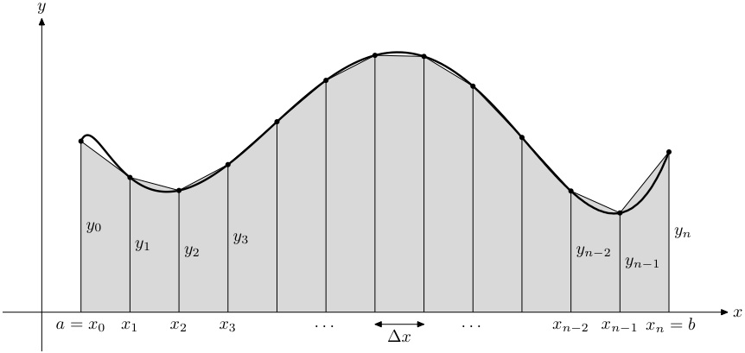
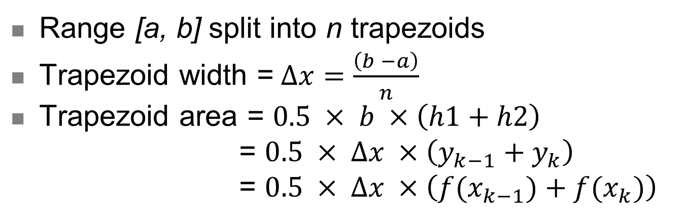
P5: trapezoidal method
Range [a, b] split into n trapezoids
Trapezoid width =$∆x=\frac{\left(b −a\right)}{n}$
Trapezoid area = $0.5 × b ×\left(h1+h2\right)$
= $0.5 × ∆x ×\left(y_{k−1}+y_{k}\right)$
= $0.5 × ∆x ×\left({f(x}_{k−1})+f(x_{k})\right)$

Slide 7
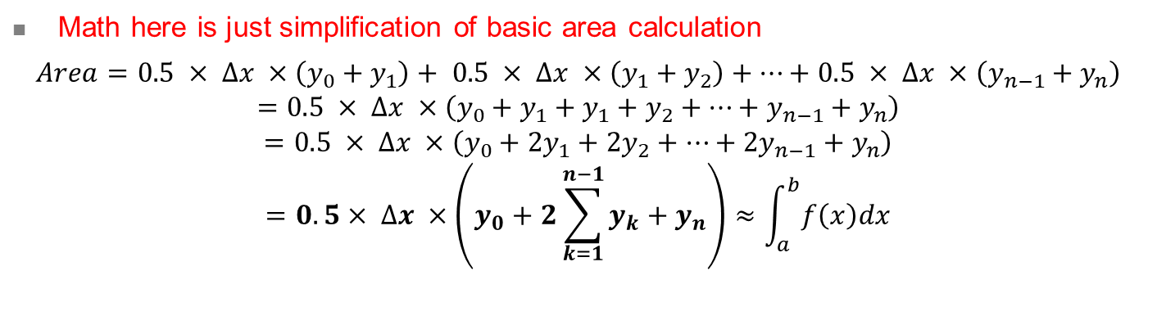
P5: trapezoidal method (continued)
Math here is just simplification of basic area calculation
$$Area=0.5 × ∆x ×\left(y_{0}+y_{1}\right)+ 0.5 × ∆x ×\left(y_{1}+y_{2}\right)+…+0.5 × ∆x ×\left(y_{n−1}+y_{n}\right)$$
$$=0.5 × ∆x ×\left(y_{0}+y_{1}+y_{1}+y_{2}+…+y_{n−1}+y_{n}\right)$$
$$=0.5 × ∆x ×\left(y_{0}+2y_{1}+2y_{2}+…+{2y}_{n−1}+y_{n}\right)$$
$$=0.5× ∆x ×\left(y_{0}+2\sum_{k=1}^{n−1}{y_{k}}+y_{n}\right)≈\int_{a}^{b}{f\left(x\right)dx}$$

Slide 8
P5: implementation warning
Go through x values → generate y values (trapezoid heights)
How should you code that process?
For loop can iterate over range, but be careful
Wrong idea: loop over x values, i.e.
for (x = a; x < b; x += deltaX) {…}
What’s the potential problem?
What data type should x, a, b, & deltaX be?
All variables of type double → approximations
Rounding errors will affect # loop iterations
Is there a whole number you can use with loop?
# iterations can (and should) be based on n
Iterations might not exactly = n (could be n – 1, n + 1, ?)

Slide 9
Exam 2 notes
Allowed one 8.5” x 11” double-sided note sheet
No other notes
No electronic devices (calculator, phone, etc.)
Exam will last 50 minutes
Covers material starting after Exam 1, through lecture 22 (lectures 13-22, except 14)
Same general format as Exam 1
3 sections (each with multiple parts, so ~10 questions) + 1 extra credit question
For loops (code reading/writing)
Functions (code reading/writing, MC)
Arrays (code reading, MC)

Slide 10
Review: for loops
for (<init var>; <test>; <change var>)
<statements>
Operators to directly change variable
x++, x-- → post-increment/decrement
++x, --x → pre-increment/decrement
+=, -=, *=, /= → augmented assignment
Pre-/post-increment: determines order of evaluation/change
y = x++ → y = x, then x = x + 1 (post-inc)
y = ++x → x = x + 1, then y = x (pre-inc)

Slide 11
Review: functions
Key points to understand:
Arguments can be:
Passed by value: copy of argument is sent to function
Arguments cannot be modified outside function
Passed by address: address of argument
Use pointers or address operator (&)
Arguments can be modified outside function—allows function to change >1 value
Return value
Expression following return keyword
Value copied back to where function is called
Can be assigned to variable, used in another expression, etc.

Slide 12
Review: pointers
Pointer: address of a variable
Can get address of existing object using &
Can get value of existing pointer using *
Pointer declaration:
<base type>* <pointer name>
Base type determines how reference is interpreted
Use pointers as function arguments → pass by address

Slide 13
Review: pass by value; return value
int f(int x, int y) {
x = x + 2; // Change x only // inside function
return (x + y) / 2;
}
int main() {
int a = 10;
int b = 20;
int c = f(a, b); // Given f()
… // above, c = 16
printf("%d", f(5, 15)); // Prints 11
… // (return
// val. of f)
}

Slide 14
Review: pass by address
int f2(int *p1, int *p2) {
*p1 = *p1 + 2;
*p2 = *p2 – 3;
return *p1 + *p2;
}
int main() {
int a = 10;
int b = 20;
int c = f2(&a, &b); // a = a + 2 = 12
// b = b – 3 = 17
// c = a + b = 29
}

Slide 15
Review: 1D arrays
Arrays: groups of data with same type
x[10] has 10 elements, x[0] through x[9]
Can also define with initial values
e.g. double list[] = {1.2, 0.75, -3.233};
If array size > initial list size, remaining values = 0
Given int arr[6] = {1, 2, 3} → arr = {1, 2, 3, 0, 0, 0}
Must be sure to access inside bounds
0 is always index of first element
Maximum valid index is (array size) – 1
Commonly use for loops to go through array

Slide 16
Review: 2D arrays
Declared similarly to 1D arrays
Example (see below): int x[3][4];
Index elements similarly to 1-D arrays
Initialize: int y[3][4] =
{ {1, 2, 3, 4},
{5, 6, 7, 8},
{9, 10, 11, 12} };
Typically used with nested for loops
 | Col. 0 | Col. 1 | Col. 2 | Col. 3
Row 0 | x[0][0] | x[0][1] | x[0][2] | x[0][3]
Row 1 | x[1][0] | x[1][1] | x[1][2] | x[1][3]
Row 2 | x[2][0] | x[2][1] | x[2][2] | x[2][3]

Slide 17
Final notes
Next time: Exam 2
Please be on time
Please attend the section for which you are registered
Reminders:
Program 5 due 4/5

