Slide 1
EECE.2160 ECE Application Programming
Instructors:
Dr. Michael Geiger & Dr. Lin Li
Spring 2019
Lecture 7:
Debugging basics (PE1)
If statements

Slide 2
Lecture outline
Announcements/reminders
Textbook exercises due 3 days after each lecture
Program 2 due Monday, 2/11
Today’s lecture
Brief flowchart review
Debugging basics
If statements

Slide 3
Flowcharts
Graphical representation of process
Shows all steps and their order
In programming, use to organize program before writing code
Basic elements
Process
Terminator (start/end)
Input/Output
Connector
Decision
Connector (off page)

Slide 4
Example: Quadratic Equation Solver
Start
Output
“Quadratic Equation Solver”
Output
“Enter A, B, C: ”
Input A, B, C

Slide 5
Quadratic Equation Solver (cont.)
A = 0?
TRUE
Output
X
FALSE
DISC=B*B-4*A*C
DISC = 0?
TRUE
Output
X
FALSE
DISC>0?
TRUE
Output
X1,X2
FALSE
Output
XREAL + XIMAG i
XREAL – XIMAG i
Done

Slide 6
Sample program
Prompts user to enter four numbers on a single line, which represent the contents of a 2x2 array
After reading values, program prints matrix represented by these values
For example, if the user enters “1 2 3 4”, print:
1 2
3 4
Assume all values have the same number of digits
Also, calculate the matrix determinant and print it on a separate line
In example above, determinant = (1x4) - (2x3) = 4-6 = -2

Slide 7
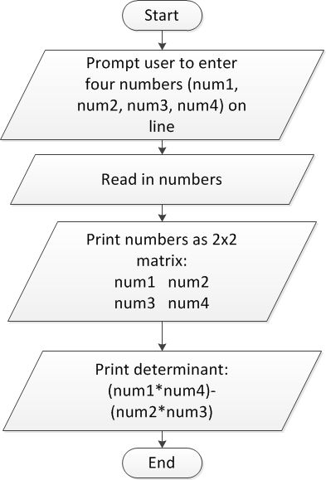
Sample program: flowchart

Slide 8
Debugging
Most IDEs allow ability to view state of program while running through debugger
View variable values
Execute program:
One line at a time (single step)
By running until reaching a pre-defined stopping point (breakpoint)
Can isolate bugs without altering program
Alternate solution: inserting print statements to show program state at various points
Disadvantages
Inefficient--repeated compilation, must keep adding statements
May actually alter operation of other statements

Slide 9
Debug demonstration
Will use sample program to demonstrate use of following key features
Breakpoints
Single stepping through program
Viewing program state (variable values)

Slide 10
Decisions
Conditionally execute some path
May want to:
Only perform operation if condition is true:
A = 0?
TRUE
FALSE
A = 0?
TRUE
X = x + 1
FALSE

Slide 11
Decisions (cont.)
May want to:
Perform one operation if condition is true, another if false:
A = 0?
TRUE
X = x + 1
FALSE
X = x - 1

Slide 12
Decisions (cont.)
May want to:
Check multiple conditions, in order
A = 0?
TRUE
X = x + 1
FALSE
B=1?
TRUE
X = x - 1
FALSE
X = 0

Slide 13
if statements
Frequently want to conditionally execute code
Range checking
Error checking
Different decisions based on input, or result of operation
Basic conditional execution: if statement
Form:
if (<expression>)
<statement>
[ else brackets show
<statement> ] else is optional

Slide 14
if statements (cont.)
<expression> can be any valid expression
Considered “false” if 0, “true” if nonzero
Can use comparisons:
Greater than/less than: > <
e.g. if (a < b)
Greater than or equal/less than or equal: >= <=
e.g. if (x <= 20)
Equal/not equal: == !=
e.g. if (var == 10)

Slide 15
if statements (cont.)
<expression> can be any valid expression
Can combine multiple conditions using
Logical AND: &&
Logical OR: ||
e.g. if ((x < 3) && (y > 5))
Can test inverse of condition using logical NOT: !
e.g. if (!(x < 3)) → equivalent to if (x >= 3)
These operators: not bitwise operators!
A & B is a bitwise operation
A && B has only 2 possible results: 0 or “non-zero”

Slide 16
if statements (cont.)
<statement> can be one or more lines
If just one line, no additional formatting needed
if (x < 3)
printf(“x = %d\n”, x);
If multiple lines, statement is block enclosed by { }
if (x < 3) {
printf(“x = %d\n”, x);
x = x + 3;
}
else part is optional—covers cases if condition is not true

Slide 17
if
if (a > b) big = a; else big = b;
if (a+6*3-43) printf("wow is this not cool"); else printf("this is not cool");

Slide 18
if (common pitfalls)
a single equals means ASSIGN.
a double equal must be used to check for equality.
x=12345;
if (x=3) { printf("x is 3\n"); } else { printf("x is not 3\n"); }
This code will ALWAYS print: x is 3

Slide 19
if (example)
void main(void) { float a,b,c,disc; : scanf("%f %f %f",&a,&b,&c); if (a==0) { // statements } else { disc = b*b-4*a*c; if ( disc < 0 ) { // statements } else { // statements } }
}

Slide 20
Example: if statements
What does the following code print?
int main() {
int x = 3;
int y = 7;
if (x > 2)
x = x - 2;
else
x = x + 2;
if ((y % 2) == 1)
{
y = -x;
if ((x != 0) && (y != -1))
y = 0;
}
printf("x = %d, y = %d\n", x, y);
return 0;
}

Slide 21
Example solution
int main() {
int x = 3;
int y = 7;
if (x > 2) → Condition is true, since 3 > 2
x = x - 2; → x set to 1
else
x = x + 2;
if ((y % 2) == 1) → Tests if y is an odd number--true condition
{
y = -x; → y set to -1
if ((x != 0) && (y != -1)) → First part of condition is true,
second part is false--overall false
y = 0;
}
printf("x = %d, y = %d\n", x, y); → Prints: x = 1, y = -1
return 0;
}

Slide 22
Final notes
Next time
Range checking with if statements
Reminders:
Textbook exercises due 3 days after each lecture
Program 2 due Monday, 2/11

