Slide 1
EECE.3220 Data Structures
Instructor:
Dr. Michael Geiger
Spring 2019
Lecture 16:
Exam 1 Review

Slide 2
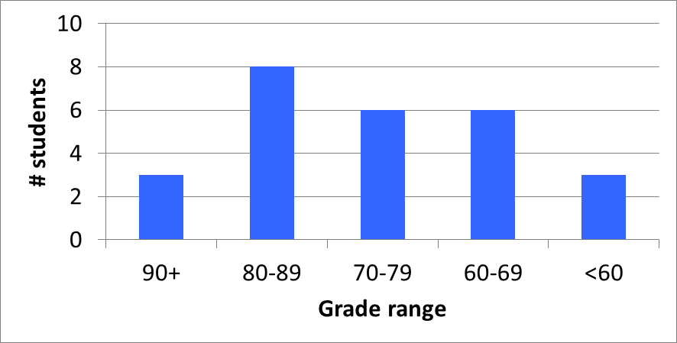
Exam stats & grade distribution
Section averages:
S1: 19.5 / 24 (81%)
S2: 8.9 / 14 (64%)
S3: 9.5 / 12 (79%)
S4: 10.5 / 14 (75%)
S5: 14.3 / 20 (72%)
S6: 12 / 16 (75%)
Average: 74.8
Median: 77.5
Std. deviation: 13.8
Max: 93
Doesn’t include XC points (average 5.8, 13 responses)

Slide 3
Final notes
Next time
Dynamic allocation (Monday, 3/18)
Enjoy your Spring Break!
Reminders:
Program 2 due 3/21

