Slide 1
EECE.3220 Data Structures
Instructor:
Dr. Michael Geiger
Spring 2019
Lecture 34:
Exam 3 Preview

Slide 2
Lecture outline
Announcements/reminders
Program 5 (extra credit) posted; due 5/9
5/9 last day to submit all code (late, regrade, etc)
Exam 3: Wednesday 5/8 3-6 PM, Ball 208
Course eval to be submitted at final exam
Link to be posted on site; blank copies available outside office
Today’s lecture: Exam 3 Preview

Slide 3
Exam 3 notes
Allowed two 8.5” x 11” double-sided sheet of notes
No other notes, electronic devices (calculator, phone)
Exam will last three hours but will be roughly same length as Exams 1/2
Covers lectures 27-33

Slide 4
Exam sections (CR = code reading, CW = code writing, MC = multiple choice)
Array-based queues (CR/CW)
Linked queues (CR/CW)
Linked lists (CR/CW/maybe MC)
Survey of other data types (MC)
Binary search trees
Heaps
Priority queues
Hash tables
Extra credit

Slide 5
Review: Queue ADT
Queue is first-in, first-out (FIFO) data structure
Definition
Ordered collection of data items
Items only removed (or read) from the front
Items only added to the back
Operations
Construction (start with empty queue)
Check if queue is empty
Enqueue: add data to the back of the queue
Dequeue: remove data from the front of the queue
Read item at front of queue

Slide 6
Review: Array-based queues
Treat array as circular
Issue #1: What do front/back refer to?
Position to read/write next (start both at 0; read/write then inc)
Position most recently read/written (start at -1 or cap-1; inc then read/write)
Issue #2: Tracking full/empty
Only store front/back and leave 1 array slot empty
Store front/back & extra “empty” variable (either Boolean or just count # full/empty slots)

Slide 7
Review: Linked data structures
Linked queues
Front pointer points to first node in queue
Back pointer points to last node in queue
Last node: next pointer = NULL
See example code for specific details
Linked lists
Single pointer to first node
Insert data in order
Traverse to appropriate spot; change pointers to add new
Can delete anywhere
Update pointers to ensure list unbroken

Slide 8
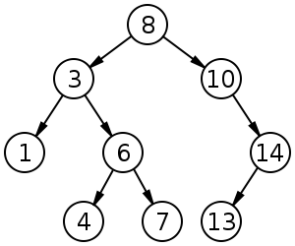
Review: Binary search tree
Binary search tree: binary tree in which each node follows property
value in left child of node ≤ value in node ≤ value in right child of node
Source: https://commons.wikimedia.org/w/index.php?curid=488330

Slide 9
Review: Heaps
A heap is a binary tree with properties:
It is complete
Each level of tree completely filled (except possibly bottom)
It satisfies heap-order property
Data in each node >= data in children
Also called a maxheap
If data in node <= data in children, it’s a minheap
Can be efficiently stored in array
Store all nodes at given level from left to right in consecutive locations
If first element @ index 1, then, given index n
Children are at indexes 2*n and 2*n + 1
Parent is at index n/2
Heapsort: O(n log(n)) sort
Make array/part of array into heap, then move highest val
Operate on smaller & smaller subsets

Slide 10
Review: Priority Queue
A collection of data elements
Items stored in order by priority
Higher priority items removed ahead of lower
Commonly implemented in heap
Highest priority item → top of heap
Write priority queue operations in terms of heap operations
Example: remove highest priority = remove top of heap

Slide 11
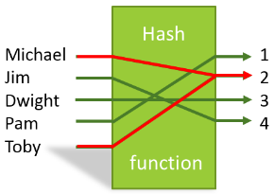
Review: Hash Tables
In some situations faster search is needed
Solution is to use a hash function
Value of key field given to hash function
Location in a hash table is calculated

Slide 12
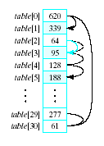
Review: Linear probing
Observe the problem with same value returned by h(i) for different values of i
Called collisions
A simple solution is linear probing
Linear search begins at collision location
Continues until empty slot found for insertion

Slide 13
Review: collision strategies
Linear probing: start at index & search in order
Quadratic probing
Probe sequence from location i is i + 1, i – 1, i + 4, i – 4, i + 9, i – 9, …
Secondary clusters can still form
Double hashing
Use a second hash function to determine probe sequence
Chaining: build linked list at each position

Slide 14
Final notes
Next time
Exam 3: 5/8, 3-6 PM, Ball 208
Reminders:
Program 5 (extra credit) posted; due 5/9
5/9 last day to submit all code (late, regrade, etc)
Course eval to be submitted at final exam
Link to be posted on site; blank copies available outside office

