Slide 1
16.216
ECE Application Programming
Instructor: Dr. Michael Geiger
Fall 2011
Lecture 14: Exam 1 Review

Slide 2
Lecture outline
Announcements/reminders
  Program 4 due tonight
  Program 5 won’t be posted until next week
  No Monday lecture (Columbus Day)
Today: Exam 1 Review
  Exam stats
  Regrades
  Exam solution
Early feedback forms
ECE Application Programming: Lecture 14

Slide 3
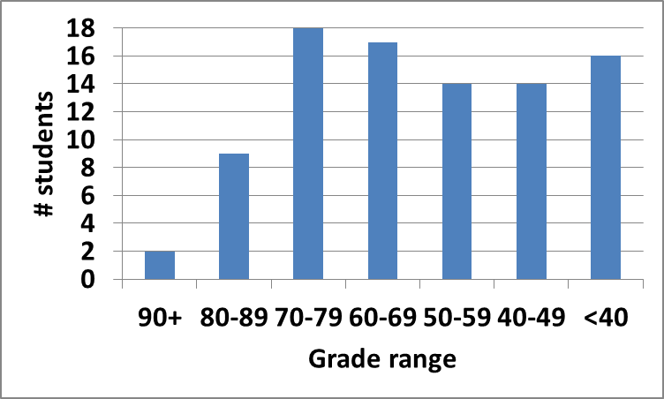
Exam stats & grade distribution
Average: 58.3
Median: 60
Std. deviation: 18.6
Max: 94
Question-by-question averages:
  Q1: 17.2 / 24 (72%)
  Q2: 23.6 / 37 (64%)
  Q3: 17.4 / 39 (45%)
ECE Application Programming: Lecture 14

Slide 4
Regrade requests
Due 10/14
Must be written
You must also return your exam
  Do not write on your exam if you plan on submitting a regrade request
Must demonstrate understanding of problem
  Bad: “I deserve more points on Problem 2a.”
  Good: “I deserve more points on Problem 2a because I calculated a wrong value for f based on an incorrect value for x. I used the right formula; I just plugged in the wrong value.”
ECE Application Programming: Lecture 14

Slide 5
Next time
Loops
ECE Application Programming: Lecture 14

