Slide 1
16.216
ECE Application Programming
Instructor: Dr. Michael Geiger
Fall 2011
Lecture 17: for loops

Slide 2
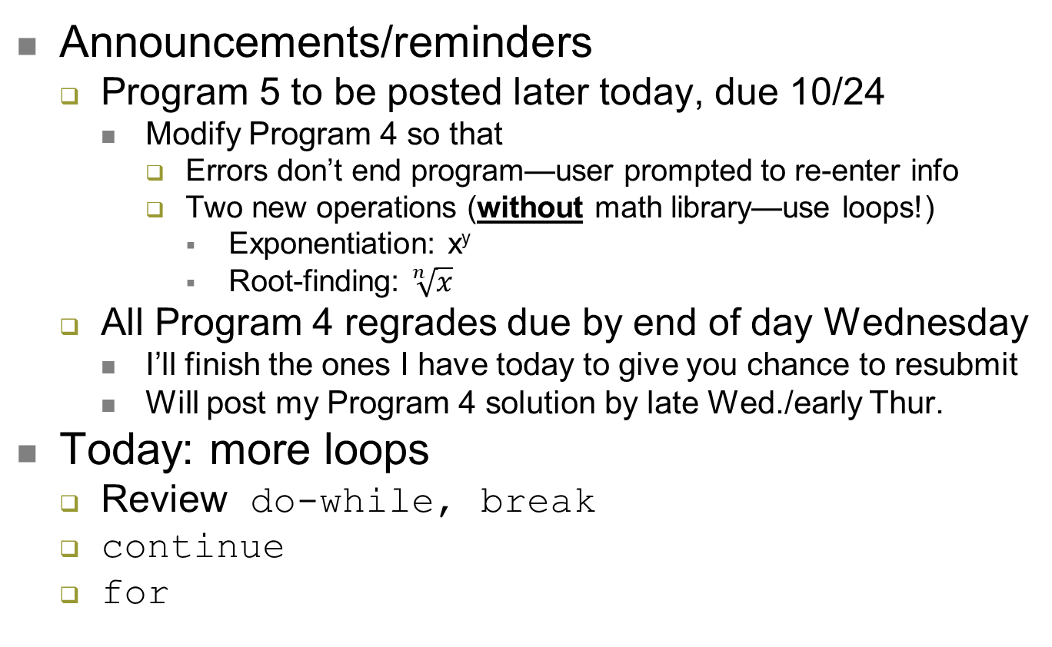
Lecture outline
ECE Application Programming: Lecture 17

Slide 3
Review: do-while loops, break
do-while similar to while, but post-tested
  Loop body executes at least once
  do {
  <statements>
  } while ( <expression> );
Exiting loop early: break
  Useful if exit condition can occur in middle of loop, e.g.
    do {
    scanf(“%lf”, &grd);
    if ((grd < 0.0) || (grd > 100.0))
    break;
    // Implied “else”
    grdTotal = grdTotal + grd;
    grdCount = grdCount + 1;
    } while (1);
ECE Application Programming: Lecture 17

Slide 4
Using continue with loops
Want to leave loop body but execute more iterations
  Use continue—will end loop and then evaluate condition
Example: Read and sum 10 non-zero numbers
n = 0;
sum = 0;
while (n < 10) {
scanf(“%d”, &i);
if (i == 0)
continue;
sum = sum + i;
n++;
/* continue jumps to this point */
}
ECE Application Programming: Lecture 17

Slide 5
Justifying for loops
Common loop structure
  Initialize variable
  Loop until that variable reaches certain limit
  At end of each iteration, change variable by fixed amount
Example: squares program
i = 0;
while (i <= 10) {
iSquared = i * i;
printf("%2d%10d\n", i, iSquared);
i = i + 1;
}
ECE Application Programming: Lecture 17

Slide 6
for loops
for loops include all three aspects in one construct
Form:
for (<init var>; <test>; <change var>)
<statements>
<init var> is basic assignment
<test> same type of condition as if, while
<change var> change variable by fixed amount
Example: for (i = 0; i < 20; i++)
  … You may be wondering what i++ means
ECE Application Programming: Lecture 17

Slide 7
Changing variables
Can do operation + assignment w/one operator
Simply adding/subtracting 1:
  x++ → x = x + 1 (post-increment)
  x-- → x = x – 1 (post-decrement)
  ++x → x = x + 1 (pre-increment)
  --x → x = x – 1 (pre-decrement)
Augmented assignment: change variable by amount other than 1
  x += y → x = x + y
  x -= y → x = x – y
  x *= y → x = x * y
  x /= y → x = x / y
ECE Application Programming: Lecture 17

Slide 8
Pre- vs. post-increment/decrement
Pre-increment/decrement: perform increment/ decrement, then evaluate expression
Post-increment/decrement: evaluate expression, then perform increment/decrement
Example: what does the following print?
int n = 5;
printf(“n = %d\n”, ++n);
printf(“Now, n = %d\n”, n++);
printf(“Finally, n = %d\n”, n);
ECE Application Programming: Lecture 17

Slide 9
Example soln.
int n = 5;
printf(“n = %d\n”, ++n);
printf(“Now, n = %d\n”, n++);
printf(“Finally, n = %d\n”, n);
Output:
n = 6 (n pre-incremented)
Now, n = 6 (n post-incremented)
Finally, n = 7 (Shows effect of n++)
ECE Application Programming: Lecture 17

Slide 10
Simple usage of for loop
Common sequence of code:
x=0;
while (x<12)
{
printf("%d ",x);
x++;
}
Output:
0 1 2 3 4 5 6 7 8 9 10 11
ECE Application Programming: Lecture 17
Notes:
ECE 160 - Intro to Computer Engineering I
03/07/2005
(c) 2005, P. H. Viall

Slide 11
Intro to for loops
Common sequence of code:
x=0;
while (x<12)
{
printf("%d ",x);
x++;
}
Equivalent for construct
for (x=0 ; x<12 ; x++ )
{
printf("%d ",x);
}
Initial value
Test condition
Body of loop (may be 0, 1, or several statements)
End of loop change
ECE Application Programming: Lecture 17

Slide 12
Repetition with for loop
Rewriting squares program with loop
int main() {
int i; // Number to square
int iSquared; // Square of the number
printf(" i i^2\n"); // Column headings
// Compute and display the squares of numbers 0 to 10
for (i = 0; i <= 10; i++) { // Loop until i > 10
iSquared = i * i;
printf("%2d%10d\n", i, iSquared);
}
return 0;
}
ECE Application Programming: Lecture 17

Slide 13
Repetition with for loop (cont.)
Generalizing program:
int main() {
int i; // Number to square
int iSquared; // Square of the number
int iStart; // Initial value
int iStop; // Last value
int iStep; // Increment
printf(“Enter start, stop, and increment: “);
scanf(“%d %d %d”, &iStart, &iStop, &iStep);
printf(" i i^2\n"); // Column headings
// Compute and display the squares of numbers iStart to iStop
// with increment iStep
for (i = iStart; i <= iStop; i += iStep) {
iSquared = i * i;
printf("%2d%10d\n", i, iSquared);
}
return 0;
}
ECE Application Programming: Lecture 17

Slide 14
Example: for loops
What does each of the following print?
for (i=5; i<40; i+=8)
{
printf("%d ", i);
}
for (i=10; i<=100; i=i+10)
{
if (i%20)
printf("%d ", i);
}
for (i=-5; i<-10; i--)
{
printf("%d ", i);
}
for (i=5; i<10; i+=i%2)
{
printf("%d ", i++);
}
ECE Application Programming: Lecture 17

Slide 15
Example solution
What does each of the following print?
for (i=5; i<40; i+=8)
{
printf("%d ", i);
}
OUTPUT: 5 13 21 29 37
for (i=10; i<=100; i=i+10)
{
if (i%20)
printf("%d ", i);
}
OUTPUT: 10 30 50 70 90
for (i=-5; i<-10; i--)
{
printf("%d ", i);
}
OUTPUT: No output
for (i=5; i<10; i+=i%2)
{
printf("%d ", i++);
}
OUTPUT: 5 6 8
ECE Application Programming: Lecture 17

Slide 16
Next time
PE3: Practice using loops
ECE Application Programming: Lecture 17

