Slide 1
16.216
ECE Application Programming
Instructor: Dr. Michael Geiger
Fall 2012
Lecture 13:
Exam 1 Review

Slide 2
Lecture outline
Announcements/reminders
  Program 3 regrades due Tuesday, 10/9
  Program 4 to be posted; due date TBD
  No class Monday (Columbus Day)
  Early feedback forms Wednesday
Today’s class: Exam 1 Review
  Exam stats
  Regrade requests
  Solution
ECE Application Programming: Exam 1 Review

Slide 3
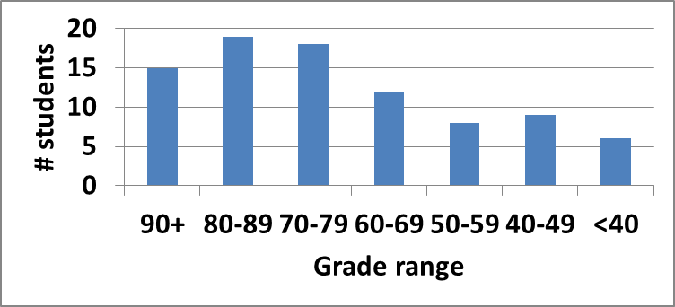
Exam stats & grade distribution
Average: 71.3
Median: 74
Std. deviation: 18.9
Max: 100
Question-by-question averages:
  Q1: 13.9 / 20 (69%)
  Q2: 30.2 / 40 (76%)
  Q3: 27.2 / 40 (68%)
Extra credit
  26 students completed
  6.5 average
ECE Application Programming: Exam 1 Review

Slide 4
Regrade requests
Due 10/12
Must be written
You must also return your exam
  Do not write on your exam if you plan on submitting a regrade request
Must demonstrate understanding of problem
  Bad: “I deserve more points on Problem 2a.”
  Good: “I deserve more points on Problem 2a because I calculated a wrong value for f based on an incorrect value for x. I used the right formula; I just plugged in the wrong value.”
ECE Application Programming: Exam 1 Review

Slide 5
Next time
For loops
Early feedback form
Reminders:
  Program 3 regrades due Tuesday, 10/9
  Program 4 to be posted; due date TBD
  No class Monday (Columbus Day)
ECE Application Programming: Exam 1 Review

