Slide 1
16.216
ECE Application Programming
Instructor: Dr. Michael Geiger
Fall 2013
Lecture 10
PE2: Loops and conditionals

Slide 2
Lecture outline
Announcements/reminders
  Program 2 regrades due 9/27
  Program 3 due today
  Program 4 to be posted; due 10/7
  Exam 1: Wednesday, 10/2
    Will be allowed one 8.5” x 11” double-sided note sheet
Review
  Loops: for
Today’s lecture
  PE2: Loops
ECE Application Programming: Lecture 10

Slide 3
Review: for loops
for (<init var>; <test>; <change var>)
<statements>
Operators to directly change variable
  x++, x-- → post-increment/decrement
  ++x, --x → pre-increment/decrement
  +=, -=, *=, /= → augmented assignment
ECE Application Programming: Lecture 10

Slide 4
Today’s program should:
Prompt user to enter an input character and an integer, n.
  If not correctly formatted, print error, clear line, and repeat
Depending on the character entered, do the following:
  ‘F’ or ‘f’: Compute and print the factorial of n, n!
    For example, if the user enters F 5, print 5! = 120
  ‘P’ or ‘p’: Compute 2^{n}, but only if n >= 0.
    For example, if the user enters p 2, print 2^2 = 4
    Print an error if n < 0.
  ‘X’ or ‘x’: Exit the program
  In all other cases, print an error:
    For example: Invalid command Z entered
If the user enters any command other than ‘X’ or ‘x’, return to the initial prompt and repeat the program.
Will likely complete parts in red on Friday
ECE Application Programming: Lecture 10

Slide 5
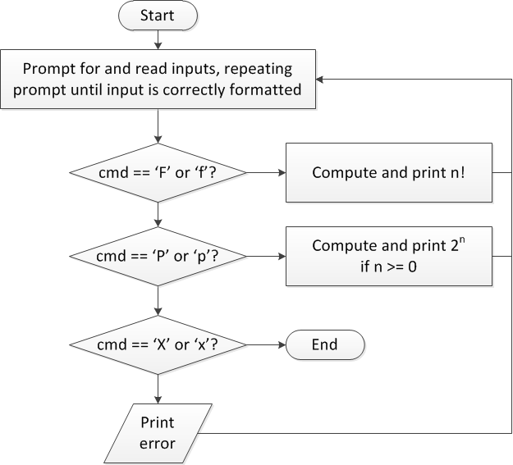
Flow charts: overall flow
ECE Application Programming: Lecture 10

Slide 6
Discussion: Overall flow
Whole program contains loop
  Repeats process until user enters ‘X’ or ‘x’
  Use while or do-while—unknown # of iterations
  Since exit condition ends program, infinite loop
Testing cmd: switch statement
  Checking equality of cmd to constant values
Exiting program: return statement
  Use return at any point to end current function (including main)
ECE Application Programming: Lecture 10

Slide 7
Code: overall flow (skeleton code)
while (1) { // Loop repeats until user enters 'X' or 'x'
/* Code to read cmd, n */
/* Evaluate cmd and perform appropriate operation */
switch (cmd) {
case 'F':
case 'f':
/* Calculate n! */
break;
case 'P':
case 'p':
/* Calculate 2^n, if n >= 0; print error otherwise */
break;
case 'X':
case 'x':
return; // Exit program
default:
printf("Invalid command %c entered\n", cmd);
}
}
ECE Application Programming: Lecture 10

Slide 8
Final notes
Next time
  Finish PE2: Loops
    Reading input until valid values are entered
    Calculating n!
    Calculating 2^{n}
Reminders:
  Program 2 regrades due 9/27
  Program 3 due today
  Program 4 to be posted; due 10/7
  Exam 1: Wednesday, 10/2
    Will be allowed one 8.5” x 11” double-sided note sheet
ECE Application Programming: Lecture 10

