Slide 1
16.216
ECE Application Programming
Instructor: Dr. Michael Geiger
Fall 2014
Lecture 11:
For loops

Slide 2
Lecture outline
Announcements/reminders
  Program 2 regrades due Monday, 9/29
  Program 4 to be posted; due 10/6
  Exam 1: Wednesday, 10/1
    Will be allowed one 8.5” x 11” double-sided note sheet
    No calculators or other electronic devices allowed
  Old exams on website
Today’s lecture
  For loops
  Finish PE2
ECE Application Programming: Lecture 11

Slide 3
Iterative methods
Repeat calculation until correct value reached
“Correctness” defined as:
  Difference between old, new value <= max error
  Max error == .000001 in Prog. 4
General process:
newVal = <initial value>;
do {
oldVal = newVal;
newVal = <equation based on oldVal>;
} while (fabs(newVal – oldVal) > max_err);
Remember, you can’t use <math.h>, so you’ll need your own way of computing absolute value (fabs())
ECE Application Programming: Lecture 20

Slide 4
Justifying for loops
Common loop structure
  Initialize variable
  Loop until that variable reaches certain limit
  At end of each iteration, change variable by fixed amount
Example: squares program
i = 0;
while (i <= 10) {
iSquared = i * i;
printf("%2d%10d\n", i, iSquared);
i = i + 1;
}
ECE Application Programming: Lecture 11

Slide 5
for loops
for loops include all three aspects in one construct
Form:
for (<init var>; <test>; <change var>)
<statements>
<init var> is basic assignment
<test> same type of condition as if, while
<change var> change variable by fixed amount
Example: for (i = 0; i < 20; i++)
  … You may be wondering what i++ means
ECE Application Programming: Lecture 11

Slide 6
Changing variables
Can do operation + assignment w/one operator
Simply adding/subtracting 1:
  x++ → x = x + 1 (post-increment)
  x-- → x = x – 1 (post-decrement)
  ++x → x = x + 1 (pre-increment)
  --x → x = x – 1 (pre-decrement)
Augmented assignment: change variable by amount other than 1
  x += y → x = x + y
  x -= y → x = x – y
  x *= y → x = x * y
  x /= y → x = x / y
ECE Application Programming: Lecture 11

Slide 7
Pre- vs. post-increment/decrement
Pre-increment/decrement: perform increment/ decrement, then evaluate expression
Post-increment/decrement: evaluate expression, then perform increment/decrement
Example: what does the following print?
int n = 5;
printf(“n = %d\n”, ++n);
printf(“Now, n = %d\n”, n++);
printf(“Finally, n = %d\n”, n);
ECE Application Programming: Lecture 11

Slide 8
Example soln.
int n = 5;
printf(“n = %d\n”, ++n);
printf(“Now, n = %d\n”, n++);
printf(“Finally, n = %d\n”, n);
Output:
n = 6 (n pre-incremented)
Now, n = 6 (n post-incremented)
Finally, n = 7 (Shows effect of n++)
ECE Application Programming: Lecture 11

Slide 9
Simple usage of for loop
Common sequence of code:
x=0;
while (x<12)
{
printf("%d ",x);
x++;
}
Output:
0 1 2 3 4 5 6 7 8 9 10 11
ECE Application Programming: Lecture 11
Notes:
ECE 160 - Intro to Computer Engineering I
03/07/2005
(c) 2005, P. H. Viall

Slide 10
Intro to for loops
Common sequence of code:
x=0;
while (x<12)
{
printf("%d ",x);
x++;
}
Equivalent for construct
for (x=0 ; x<12 ; x++ )
{
printf("%d ",x);
}
Initial value
Test condition
Body of loop (may be 0, 1, or several statements)
End of loop change
ECE Application Programming: Lecture 11

Slide 11
Repetition with for loop
Rewriting squares program with loop
int main() {
int i; // Number to square
int iSquared; // Square of the number
printf(" i i^2\n"); // Column headings
// Compute and display the squares of numbers 0 to 10
for (i = 0; i <= 10; i++) { // Loop until i > 10
iSquared = i * i;
printf("%2d%10d\n", i, iSquared);
}
return 0;
}
ECE Application Programming: Lecture 11

Slide 12
Repetition with for loop (cont.)
Generalizing program:
int main() {
int i; // Number to square
int iSquared; // Square of the number
int iStart; // Initial value
int iStop; // Last value
int iStep; // Increment
printf(“Enter start, stop, and increment: “);
scanf(“%d %d %d”, &iStart, &iStop, &iStep);
printf(" i i^2\n"); // Column headings
// Compute and display the squares of numbers iStart to iStop
// with increment iStep
for (i = iStart; i <= iStop; i += iStep) {
iSquared = i * i;
printf("%2d%10d\n", i, iSquared);
}
return 0;
}
ECE Application Programming: Lecture 11

Slide 13
Example: for loops
What does each of the following print?
for (i=5; i<40; i+=8)
{
printf("%d ", i);
}
for (i=10; i<=100; i=i+10)
{
if (i%20)
printf("%d ", i);
}
for (i=-5; i<-10; i--)
{
printf("%d ", i);
}
for (i=5; i<10; i+=i%2)
{
printf("%d ", i++);
}
ECE Application Programming: Lecture 11

Slide 14
Example solution
What does each of the following print?
for (i=5; i<40; i+=8)
{
printf("%d ", i);
}
OUTPUT: 5 13 21 29 37
for (i=10; i<=100; i=i+10)
{
if (i%20)
printf("%d ", i);
}
OUTPUT: 10 30 50 70 90
for (i=-5; i<-10; i--)
{
printf("%d ", i);
}
OUTPUT: No output
for (i=5; i<10; i+=i%2)
{
printf("%d ", i++);
}
OUTPUT: 5 6 8
ECE Application Programming: Lecture 11

Slide 15
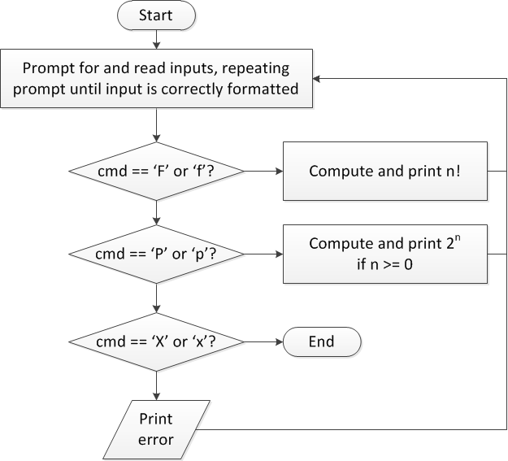
Finishing PE2: Overall flowchart
ECE Application Programming: Lecture 11

Slide 16
PE2 skeleton code
while (1) { // Loop repeats until user enters 'X' or 'x'
/* Code to read cmd, n */
/* Evaluate cmd and perform appropriate operation */
switch (cmd) {
case 'F':
case 'f':
/* Calculate n! */
break;
case 'P':
case 'p':
/* Calculate 2^n, if n >= 0; print error otherwise */
break;
case 'X':
case 'x':
return; // Exit program
default:
printf("Invalid command %c entered\n", cmd);
}
}
ECE Application Programming: Lecture 11

Slide 17
Next step
Write flowcharts for
  Computing n!
  Computing 2^{n} if n >= 0
Complete code
ECE Application Programming: Lecture 11

Slide 18
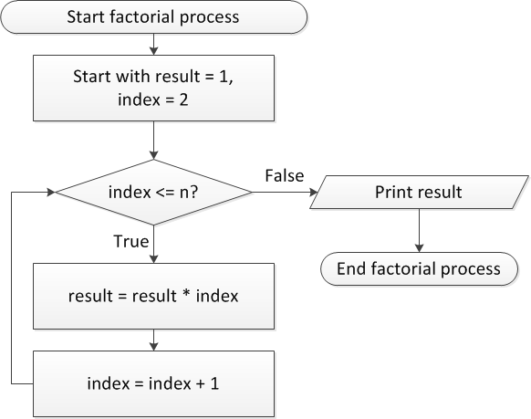
Flow charts: Calculating n!
ECE Application Programming: Lecture 11

Slide 19
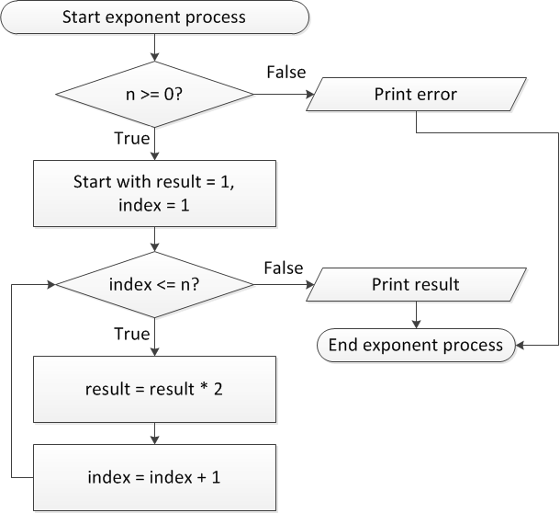
Flow charts: Calculating 2^{n}
ECE Application Programming: Lecture 11

Slide 20
Discussion: Factorial/2^{n}
Loop for each process covers fixed range of values
  Use for loop
Can declare single variable to hold both results, since only one will be calculated
ECE Application Programming: Lecture 11

Slide 21
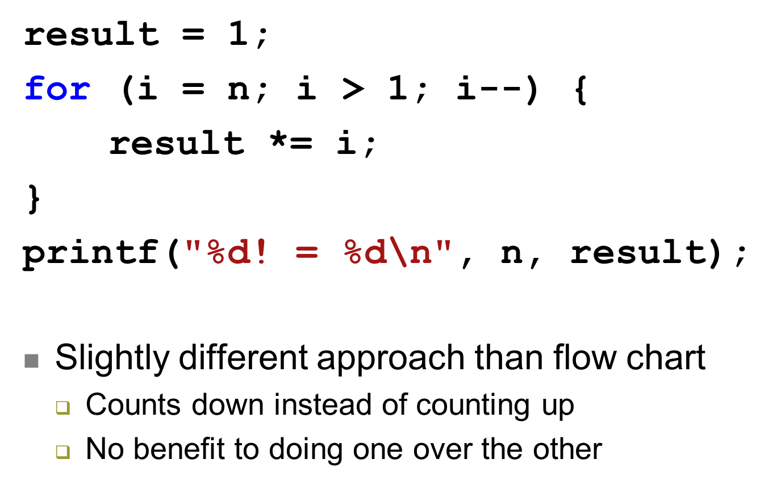
Code: factorial
ECE Application Programming: Lecture 11

Slide 22
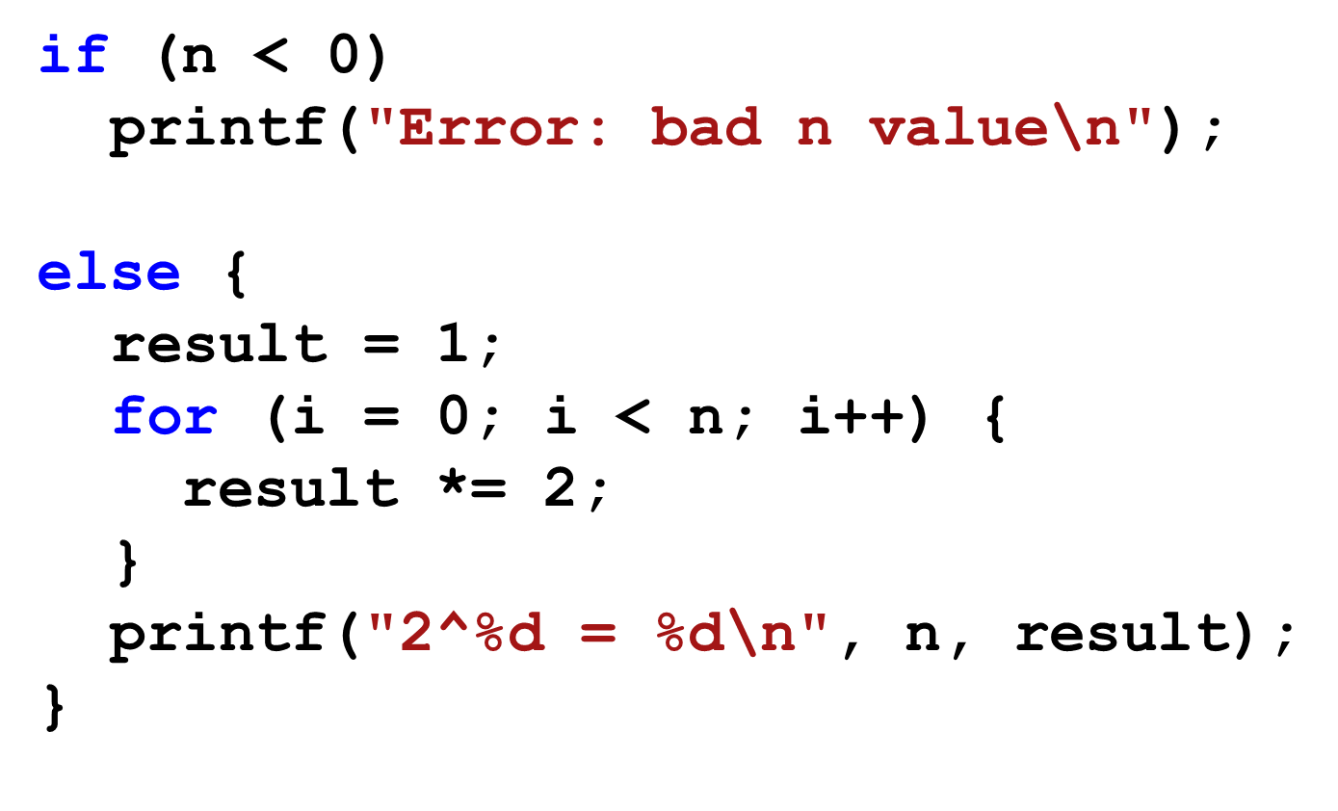
Code: 2^{n}
ECE Application Programming: Lecture 11

Slide 23
Final notes
Next time
  Exam 1 Preview
Reminders:
  Program 2 regrades due Monday, 9/29
  Program 4 to be posted; due 10/6
  Exam 1: Wednesday, 10/1
    Will be allowed one 8.5” x 11” double-sided note sheet
    No calculators or other electronic devices allowed
  Old exams on website
ECE Application Programming: Lecture 11

