Slide 1
16.216
ECE Application Programming
Instructor: Dr. Michael Geiger
Fall 2014
Lecture 14:
Function examples
Exam 1 Review

Slide 2
Lecture outline
Announcements/reminders
  Program 5 to be posted; due date TBD
  No class Monday
Review
  Functions
Today’s lecture
  Function examples
  Exam 1 Review
ECE Application Programming: Lecture 14

Slide 3
Review: functions
Used to break programs into smaller pieces
  Useful when code sequences repeated
Functions have:
  An optional return value
  A name
  Optional arguments
Must be prototyped or written completely prior to use
ECE Application Programming: Lecture 14

Slide 4
Example
What does the following print?
int f(int a, int b);
int main() {
  int x = 1;
  int y = 2;
  int result1, result2, result3;
  result1 = f(x, y);
  result2 = f(y, result1);
  result3 = f(result1, result2);
  printf("x = %d, y = %d\n", x, y);
  printf("Result 1: %d\n", result1);
  printf("Result 2: %d\n", result2);
  printf("Result 3: %d\n", result3);
  return 0;
}
int f(int a, int b)
{
  int i; // Loop index
  int r = 0; // Result
  for (i = 0; i < a; i++)
  r += b;
  return r;
}
ECE Application Programming: Lecture 14

Slide 5
Example solution
x = 1, y = 2
Result 1: 2
Result 2: 4
Result 3: 8
ECE Application Programming: Lecture 14

Slide 6
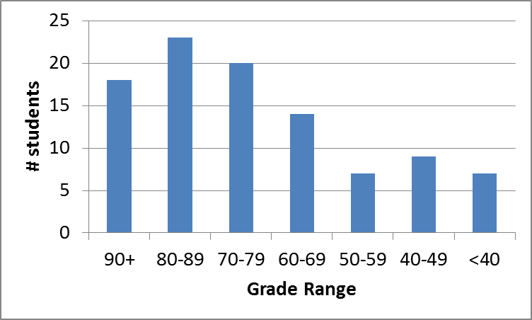
Exam stats & grade distribution
Average: 72.2
Median: 76.8
Std. deviation: 18.4
Max: 99
Question-by-question averages:
  Q1: 12.4 / 20 (62%)
  Q2: 32.8 / 40 (82%)
  Q3: 27.0 / 40 (68%)
Extra credit
  58 students completed
  6.9 average
ECE Application Programming: Lecture 14

Slide 7
Regrade requests
Due 10/15
Must be written
You must also return your exam
  Do not write on your exam if you plan on submitting a regrade request
Must demonstrate understanding of problem
  Bad: “I deserve more points on Problem 2a.”
  Good: “I deserve more points on Problem 2a because I calculated a wrong value for f based on an incorrect value for x. I used the right formula; I just plugged in the wrong value.”
ECE Application Programming: Lecture 14

Slide 8
Final notes
Next time
  Pointer arguments
Reminders:
  Program 5 to be posted; due date TBD
  No class Monday
ECE Application Programming: Lecture 14

