Slide 1
16.216
ECE Application Programming
Instructor: Dr. Michael Geiger
Fall 2014
Lecture 35:
Dynamically allocated data structures (continued)

Slide 2
Lecture outline
Announcements/reminders
  Program 10 due 12/10 (last day of classes)
  Grading notes
    P5 grading done; just needs review
    Late penalties halved (starting with P4)
      Divide actual late days by 2
      No deduction for 1 day late, -1 for 2-3 days late, etc.
    Max penalty still -32
    Will drop lowest of 10 program grades
Today’s class
  Continue with dynamically allocated data structures
ECE Application Programming: Lecture 35

Slide 3

Review: pointer-based data structures
Data structures to optimize data organization
Structure containing pointer(s) to other structure
  Adding data: allocate space for new node, then adjust pointers
Example: linked list
typedef struct node {
int value; // Data
struct node *next; // Pointer to
// next node
} LLnode;
    Image source: http://en.wikipedia.org/wiki/Linked_list
ECE Application Programming: Lecture 35

Slide 4
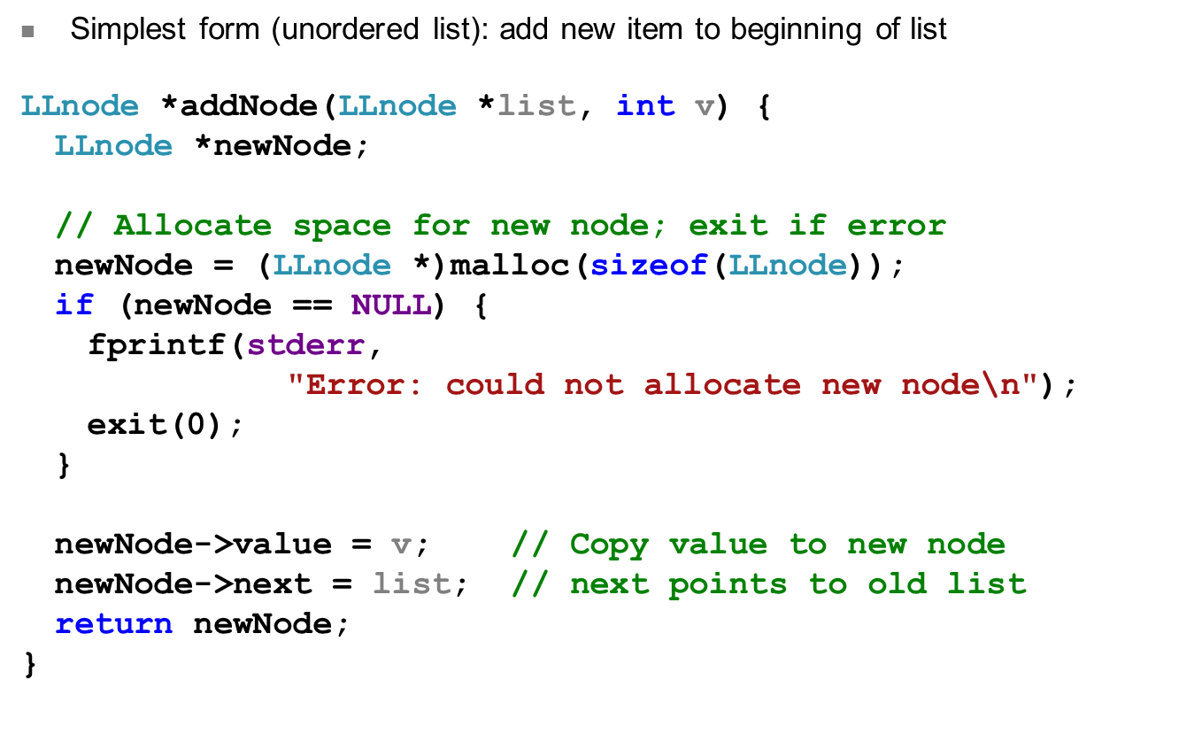
Review: Adding to list
ECE Application Programming: Lecture 35

Slide 5
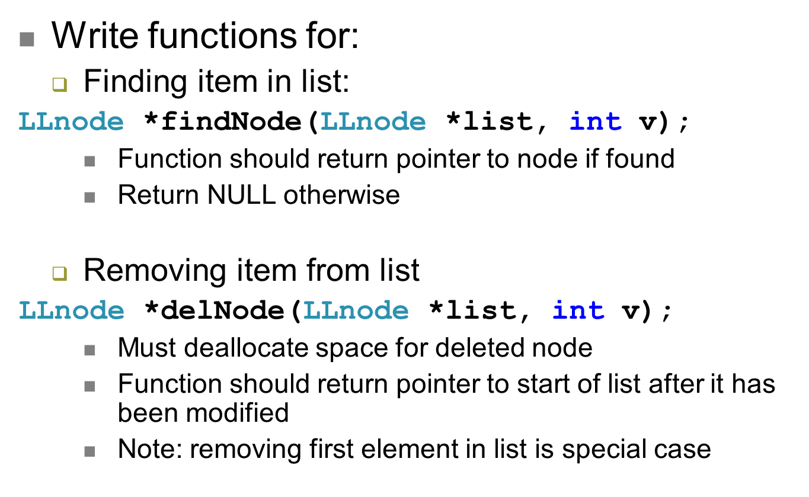
Examples
ECE Application Programming: Lecture 35

Slide 6
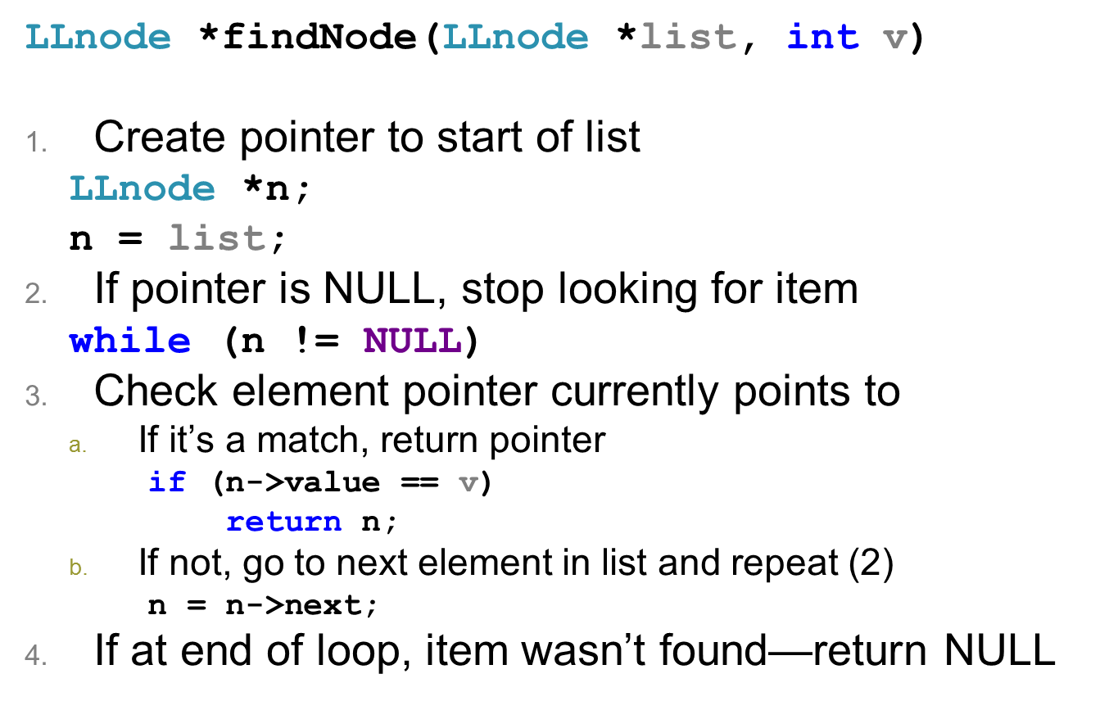
Finding item in list
ECE Application Programming: Lecture 35

Slide 7
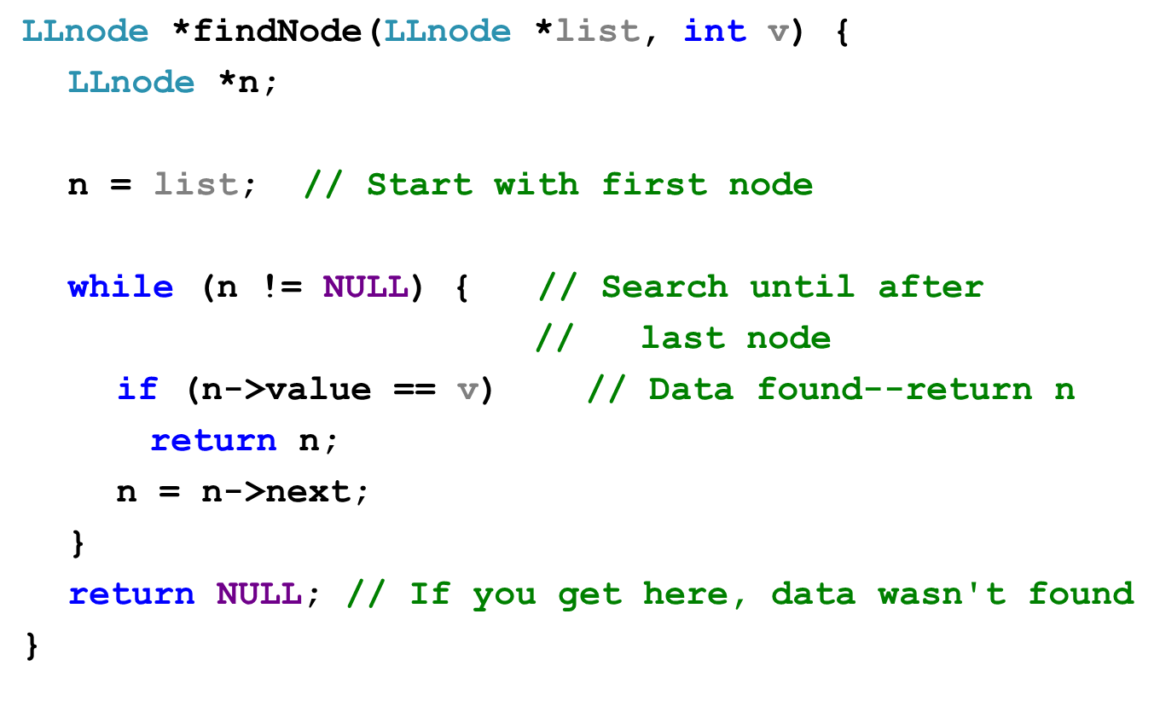
Solution
ECE Application Programming: Lecture 35

Slide 8
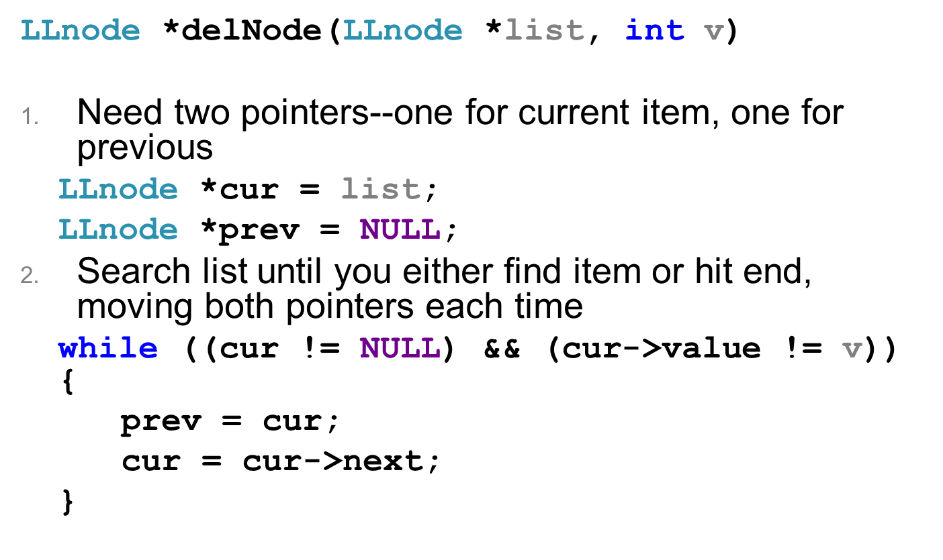
Deleting item from list
ECE Application Programming: Lecture 35

Slide 9
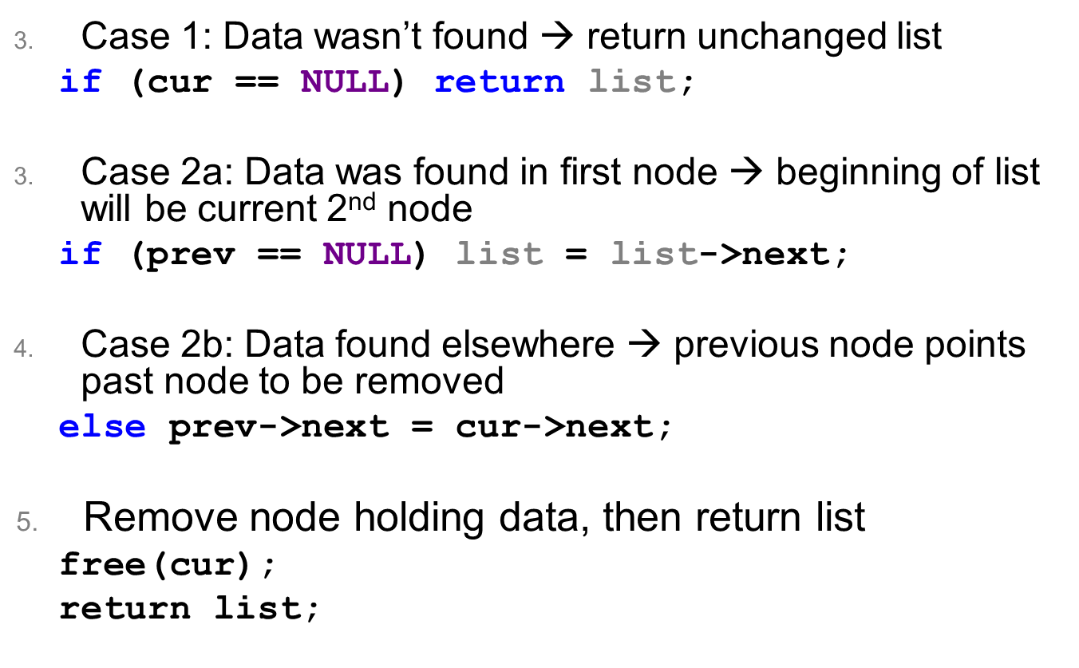
Deleting item from list (continued)
ECE Application Programming: Lecture 35

Slide 10
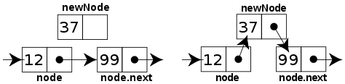
Sorted linked list
Can ensure each item is sorted as it’s added
  Slower item insertion, but faster search
Not easy with arrays: must move existing data
Keeping linked list sorted
  Find appropriate location
    Often done by going “past” appropriate spot
  Modify pointers
    Node before correct spot points to new node
    New node points to node after correct spot
    Image source: http://en.wikipedia.org/wiki/Linked_list
ECE Application Programming: Lecture 35

Slide 11
Next time
Finish discussing dynamically allocated data structures
Reminders:
  Program 10 due 12/10 (last day of classes)
  Grading notes
    P5 grading done; just needs review
    Late penalties halved (starting with P4)
      Divide actual late days by 2
      No deduction for 1 day late, -1 for 2-3 days late, etc.
    Max penalty still -32
    Will drop lowest of 10 program grades
ECE Application Programming: Lecture 35

