Slide 1
16.216
ECE Application Programming
Instructor: Dr. Michael Geiger
Fall 2014
Lecture 5:
scanf() examples
PE1: Flowcharts and debugging

Slide 2
Lecture outline
Announcements/reminders
  Program 2 due 9/17
Review
  Operators
  Basic variable output with printf()
  Basic variable input with scanf()
Today’s lecture
  scanf() examples
  PE1: Flowcharts and debugging
ECE Application Programming: Lecture 5

Slide 3
Review: Arithmetic Operations
Operation | Operator
Addition | +
Subtraction | -
Multiplication | *
Division | /
Modulus Division (Remainder) | %
ECE Application Programming: Lecture 5

Slide 4
Review: printf() basics
To print variables (or constants), insert %<type> in your printf() format string
  %c: single character
  %d or %i: signed decimal integer
  %u: unsigned decimal integer
  %x or %X: unsigned hexadecimal integer
  %f: float
  %lf: double
  %s: string
Each %<type> must correspond to a variable or constant that follows
  printf("a=%f, b=%f",a,b);
ECE Application Programming: Lecture 5

Slide 5
Review: scanf()
To read input, use format specifiers in scanf() format string, followed by addresses of variables
  scanf("%d %f",&hours,&rate);
Space in format string only matters if using %c format specifier
If format of input does not match format specifier, scanf() stops and returns # values successfully read
ECE Application Programming: Lecture 5

Slide 6
scanf() return value
scanf() returns # of successfully read items
  Ex.: given scanf("%d%d", &x, &y);
    Input: 3 7 → x = 3, y = 7, return value = 2
    Input: 3 7.2 → x = 3, y = 7, return value = 2
    Input: 3 .3 → x = 3, y = ?, return value = 1
      y is unchanged
    Input: x1 7 → x = ?, y = ?, return value = 0
      x, y both unchanged
Can assign return value to variable
  Example:
  int numRead; // # input values read
  numRead = scanf("%d%d", &x, &y);
ECE Application Programming: Lecture 4

Slide 7
Example
Variables: int i; double d; char c;
What values are read for each of the following inputs and scanf() calls? Assume the input is as follows: 34 5.7
  scanf("%d%lf", &i, &d)
  scanf("%d %lf", &i, &d)
  scanf("%lf%d", &d, &i)
  scanf("%d%c", &i, &c)
  scanf("%d %c", &i, &c)
ECE Application Programming: Lecture 5

Slide 8
Example solution
What values are read for each of the following inputs and scanf() calls?
  scanf("%d%lf", &i, &d)
  → i = 34, d = 5.7
  scanf("%d %lf", &i, &d)
  → i = 34, d = 5.7
  scanf("%lf%d", &d, &i)
  → d = 34, i = 5
  scanf("%d%c", &i, &c)
  → i = 34, c = ' ' (space)
  scanf("%d %c", &i, &c)
  → i = 34, c = '5'
ECE Application Programming: Lecture 5

Slide 9
Using scanf() and printf() together
#include <stdio.h>
int main()
{
int hours;
float rate;
float grosspay;
printf("Enter hours: ");
scanf("%d",&hours);
printf("Enter pay rate: ");
scanf("%f",&rate);
grosspay = hours * rate;
printf("You earned $%f\n",grosspay);
}
ECE Application Programming: Lecture 5
Notes:
ECE 160 - Introduction to Computer Engineering I
02/09/2005
(c) 2005, P. H. Viall

Slide 10
scanf() function - Payroll Ver 2
#include <stdio.h>
int main()
{
double hours;
double rate;
double grosspay;
printf("Enter hours: ");
scanf("%lf",&hours);
printf("Enter pay rate: ");
scanf("%lf",&rate);
grosspay = hours * rate;
printf("You earned $%lf\n",grosspay);
}
ECE Application Programming: Lecture 5
Notes:
ECE 160 - Introduction to Computer Engineering I
02/09/2005
(c) 2005, P. H. Viall

Slide 11
Flowcharts
Graphical representation of process
  Shows all steps and their order
  In programming, use to organize program before writing code
Basic elements
Process
Terminator (start/end)
Input/Output
Connector
Decision
Connector (off page)
ECE Application Programming: Lecture 5

Slide 12

Example: Quadratic Equation Solver
Start
Output
“Quadratic Equation Solver”
Output
“Enter A, B, C: ”
Input A, B, C
ECE Application Programming: Lecture 5

Slide 13

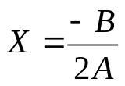

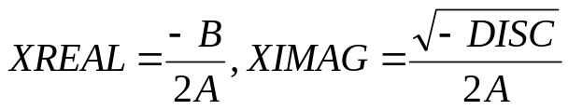
Quadratic Equation Solver (cont.)
A = 0?
TRUE
Output
X
FALSE
DISC=B*B-4*A*C
DISC = 0?
TRUE
Output
X
FALSE
DISC>0?
TRUE
Output
X1,X2
FALSE
Output
XREAL + XIMAG i
XREAL – XIMAG i
ECE Application Programming: Lecture 5
Done

Slide 14
Exercise: Flowchart
Design a flowchart to solve the following:
  Prompt a user to enter four numbers on a single line, which represent the contents of a 2x2 array
  After reading the values, your program should print the matrix represented by these values
    For example, if the user enters “1 2 3 4”, print:
  1 2
  3 4
    Assume all values have the same number of digits
  Also, calculate the matrix discriminant and print it on a separate line
    In the example above, discriminant = (1x4) - (2x3) = 4-6 = -2
ECE Application Programming: Lecture 5

Slide 15
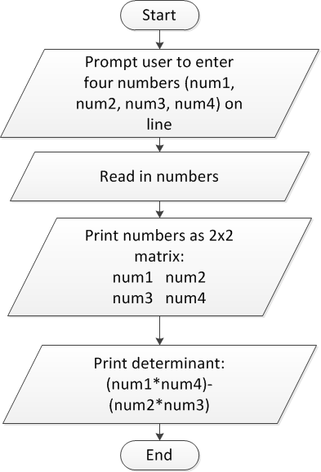
Flowchart: solution
ECE Application Programming: Lecture 5

Slide 16
Converting flowchart to program
What data are used in the process?
  Can those data be represented as constants?
  If not, what variables are needed?
    How many?
    What type(s)?
    How should variables be named?
What C statement corresponds to each process step?
  Input statements: scanf()
  Output statements: printf()
  Terminators: start/end of main() function
    Will generalize later to any function
  General process steps: basic expressions
    May need multiple lines of code
ECE Application Programming: Lecture 5

Slide 17
Debugging
Most IDEs allow ability to view state of program while running through debugger
  View variable values
  Execute program:
    One line at a time (single step)
    By running until reaching a pre-defined stopping point (breakpoint)
Can isolate bugs without altering program
  Alternate solution: inserting print statements to show program state at various points
  Disadvantages
    Inefficient--repeated compilation, must keep adding statements
    May actually alter operation of other statements
ECE Application Programming: Lecture 5

Slide 18
Debugger demonstration
Demonstration of Visual Studio debugger
  Variables
    Watch window
    Autos window
    Locals window
  Single step options
    Step over
    Step into/step out
  Breakpoints
    Setting breakpoints
    Running to next breakpoint
ECE Application Programming: Lecture 5

Slide 19
Final notes
Next time
  Output formatting
  Conditional statements: if
Reminders:
  Program 2 due 2/5
ECE Application Programming: Lecture 5

