Slide 1
16.216
ECE Application Programming
Instructor: Dr. Michael Geiger
Spring 2012
Lecture 15: Exam 1 Review

Slide 2
Lecture outline
Announcements/reminders
  Program 5 to be posted ASAP
  Grading on previous programs to be completed ASAP
Today: Exam 1 Review
  Exam stats
  Regrades
  Exam solution
Early feedback forms
ECE Application Programming: Exam 1 Review

Slide 3
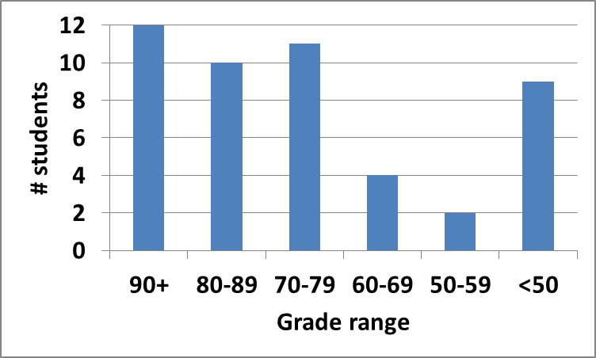
Exam stats & grade distribution
Average: 73.6
Median: 78.25
Std. deviation: 21.1
Max: 99
Question-by-question averages:
  Q1: 15.9 / 20 (80%)
  Q2: 30.9 / 40 (77%)
  Q3: 26.7 / 40 (67%)
Extra credit
  26 students completed
  6.5 average
ECE Application Programming: Exam 1 Review

Slide 4
Notes
Extra credit: added after finding overall average
Grading breakdown
  Programs: 60% (4 of ~10 complete)
  Exam 1: 10%
  Exam 2: 15%
  Exam 3: 15%
Additional assistance
  Instructor office hours
    Dr. Geiger: M/W/Th 1-3, Engineering 118A
    Sai (TA): M/W 9:30-11:30 AM, Ball 220
    Both available by appointment—contact via e-mail
  Help from tutoring center
ECE Application Programming: Exam 1 Review

Slide 5
Regrade requests
Due 3/7
Must be written
You must also return your exam
  Do not write on your exam if you plan on submitting a regrade request
Must demonstrate understanding of problem
  Bad: “I deserve more points on Problem 2a.”
  Good: “I deserve more points on Problem 2a because I calculated a wrong value for ivarB based on an incorrect value for ivarA. I used the right formula; I just plugged in the wrong value.”
ECE Application Programming: Exam 1 Review

Slide 6
Next time
Loops
ECE Application Programming: Exam 1 Review

