Slide 1
16.216
ECE Application Programming
Instructor: Dr. Michael Geiger
Spring 2012
Lecture 20: PE3 (continued)

Slide 2
Lecture outline
Announcements/reminders
  Program 5 posted; due 3/26
    Flowcharts due 3/21
  Program 4 grading to be done today
Today
  Review: break/continue statements
  Finish PE3
ECE Application Programming: Lecture 20

Slide 3
Review: break/continue
Exiting loop early: break
  Useful if exit condition can occur in middle of loop, e.g.
    do {
    scanf(“%lf”, &grd);
    if ((grd < 0.0) || (grd > 100.0))
    break;
    // Implied “else”
    grdTotal = grdTotal + grd;
    grdCount = grdCount + 1;
    } while (1);
Exiting current iteration early: continue
  Similar to break, but only ends current iteration
  When used with for loop, does execute variable change (e.g., i++ in for (i = 0; i < 10; i++))
ECE Application Programming: Lecture 20

Slide 4
Last time: PE3 program
Prompt the user to enter a single input character followed by an integer, n.
  If not correctly formatted, print error, clear rest of line, and repeat prompt
Depending on the character entered, do the following:
  ‘F’ or ‘f’: Compute and print the factorial of n, n!
    For example, if the user enters F 5, print 5! = 120
  ‘P’ or ‘p’: Compute 2^{n}, but only if n >= 0.
    For example, if the user enters p 2, print 2^2 = 4
    Print an error if n < 0.
  ‘X’ or ‘x’: Exit the program
  In all other cases, print an error:
    For example: Invalid command Z entered
If the user enters any command other than ‘X’ or ‘x’, return to the initial prompt and repeat the program.
ECE Application Programming: Lecture 20

Slide 5
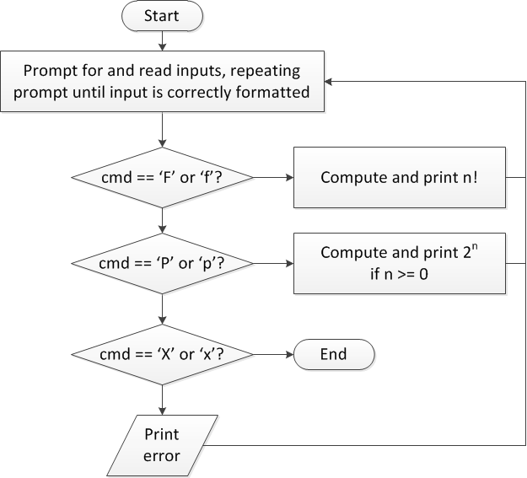
Flow charts: overall flow
ECE Application Programming: Lecture 20

Slide 6
Discussion: Overall flow
Whole program contains loop
  Repeats process until user enters ‘X’ or ‘x’
  Use while or do-while—unknown # of iterations
  Since exit condition ends program, infinite loop
Testing cmd: switch statement
  Checking equality of cmd to constant values
Exiting program: return statement
  Use return at any point to end current function (including main)
ECE Application Programming: Lecture 20

Slide 7
Code: overall flow (skeleton code)
while (1) { // Loop repeats until user enters 'X' or 'x'
/* Code to read cmd, n */
/* Evaluate cmd and perform appropriate operation */
switch (cmd) {
case 'F':
case 'f':
/* Calculate n! */
break;
case 'P':
case 'p':
/* Calculate 2^n, if n >= 0; print error otherwise */
break;
case 'X':
case 'x':
return;// Exit program
default:
printf("Invalid command %c entered\n", cmd);
}
}
ECE Application Programming: Lecture 20

Slide 8
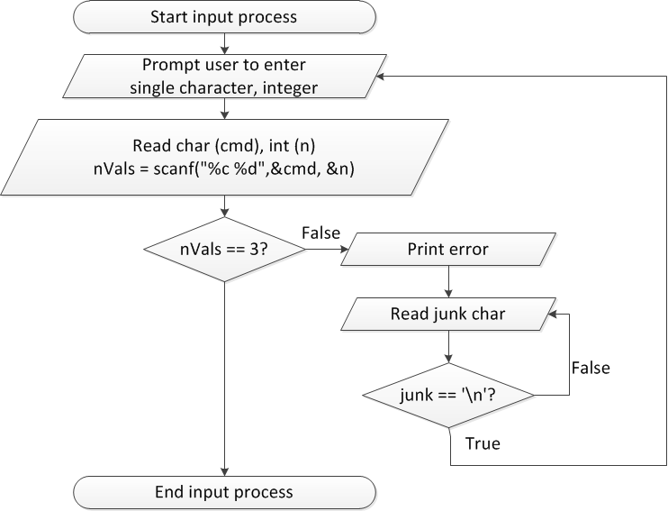
Flow charts: reading input
ECE Application Programming: Lecture 20

Slide 9
Discussion: Reading input
Loop that repeats as long as input incorrect
  Once input formatted correctly, exit → break
Loop inside that one to handle reading of remainder of line
  Read character until you reach end of line
Both while/do-while loops
ECE Application Programming: Lecture 20

Slide 10
Code: Reading input
do {
printf("Enter command and integer: ");
nVals = scanf("%c %d", &cmd, &n);
// Correctly formatted input
if (nVals == 3)
break;
// Otherwise, clear line
do {
scanf("%c", &junk);
} while (junk != '\n');
} while (1);
ECE Application Programming: Lecture 20

Slide 11
Today
Write flowcharts for
  Computing n!
  Computing 2^{n} if n >= 0
Complete code
ECE Application Programming: Lecture 20

Slide 12
Program 5
Similar to this exercise, Program 4
Errors do not cause program to exit
Read expression
  If incorrect, print error and repeat prompt
Operations
  A^{n} → A ^ n
    Note that n can be negative, 0, or positive
  Nth root of A → A R n or A r n
    Uses iterative methods
  Cannot use <math.h>
ECE Application Programming: Lecture 20

Slide 13
Iterative methods
Repeat calculation until correct value reached
“Correctness” defined as:
  Difference between old, new value <= max error
  Max error == .000001 in Prog. 5
General process:
newVal = <initial value>;
do {
oldVal = newVal;
newVal = <equation based on oldVal>;
} while (fabs(newVal – oldVal) > max_err);
Remember, you can’t use <math.h>, so you’ll need your own way of computing absolute value (fabs())
ECE Application Programming: Lecture 20

Slide 14
Next time
Functions
ECE Application Programming: Lecture 20

