Slide 1
16.216
ECE Application Programming
Instructor: Dr. Michael Geiger
Spring 2012
Lecture 27: Exam 2 Review

Slide 2
Lecture outline
Announcements/reminders
  Program 6 due 4/11
  Grading on previous programs to be completed ASAP
Today: Exam 2 Review
  Exam stats
  Regrades—as with Exam 1, one week to complete (due 4/13)
  Figuring out where you stand
  Exam solution
ECE Application Programming: Exam 2 Review

Slide 3
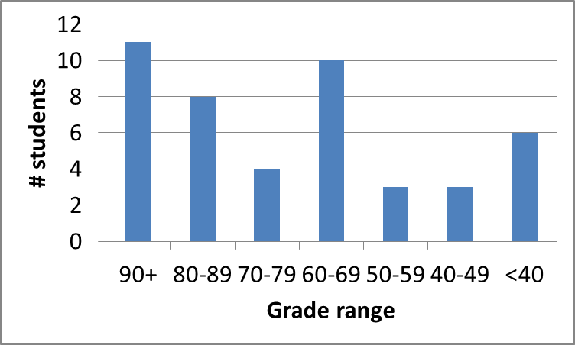
Exam stats & grade distribution
Average: 69.6
Median: 70
Std. deviation: 22.7
Max: 100
  4 perfect scores
Question-by-question averages:
  Q1: 12.2 / 20 (61%)
  Q2: 28.6 / 40 (71%)
  Q3: 28.8 / 40 (72%)
Extra credit
  22 students completed
  7.0 average
ECE Application Programming: Exam 2 Review

Slide 4
Figuring out where you stand
Programs: 60% (5/9 done; 4/9 graded)
Exams: 40% (10% + 15% + 15%)
~45% of your grade still to be determined
Estimating your grade
  Program avg (PA) = (total program points) / 3.5
  Exam avg (EA) =
  ((Exam1) + (Exam2 * 1.5)) / 2.5
  Overall avg = PA * 0.6 + EA * 0.4
ECE Application Programming: Exam 2 Review

Slide 5
Figuring out where you stand
Estimated avg = PA * 0.6 + EA * 0.4
Current course average: ~80%, SD = 16
  You should assume final grades will not be curved
Typical grading scale without curve
  A: 93+
  A-: 90-92
  B+: 88-89
  B: 83-87
  B-: 80-82
  C+: 78-79
  C: 73-77
  C-: 70-72
  D+: 68-69
  D: 60-67
  F: < 60
ECE Application Programming: Exam 2 Review

Slide 6
Next time
Loops
ECE Application Programming: Exam 2 Review

