Slide 1
16.216
ECE Application Programming
Instructor: Dr. Michael Geiger
Spring 2013
Lecture 18:
PE3: Functions

Slide 2
Lecture outline
Announcements/reminders
  Midterm grades in iSiS
  Program 6 due 3/22
  Program 4, 5 regrades due 3/25
  Exam 2 Wednesday, 3/27
Today’s class
  PE3: Writing functions
Note: We’ll review arrays Wednesday, when we start discussing them again
ECE Application Programming: Lecture 18

Slide 3
PE3: Change problem
Given any amount of change under $2.00, determine and print out the minimum number of coins required to make that amount of change.
  Available coins are Halves (half dollars), Quarters, Dimes, Nickels, and Pennies.
ECE Application Programming: Lecture 18

Slide 4
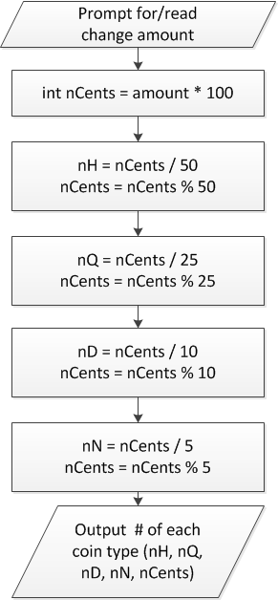
Flowchart
Treat change amount as integer (nCents)
  Can now use division & modulus
nCents = # pennies after previous four coin types have been taken out
ECE Application Programming: Lecture 18

Slide 5
When to use functions
Find a particular step or series of steps being repeated in your code
  If code is exactly the same, you need no arguments
  If one or more values change, but actual calculations are the same, values can be function arguments
  If function modifies:
    1 variable: just return it
    2+ variables: use pointer argument(s)
Reassess change example
  Steps for creating change are extremely similar
  What changes each time?
  How should we use those values in a function?
    Inputs, outputs, variables … ?
ECE Application Programming: Lecture 18

Slide 6
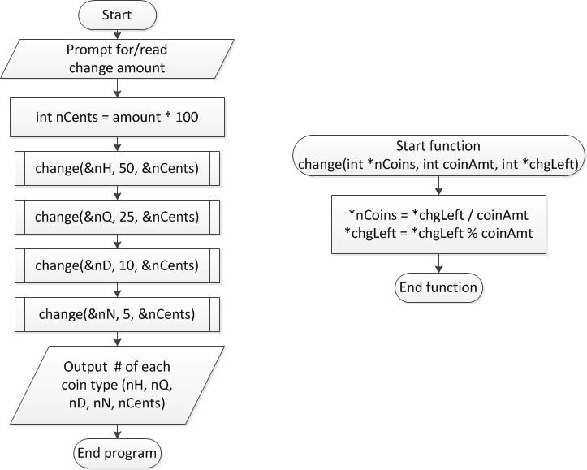
Overall flowchart
ECE Application Programming: Lecture 18

Slide 7
Next time
Two dimensional arrays; arrays and functions
Announcements/reminders
  Midterm grades in iSiS
  Program 6 due 3/22
  Program 4, 5 regrades due 3/25
  Exam 2 Wednesday, 3/27
ECE Application Programming: Lecture 18

