Slide 1
16.216
ECE Application Programming
Instructor: Dr. Michael Geiger
Spring 2014
Lecture 12:
Exam 1 Review

Slide 2
Lecture outline
Announcements/reminders
  Program 4 due 2/28
  CoE free skate today 1:30-2:50 @ Tsongas
Today’s class: Exam 1 Review
  Exam stats
  Regrade requests
  Solution
ECE Application Programming: Exam 1 Review

Slide 3
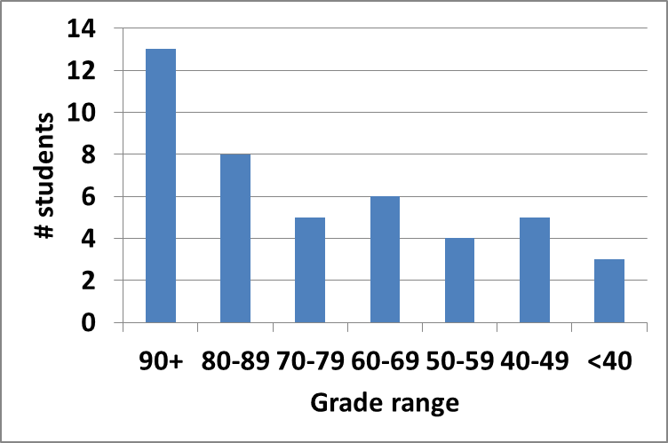
Exam stats & grade distribution
Average: 72.8
Median: 79
Std. deviation: 21
Max: 96
Question-by-question averages:
  Q1: 13.4 / 20 (67%)
  Q2: 31.8 / 40 (80%)
  Q3: 27.6 / 40 (69%)
Extra credit
  35 students completed
  6.2 average
ECE Application Programming: Exam 1 Review

Slide 4
Regrade requests
Due 2/28
Must be written
You must also return your exam
  Do not write on your exam if you plan on submitting a regrade request
Must demonstrate understanding of problem
  Bad: “I deserve more points on Problem 2a.”
  Good: “I deserve more points on Problem 2a because I calculated a wrong value for f based on an incorrect value for x. I used the right formula; I just plugged in the wrong value.”
ECE Application Programming: Exam 1 Review

Slide 5
Final notes
Next time
  For loops
Reminders:
  Program 4 due 2/28
  CoE free skate today 1:30-2:50 @ Tsongas
ECE Application Programming: Exam 1 Preview

