Slide 1
16.216
ECE Application Programming
Instructor: Dr. Michael Geiger
Summer 2012
Lecture 6
PE3: Loops
Functions
Exam 1 Review

Slide 2
Lecture outline
Announcements/reminders
  Program 5 due Tuesday, 7/31
  Program 6 posted; due Friday, 8/3
  Program 7/8 due dates pushed back; no Program 9
  Will catch up on program grading ASAP
  Exam 2 next Thursday, 8/2
Today’s lecture:
  PE3: Loops
  Functions
  Exam 2 Review
ECE Application Programming: Lecture 6

Slide 3
Review: loops
Used for repetition of code
while (<expression>)
  <statement> ← loop body
do {
<statements>
} while ( <expression> );
for (<init var>; <test>; <change var>)
<statements>
Exiting loop early: break
Skipping rest of loop body (but staying in loop): continue
Operators to directly change variable
  x++, x-- → post-increment/decrement
  ++x, --x → pre-increment/decrement
  +=, -=, *=, /= → augmented assignment
ECE Application Programming: Lecture 6

Slide 4
Today’s program should:
Prompt the user to enter a single input character followed by an integer, n.
  If not correctly formatted, print error, clear rest of line, and repeat prompt
Depending on the character entered, do the following:
  ‘F’ or ‘f’: Compute and print the factorial of n, n!
    For example, if the user enters F 5, print 5! = 120
  ‘P’ or ‘p’: Compute 2^{n}, but only if n >= 0.
    For example, if the user enters p 2, print 2^2 = 4
    Print an error if n < 0.
  ‘X’ or ‘x’: Exit the program
  In all other cases, print an error:
    For example: Invalid command Z entered
If the user enters any command other than ‘X’ or ‘x’, return to the initial prompt and repeat the program.
ECE Application Programming: Lecture 6

Slide 5
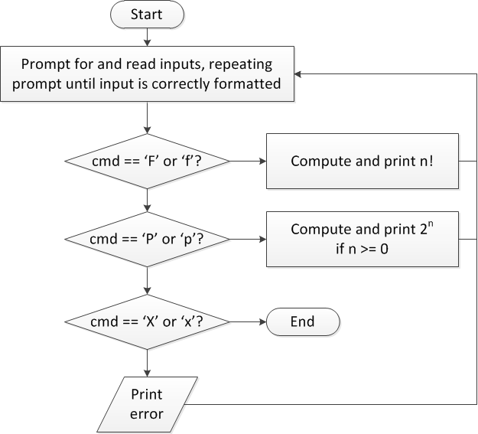
Flow charts: overall flow
ECE Application Programming: Lecture 6

Slide 6
Discussion: Overall flow
Whole program contains loop
  Repeats process until user enters ‘X’ or ‘x’
  Use while or do-while—unknown # of iterations
  Since exit condition ends program, infinite loop
Testing cmd: switch statement
  Checking equality of cmd to constant values
Exiting program: return statement
  Use return at any point to end current function (including main)
ECE Application Programming: Lecture 6

Slide 7
Code: overall flow (skeleton code)
while (1) { // Loop repeats until user enters 'X' or 'x'
/* Code to read cmd, n */
/* Evaluate cmd and perform appropriate operation */
switch (cmd) {
case 'F':
case 'f':
/* Calculate n! */
break;
case 'P':
case 'p':
/* Calculate 2^n, if n >= 0; print error otherwise */
break;
case 'X':
case 'x':
return; // Exit program
default:
printf("Invalid command %c entered\n", cmd);
}
}
ECE Application Programming: Lecture 6

Slide 8
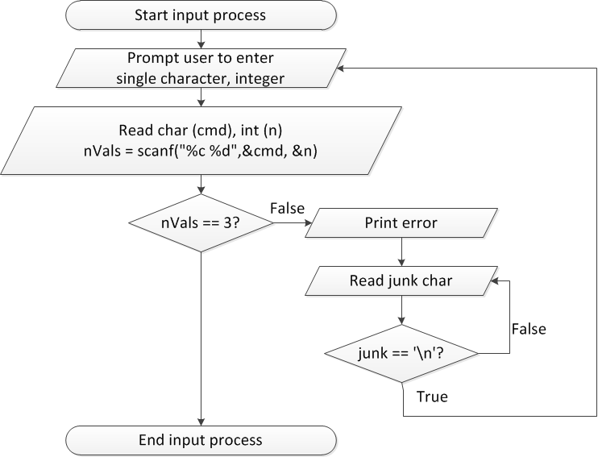
Flow charts: reading input
ECE Application Programming: Lecture 6

Slide 9
Discussion: Reading input
Loop that repeats as long as input incorrect
  Once input formatted correctly, exit → break
Loop inside that one to handle reading of remainder of line
  Read character until you reach end of line
Both while/do-while loops
ECE Application Programming: Lecture 6

Slide 10
Code: Reading input
do {
printf("Enter command and integer: ");
nVals = scanf("%c %d", &cmd, &n);
// Correctly formatted input
if (nVals == 3)
break;
// Otherwise, clear line
do {
scanf("%c", &junk);
} while (junk != '\n');
} while (1);
ECE Application Programming: Lecture 6

Slide 11
Next step
Write flowcharts for
  Computing n!
  Computing 2^{n} if n >= 0
Complete code
ECE Application Programming: Lecture 6

Slide 12
Program 5
Similar to this exercise, Program 4
Errors do not cause program to exit
Read expression
  If incorrect, print error and repeat prompt
Operations
  A^{n} → A ^ n
    Note that n can be negative, 0, or positive
  Nth root of A → A R n or A r n
    Uses iterative methods
  Cannot use <math.h>
ECE Application Programming: Lecture 6

Slide 13
Iterative methods
Repeat calculation until correct value reached
“Correctness” defined as:
  Difference between old, new value <= max error
  Max error == .000001 in Prog. 5
General process:
newVal = <initial value>;
do {
oldVal = newVal;
newVal = <equation based on oldVal>;
} while (fabs(newVal – oldVal) > max_err);
Remember, you can’t use <math.h>, so you’ll need your own way of computing absolute value (fabs())
ECE Application Programming: Lecture 6

Slide 14
Functions
Functions used to break problem down into small, "bite-sized" pieces.
  Make code more manageable and readable
  Identify reusable pieces
Functions have an optional type of return value, a name, and optional arguments
Functions return at most, ONE value
Functions must be either "prototyped" or declared prior to use. Good programming practices requires all functions to be prototyped.
ECE Application Programming: Lecture 6
Notes:
ECE 160 - Introduction to Computer Engineering I
02/09/2005
(c) 2005, P. H. Viall

Slide 15
Functions
name of function
type of value returned
parameters of function (variables in)
double hyp(double a, double b)
{
double sum, result;
sum = a*a + b*b;
result = sqrt(sum);
return result;
}
Alternate way of writing above function
double hyp(double a, double b)
{
return sqrt(a*a + b*b);
}
Single value returned by function
ECE Application Programming: Lecture 6

Slide 16
Functions - complete program
#include <stdio.h>
#include <math.h>
double hyp(double a, double b);
void main()
{
double x,y,h;
printf("Enter two legs of triangle: ");
scanf("%lf %lf",&x,&y);
h=hyp(x,y);
printf("Trgle w legs %lf and %lf has hyp of %lf\n",x,y,h);
}
double hyp(double a, double b)
{
double sum, result;
sum = a*a + b*b;
result = sqrt(sum);
return result;
}
prototype (note semi-colon )
actual function definition
(NO semi-colon )
ECE Application Programming: Lecture 6

Slide 17
Functions - scope
#include <stdio.h>
#include <math.h>
double hyp(double a, double b);
void main()
{
double x,y,h;
printf("Enter two legs of triangle: ");
scanf("%lf %lf",&x,&y);
h=hyp(x,y);
printf("Trgle w legs %lf and %lf has hyp of %lf\n",x,y,h);
}
double hyp(double a, double b)
{
double sum, result;
sum = a*a + b*b;
result = sqrt(sum);
return result;
}
x
?
y
?
h
?
a
?
b
?
sum
?
result
?
ECE Application Programming: Lecture 6

Slide 18
Functions - scope
#include <stdio.h>
#include <math.h>
double hyp(double a, double b);
void main()
{
double x,y,h;
printf("Enter two legs of triangle: ");
scanf("%lf %lf",&x,&y);
h=hyp(x,y);
printf("Trgle w legs %lf and %lf has hyp of %lf\n",x,y,h);
}
double hyp(double a, double b)
{
double sum, result;
sum = a*a + b*b;
result = sqrt(sum);
return result;
}
x
3.0
y
4.0
h
?
a
?
b
?
sum
?
result
?
ECE Application Programming: Lecture 6

Slide 19
Functions - scope
#include <stdio.h>
#include <math.h>
double hyp(double a, double b);
void main()
{
double x,y,h;
printf("Enter two legs of triangle: ");
scanf("%lf %lf",&x,&y);
h=hyp(x,y);
printf("Trgle w legs %lf and %lf has hyp of %lf\n",x,y,h);
}
double hyp(double a, double b)
{
double sum, result;
sum = a*a + b*b;
result = sqrt(sum);
return result;
}
x
3.0
y
4.0
h
?
a
3.0
b
4.0
sum
?
result
?
ECE Application Programming: Lecture 6

Slide 20
Functions - scope
#include <stdio.h>
#include <math.h>
double hyp(double a, double b);
void main()
{
double x,y,h;
printf("Enter two legs of triangle: ");
scanf("%lf %lf",&x,&y);
h=hyp(x,y);
printf("Trgle w legs %lf and %lf has hyp of %lf\n",x,y,h);
}
double hyp(double a, double b)
{
double sum, result;
sum = a*a + b*b;
result = sqrt(sum);
return result;
}
x
3.0
y
4.0
h
?
a
3.0
b
4.0
sum
25.0
result
?
ECE Application Programming: Lecture 6

Slide 21
Functions - scope
#include <stdio.h>
#include <math.h>
double hyp(double a, double b);
void main()
{
double x,y,h;
printf("Enter two legs of triangle: ");
scanf("%lf %lf",&x,&y);
h=hyp(x,y);
printf("Trgle w legs %lf and %lf has hyp of %lf\n",x,y,h);
}
double hyp(double a, double b)
{
double sum, result;
sum = a*a + b*b;
result = sqrt(sum);
return result;
}
x
3.0
y
4.0
h
?
a
3.0
b
4.0
sum
25.0
result
5.0
ECE Application Programming: Lecture 6

Slide 22
Functions - scope
#include <stdio.h>
#include <math.h>
double hyp(double a, double b);
void main()
{
double x,y,h;
printf("Enter two legs of triangle: ");
scanf("%lf %lf",&x,&y);
h=hyp(x,y);
printf("Trgle w legs %lf and %lf has hyp of %lf\n",x,y,h);
}
double hyp(double a, double b)
{
double sum, result;
sum = a*a + b*b;
result = sqrt(sum);
return result;
}
x
3.0
y
4.0
h
?
a
3.0
b
4.0
sum
25.0
result
5.0
ECE Application Programming: Lecture 6

Slide 23
Functions - scope
#include <stdio.h>
#include <math.h>
double hyp(double a, double b);
void main()
{
double x,y,h;
printf("Enter two legs of triangle: ");
scanf("%lf %lf",&x,&y);
h=hyp(x,y);
printf("Trgle w legs %lf and %lf has hyp of %lf\n",x,y,h);
}
double hyp(double a, double b)
{
double sum, result;
sum = a*a + b*b;
result = sqrt(sum);
return result;
}
x
3.0
y
4.0
h
5.0
NOTE - a and b are NOT copied back to x and y
ECE Application Programming: Lecture 6

Slide 24
Exercise - What prints (if 5, 12 entered)
#include <stdio.h>
#include <math.h>
double hyp(double a, double b);
void main()
{
double x,y,h;
printf("Enter two legs of triangle: ");
scanf("%lf %lf",&x,&y);
h=hyp(x,y);
printf("Trgle w legs %lf and %lf has hyp of %lf\n",x,y,h);
}
double hyp(double a, double b)
{
double sum, result;
a = 3;
b = 4;
sum = a*a + b*b;
result = sqrt(sum);
return result;
}
x
y
h
a
b
sum
result
ECE Application Programming: Lecture 6

Slide 25
Answer
Trgle w legs 5.000000 and 12.000000 has hyp of 5.00000
ECE Application Programming: Lecture 6

Slide 26
Example
What does the following print?
int f(int a, int b);
int main() {
  int x = 1;
  int y = 2;
  int result1, result2, result3;
  result1 = f(x, y);
  result2 = f(y, result1);
  result3 = f(result1, result2);
  printf("x = %d, y = %d\n", x, y);
  printf("Result 1: %d\n", result1);
  printf("Result 2: %d\n", result2);
  printf("Result 3: %d\n", result3);
  return 0;
}
int f(int a, int b)
{
  int i; // Loop index
  int r = 0; // Result
  for (i = 0; i < a; i++)
  r += b;
  return r;
}
ECE Application Programming: Lecture 6

Slide 27
Example solution
x = 1, y = 2
Result 1: 2
Result 2: 4
Result 3: 8
ECE Application Programming: Lecture 6

Slide 28
Example: Writing functions
Write a function that:
  Prints a series of LINE_LENGTH dashes on a single line
    LINE_LENGTH is a predefined constant (using #define)
  Reads an integer value from the console input and returns 1 if the value is even, 0 if it’s odd
  Takes four double-precision numbers as arguments and returns their average
ECE Application Programming: Lecture 6

Slide 29
Example solutions
Write a function that: prints a series of LINE_LENGTH dashes on a single line
  LINE_LENGTH is a predefined constant (using #define)
void printLine() {
int i;
for (i = 0; i < LINE_LENGTH; i++)
printf(“-”);
}
ECE Application Programming: Lecture 6

Slide 30
Example solutions (cont.)
  Write a function that: reads an integer value from the console input and returns 1 if the value is even, 0 if it’s odd
int checkEvenOdd() {
int value;
scanf(“%d”, &value);
if ((value % 2) == 0)
return 1;
else
return 0;
}
ECE Application Programming: Lecture 6

Slide 31
Example solutions (cont)
  Write a function that: takes four double-precision numbers as arguments and returns their average
double avgFour(double a, double b,
double c, double d)
{
return (a + b + c + d) / 4.0;
}
ECE Application Programming: Lecture 6

Slide 32
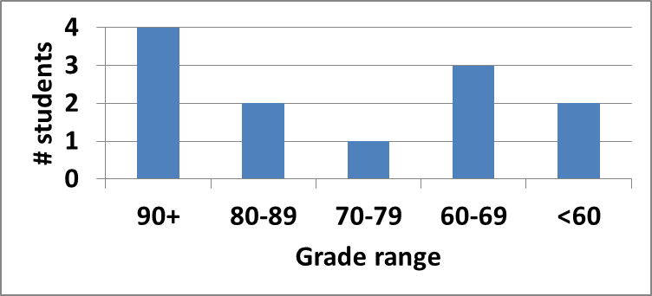
Exam 1 stats & grade distribution
Average: 75
Median: 78.25
Std. deviation: 20.5
Max: 97.5
Question-by-question averages:
  Q1: 17.5 / 20 (88%)
  Q2: 29.5 / 40 (74%)
  Q3: 28.0 / 40 (70%)
Extra credit
  9 students completed
  7.3 average
ECE Application Programming: Lecture 6

Slide 33
Regrade requests
Due 8/2
Must be written
You must also return your exam
  Do not write on your exam if you plan on submitting a regrade request
Must demonstrate understanding of problem
  Bad: “I deserve more points on Problem 2a.”
  Good: “I deserve more points on Problem 2a because I calculated a wrong value for intB based on an incorrect value for intA. I used the right formula; I just plugged in the wrong value.”
ECE Application Programming: Lecture 6

Slide 34
Next time
Pointers
Exam 2 Preview
Reminders
  Program 5 due Tuesday, 7/31
  Program 6 due Friday, 8/3
  Exam 2 Thursday, 8/2
ECE Application Programming: Lecture 6

