Slide 1
16.216
ECE Application Programming
Instructor: Dr. Michael Geiger
Spring 2015
Lecture 14:
Exam 1 Review

Slide 2
Lecture outline
Announcements/reminders
  Please see me to get your exam
  Program 4 due 3/4
Today’s lecture: Exam 1 Review
  Regrade requests
  Exam stats
  Solution
Microprocessors I: Exam 1 Review

Slide 3
Regrade requests
Due Monday, 3/9
Must be written (preferably on a separate sheet)
You must also return your exam
  Do not write on your exam if you plan on submitting a regrade request
Must demonstrate understanding of problem
  Bad: “I deserve more points on Problem 2a.”
  Good: “I deserve more points on Problem 2a because I calculated a wrong result for variable based on a wrong result from a previous variable. I used the right operation; I just plugged in the wrong value.”
Microprocessors I: Exam 1 Review

Slide 4

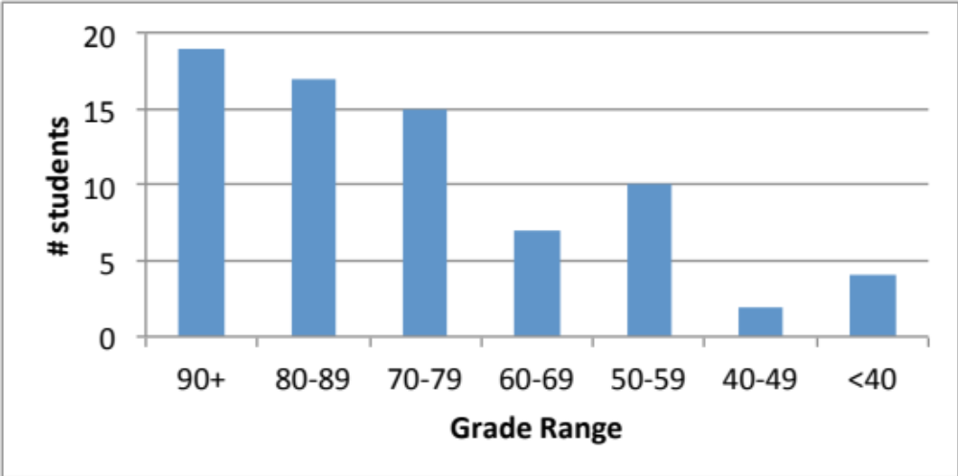
Exam stats & grade distribution
Question-by-question averages:
  Q1: 14.2 / 20 (71%)
  Q2: 32.4 / 40 (81%)
  Q3: 28.7 / 40 (72%)
  XC: 7.0 / 10 (45 responses)
Average: 75.2
Median: 78
Std. deviation: 17.4
Max: 99
Microprocessors I: Exam 1 Review

Slide 5
Final notes
Next time:
  Functions
Microprocessors I: Exam 1 Review

