Slide 1
16.216
ECE Application Programming
Instructor: Dr. Michael Geiger
Spring 2015
Lecture 33:
Dynamic memory allocation

Slide 2
Lecture outline
Announcements/reminders
  No lecture Friday—Dr. Geiger out of town Th-Sun
  Exam review session Monday 5/4, 11:30-? (at least 12:30), Ball 214_x0013_
  Program 9 due today
  Program 10 due 5/6
  Change in grading policy
    If you complete 9 programs, will drop lowest program grade
    If you complete 10 programs, will drop 2 lowest program grades
    Late penalties to be capped—turn in whatever you can by 5/8
Today’s class
  Dynamically allocated structures
ECE Application Programming: Lecture 34

Slide 3
Dynamic allocation and structures
Can use sizeof() to get # bytes in structure
Examples (using StudentInfo struct):
StudentInfo *p;
p = (StudentInfo *)malloc(sizeof(StudentInfo));
StudentInfo *arr;
int n;
printf("Enter array size: ");
scanf("%d", &n);
arr = (StudentInfo *)malloc(n * sizeof(StudentInfo));
ECE Application Programming: Lecture 34

Slide 4
Data structures
Data structure: way of storing and organizing data
  Arrays are one relatively inefficient example
Other structures designed to optimize:
  Organizing / sorting data
  Adding new data
  Removing unwanted data
  Searching for data
ECE Application Programming: Lecture 34

Slide 5
Pointer-based data structures
Many structures extensively use pointers
Each element within structure contains data + pointer(s) to one or more other elements
Usually functions for common operations
  Add new element
    Dynamically allocate new element
    Modify appropriate pointer(s) in other element(s) to point to new element
    Set pointer(s) in new element to point to other(s)
  Delete element
    Modify pointer(s) in other element(s) so they don’t point to element being removed
    Deallocate removed element
  Find element
    Follow pointers to move from one element to next
ECE Application Programming: Lecture 34

Slide 6

Linked list
Simple pointer-based structure: linked list
Each element (node) contains data + pointer to next element in list
Last element points to NULL
Program using list needs pointer to first node
Image source: http://en.wikipedia.org/wiki/Linked_list
ECE Application Programming: Lecture 34

Slide 7
Linked list definition
Structure to hold list of integers
typedef struct node {
int value; // Data
struct node *next; // Pointer to
// next node
} LLnode;
Note definition style has changed slightly
  Type “name” both before and after { }
  Name before (struct node) is necessary to use type inside structure definition
  Name after (LLnode) can be used in rest of program
ECE Application Programming: Lecture 34

Slide 8
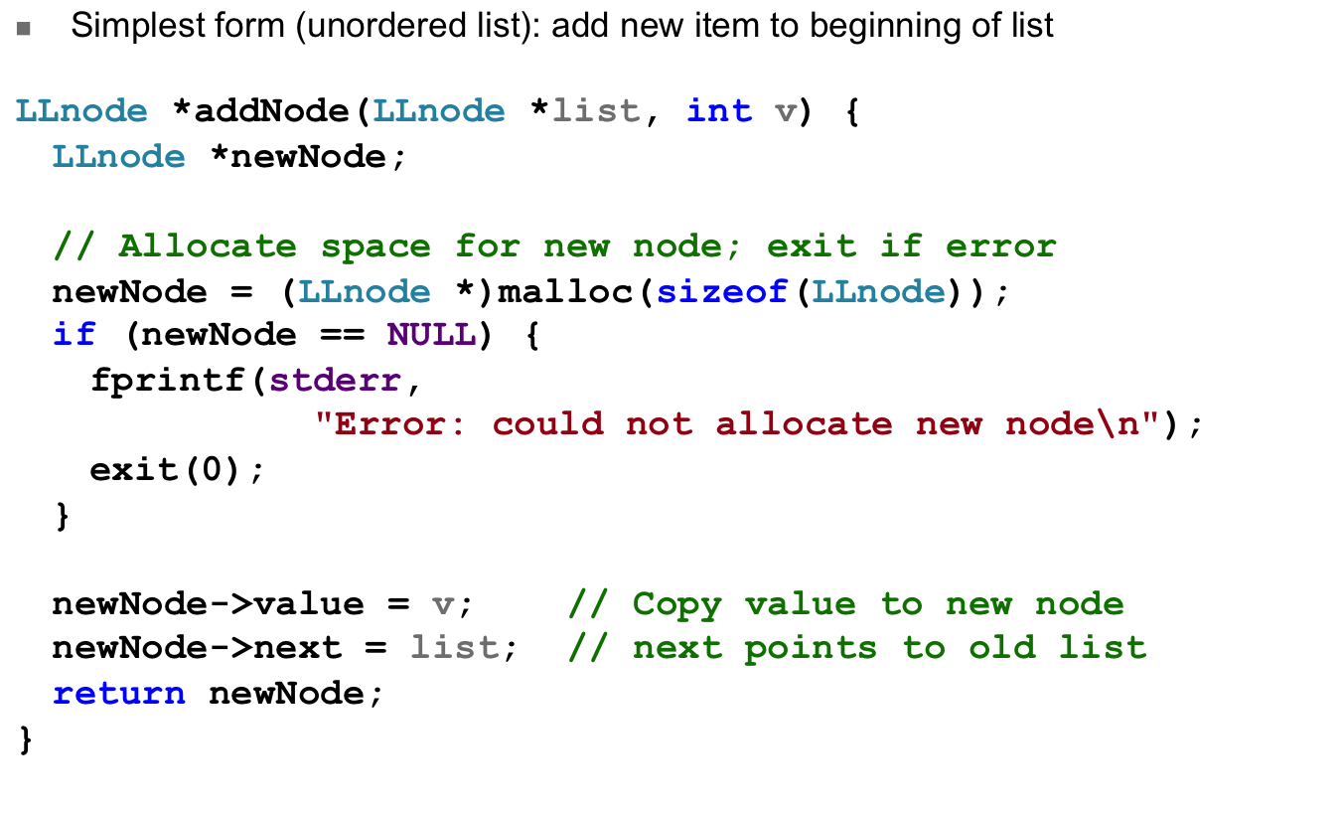
Adding to list
ECE Application Programming: Lecture 34

Slide 9
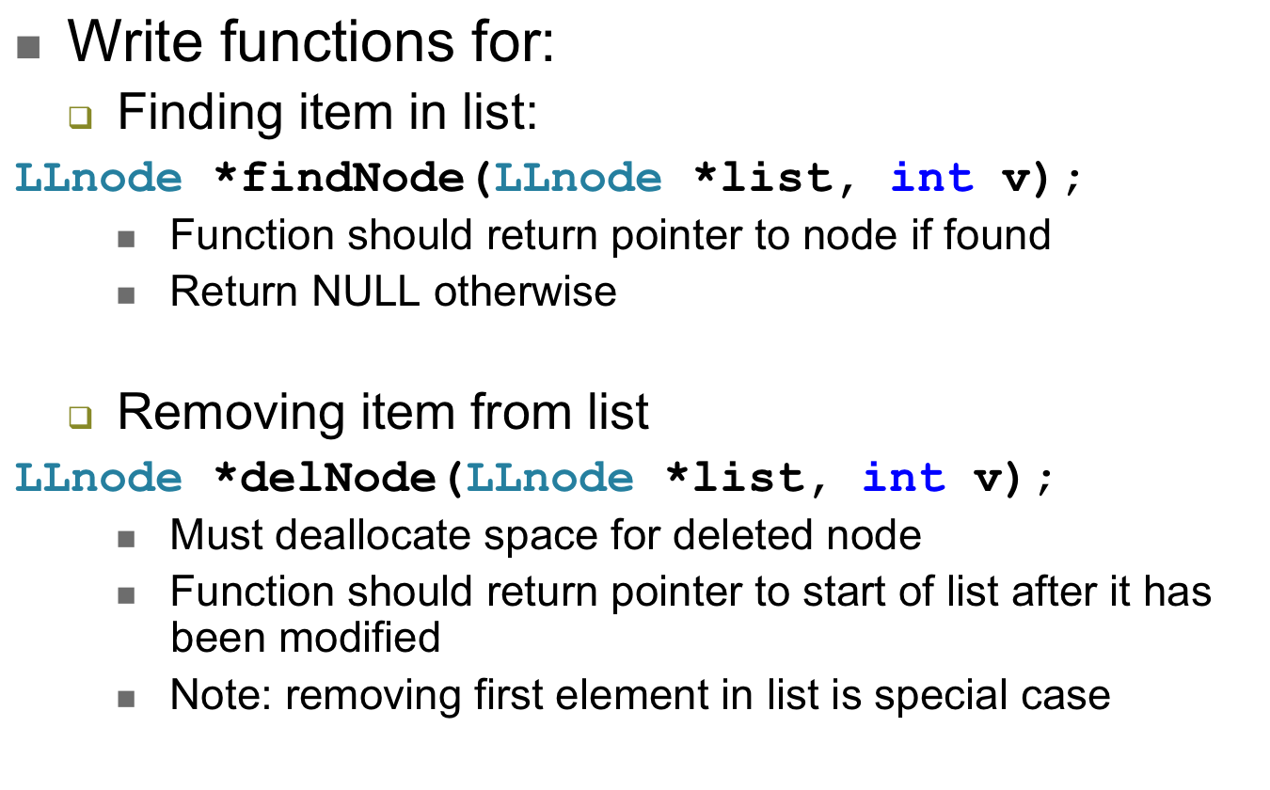
Examples
ECE Application Programming: Lecture 34

Slide 10
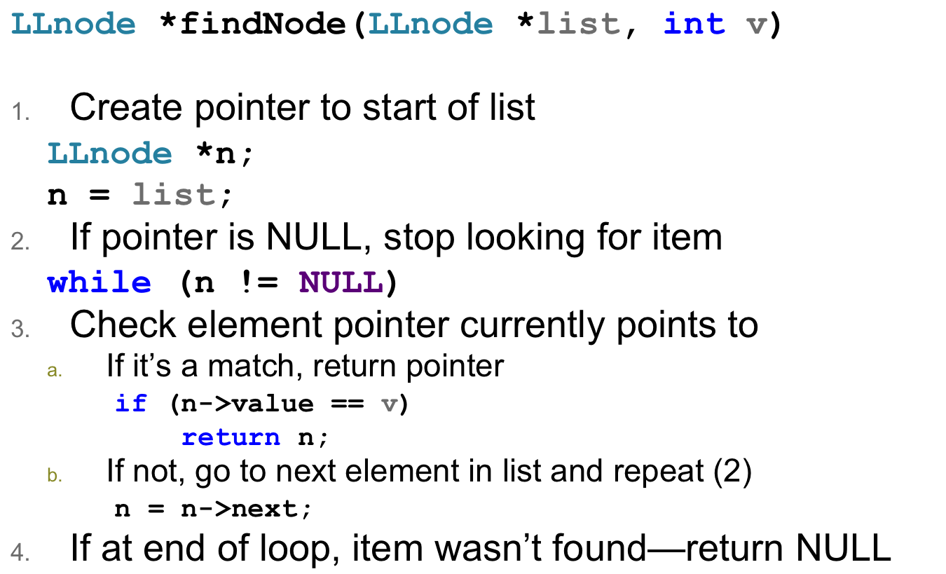
Finding item in list
ECE Application Programming: Lecture 34

Slide 11
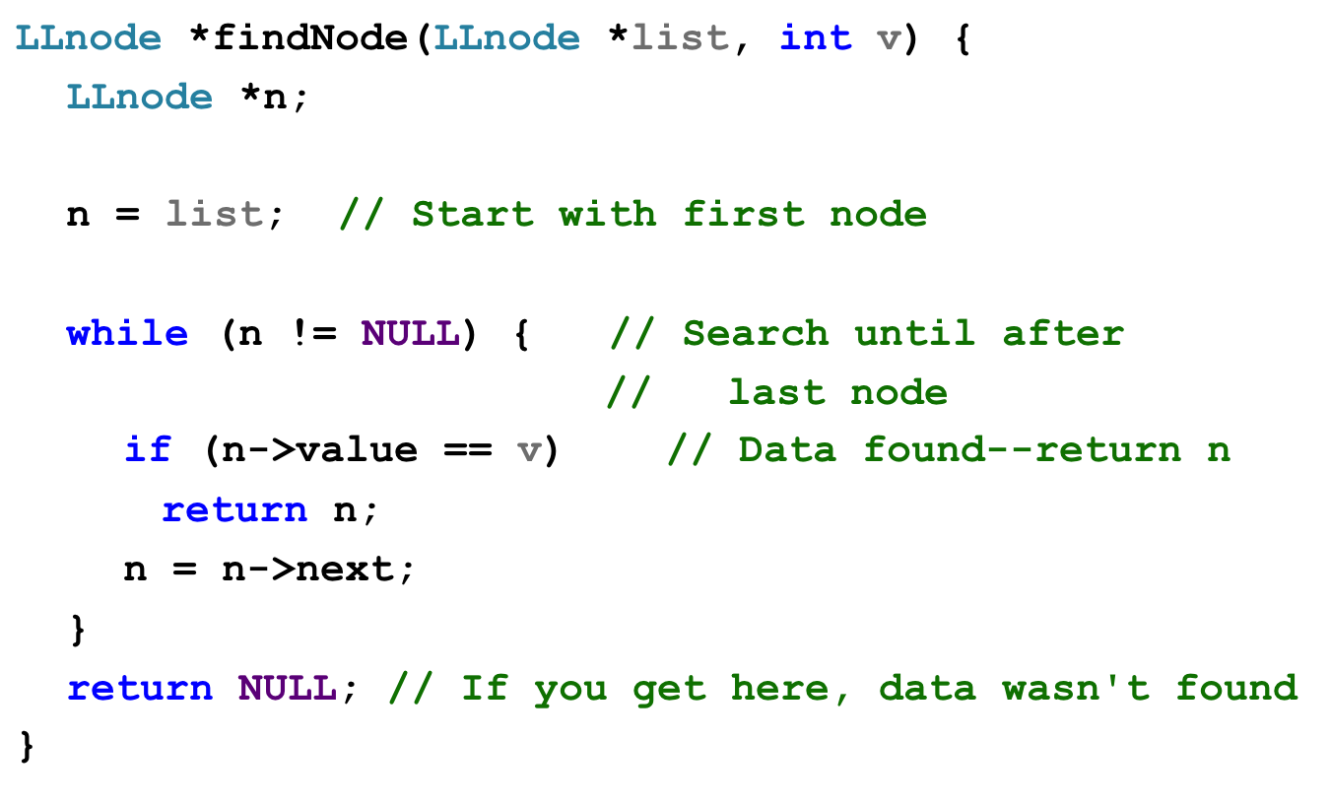
Solution
ECE Application Programming: Lecture 34

Slide 12
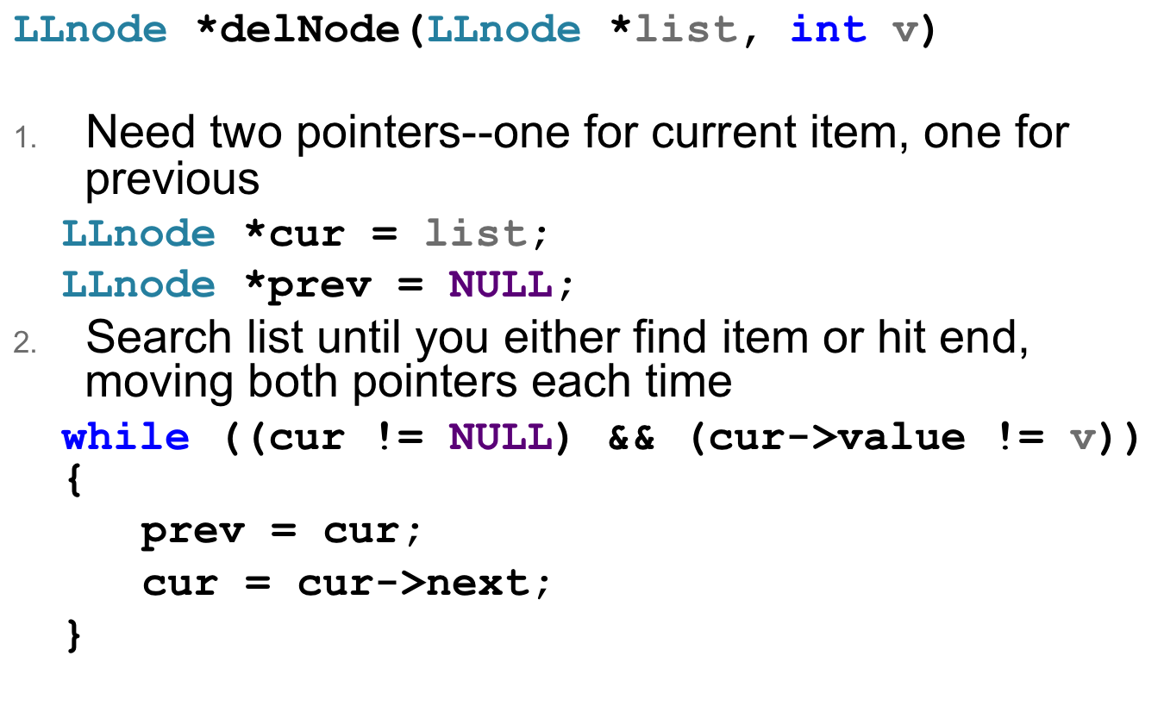
Deleting item from list
ECE Application Programming: Lecture 34

Slide 13
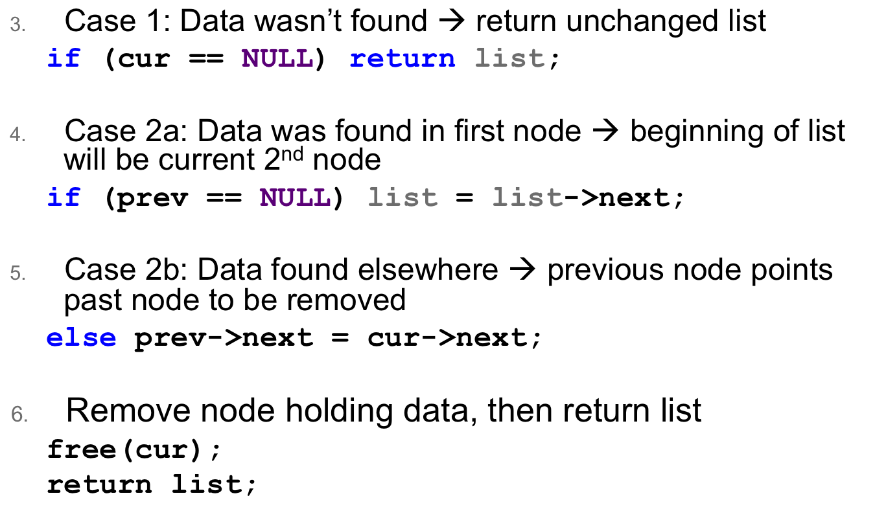
Deleting item from list (continued)
ECE Application Programming: Lecture 34

Slide 14
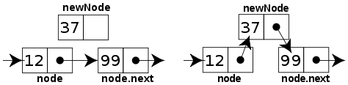
Sorted linked list
Can ensure each item is sorted as it’s added
  Slower item insertion, but faster search
Not easy with arrays: must move existing data
Keeping linked list sorted
  Find appropriate location
    Often done by going “past” appropriate spot
  Modify pointers
    Node before correct spot points to new node
    New node points to node after correct spot
    Image source: http://en.wikipedia.org/wiki/Linked_list
ECE Application Programming: Lecture 34

Slide 15
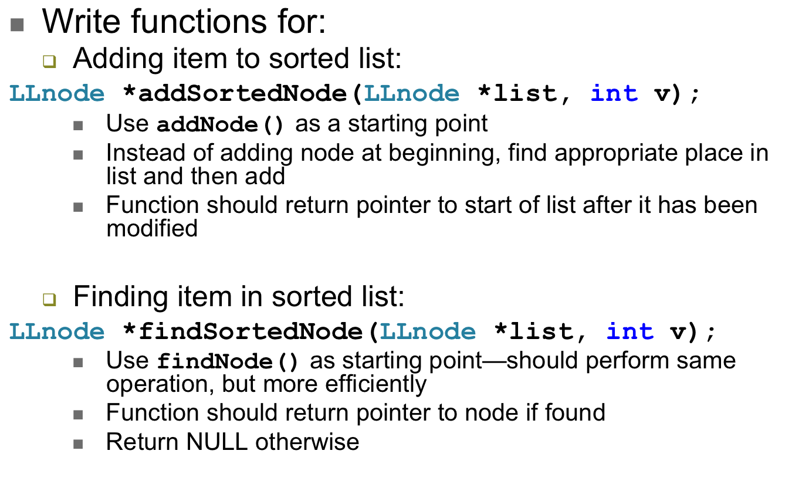
Examples
ECE Application Programming: Lecture 34

Slide 16
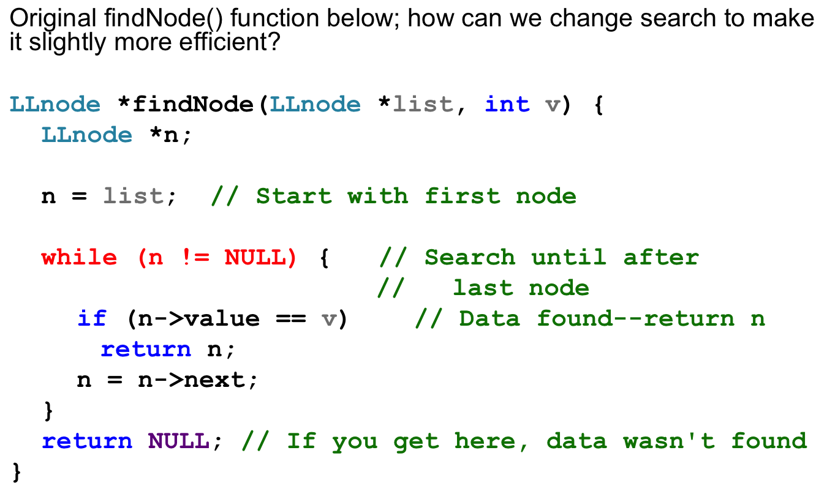
Going from findNode → findSortedNode
ECE Application Programming: Lecture 34

Slide 17
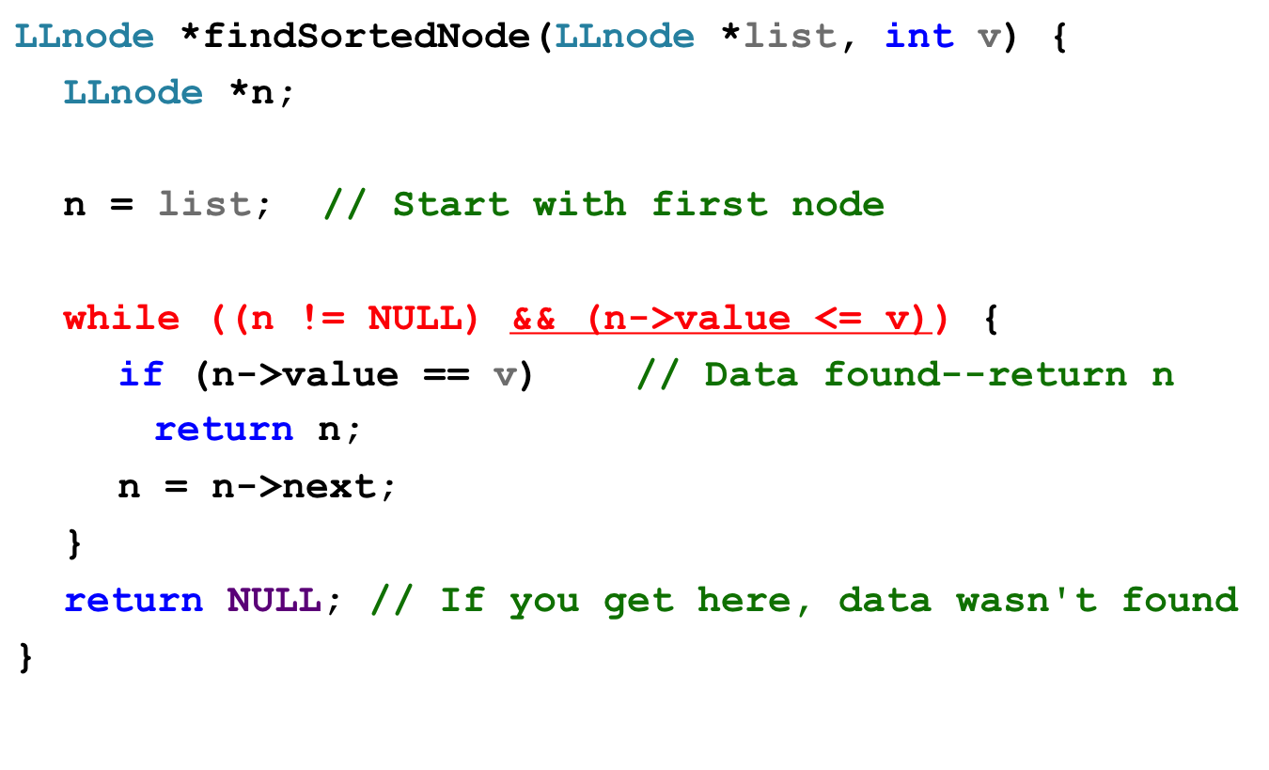
Going from findNode → findSortedNode
ECE Application Programming: Lecture 34

Slide 18
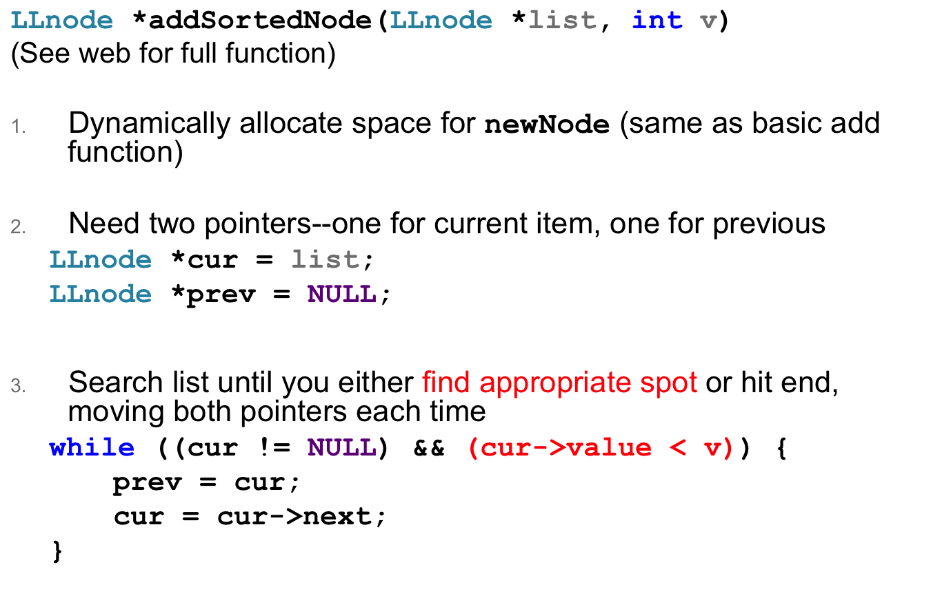
Adding item to sorted list
ECE Application Programming: Lecture 34

Slide 19
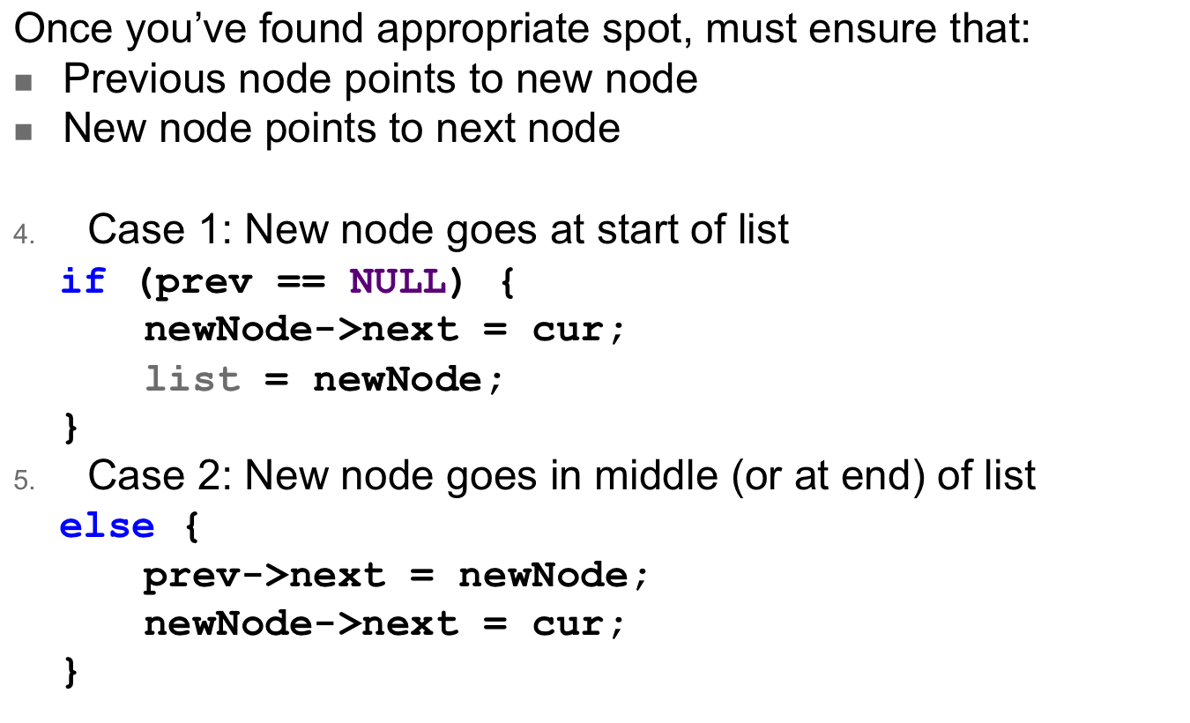
Adding item to sorted list (continued)
ECE Application Programming: Lecture 34

Slide 20
Program 10 notes
DLList structure: pointers to first and last nodes
  Main program starts with DLList structure in which both pointers are NULL
DLL → more pointers to change
  Adding to list
    Must dynamically allocate space for string to add it
    Make sure that prev & next pointers are set in all appropriate nodes
      New node, previous node, next node
    Special cases for empty list, first node, and last node
  Deleting from list
    Previous & next nodes must point past node to be removed
    Special cases for first node, last node, and list with one item
    Make sure you free string before freeing node
  Finding, printing: similar to basic linked list
ECE Application Programming: Lecture 34

Slide 21
Next time
Exam 3: Tuesday, May 5, 11:30-2:30
  Must complete course evaluation before exam
Reminders:
  No lecture Friday—Dr. Geiger out of town Th-Sun
  Exam review session Monday 5/4, 11:30-? (at least 12:30), Ball 214
  Program 9 due today
  Program 10 due 5/6
  Change in grading policy
    If you complete 9 programs, will drop lowest program grade
    If you complete 10 programs, will drop 2 lowest program grades
    Late penalties to be capped—turn in whatever you can by 5/8
ECE Application Programming: Lecture 34

