Slide 1
16.317
Microprocessor Systems Design I
Instructor: Dr. Michael Geiger
Fall 2012
Lecture 17:
Protected mode examples

Slide 2
Lecture outline
Announcements/reminders
  Lab 1 due 10/22
Today’s lecture
  Midterm grades in iSiS
  Multitasking
  Protected mode examples
Microprocessors I: Lecture 17

Slide 3
Review: protected mode memory accesses
Determine if access is local or global
  Use TI bit in selector
    Segment registers now function as selectors
    TI == 0 → global access
    TI == 1 → local access
Find the starting address of the appropriate descriptor table
  Global access uses GDT
    GDTR holds base/limit of GDT
  Local access uses current LDT
    LDTR cache holds base/limit of LDT
Microprocessors I: Lecture 17

Slide 4
Review: protected mode memory accesses
Find the right descriptor in GDT/LDT
  Index field in selector chooses entry in GDT/LDT
    Tables are 0 indexed → 1st descriptor = descriptor #0
  Starting address of descriptor =
  (table base) + (index * 8)
  Descriptor holds base/limit for segment
Use the segment base address found in the descriptor to calculate the physical address
  Physical address = (segment base) + (EA)
Microprocessors I: Lecture 17

Slide 5
Review: local descriptor table
Each task has its own local descriptor table
LDT changes every time you change tasks
  Base/limit of that table changes
    LDTR cache holds LDT base (32 bits) and limit (16 bits)
LDT base/limit for each task is stored in a descriptor in the GDT
LDTR: selector pointing to GDT entry describing LDT for current task
  TI == 0 in LDTR
  Index point to descriptor with LDT base/limit for current task
  On task switch, LDTR changed and LDT base/limit reloaded
Microprocessors I: Lecture 17

Slide 6
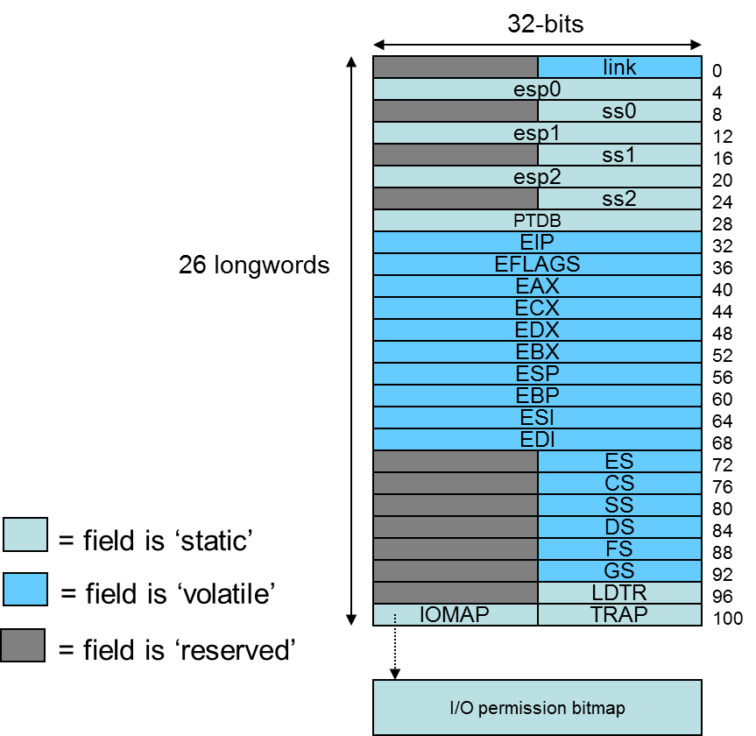
Multitasking
Most systems run multiple tasks
  Different programs
  Different threads in same program
Task switch: save state of current task; transfer control to new task
80386 specifics
  Task state segment (TSS): saved task state (picture at right)
    Every TSS resides in global memory
  Task register (TR): selector pointing to descriptor in GDT for current TSS
    Limit, base of current TSS cached
  Task switch = jump or call instruction that changes task
Figure from cs.usfca.edu/~cruse/cs630f06/lesson08.ppt
Microprocessors I: Lecture 17
Notes:
Chapter 8

Slide 7
Protected mode memory access examples
See handout
Microprocessors I: Lecture 17

Slide 8
Final notes
Next time: Protected mode practice problems
Reminders:
  Lab 1 due 10/22
Microprocessors I: Lecture 17

