Slide 1
16.317
Microprocessor Systems Design I
Instructor: Dr. Michael Geiger
Fall 2012
Lecture 24:
Exam 2 Review

Slide 2
Lecture outline
Announcements/reminders
  No class Monday (Veterans’ Day)
  Lab 2 due 11/14
Today’s lecture: Exam 2 Review
  Exam stats
  Regrade requests: due in writing, 11/16
  Figuring out where you stand
  Exam solution
Microprocessors I: Exam 2 Review

Slide 3
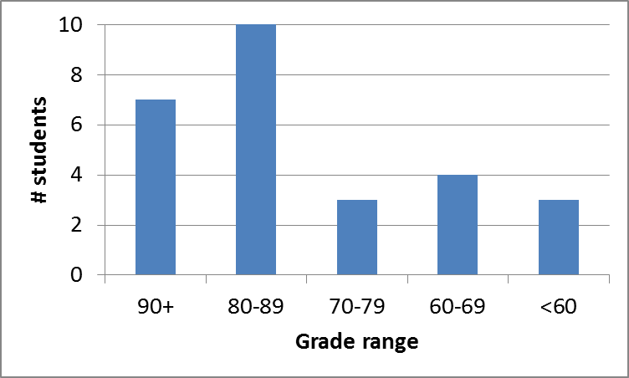
Exam stats & grade distribution
Average: 80.1
Median: 84
Std. deviation: 14.1
Max: 100
Question-by-question averages:
  Q1: 13.0 / 20 (65%)
  Q2: 36.4 / 40 (91%)
  Q3: 30.7 / 40 (77%)
Microprocessors I: Exam 2 Review

Slide 4
Figuring out where you stand
Homework: 25% (3/5 done; 2/5 graded)
Labs: 30% (1/4 done)
Exams: 45% (15% + 15% + 15%)
47.5% of your grade still to be determined
Estimating your grade
  Homework avg (HWA) =
  (total homework points) / 2
  Lab avg (LA) = score from Lab 1
  Exam avg (EA) =
  ((Exam1) + (Exam2)) / 2
  Overall avg = HWA * 0.25 + LA * 0.30 + EA * 0.45
Microprocessors I: Exam 2 Review

Slide 5
Figuring out where you stand
Estimated avg.
= HWA * 0.25 + LA * 0.35 + EA * 0.55
Current course average: ~80%, SD ≈ 12
  “Curve” would add at most ~3 points, possibly less, to those below mean
  Therefore, right now:
    Min grade for C-: 67
    Min grade for D: 54
    THESE NUMBERS WILL ALMOST CERTAINLY CHANGE BEFORE SEMESTER’S END—THESE FIGURES ARE JUST ROUGH ESTIMATES!!!!!
Microprocessors I: Exam 2 Review

Slide 6
Final notes
Next time:
  PIC programming
Reminders:
  No class Monday (Veterans’ Day)
  Lab 2 due 11/14
Microprocessors I: Exam 2 Review

