Slide 1
16.317
Microprocessor Systems Design I
Instructor: Dr. Michael Geiger
Fall 2012
Lecture 29:
Stepper motors; motor control

Slide 2
Lecture outline
Announcements/reminders
  Today is the last lecture of new material
    Friday, 11/30 – Friday, 12/7: Lab hours in Ball 407
    Monday, 12/10: Exam 3 Preview
  Lab 3 due 11/30
  HW 4 due 12/3
  Lab 4 due 12/10
  HW 5 will be posted late this week/early next week, also due 12/10
Today’s lecture:
  Stepper motors
  Motor control with PIC
Microprocessors I: Lecture 29

Slide 3
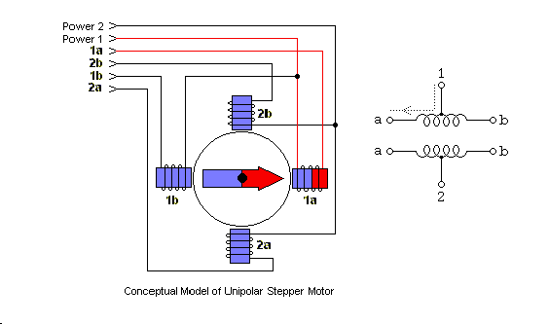
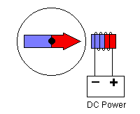
Lab 4 Intro: Stepper motors
Magnet attached to shaft
Current through coil → magnetic field
  Reverse current → reverse field
Pair of coils used to attract magnet to one of 4 different directions
Unipolar stepper motor: center taps on coil make current reversal easy
  Microcontroller can activate drive transistors
Magnet rotor
coil
Microprocessors I: Lecture 29
Notes:
Major differences between uni-polar and bi-polar.
Uni-polar
has logically two windings per phase, so a magnetic pole can be reversed without switching the direction of current,
A microcontroller or stepper motor controller can be used to activate the drive transistors in the right order,
Less torque
bi-polar
has logically a single winding per phase, so current in a winding needs to be reversed in order to reverse a magnetic pole,
driving circuit must be more complicated, typically with an H-bridge arrangement
More torque

Slide 4
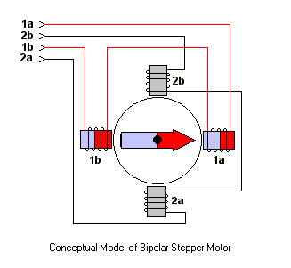
How Bi-polar Stepper Motor Works
Bipolar stepper motor
  More torque than unipolar motor
  Similar principle, but no center taps
    Need glue circuitry (use H-bridge)
Microprocessors I: Lecture 29

Slide 5
Sequences (1 = phase activated)
Table of Stepping Sequences
Sequence | Polarity | Name | Description
0001 0010 0100 1000 | ---+ --+- -+-- +--- | Wave Drive, One-Phase | Consumes the least power. Only one phase is energized at a time. Assures positional accuracy regardless of any winding imbalance in the motor.
0011 0110 1100 1001 | --++ -++- ++-- +--+ | Hi-Torque, Two-Phase | Hi Torque - This sequence energizes two adjacent phases, which offers an improved torque-speed product and greater holding torque.
0001 0011 0010 0110 0100 1100 1000 1001 | ---+ --++ --+- -++- -+-- ++-- +--- +--+ | Half-Step | Half Step - Effectively doubles the stepping resolution of the motor, but the torque is not uniform for each step. (Since we are effectively switching between Wave Drive and Hi-Torque with each step, torque alternates each step.) Note that this sequence is 8 steps.
Microprocessors I: Lecture 29

Slide 6
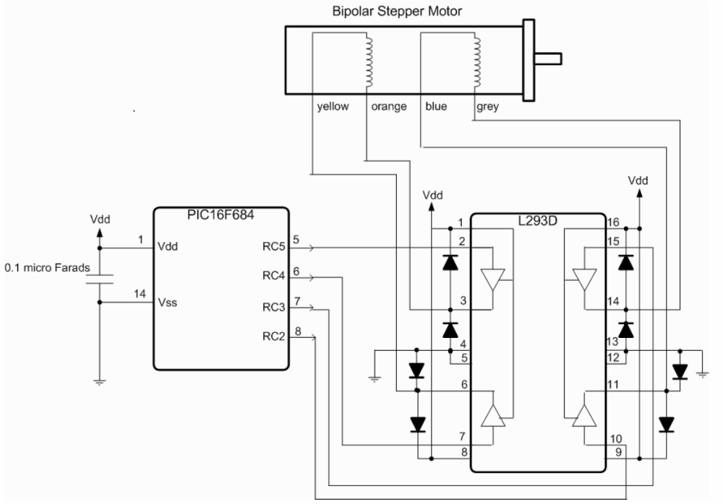
The Schematic
Microprocessors I: Lecture 29
Notes:
Because of power requirements, induction of the windings, and temperature management, motors cannot be directly powered by most digital controllers. Some "glue circuitry," such as a motor controller (H-bridge) is necessary between digital controller and motor. The above image shows the basic circuit of a motor controller which can also sense motor current. (One wire of the motor is shown; a stepper motor would require such a circuit for four wires, and a normal DC motor for two. This circuitry is typically all included in an integrated H-bridge chip.

Slide 7
Our energization pattern
Step | Up-down Coil | East-West Coil
1 | South | Off
2 | South | South
3 | Off | South
4 | North | South
5 | North | Off
6 | North | North
7 | Off | North
8 | South | North
Microprocessors I: Lecture 29

Slide 8
Our control sequence
RC5 | RC4 | RC3 | RC2
0 | 1 | 1 | 1
0 | 1 | 0 | 1
0 | 0 | 0 | 1
1 | 0 | 0 | 1
1 | 0 | 0 | 0
1 | 0 | 1 | 0
1 | 1 | 1 | 0
0 | 1 | 1 | 0
Microprocessors I: Lecture 29

Slide 9
Sequence 0111
OFF
0
1
1
1
Microprocessors I: Lecture 29

Slide 10
Sequence 0101
0
1
0
1
Microprocessors I: Lecture 29

Slide 11
The code (comments, directives)
title "asmStepper - PIC16F684 Bipolar Stepper Motor Control"
;
; This Program Outputs a new Bipolar Stepper Motor Sequence
; once every 250 ms.
;
; Hardware Notes:
; PIC16F684 running at 4 MHz Using the Internal Clock
; Internal Reset is Used
; RC5:RC2 - L293D Stepper Motor Control
;;
; Myke Predko
; 05.01.14
;
LIST R=DEC ;yluo note: list directive to specify assembler options
INCLUDE "p16f684.inc"
Microprocessors I: Lecture 29
Notes:
List directive is used to specify different assembly and listing commands to the assembler program.
R=DEC means the default number base in 10.
_CONFIG directive is used to specify the configuration word bits. Each parameter is ANDed together to specify which bits are reset and set.

Slide 12
The Code (configuration code and data variables)
__CONFIG _FCMEN_OFF & _IESO_OFF & _BOD_OFF & _CPD_OFF & _CP_OFF & _MCLRE_OFF & _PWRTE_ON & _WDT_OFF & _INTOSCIO
; Variables
CBLOCK 0x20
Dlay, i
ENDC
PAGE
; Mainline
org 0
nop ; For ICD Debug
Microprocessors I: Lecture 29

Slide 13
The code (initialization)
movlw 1 << 2 ; Start with Bit 2 Active
movwf PORTC
movlw 7 ; Turn off Comparators
movwf CMCON0
bsf STATUS, RP0 ; Execute out of Bank 1
clrf ANSEL ^ 0x080 ; All Bits are Digital
movlw b'000011' ; RC5:RC2 are Outputs
movwf TRISC ^ 0x080
bcf STATUS, RP0 ; Return Execution to Bank 0
clrf i
Microprocessors I: Lecture 29

Slide 14
The code (main loop)
Loop: ; Return Here for Next Value
movlw HIGH ((250000 / 5) + 256)
movwf Dlay
movlw LOW ((250000 / 5) + 256)
addlw -1 ; 250 ms Delay
btfsc STATUS, Z
decfsz Dlay, f
goto $ - 3
movf i, w
call SwitchRead
movwf PORTC
incf i, f ; i = (i + 1) % 8;
bcf i, 3
goto Loop
SwitchRead:
addwf PCL, f ; Staying in First 256 Instructions
dt b'011100', b'010100', b'000100', b'100100'
dt b'100000', b'101000', b'111000', b'011000'
end
Microprocessors I: Lecture 29

Slide 15
Final notes
Today is the last lecture of new material
  Friday, 11/30 – Friday, 12/7: Lab hours in Ball 407
  Monday, 12/10: Exam 3 Preview
Lab 3 due 11/30
  Must check out PICkit
HW 4 due 12/3
Lab 4 due 12/10
HW 5 will be posted late this week/early next week, also due 12/10
Microprocessors I: Lecture 29

