Slide 1
16.317
Microprocessor Systems Design I
Instructor: Dr. Michael Geiger
Fall 2012
Lecture 3: 80386DX intro

Slide 2
Lecture outline
Announcements/reminders
  Sign up for the discussion group on piazza.com
Today’s lecture: General microprocessor overview (cont.)
  Microprocessor architecture
  Instruction set architecture
  Operations
  Data
80386DX introduction
Microprocessors I: Lecture 3

Slide 3
Review
Instruction set architecture
  Defines how programmer interfaces with hardware
  Operations generally fall into one of four groups
    Data transfer: move data across storage locations
    Arithmetic: add, subtract, etc.
    Logical: AND, OR, shifts, etc.
    Program control: jumps/branches/calls
Microprocessors I: Lecture 3

Slide 4
Review (cont.)
Instruction set architecture (cont.)
  Operands: the data being operated on
    How are the bits interpreted? (int, FP, signed/unsigned)
    What size are they? (byte, word, etc.)
    How do we reference operands?
  Instruction formats: how instructions are encoded
Data storage
  Registers
  Memory
Microprocessors I: Lecture 3

Slide 5
Registers
Small, fast set of storage locations close to processor
Primarily used for computation, short-term storage
  Speed → ideal for individual operations
  Lack of capacity → will frequently overwrite
Reference registers by name
  Example: ADD AX, BX → AX = AX + BX
  AX, BX are registers in x86 architecture
Microprocessors I: Lecture 2

Slide 6
Memory
Provides enough capacity for all code, data (possibly I/O as well)
Typically organized as hierarchy
Used primarily for long-term storage
  Lacks speed of registers
  Provides capacity to ensure data not overwritten
Reference memory by address
  Example: MOV AX, DS:[100H]
  → AX = memory at address DS:[100H]
Microprocessors I: Lecture 2

Slide 7
Memory (cont.)
Accessing single byte is easy
Considerations with multi-byte data
  Are the data aligned?
    Easier/faster to access aligned data
  How are the data organized in memory (“endianness”)?
    Given 32-bit number: DEADBEEFH or 0xDEADBEEF
    Which byte—MSB (0xDE) or LSB (0xEF) gets stored in memory first?
Microprocessors I: Lecture 2

Slide 8
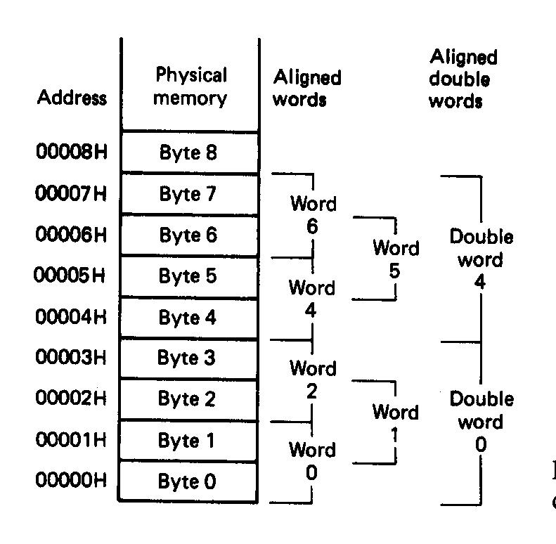
Aligned Words, Double words
Aligned data: address is divisible by number of bytes
  2 bytes → address must be even
  4 bytes → address must be multiple of 4
In figure at left
  Words 0, 2, 4, 6 aligned
  Double words 0, 4 aligned
  “Word X” = word with starting address X
Microprocessors I: Lecture 2
Notes:
Chapter 2

Slide 9
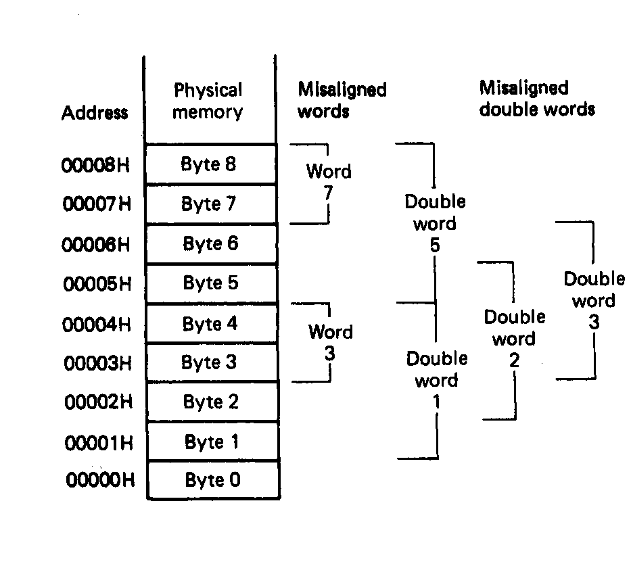
Misaligned Words
x86 architecture doesn’t require aligned data access
In figure, misaligned data:
  Words 3, 7
  Double words 1, 2, 3, 5
Performance impact for accessing unaligned data in memory (32-bit data bus)
Microprocessors I: Lecture 2
Notes:
Chapter 2

Slide 10
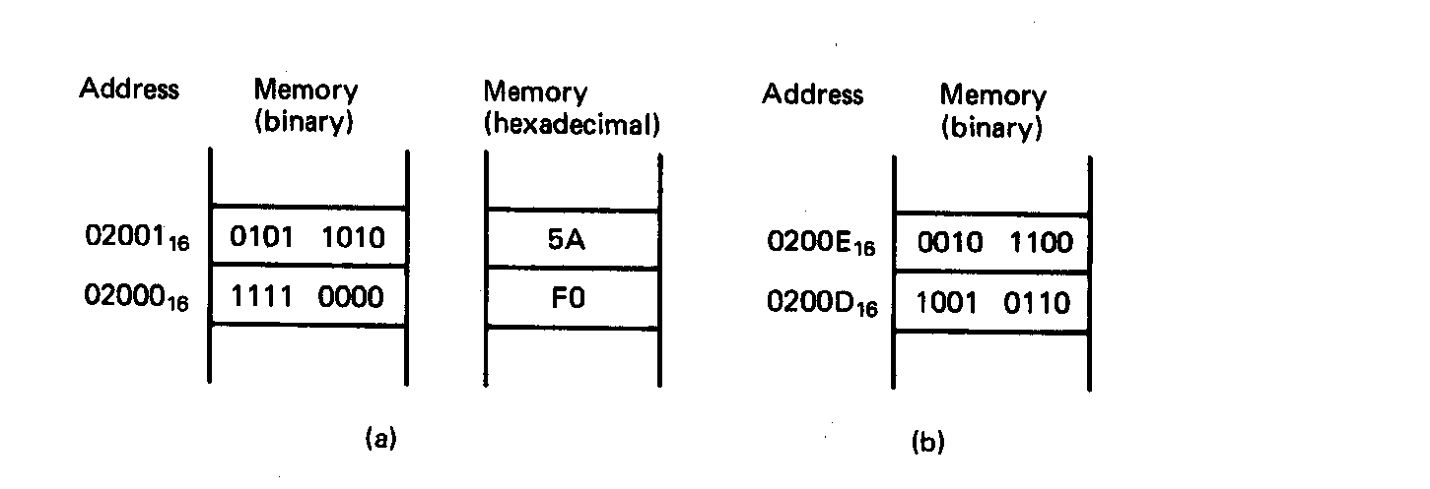
Examples of Words of Data
“Little endian” organization
Most significant byte at high address
Least significant byte at low address
Example [Fig. 2.5 (a)]
(02001₁₆) = 0101 1010₂=5AH= MS-byte
(02000₁₆) = 1111 0000₂=F0H= LS-byte
as a word they give
01011010 11110000₂=5AF0H
Microprocessors I: Lecture 2
Notes:
Chapter 2

Slide 11
Examples of Words of Data
What is the data word shown in this figure?
  Express your result in hexadecimal
Is the word aligned?
Answer:
  MSB = 00101100₂ = 2C₁₆
  LSB = 10010110₂ = 96₁₆
  → Full word = 2C96₁₆
  Starting address = 0200D₁₆
  → Address not divisible by 2
  → Word is not aligned
Microprocessors I: Lecture 2
Notes:
Chapter 2

Slide 12
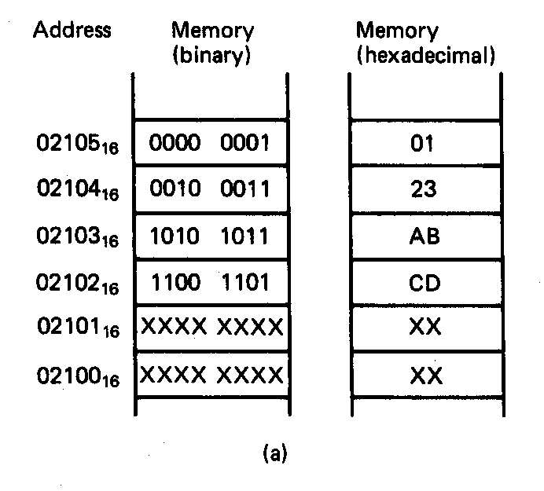
Example of Double Word
What is the double word shown in this figure?
Is it aligned?
Answer:
  LSB = CD₁₆
  MSB = 01₁₆
  → Arranging as 32-bit data:
  0123ABCD₁₆
  Starting address = 02102₁₆
  → Not divisible by 4
  → Double word is unaligned
Microprocessors I: Lecture 2
Notes:
Chapter 2

Slide 13
80386DX intro
General purpose processor
Supports use of 8, 16, or 32 bit data
Allows both register and memory operands
Segmented memory architecture
Real and protected mode operation
  Protected mode supports virtual memory
Microprocessors I: Lecture 3

Slide 14
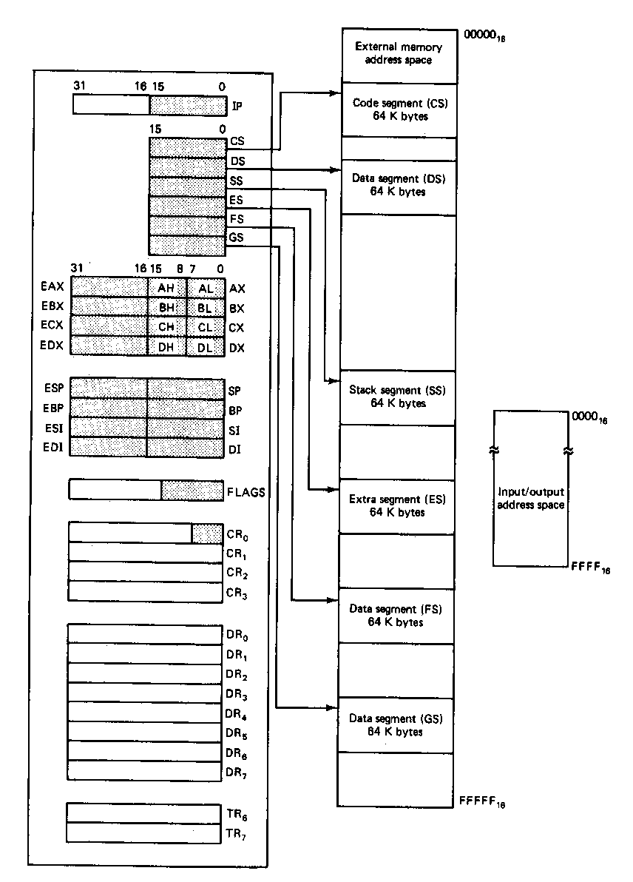
Register Set
Eight 32-bit registers
  (4) Data registers- EAX, EBX, ECX, EDX, can be used as 32, 16 or 8bit
  (2) Pointer registers- EBP, ESP
  (2) Index registers- ESI, EDI
Seven 16-bit registers
  (1) Instruction pointer- IP
  (6) Segment registers- CS, DS, SS, ES, FS, GS
Flags (status) register-EFLAGS
Control register- CR0
Microprocessors I: Lecture 3
Notes:
Chapter 2

Slide 15
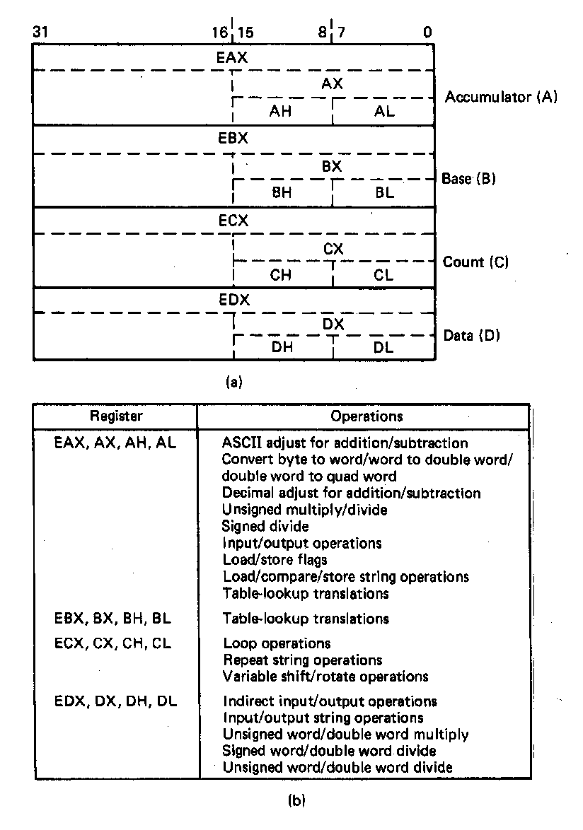
General Purpose Data Registers
Four general purpose data registers
  Accumulator (A) register
  Base (B) register
  Count (C) register
  Data (D) register
Can hold 8-bit, 16-bit, or 32-bit data
  AH/AL = high and low byte value
  AX = word value
  EAX = double word value
General uses:
  Hold data such as source or destination operands for most operations—ADD, AND, SHL
  Hold address pointers for accessing memory
Some also have dedicated special uses
  C—count for loop,
  B—table look-up translations, base address
  D—indirect I/O and string I/O
Microprocessors I: Lecture 3
Notes:
Chapter 2

Slide 16
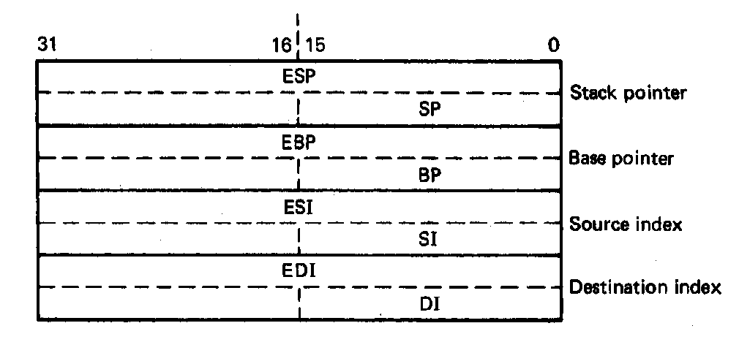
Pointer Registers
Two pointer registers
  Stack pointer register
    ESP = 32-bit extended stack pointer
    SP = 16-bit stack pointer
  Base pointer register
    EBP = 32-bit extended base pointer
    BP = 16-bit base pointer
Use to access information in stack segment of memory
  SP/BP offsets from the current value of the stack segment base address
  Select a specific storage location in the current 64K-byte stack segment
    SS:SP—points to top of stack (TOS)
    SS:BP—points to data in stack
Microprocessors I: Lecture 3
Notes:
Chapter 2

Slide 17
Index Registers
Two index registers
  Source index register
    ESI = 32-bit source index register
    SI = 16-bit source index register
  Destination index registers
    EDI = 32-bit destination index register
    DI = 16-bit destination index register
  Used to access source and destination operands in data segment of memory
    DS:SI—points to source operand in data segment
    DS:DI—points to destination operand in data segment
    Also used to access information in the extra segment (ES)
Microprocessors I: Lecture 3
Notes:
Chapter 2

Slide 18
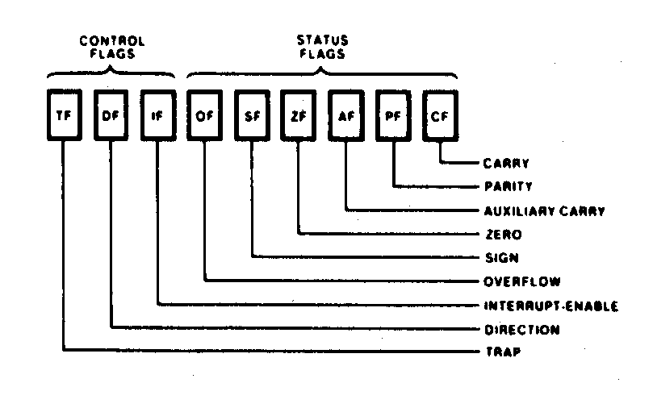
Flags Register
32-bit register holding single bit status and control information
9 active flags in real mode
Two categories
  Status flags: conditions resulting from instruction
    Most instructions update status
    Used as test conditions
  Control flags: control processor functions
    Used by software to turn on/off operating capabilities
Microprocessors I: Lecture 3
Notes:
Chapter 2

Slide 19
Status Flags
Carry flag (CF)
  1 = carry-out or borrow-in from MSB of the result during the execution of an arithmetic instruction
  0 = no carry or borrow has occurred
Parity flag (PF)
  1 = result produced has even parity
  0 = result produced has odd parity
Zero flag (ZF)
  1 = result produced is zero
  0 = result produced is not zero
Sign bit (SF)
  1 = result is negative
  0 = result is positive
Others
  Overflow flag (OF)
  Auxiliary carry flag (AF)
Microprocessors I: Lecture 3
Notes:
Chapter 2

Slide 20
Control Flags
Trap flag (TF)
  1/0 = turn on/off single-step mode
  Mode useful for debugging
  Employed by monitor to execute one instruction at a time (single step execution)
Interrupt flag (IF)
  Used to enable/disable external maskable interrupt requests
  1/0 = enable/disable external interrupts
Direction flag (DF)
  Used to determine the direction in which string operations occur
  1/0 = automatically decrement/increment string address—proceed from high address to low address
Microprocessors I: Lecture 3
Notes:
Chapter 2

Slide 21
Addressing modes
Addressing modes: ways of specifying operand location
Where are operands stored? (3 location types)
  Registers → register addressing
    Provide name of register; value read from register
  Memory
    Provide address in memory; value read from that location
    Several modes for specifying memory address
  In the instruction → immediate addressing
Microprocessors I: Lecture 2

Slide 22
Memory addressing
Instructions accessing memory generate effective address (EA)
  Address calculated as part of instruction
  EA can be used as
    Actual memory address in a simple memory system
    Address within a particular segment in a segmented memory architecture
Effective address calculations can involve
  A constant value
  One or more values stored in registers
  Some combination of register and constant
Microprocessors I: Lecture 2

Slide 23
General memory addressing modes
Memory direct addressing
  EA = constant value encoded in instruction
Register indirect addressing
  EA = value stored in register
Base + displacement addressing
  EA = constant displacement + base register(s)
  Can have variations of this mode based on number and type of registers
Less commonly used modes on some MPUs
  Memory indirect addressing
  Scaled addressing
Microprocessors I: Lecture 2

Slide 24
Final notes
Next time: continue with the 80386DX
  80386DX addressing
  Memory operands in 80386DX instructions
Reminders:
  Check the course web page
  Join the course discussion group on piazza.com
  Lab 1 and/or HW 1 to be posted this week
Microprocessors I: Lecture 3

