Slide 1
16.317
Microprocessor Systems Design I
Instructor: Dr. Michael Geiger
Fall 2012
Lecture 8:
Logical instructions

Slide 2
Lecture outline
Announcements/reminders
  HW 1 due today
  HW2 (due 9/28), Lab 1 coming soon
Review
  Arithmetic instructions
Today’s lecture
  Logical instructions
Microprocessors I: Lecture 8

Slide 3
Review
Reviewed flags: CF, AF, SF, ZF, PF, OF
Addition instructions
  ADD AX,BX → AX = AX + BX
  ADC AX,BX → AX = AX + BX + CF
  INC AX → AX = AX + 1
Subtraction instructions
  SUB AX,BX → AX = AX – BX
  SBB AX,BX → AX = AX – BX – CF
  DEC AX → AX = AX – 1
  NEG AX → AX = -AX = 0 - AX
Microprocessors I: Lecture 8

Slide 4
Review (cont.)
Multiplication instructions
  MUL (unsigned), IMUL (signed)
  Result uses 2x bits of source
  Source usually implied (AL/AX/EAX)
Division instructions
  DIV (unsigned), IDIV (signed)
  Implied source (AX, (DX,AX), (EDX,EAX)) 2x bits of specified source
  Quotient/remainder split across result
Microprocessors I: Lecture 8

Slide 5
Logical instructions (+ shift, rotate)
AND
OR
XOR
NOT
SAL/SHL
SHR
SAR
SHLD
SHRD
ROL
ROR
RCL
RCR
Microprocessors I: Lecture 8

Slide 6
AND / OR / XOR / NOT
All logical operations use form: <op> D, S → (D) = (D) <op> (S)
  May have one memory operand
  Source may be immediate
Flags updated: CF, OF, SF, ZF, PF
AND → Logical AND
OR → Logical inclusive-OR
XOR → Logical exclusive-OR
NOT → Logical NOT
Microprocessors I: Lecture 8
Notes:
Chapter 5 part 2

Slide 7
Logical instructions: example
Show the state of AL after each instruction in the following sequence:
  MOV AL, 55H
  AND AL, 1FH
  OR AL, C0H
  XOR AL, 0FH
  NOT AL
Microprocessors I: Lecture 8

Slide 8
Logical instructions: solution
Show the state of AL after each instruction
  MOV AL, 55H
    AL = 55H
  AND AL, 1FH
    AL = 55H AND 1FH = 01010101 AND 00011111
    = 00010101 = 15H
  OR AL, C0H
    AL = 15H OR C0H = 00010101 OR 11000000
    = 11010101 = D5H
  XOR AL, 0FH
    AL = D5H XOR 0FH = 11010101 XOR 00001111
    = 11011010 = DAH
  NOT AL
    AL = NOT DAH = NOT(11011010) = 00100101 = 25H
Microprocessors I: Lecture 8

Slide 9
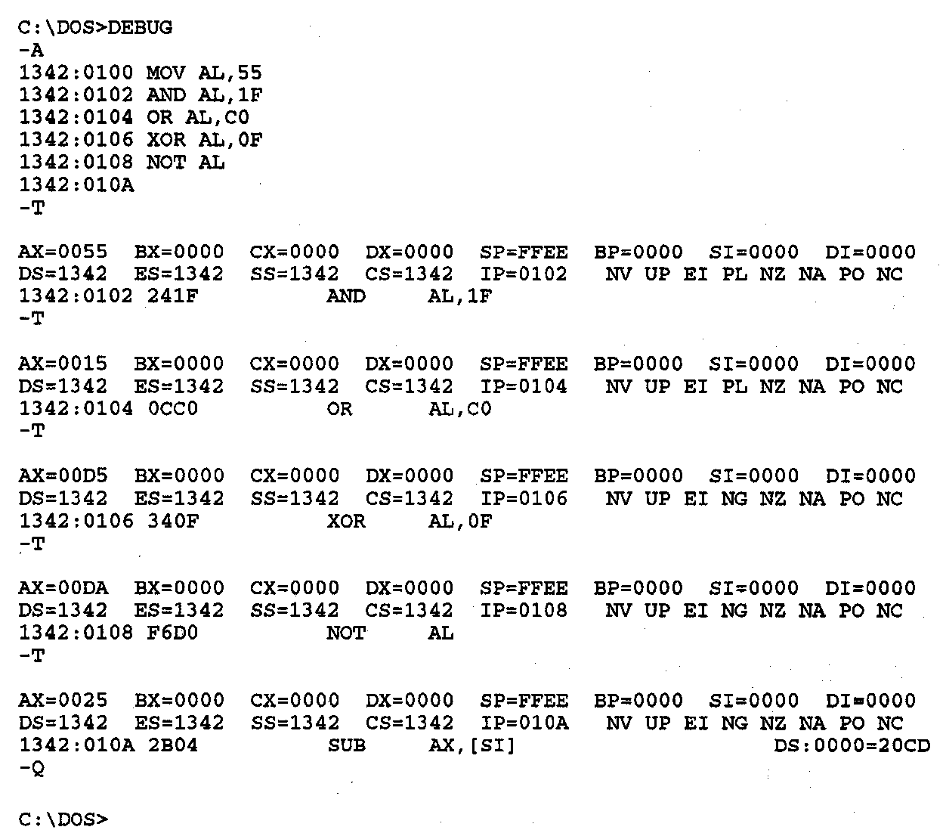
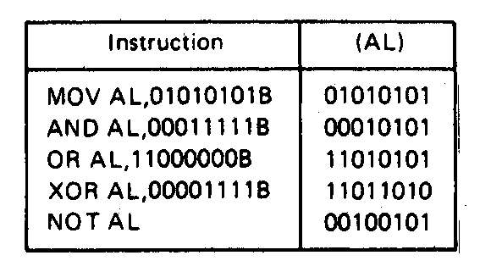
Logic Instructions- Example
Figure on right shows DEBUG program running this code
Each “T” executes one instruction; shows state of all registers/flags
Microprocessors I: Lecture 8
Notes:
Chapter 5 part 2

Slide 10
SHL / SAL / SHR / SAR
Shift instruction format: <op> D, <shamt>
  Destination may be register/memory
  <shamt>: shift amount
    May be immediate or register CL
All shift instructions store last bit shifted out in carry flag (CF)
SHL: logical shift left (double-precision version SHLD)
SAL: arithmetic shift left
  Shift to left by <shamt> bits; shift 0s into LS bits
SHR: logical shift right (double-precision version SHRD)
  Shift to right by <shamt> bits; shift 0s into MS bits
SAR: arithmetic shift right
  Shift to right by <shamt> bits; copy original MSB to fill MS bits (keep sign of value intact)
Microprocessors I: Lecture 8

Slide 11
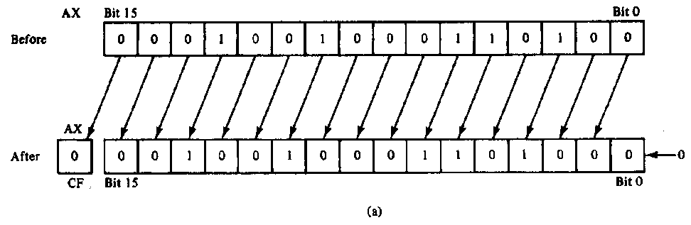
SAL/SHL example
SHL AX,1
Before execution
  Dest = (AX) = 1234H = 0001 0010 0011 0100₂ ,
  Count = 1, CF = X
Operation
  The value in all bits of AX are shifted left one bit position
  Emptied LSB is filled with 0
  Value shifted out of MSB goes to carry flag
After execution
  Dest = (AX) = 2468H = 0010 0100 0110 1000₂ , CF = 0
Notes
  MSB isolated in CF; can be used by conditional instruction
  Result has been multiplied by 2
Microprocessors I: Lecture 8

Slide 12
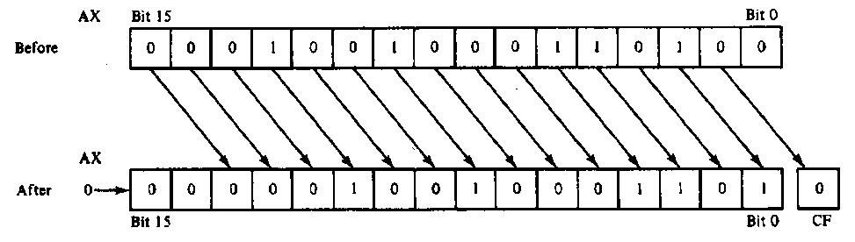
SHR example
SHR AX,CL
Before execution
  Dest = (AX) = 1234H = 466010 = 0001 00100011 0100₂
  Count = (CL) = 02H , CF = X
Operation
  The value in all bits of AX are shifted right two bit positions
  Emptied MSBs are filled with 0s
  Values shifted out of LSBs go to carry flag
After execution
  Dest = (AX) = 048DH = 116510 = 0000 0100 1000 1101₂ ,CF = 0
Notes:
  Bit 1 isolated in CF
  Result has been divided by 4
    4 X 1165 = 4660
Microprocessors I: Lecture 8

Slide 13
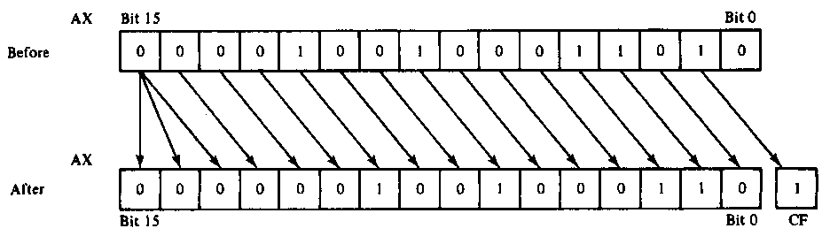
SAR example
SAR AX,CL
Before execution
  Dest = (AX) = 091AH = 0000100100011010₂ = +2330, Count = 02H , CF = X
Operation
  The value in all bits of AX are shifted right two bit positions
  Emptied MSB is filled with the value of the sign bit—sign maintained
  Values shifted out of LSBs go to carry flag
After execution
  Dest = (AX) = 0246H = 0000001001000110₂ = +582 , CF = 1
Conclusion
  Bit 1 isolated in CF
  Result has been sign extended
  Result value has been divided by 4 and rounded to integer
    4 X +582 = +2328
Microprocessors I: Lecture 8

Slide 14
Shift Instructions- Application
Application–Isolating a bit from a byte of data in memory in the carry flag
Example:
  Instruction sequence
    MOV AL,[CONTROL_FLAGS]
    MOV CL, 04H
    SHR AL,CL
  Before execution
    (CONTROL_FLAGS) = B₇B₆B₅B₄B₃B₂B₁B₀
  After executing 1st instruction
    (AL) =B₇B₆B₅B₄B₃B₂B₁B₀
  After executing 2nd instruction
    (CL) = 04H
  After executing 3rd instruction
    (AL) = 0000B₇B₆B₅B₄
    (CF) = B₃
Microprocessors I: Lecture 8
Notes:
Chapter 5 part 2

Slide 15
Shift example
Example: Given AL = 15H, CL = 03H, and CF = 0 show the state of AL and CF after each instruction in the sequence below:
  SHL AL, 1
  SHR AL, CL
  SAL AL, 5
  SAR AL, 2
Microprocessors I: Lecture 8

Slide 16
Solution
Initially, AL = 15H = 00010101₂
SHL AL, 1
  AL = (00010101 << 1) = 00101010₂ = 2AH
  CF = last bit shifted out = 0
SHR AL, CL
  AL = (00101010 >> 3) = 00000101₂ = 05H
  CF = last bit shifted out = 0
SAL AL, 5
  “Arithmetic” left shift same as SHL
  AL = (00000101 << 5) = 10100000₂ = A0H
  CF = last bit shifted out = 0
SAR AL, 2
  Arithmetic right shift keeps sign intact—copy MSB to fill leftmost positions
  AL = (10100000 >> 2) = 11101000₂ = E8H
  CF = last bit shifted out = 0
Microprocessors I: Lecture 8

Slide 17
Final notes
Next time: Continue with instructions
Reminders:
  HW 1 due Friday, 9/21
  Lab 1 coming soon
Microprocessors I: Lecture 8

