Slide 1
16.317
Microprocessor Systems Design I
Instructor: Dr. Michael Geiger
Fall 2013
Lecture 13:
Exam 1 Review

Slide 2
Lecture outline
Announcements/reminders
  Early feedback forms to be distributed Monday
Today’s lecture: Exam 1 Review
  Regrade requests
  Exam stats
  Solution
Microprocessors I: Exam 1 Review

Slide 3
Regrade requests
Due Friday, 10/11
Must be written (preferably on a separate sheet)
You must also return your exam
  Do not write on your exam if you plan on submitting a regrade request
Must demonstrate understanding of problem
  Bad: “I deserve more points on Problem 3.”
  Good: “I deserve more points on Problem 3 because I calculated a wrong result for one instruction based on a wrong result from a previous instruction. I used the right operation; I just plugged in the wrong value.”
Microprocessors I: Exam 1 Review

Slide 4
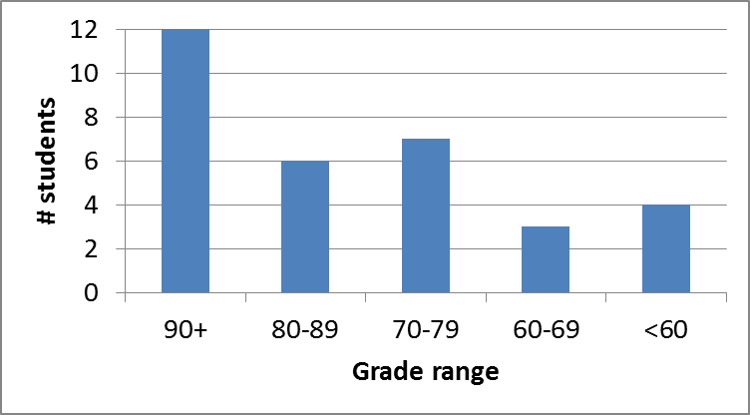
Exam stats & grade distribution
Question-by-question averages:
  Q1: 13.8 / 20 (69%)
  Q2: 25.5 / 30 (85%)
  Q3: 21.0 / 25 (84%)
  Q4: 20.8 / 25 (83%)
  Q5: 5.3 / 10 (11 responses)
Average: 81.1
Median: 85.5
Std. deviation: 16.4
Max: 100 (x3)
Microprocessors I: Exam 1 Review

Slide 5
Final notes
Next time:
  Compare and conditional execution
  Early feedback forms
Microprocessors I: Exam 1 Review

