Slide 1
16.317
Microprocessor Systems Design I
Instructor: Dr. Michael Geiger
Fall 2013
Lecture 15
Jump and loop instructions

Slide 2
Lecture outline
Announcements/reminders
  HW 4 to be posted; due 10/16
  Exam 1 regrade requests due 10/11
Review
  Compare instructions
  CMOV
  Set on condition
Today’s lecture
  Jump instructions
  Loop instructions
Microprocessors I: Lecture 15

Slide 3
Review: compare
CMP D, S
  Flags show result of (D) – (S)
    Assumes signed computation
  ZF = 1 → D == S
  ZF = 0, (SF XOR OF) = 1 → D < S
  ZF = 0, (SF XOR OF) = 0 → D > S
Condition codes: mnemonics implying certain flag conditions
Microprocessors I: Lecture 15

Slide 4
Review: conditional instructions
Conditional move
  Move performed only if condition is true
SETcc D
  Sets single byte destination to 1 (01H) if condition true; all 0s (00H) if condition false
  Can be used to build up complex conditions
Microprocessors I: Lecture 15

Slide 5
Jump instructions
Used to change flow of program
  Next instruction specified by operand
Two general types
  Unconditional: JMP <target>
    Always goes to address indicated by <target>
  Conditional: Jcc <target>
    Jump only occurs if condition true
    cc replaced by valid condition code
      Most codes discussed in previous lecture
      Additional codes: CXZ/ECXZ
      → CX/ECX register is zero
Microprocessors I: Lecture 15

Slide 6
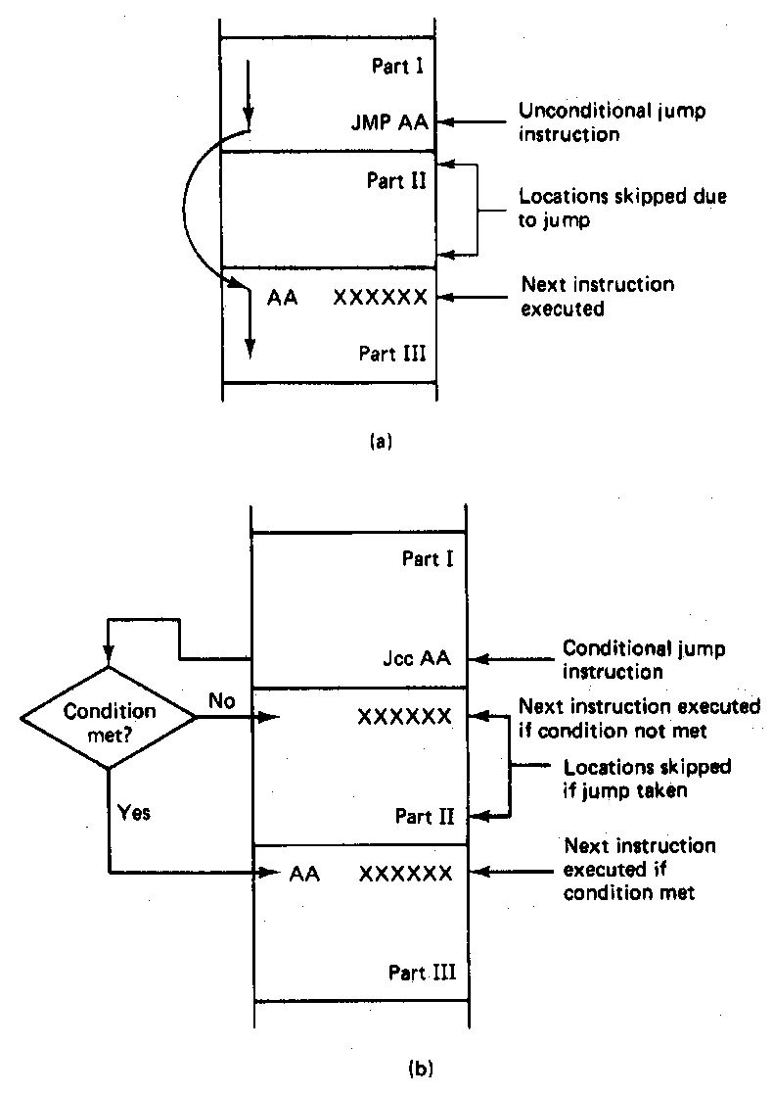
Jump Instructions
Microprocessors I: Lecture 15
Notes:
Chapter 6 part 1

Slide 7
Jump targets
Depends on distance from jump instruction
  Recall: CS:IP is logical addr. of current inst.
Intrasegment: target in same segment
  8-bit (short-label)/16-bit (near-label) immediate
    Signed offset added to current IP
    Usually specified by code writer simply as label
      E.g., JMP LABEL1
  16-bit register or memory location
    IP overwritten by contents of memory or register
    Register example: JE BX
    Memory example: JE WORD PTR [BX]
Microprocessors I: Lecture 15

Slide 8
Jump targets (cont.)
Depends on distance from jump instruction
  Recall: CS:IP is logical addr. of current inst.
Intersegment: target in different segment
  32-bit (far-label) immediate
  32-bit register
  32-bit memory location (DWORD PTR)
  In all cases, CS = upper 16 bits; IP = lower 16 bits
Microprocessors I: Lecture 15

Slide 9
Example: program structure 1
Given the instructions below, what are the resulting register values if:
  AX = 0010H, BX = 0010H
  AX = 1234H, BX = 4321H
What type of high-level program structure does this sequence demonstrate?
Instructions
  CMP AX, BX
  JE L1
  ADD AX, 1
  JMP L2
  L1: SUB AX, 1
  L2: MOV [100H], AX
Microprocessors I: Lecture 15

Slide 10
Example solution
First case: AX = BX = 0010H
  CMP AX, BX → Shows AX == BX
  JE L1 → Cond. true—jump to L1
  ADD AX, 1
  JMP L2
  L1: SUB AX, 1 → AX = AX – 1 = 000F
  L2: MOV [100H], AX → Store 000F at DS:100H
Microprocessors I: Lecture 15

Slide 11
Example solution (cont.)
Second case: AX = 1234H, BX = 4321H
  CMP AX, BX → Shows AX < BX
  JE L1 → Cond. false—no jump
  ADD AX, 1 → AX = AX + 1 = 1235H
  JMP L2
  L1: SUB AX, 1 → AX = AX – 1 = 000F
  L2: MOV [100H], AX → Store 000F at DS:100H
Microprocessors I: Lecture 15

Slide 12
Example solution (cont.)
High-level program structure: if/else statement
  If part: compare + jump (if (AX == BX))
  Else part: what follows if condition false
  Unconditional jump used to skip “if” part
  Both parts have same exit (L2)
Microprocessors I: Lecture 15

Slide 13
Example: program structure 2
Given the instructions below, what are the resulting register values if, initially, AX = 0001H?
What type of high-level program structure does this sequence demonstrate?
Instructions
  MOV CL, 5
  L: SHL AX, 1
  DEC CL
  JNZ L
Microprocessors I: Lecture 15

Slide 14
Example: program structure 3
Given the instructions below, what are the resulting register values if, initially, AX = 0001H?
What type of high-level program structure does this sequence demonstrate?
Instructions
  MOV CL, 5
  L: JCXZ END
  ADD AX, AX
  DEC CL
  JMP L
  END: MOV [10H], AX
Microprocessors I: Lecture 15

Slide 15
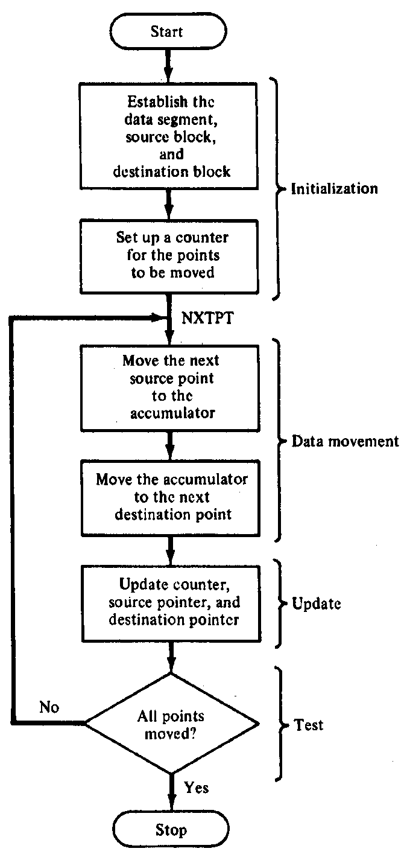
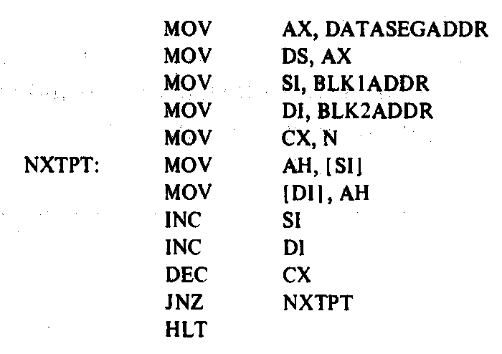
Block Move Program
Microprocessors I: Lecture 15
Notes:
Chapter 6 part 1

Slide 16
Loop instructions
Common operations in basic loops
  Compare
  Conditional jump
  Decrement loop counter (CX)
Loop instructions combine all into one op
  All decrement CX by 1, then check if CX == 0
  <target> must be short-label (8-bit immediate)
  LOOP <target>: Return to <target> if CX != 0
  LOOPE/LOOPZ <target>: Return to <target> if (CX != 0) && (ZF == 1)
  LOOPNE/LOOPNZ <target>: Return to <target> if (CX != 0) && (ZF != 1)
Microprocessors I: Lecture 15

Slide 17
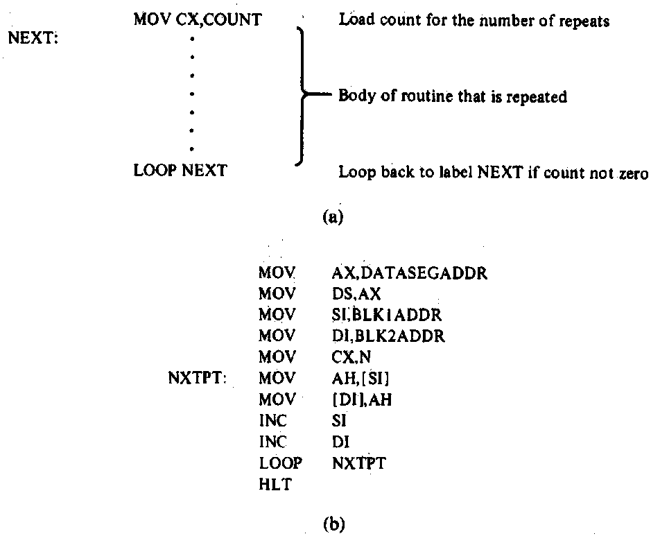
Loop Program Structure
Structure of a loop
  CX = initial count
  Loop body: code to be repeated
  Loop instruction– determines if loop is complete or if the body is to repeat
Example: block move
Microprocessors I: Lecture 15
Notes:
Chapter 6 part 2

Slide 18
Loop example 1
Rewrite the post-tested loop seen earlier using a loop instruction:
  MOV CL, 5
  L: SHL AX, 1
  DEC CL
  JNZ L
Solution:
  MOV CL, 5
  L: SHL AX, 1
  LOOP L
Microprocessors I: Lecture 15

Slide 19
Loop example 2
Describe the operation of the following program (Example 6.15-6.16).
What is the final value of SI if the 15 bytes between 0A001 and 0A00F have the following values?
  00 01 02 03 04 05 06 07 08 09 0A 0B 0C 0D 0E
MOV DL, 05
MOV AX, 0A00
MOV DS, AX
MOV SI, 0000
MOV CX, 000F
AGAIN: INC SI
CMP [SI], DL
LOOPNE AGAIN
Microprocessors I: Lecture 15

Slide 20
Final notes
Next time:
  Subroutines
Reminders:
  HW 4 to be posted; due 10/16
  Exam 1 regrade requests due 10/11
Microprocessors I: Lecture 15

