Slide 1
16.317
Microprocessor Systems Design I
Instructor: Dr. Michael Geiger
Fall 2013
Lecture 1:
Course overview
General microprocessor introduction

Slide 2
Lecture outline
Course overview
  Instructor information
  Course materials
  Course policies
  Resources
  Tentative course outline
General microprocessor introduction
  History
  Role of the instruction set architecture
Microprocessors I: Lecture 1

Slide 3
Course staff & meeting times
Lectures:
  MWF 8-8:50 AM, Ball 314
Labs:
  Open lab hours in Ball Hall 407
  Will get card access ASAP
Instructor: Dr. Michael Geiger
  E-mail: Michael_Geiger@uml.edu
  Phone: 978-934-3618 (x43618 on campus)
  Office: 118A Perry Hall
  Office hours: M 1-2:30, W 1-2:30, Th 1-3
TA: To be announced
Microprocessors I: Lecture 1

Slide 4
Course materials
Textbook: Barry B. Brey, The Intel Microprocessors: Architecture Programming, and Interfacing, 2008, Prentice Hall.
  ISBN: 0135026458
Course website: http://mgeiger.eng.uml.edu/16317/f13/index.htm
  Will contain lecture slides, handouts, assignments
Discussion group through piazza.com
  Allow common questions to be answered for everyone
  All course announcements will be posted here
  Will use as class mailing list—you must enroll by Thursday
Microprocessors I: Lecture 1

Slide 5
Prerequisites
16.265 (Logic Design)
16.365 (Electronics I)
  16.365 is not a co-requisite
Students whose ID #s are on this list should see me re: prerequisites
  01098938
  01334858
  00729486
  00802566
  01049450
  01370251
  01336243
  01168415
Microprocessors I: Lecture 1

Slide 6
Assignments
Homework, labs, and some “hybrid” assignments (problems + programming exercise(s))
Late assignments: 10% penalty per day
All HW individual
Labs
  Can work in groups of 1 or 2 students
  Each student must complete individual lab report
    Group members may share data generated in lab (screenshots, etc.) but must write own description
    Report format specified in separate document
Microprocessors I: Lecture 1

Slide 7
Academic honesty
All assignments are to be done individually unless explicitly specified otherwise by the instructor
Any copied solutions, whether from another student or an outside source, are subject to penalty
You may discuss general topics or help one another with specific errors, but not share assignment solutions
  Must acknowledge assistance from classmate in submission
Microprocessors I: Lecture 1

Slide 8
Course policies (cont.)
Grading breakdown
  Assignments: 55%
  Exam 1: 15%
  Exam 2: 15%
  Final: 15%
Exam dates
  Exam 1: Wednesday, October 2 in class
  Exam 2: Wednesday, November 6 in class
  Exam 3: TBD (during finals)
Microprocessors I: Lecture 1

Slide 9
What you should learn in this class
Basics of computers vs. microprocessors
Two major aspects:
  How to program
    Focus on assembly language
    Will look at HLL → assembly translation, integration
    Use of HLL with microcontrollers
  How a microprocessor works with other components
    Focus on interfacing circuits and control schemes
Will work with two processor families:
  Intel x86 architecture → assembly language simulation
  PIC microcontroller → actual microcontroller programming, interfacing
Microprocessors I: Lecture 1
· To understand the interconnection of the CPU, memory, and I/O

Slide 10
Tentative course outline
General microprocessor introduction
Assembly language programming
  Start with x86; PIC microcontroller at end
  Areas will include
    Addressing modes
    Instruction types
    Programming modes
    HLL and assembly—translation; combination
External interfacing
  Processor signals used in interfacing
  Interface circuitry
  External memory
Interrupts
Microcontroller-based systems
  Microcontrollers vs. microprocessors
  Design of microcontroller-based circuits
  High-level programming of microcontrollers
Microprocessors I: Lecture 1

Slide 11
What is a computer?
From The American Heritage Dictionary:
  “One who computes”
    We could argue that people are computers
  “A device that computes, especially a programmable electronic machine that performs high-speed mathematical or logical operations or that assembles, stores, correlates, or otherwise processes information.”
    Anything from a simple abacus to the microprocessor-based computers of today
Microprocessors I: Lecture 1

Slide 12
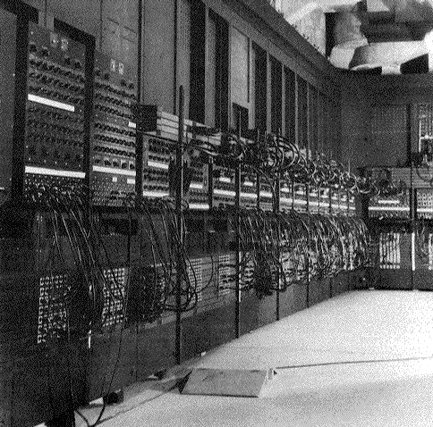
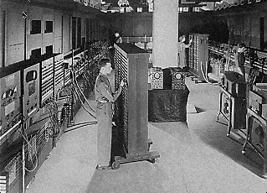
Computing history
Thirty tons
Forced air cooling
200KW
19,000 vacuum tubes
Punch card
Manual wiring
Numerical computation
The first electronic digital computer – ENIAC, built in UPenn in 1946
Source: http://ei.cs.vt.edu/~history/ENIAC.Richey.HTML
Microprocessors I: Lecture 1
Notes:
Chapter 1

Slide 13
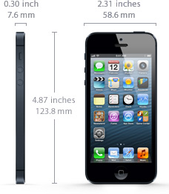
Today’s computer: one example
iPhone 5 Technical Specifications
Screen size 4 inches
Screen resolution 1136 by 640 at 326 ppi
Input method Multi-touch
Operating system iOS 6.1.4
Storage 16 / 32 / 64 GB
Cellular network UMTS/GSM/CDMA
Wireless data Wi-Fi (802.11a/b/g/n) + LTE + Bluetooth 4.0
Camera 8.0 megapixels
Battery Up to 8 hrs Internet, 8 hrs talk,
10 hrs video, 40 hrs audio,
225 hrs standby
Dimensions 4.87 x 2.3 x 0.3 inches
Weight 3.95 ounces
Source: http://www.apple.com/iphone/specs.html
Microprocessors I: Lecture 1
Notes:
Chapter 1

Slide 14
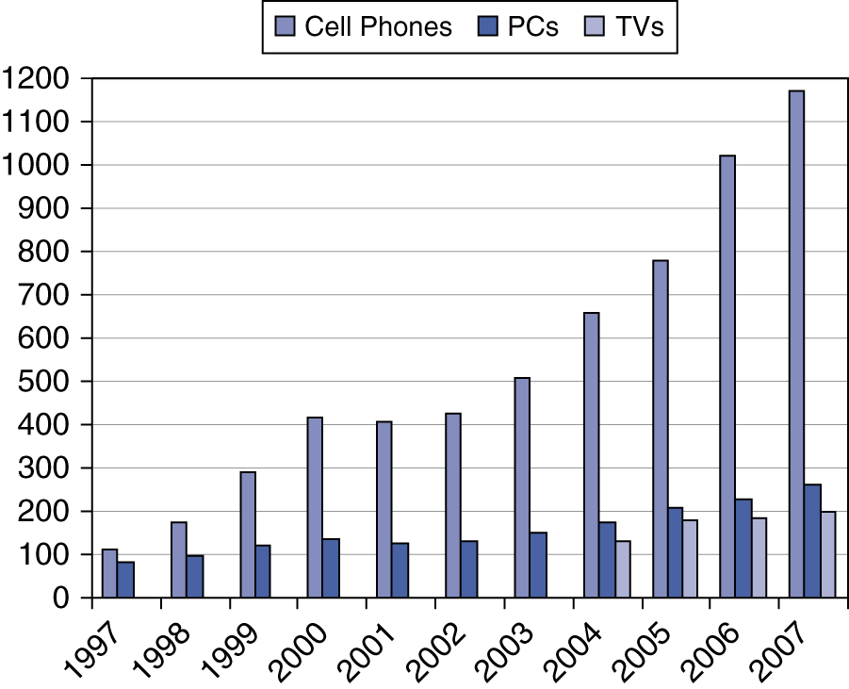
Processor market (as of 2007)
“Computer” used to just refer to PCs
Processors—and, therefore, computers—are now everywhere
Microprocessors I: Lecture 1

Slide 15
Computer components
What are the key components of a computer?
  Microprocessor (MPU/CPU) performs computation
  Input to read data from external devices
    Examples: Keyboard, mouse, ports (Ethernet, USB, etc.)
  Output to transmit data to external devices
    Examples: screen, speaker, VGA interface, ports (Ethernet, USB, etc.)
  Storage to hold program code and data
    RAM, hard disk, possibly other media (CD/DVD, external drive)
Will see that microprocessor contains smaller-scale versions of these components
  Computation engine
  I/O interface
  Internal storage
Microprocessors I: Lecture 1
Notes:
Chapter 1

Slide 16
Final notes
Next time:
  Instruction set architecture
  Data storage
  Addressing modes
Reminders:
  Sign up for the discussion group on Piazza
Microprocessors I: Lecture 1

